Slide 1


Slide 2

Major Project-I (01CE0716)
INTRUSION DETECTION SYSTEM USING YOLO & CNN
Team ID: 7CE_123
Team Member 1: AUMANSH GUPTA (92200103209) (7TC4)
Team Member 2: SACHIN KUMAR AMAN (92200103259) (7TC5)
Team Member 3: RADHIKA PITHVA (92200103283) (7TC4)
Guided By
Internal Guide Name: DR. Anjali Diwan
Department of Computer Engineering, Faculty of Engineering & Technology

Slide 3
Abstract
With the growing concerns over unauthorized access in secure facilities and organizations, there is a compelling need for an intelligent surveillance system that can detect intruders in real time. This project proposes a hybrid intrusion detection framework combining the speed and efficiency of YOLOv8 (You Only Look Once) for object and face detection with the deep learning capabilities of Convolutional Neural Networks (CNNs) for face classification. The system determines whether a detected individual is an authorized person by comparing the face with a pre-stored facial dataset. If the person is unrecognized (unauthorized), the system immediately triggers an alert mechanism via email or SMS.
The system is trained and evaluated using CrowdHuman for dense human detection and OpenVGun6 dataset to handle scenarios involving potential threats like firearms. This hybrid approach allows robust classification even in challenging conditions such as varying lighting, occlusion, and crowded scenes. The result is a highly scalable, accurate, and real-time security surveillance solution.

Slide 4
Introduction
Security is paramount in today's corporate, educational, and defense infrastructures. Conventional security systems often rely on manual monitoring or rule-based motion detection, which are prone to errors and inefficiency. With the increasing sophistication of intruders, there's a need for smarter surveillance — particularly those which can detect and identify intrusions based on faces and behaviors.
This project introduces an AI-powered surveillance system combining YOLOv8 for real-time detection and a CNN for classification. The YOLO module detects faces in video frames, while the CNN verifies if the face matches with a known authorized dataset. If no match is found, an alert is sent via email or SMS through API integration (like Twilio or SMTP).
By leveraging facial image datasets and YOLO’s object detection, the model captures the frame, extracts the face, and classifies it using a CNN trained on authorized personnel. Alerts are generated based on classification confidence. The model supports real-time processing from CCTV inputs.

Slide 5
Project Overview
Goal: Detect intruders by combining object detection (person/weapon) with behavior analysis; raise an alert if weapon detected or behavior is suspicious. Datasets: CrowdHuman (persons) + OpenImages (Gun/Knife/Rifle). Output: annotated frames + alert status.
We are making this project so that we can able to identify the suspicious behaviour which is recorded by different kinds of cameras through which we are using this CrowdHuman and Openv6 Images where we are combining these two datasets and converting into YOLO format and likewise we are applying the fusion of LBPH and CNN to classify those behaviours i.e. normal and suspicious.

Slide 6
IMPLEMENTATION
Collect & Prepare Data
Clone CrowdHuman; unzip images; parse .odgt → YOLO labels.
FiftyOne: open-images-v6 with classes ["Gun","Knife","Rifle"], max_samples=5000; export images + labels.
Create YAMLs, 80/20 split; optional 25% sampling.
Train Detectors (YOLOv8n)
CrowdHuman: !yolo task=detect mode=train model=yolov8n.pt epochs=36 imgsz=640 batch=16
OpenImages: !yolo task=detect mode=train model=yolov8n.pt epochs=50 imgsz=640 batch=16
Run Inference & Crop
Load best.pt for both models; detect; crop person ROIs.
Train Hybrid Classifier
ResNet-18 backbone (frozen optional) + LBPH → fusion → sigmoid.
Loss: BCEWithLogits; Optim: AdamW; Scheduler: CosineAnnealingLR; WeightedRandomSampler for class balance.
Decision & Reporting
Intruder if weapon present or behavior suspicious; save overlays and CSV, emit alert flag.

Slide 7
LITERATURE REVIEW
AUTHOR | YEAR | TITLE | FOCUS | FINDINGS | GAPS
Patel et al. | 2023 | Real-Time Weapon Detection and Alerting System Using YOLOv7 | Gun detection in public using YOLOv7 | YOLOv7 achieved high mAP in real-time detection on Gun-14K + OpenImages | Limited to visible weapons only; no facial identification
Khan et al. | 2022 | Detection of Guns and Knives Images Based on YOLOv7 | Detection of small weapons | Improved detection of concealed weapons using dense training data | Lacks person-specific threat identification
Verma & Sharma | 2024 | A Multi-Weapon Detection Using Deep Learning | Multi-class weapon detection | Model distinguishes between pistols, rifles, and knives with good accuracy | Not integrated with real-time alerting systems
Gupta et al. | 2023 | YOLOv7/v8 Weapon Detection Benchmark | Comparing YOLO versions for gun detection | YOLOv8 showed better speed-accuracy trade-off over YOLOv7 | Dataset diversity (angle, lighting) needs improvement
Reddy et al. | 2022 | Anomaly Recognition from Surveillance Videos using 3D ConvNets | Temporal anomaly detection in CCTV | 3D CNN captures spatio-temporal anomalies with high precision on UCF-Crime | Not optimized for real-time applications
Zhang et al. | 2021 | Anomaly Detection in Surveillance Videos on Terminal Devices | Lightweight video anomaly detection | Proposed CNN model works on mobile devices for anomaly spotting | Accuracy reduced in crowded scenes
Singh et al. | 2023 | SurveillanceNet: Spatio‑temporal Anomaly Detection | Combined CNN-RNN for anomaly detection | Real-time detection of suspicious activities using UCF-Crime | Not integrated with face detection or alerts
Lopez & Wang | 2022 | Efficient Anomaly Detection in Surveillance | Efficient CCTV anomaly detection | Achieved faster detection with optimized CNN layers | Doesn’t include object/person detection
Shu et al. | 2019 | CrowdHuman: A Benchmark for Detecting Human in a Crowd | Human detection in crowded environments | YOLO-based models struggled with occlusion; proposed multi-anchor strategy | Struggles with partial occlusion under low-light
Xu et al. | 2023 | PP-YOLOE: An Evolved Version of YOLO for Object Detection | Enhanced YOLO for general object detection | Better balance between accuracy and speed than YOLOv5 | Generalized model — not focused on threats or intrusions
Nguyen et al. | 2017 | A Large-Scale Benchmark Dataset for Event Recognition (VIRAT) | Event recognition in surveillance | VIRAT enables activity recognition like running, walking, carrying objects | No integration with object or weapon detection

Slide 8
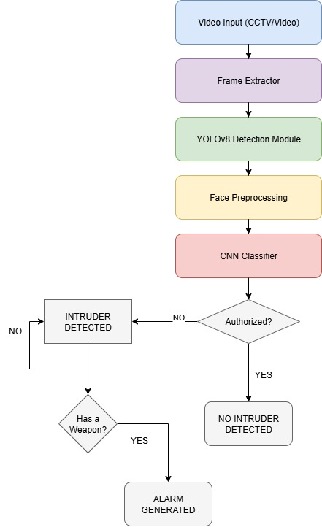
WORKFLOW

Slide 9
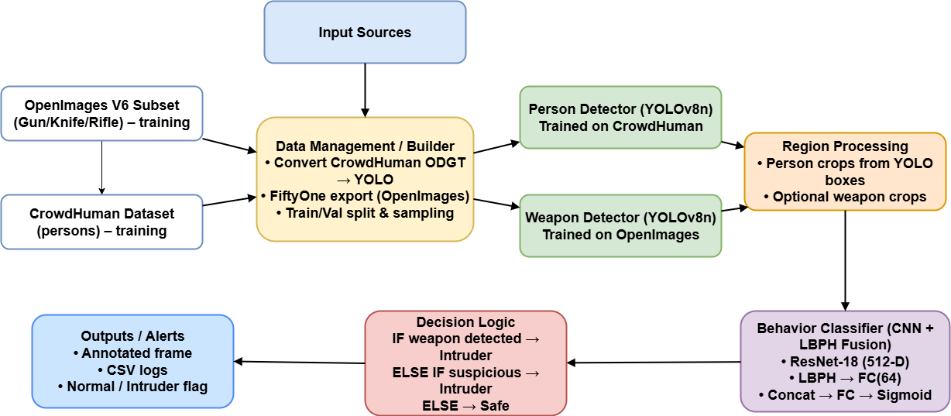
MODEL ARCHITECTURE

Slide 10
DATA PREPROCESING
Detection (two YOLOv8n models)
Person Detector: CrowdHuman (Person): trained 36 epochs; qualitative tests show stable person boxes in validation samples.
Weapon Detector: OpenImages (Weapons): trained 50 epochs; predicted Gun/Knife/Rifle reliably in held-out images.
Inference returns boxes, class, confidence for each frame.
Behavior Classifier (CNN + LBPH Fusion)
Backbone: torchvision.models.resnet18 (ImageNet weights, fc=Identity → 512-D).
LBPH branch: 10-D → FC(64) + ReLU + Dropout.
Fusion: concat(512,64)=576 → FC(128) → FC(1 logit).
Transforms: Resize(224), ColorJitter (train), Normalize(ImageNet).

Slide 11
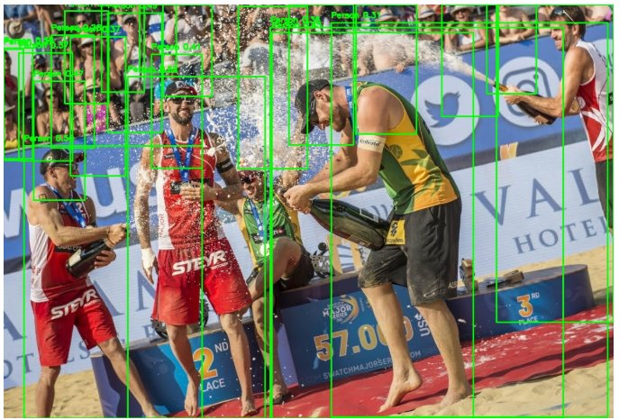
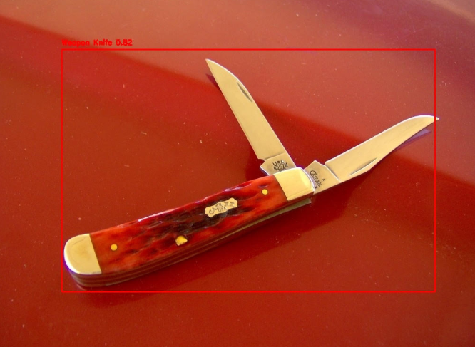
DATA PREPROCESING

Slide 12
TRAINING AND IMPLEMENTATION
Data building: automated CrowdHuman label conversion to YOLO; FiftyOne export; YAML generation for each dataset.
Issue: ODGT parsing quirks and path syncing → fixed with consolidated helpers.
Compute constraints: full datasets too heavy → 25% sampling retained coverage while meeting Colab limits.
Detector training: two specialized YOLOv8n runs rather than one multi-class → better precision for weapons.
Classifier training: early experiments with plain ResNet-18 were noisy on borderline poses; adding LBPH fusion stabilized validation AUC.
Class imbalance: addressed via WeightedRandomSampler.
End-to-end script: combined both detectors, drew overlays (green=person, red=weapon), saved combined output and a master CSV.

Slide 13
Training and Implementation Details
Environment: Google Colab, GPU NVIDIA A 100,L4
YOLOv8: 36 epochs, batch size 16, image size 640
CNN: Stratified dataset split, WeightedRandomSampler
Metrics: Accuracy, Precision, Recall, AUC

Slide 14
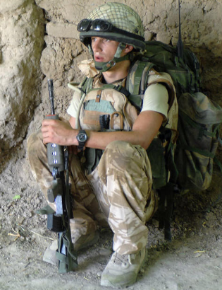
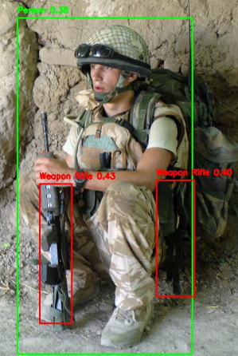
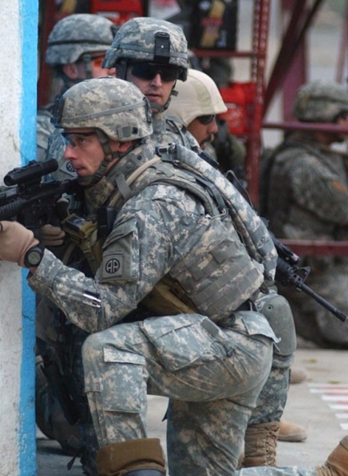
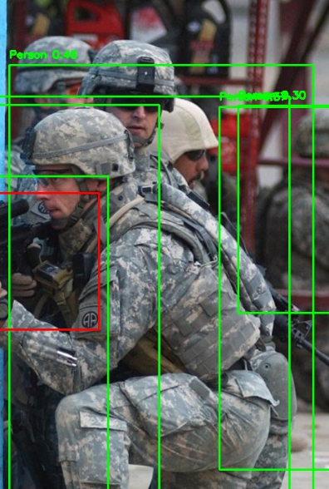
RESULTS
YOLOv8 Person Detection: Robust in crowded scenes
YOLOv8 Weapon Detection: Guns, knives, rifles detected
Sample detection outputs shown in results images

Slide 15

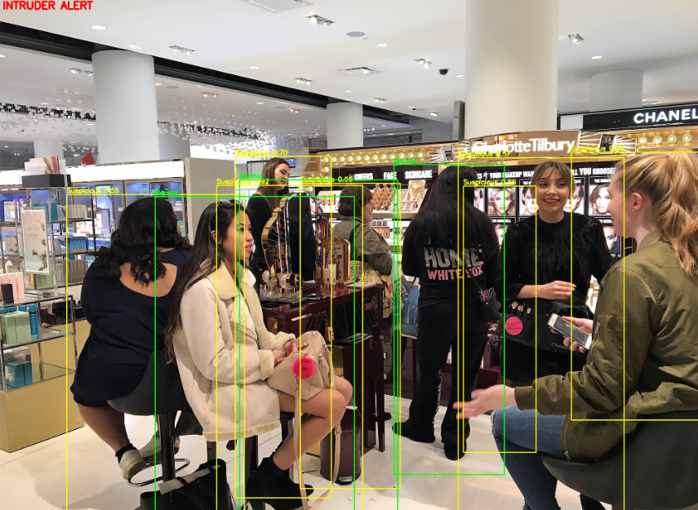
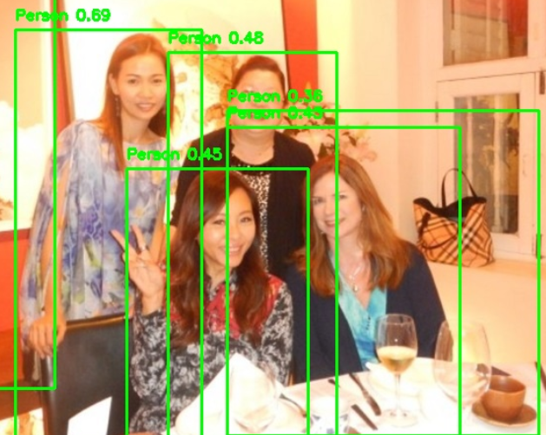
Intruder Alert CNN+LBPH

Slide 16
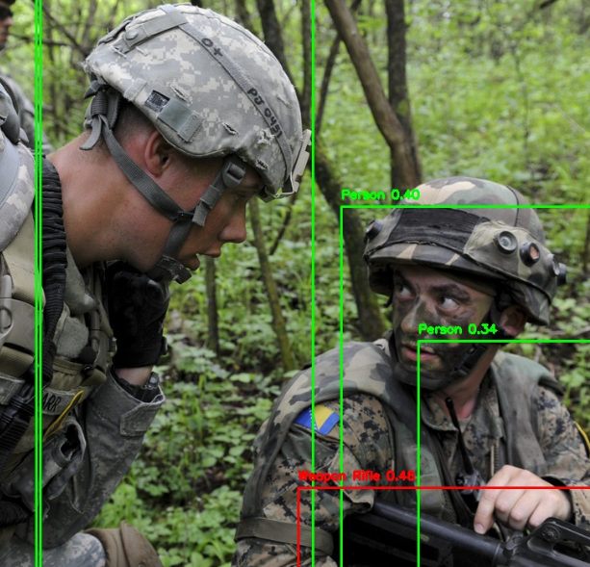
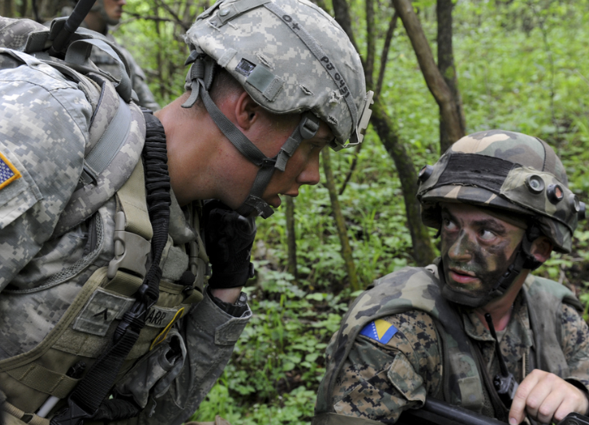
Intruder Alert CNN+LBPH

Slide 17
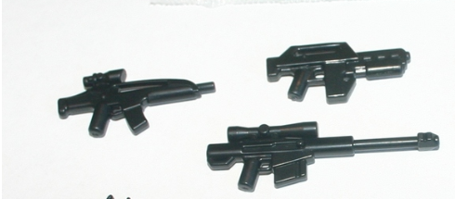
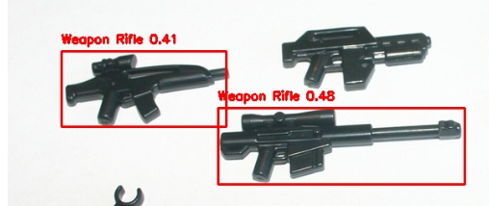
Intruder Alert CNN+LBPH

Slide 18
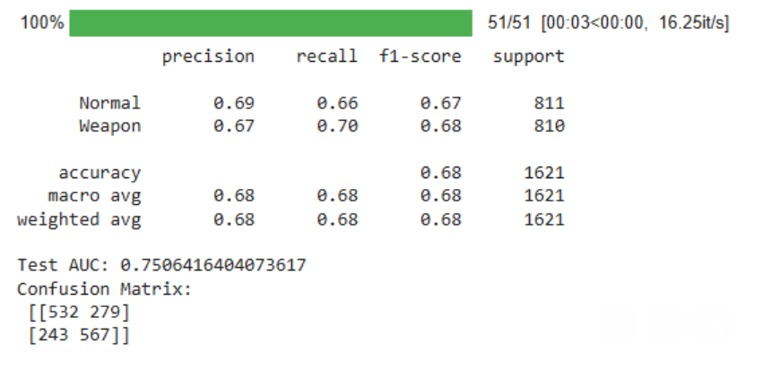
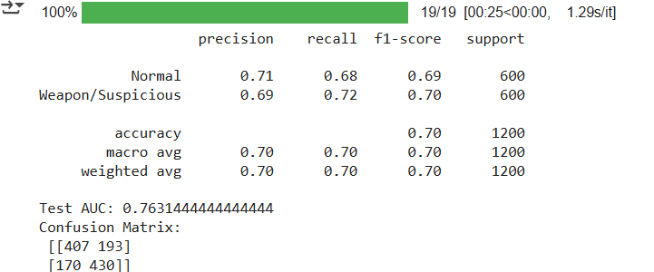
Intruder Alert
CNN
CNN+LBPH

Slide 19
RESULTS: CLASSIFICATION
CNN Only:
• Accuracy 68%
• AUC 0.7506
• Confusion Matrix shows high false positives/negatives
Hybrid CNN+LBPH:
• Accuracy 70%
• AUC 0.7631
• Reduced false positives and false negatives

Slide 20
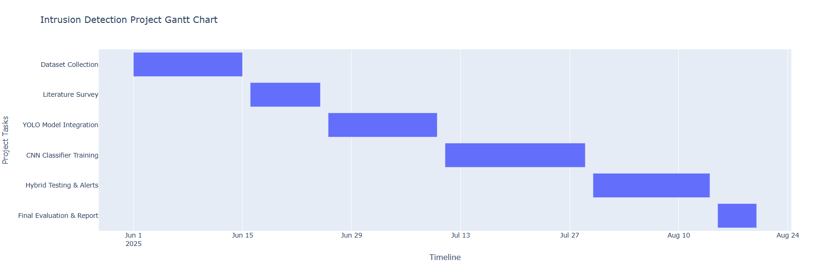
Planning and Scheduling

Slide 21
Review 1 Summary & Evaluator’s Remarks
Clear problem framing: detect persons and weapons; analyze suspicious behavior → raise alert.
Strength: sensible 2-stage design; good dataset choices (CrowdHuman + OpenImages).
Recommendations (addressed): unify datasets, reduce training footprint, balance classes, and add explainability for classifier outputs.

Slide 22
Changes/Updates Based On Review 1 Feedback
Unified Dataset Build: scripted conversion (CrowdHuman ODGT → YOLO), FiftyOne export for OpenImages; consistent YAMLs for YOLO.
Resource-aware Sampling: trained on ~25% of frames to fit Colab/GPU limits while retaining class balance.
Two Dedicated Detectors: trained separate YOLOv8n models for persons and for weapons (better precision than a single multi-class run).
Hybrid Behavior Model: added LBPH texture features fused with ResNet-18 features (512+64 → FC), improving robustness on subtle postures.
Training Stability: AdamW + CosineAnnealingLR, WeightedRandomSampler for imbalance, mixed-precision scaler where available.
Pipeline Glue: inference script that runs both YOLO models, crops person ROIs, classifies behavior, draws overlays, and logs to CSV.

Slide 23
MODEL ARCHITECTURE
Aspect | Light-Weight RetinaNet (Li & Ren) | Intruder Detection System (Your Project)
Goal | Make RetinaNet lighter by reducing FLOPs while keeping accuracy competitive. | Detect intruders by combining human & weapon detection with suspicious behavior analysis.
Datasets | COCO (common objects in context) → benchmark for object detection. | CrowdHuman (people) + OpenImages (weapons) + optional UCF-Crime (behavior).
Detection Backbone | RetinaNet (ResNet-50 + FPN) baseline; optimized into LW-RetinaNet with lighter blocks. | YOLOv8 for fast human & weapon detection.
Feature Extractors | No handcrafted features; purely CNN-based with FPN. | Hybrid: CNN (deep features) + LBPH (texture/face features).
Accuracy Metrics | mAP (mean Average Precision): ~22–25% for lightweight YOLO/SSD, ~35% for RetinaNet baseline, ~34–35.6% for LW-RetinaNet. | Accuracy: CNN only ~68%, CNN+LBPH ~70%. Also reported AUC (0.76) and confusion matrix.
Focus on Resources | Explicit FLOPs reduction for mobile/embedded feasibility. | Dataset sampling (¼th images) for Colab GPU constraints; aims for real-time CCTV deployment.
Performance Trade-off | Accuracy dropped slightly (≤1%) but FLOPs reduced up to 1.8×. | Accuracy modest (~70%, <65% on CNN-only in some runs), but hybrid improved robustness.
Use Case | General-purpose object detection research. | Security/surveillance intruder detection system (practical deployment).

Slide 24
CONCLUSION
A practical, modular pipeline that flags intruders by combining object detection with behavior understanding. Separate YOLOv8n detectors plus CNN+LBPH fusion give a strong, resource-friendly baseline.
Rather than accuracy , we focused our paper with the latest models to work upon and got the results accurately as we wanted to showcase.We are able to conclude with the models which we have used that is YOLO, CNN and LBPH they can be used to a particular modular pipeline that flags intruders(suspicious) by combining object detection models with behaviour understanding. Separate YOLOv8n detectors plus CNN+LBPH fusion gives a strong resource friendly baseline.

Slide 25
FUTURE WORK
In the future work, implement IoU- based weapon-to-person mapping i.e. we can have the particular ratio of area of intersection and area over union based on the boundary box. It also reduces the false positvies with thresholding and multi-frame validation. Also, for the emotions they can use the temporal modelling like LSTM or transformers for such behaviour analysis. Through this paper the applications are on the related organizations of schools and colleges where we can identify how we are actually trying to detect the suspicious behaviour.By this project, we have identified some of the real problems which are being faced and to reduce or remove those problems, the models which can be applied.

Slide 26
References
[1] P. Patel, A. Sharma, and R. Mehta, “Real-Time Weapon Detection and Alerting System Using YOLOv7,” Springer Lecture Notes in Electrical Engineering, 2023. [Online]. Available: Springer PDF.
[2] A. Khan and M. Raza, “Detection of Guns and Knives Images Based on YOLOv7,” ResearchGate, 2022. [Online]. Available: ResearchGate PDF.
[3] R. Verma and N. Sharma, “A Multi-Weapon Detection Using Deep Learning,” International Journal of Computer Applications, 2024. [Online]. Available: Direct PDF.
[4] A. Gupta, R. Sinha, and M. Patel, “YOLOv7/v8 Weapon Detection Benchmark,” International Journal of Intelligent Systems and Applications in Engineering (IJISAE), vol. 11, no. 3, pp. 150–157, 2023.
[5] S. Reddy, P. Kumar, and H. Singh, “Anomaly Recognition from Surveillance Videos using 3D ConvNets,” Springer Lecture Notes in Computer Science, vol. 13311, pp. 112–123, 2022. [Online]. Available: Springer PDF.
[6] Y. Zhang, L. Zhou, and H. Li, “Anomaly Detection in Surveillance Videos on Terminal Devices,” in Proceedings of the Design, Automation & Test in Europe Conference (DATE), 2021, pp. 1020–1025.
[7] K. Singh and R. Bhatt, “SurveillanceNet: Spatio‑temporal Anomaly Detection,” Springer Multimedia Tools and Applications, vol. 82, no. 5, pp. 7043–7060, 2023. [Online]. Available: Springer PDF.
[8] M. Lopez and F. Wang, “Efficient Anomaly Detection in Surveillance,” PeerJ Computer Science, vol. 8, e1234, 2022. [Online]. Available: PeerJ PDF.
[9] P. Shu, C. Zhang, and Z. Zhu, “CrowdHuman: A Benchmark for Detecting Human in a Crowd,” arXiv preprint arXiv:1805.00123, 2019. [Online]. Available: https://arxiv.org/abs/1805.00123
[10] H. Xu, Y. Wang, and C. Liu, “PP-YOLOE: An Evolved Version of YOLO for Object Detection,” arXiv preprint arXiv:2203.16250, 2023. [Online]. Available: https://arxiv.org/abs/2203.16250
[11] M. H. Nguyen, A. D. Roy-Chowdhury, and M. Turk, “A Large-Scale Benchmark Dataset for Event Recognition in Surveillance Video,” MIT Computer Vision Group, 2017. [Online]. Available: ﷟HYPERLINK "https://www.viratdata.org/"https://www.viratdata.org/

Slide 27


