Slide 1
S3 Images Test
Using real S3 images

Slide 2
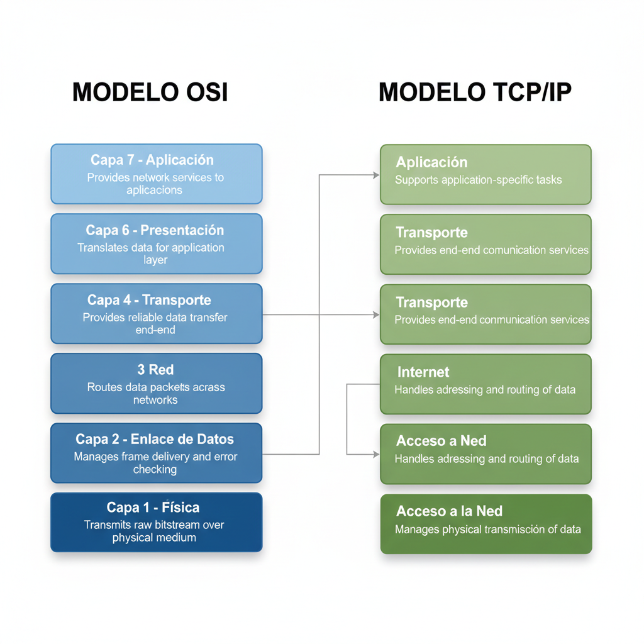
S3 Image 1
S3 image 01-01-0001.png

Slide 3
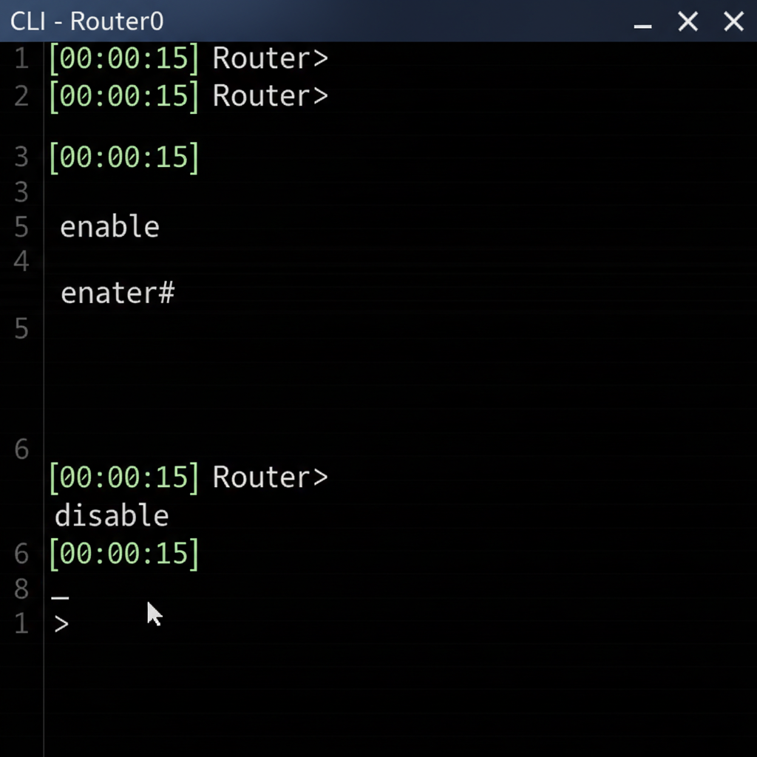
S3 Image 2
S3 image 01-02-0005.png

Slide 4
S3 Image Missing (expected fail)
📊 Diagram
Should fallback to placeholder

