Slide 1
S3 Images Test Tagged
Testing placeholder tagging

Slide 2
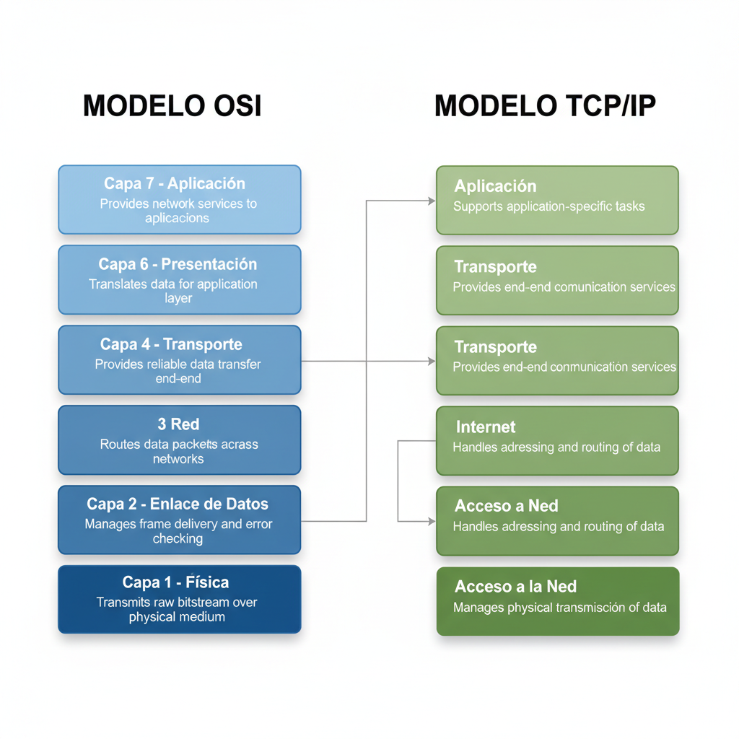
S3 Image 1
S3 image 01-01-0001.png

Slide 3
S3 Image Missing
📊 Diagram [PLACEHOLDER]
Should fallback to placeholder

