Slide 1
CLEAR Remote Control
User Manual
Created: 07/09/2018
Last revision: 10/09/2018

Slide 2
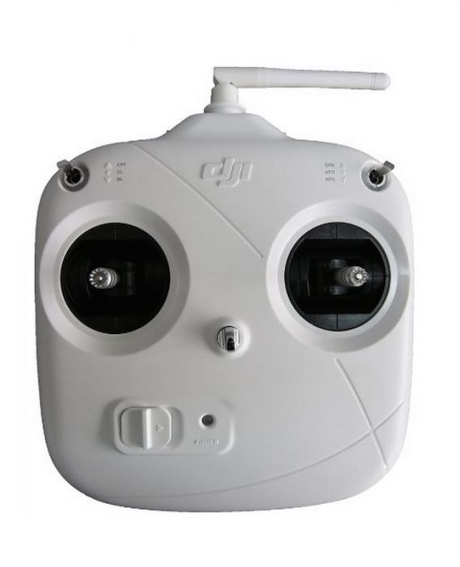
Remote Control: DJI-DT7

Slide 3
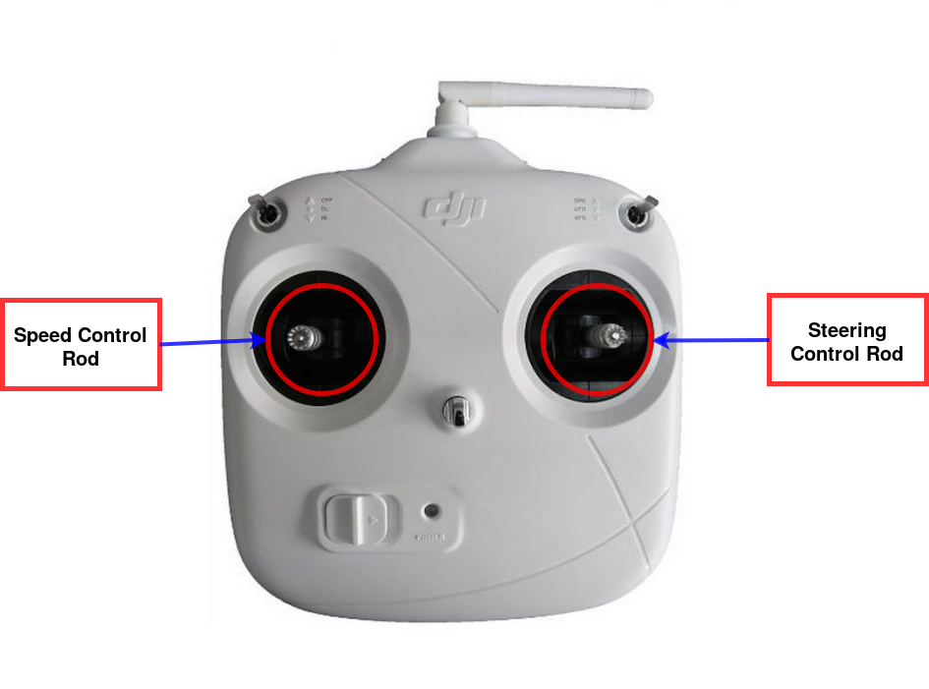
RC Control Rods

Slide 4
RC Speed Control Rod
Speed Control Rod:
Move it Up and Down to control the robot speed (forward and reverse speed respectively).
The position of this control will be used either to adjust the speed PID setpoint or to set the
output voltage, bypassing the controller (see Emergency/Disable PID Switch).

Slide 5
RC Steering Control Rod
Steering Control Rod:
Move it to the Left and Right to control the steering angle. If the PID is enabled (see Emergency
/Disable PID Switch) the control is performed in angular position, while if the PID is disabled,
the control rod changes the PWM value sent to the motor, thus controlling the angular velocity.

Slide 6
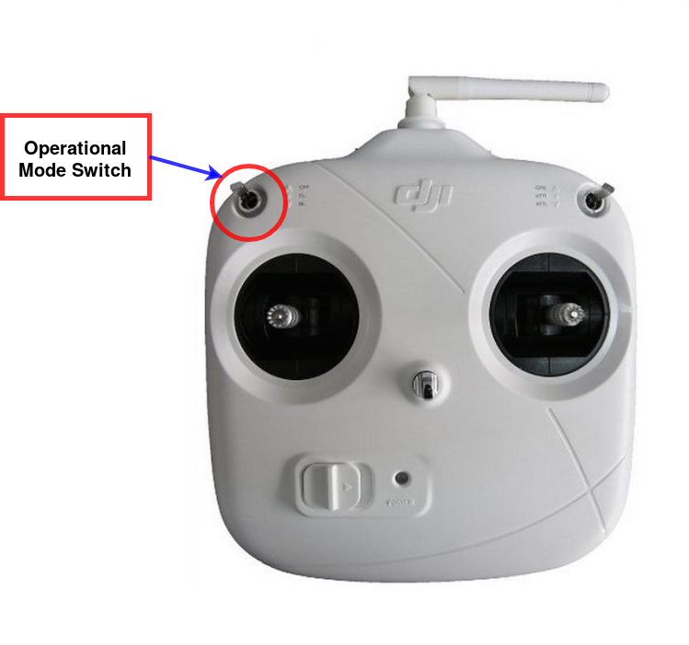
RC Operational Mode Switch

Slide 7
RC Operational Mode Switch
Up: ROS Control
Center: Manual Safe
Down: Manual NOT-SAFE

Slide 8
ROS Control Mode
(On-board LED = Blue)
- Speed and steering angle values received trough the desired_ackermann_state topic will be used to adjust the PID controllers setpoint.
Up: ROS Control
Center: Manual Safe
Down: Manual NOT-SAFE

Slide 9
ROS Control Mode
(On-board LED = Blue)
- Speed and steering angle values received trough the desired_ackermann_state topic will be used to adjust the PID controllers setpoint.
- The presence of the “speed recommender” safety system is required. This system uses on-board sensors to adjust the robot speed, approaching obs-
tacles slowly and stopping the robot if the distance becomes smaller than a user-configurable safety distance threshold.
Up: ROS Control
Center: Manual Safe
Down: Manual NOT-SAFE

Slide 10
ROS Control Mode
(On-board LED = Blue)
- Speed and steering angle values received trough the desired_ackermann_state topic will be used to adjust the PID controllers setpoint.
- The presence of the “speed recommender” safety system is required. This system uses on-board sensors to adjust the robot speed, approaching obs-
tacles slowly and stopping the robot if the distance becomes smaller than a user-configurable safety distance threshold.
- Whenever the “speed recommender” overrides the PID speed setpoint, the on-board LED will turn to Yellow. If the “speed recommender” messages are not received within a safety time threshold the system state changes automatically to Emergency mode. (Both conditions also applies to Manual Safe mode).
Up: ROS Control
Center: Manual Safe
Down: Manual NOT-SAFE

Slide 11
Manual Safe Mode
(On-board LED = Green)
- PID setpoints are controlled using the RC control rods.
Up: ROS Control
Center: Manual Safe
Down: Manual NOT-SAFE

Slide 12
Manual Safe Mode
(On-board LED = Green)
- PID setpoints are controlled using the RC control rods.
- The presence of the “speed recommender” safety system is required. If it is not detected, the system will change to Emergency mode.
Up: ROS Control
Center: Manual Safe
Down: Manual NOT-SAFE

Slide 13
Manual NOT-Safe Mode
(On-board LED = White)
- The safety system is disabled, so the robot won’t stop to avoid collisions.
Up: ROS Control
Center: Manual Safe
Down: Manual NOT-SAFE

Slide 14
Manual NOT-Safe Mode
(On-board LED = White)
- The safety system is disabled, so the robot won’t stop to avoid collisions.
- The RC control rods can be used to adjust the PID’s setpoints, or altermatively, to actuate directly the motors (speed voltage and steering PWM), bypassing the PIDs. (see Emergency/Disable PID switch).
Up: ROS Control
Center: Manual Safe
Down: Manual NOT-SAFE

Slide 15
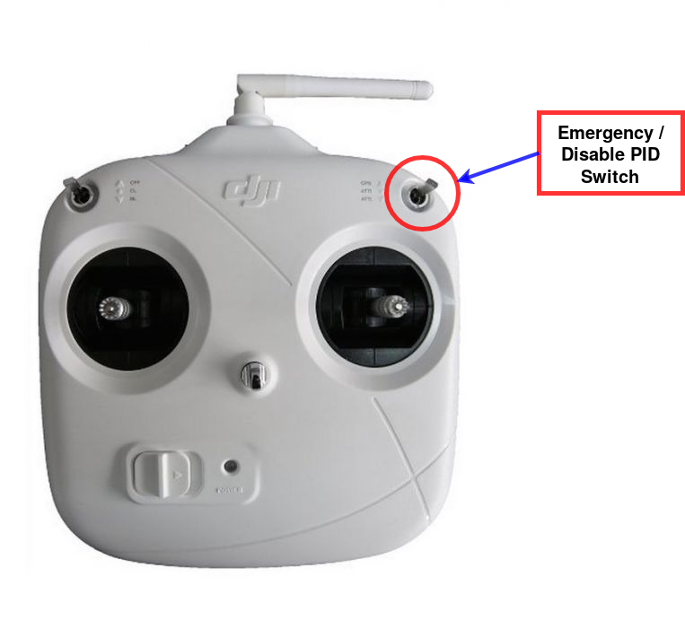
RC Emergency / Disable PID Switch
Up: Emergency
Center: No-Emergency
Down: Emergency or
Disable PID
(in Manual NOT-SAFE
mode)

Slide 16
Emergency Mode
(On-board LED = Red)
- In Emergency Mode, the motors are disabled and the brakes are activated immediately.
Up: Emergency
Center: No-Emergency
Down: Emergency or
Disable PID
(in Manual NOT-SAFE
mode)

Slide 17
Emergency Mode
(On-board LED = Red)
- In Emergency Mode, the motors are disabled and the brakes are activated immediately.
- To enter in Emergency Mode from the RC, just change the Emergency Switch to one of the extreme positions (Up or Down) except in Manual NOT-SAFE mode, where Down Position is reserved for PID controllers bypass (On-board LED → Yellow).
Up: Emergency
Center: No-Emergency
Down: Emergency or
Disable PID
(in Manual NOT-SAFE
mode)

Slide 18
Emergency Mode
(On-board LED = Red)
- In Emergency Mode, the motors are disabled and the brakes are activated immediately.
- To enter in Emergency Mode from the RC, just change the Emergency Switch to one of the extreme positions (Up or Down) except in Manual NOT-SAFE mode, where Down Position is reserved for PID controllers bypass (On-board LED → Yellow).
- To exit from Emergency mode: Set the Operational Mode Switch to “Manual NOT-SAFE” mode, set the Emergency/Disable PID switch to “No-Emergency” and rearm the system using the Horn/Rearm wheel (see next slide).
Up: Emergency
Center: No-Emergency
Down: Emergency or
Disable PID
(in Manual NOT-SAFE
mode)

Slide 19
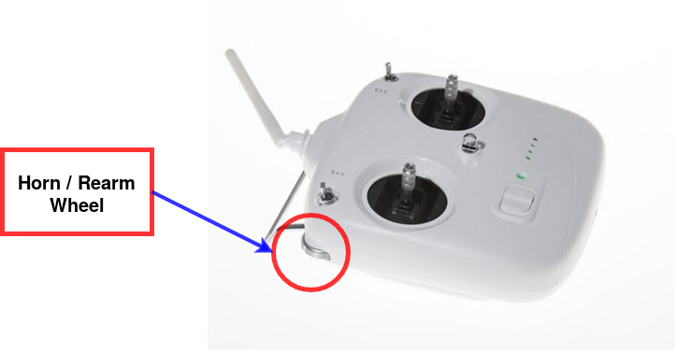
RC Horn / Rearm Wheel
Full left: Horn
Full right: Rearm
Horn / Rearm Wheel:
Drive the wheel to its left extreme position to activate the horn.
To finalize the rearm process (see Emergency / Disable PID Switch section) drive the wheel
to its right extreme position.

