Slide 1
Decoder

Slide 2
Decoder
2-to-4,
3-to-8,
…
n-to-2^{n}
E
A
B
C
O₀
O₁
O₂
O₃
O₄
O₅
O₆
O₇
0
X
X
X
0
0
0
0
0
0
0
0
O₀
ABC
O₁
ABC
1
0
0
0
1
0
0
0
0
0
0
0
A
S₂
O₂
ABC
1
0
0
1
0
1
0
0
0
0
0
0
B
S₁
3:8
O₃
ABC
1
0
1
0
0
0
1
0
0
0
0
0
C
dec
O₄
ABC
S₀
1
0
1
1
0
0
0
1
0
0
0
0
O₅
ABC
O₆
ABC
1
1
0
0
0
0
0
0
1
0
0
0
O₇
ABC
1
1
0
1
0
0
0
0
0
1
0
0
1
1
1
0
0
0
0
0
0
0
1
0
1
1
1
1
0
0
0
0
0
0
0
1
Enb

Slide 3
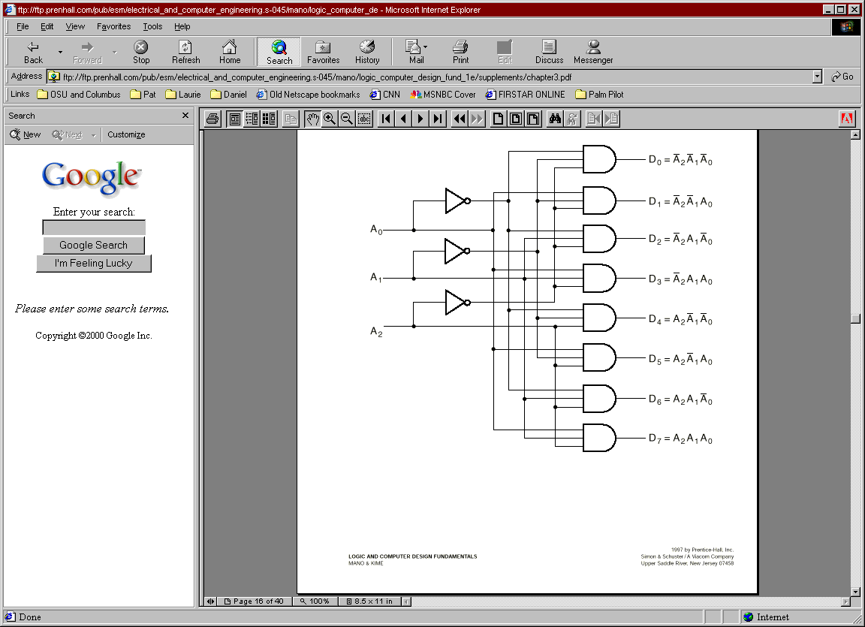
Decoder
E?

Slide 4

Design Using Decoder
Applications:
  Implementing General Logic
    Any combinational circuit can be constructed using decoders and OR gates!
Example:
0
A
‘B’C’D’
1
A
‘B’C’D
F
F1 = A' B C' D + A' B' C D + A B C D
F2 = A B C' D' + A B C
F3 = (A' + B' + C' + D')
2
A
‘B’CD’
1
3
A
‘B’CD
A
S₃
4
A
‘BC’D’
S₂
5
A
‘BC’D
B
6
A
‘BCD’
4:16
7
A
‘ BCD
C
S₁
dec
8
A
B’C’D’
F
9
A
B’C’D
2
D
S₀
10
A
B’CD’
1
1
A
B’CD
12
A
B C’D’
13
A
B C’D
14
A
B C D’
F
15
A
B C D
3
Enb

Slide 5
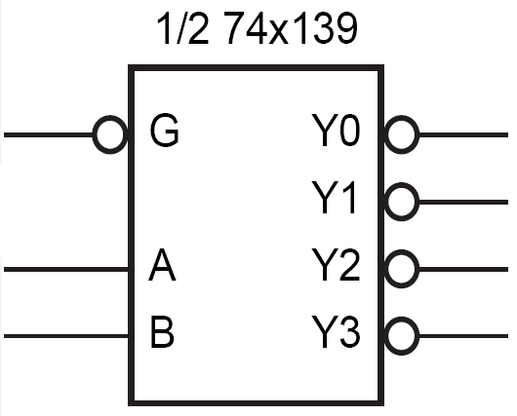
Active Low
Decoder with
  Active Low Enable
  Active Low Outputs
G | A | B | Y₀ | Y₁ | Y₂ | Y₃
1 | X | X | 1 | 1 | 1 | 1
0 | 0 | 0 | 0 | 1 | 1 | 1
0 | 0 | 1 | 1 | 0 | 1 | 1
0 | 1 | 0 | 1 | 1 | 0 | 1
0 | 1 | 1 | 1 | 1 | 1 | 0

Slide 6
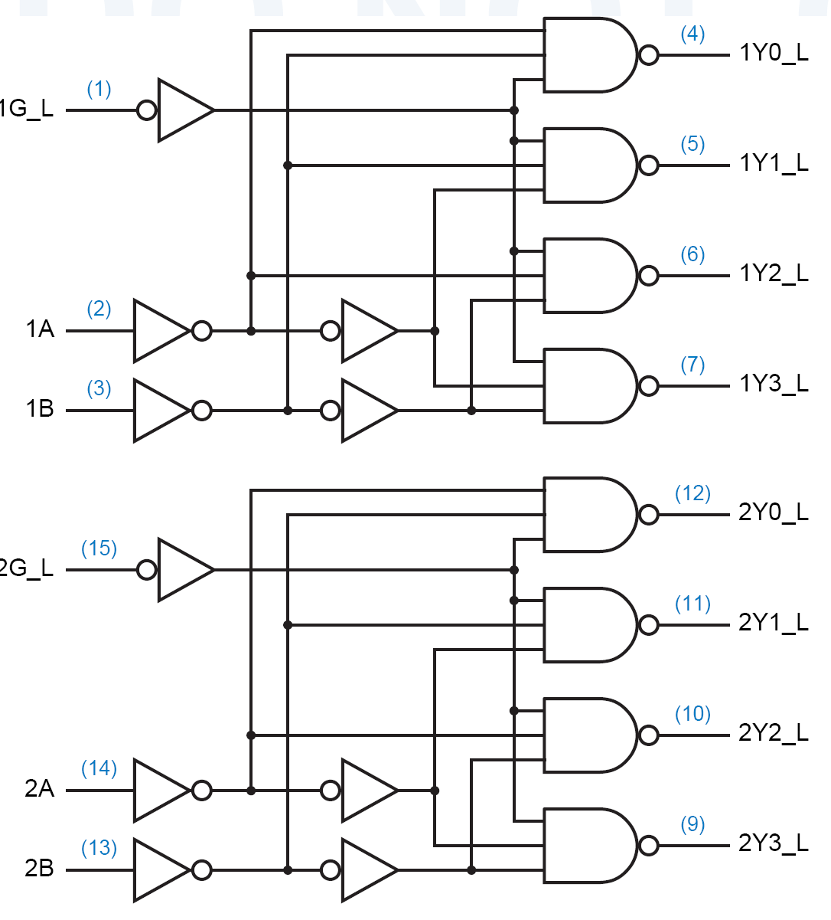
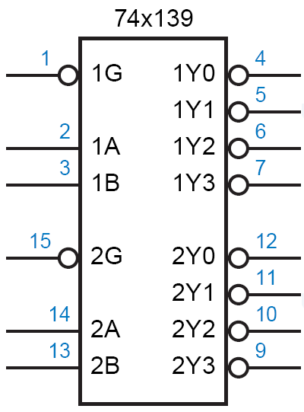
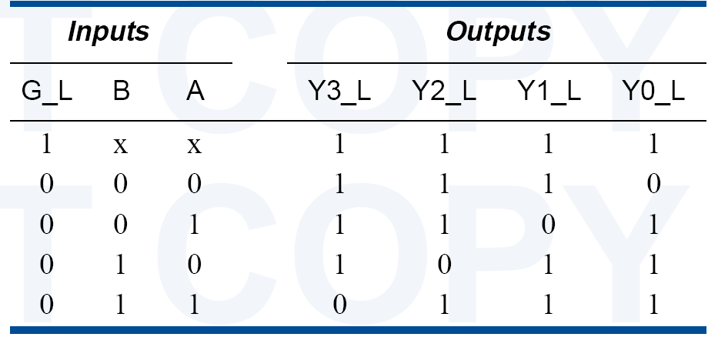
74x139 dual 2-to-4 decoder

Slide 7
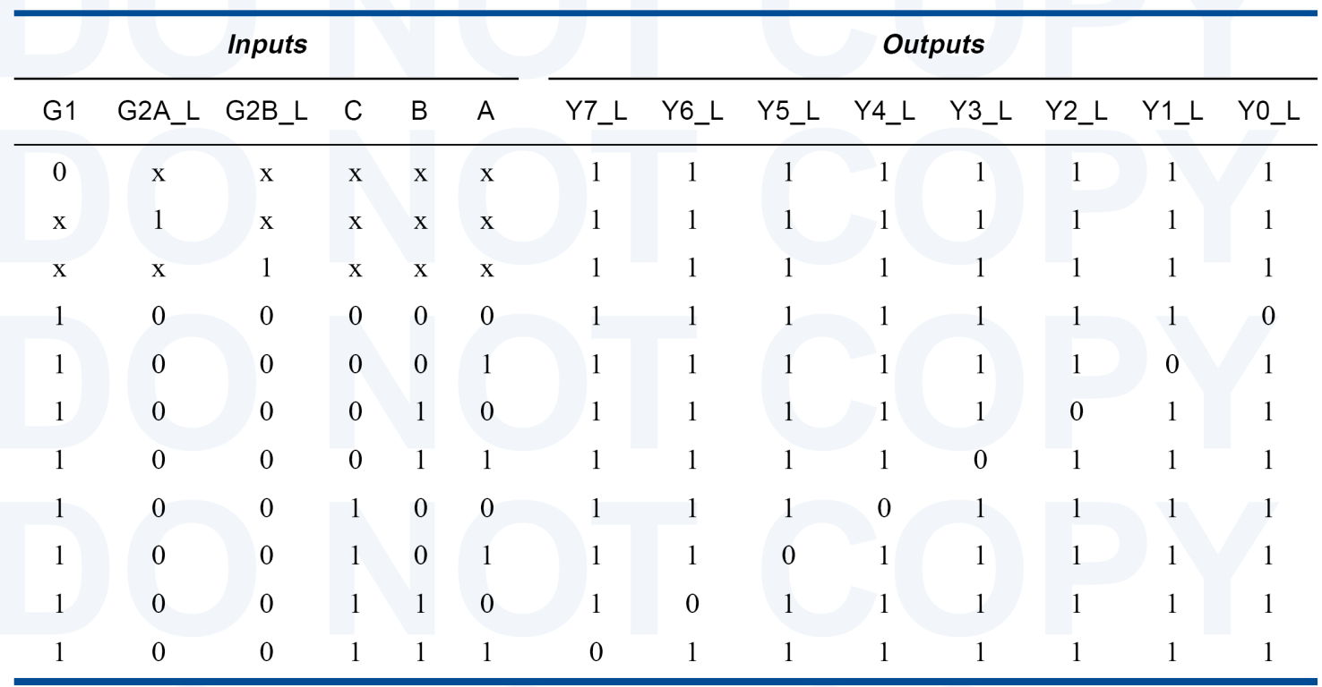
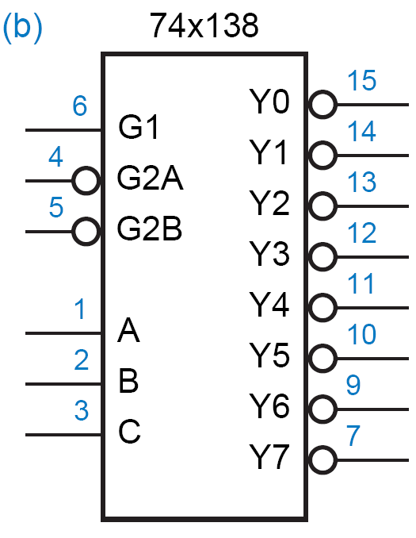
74x138 3-8 Decoder

Slide 8
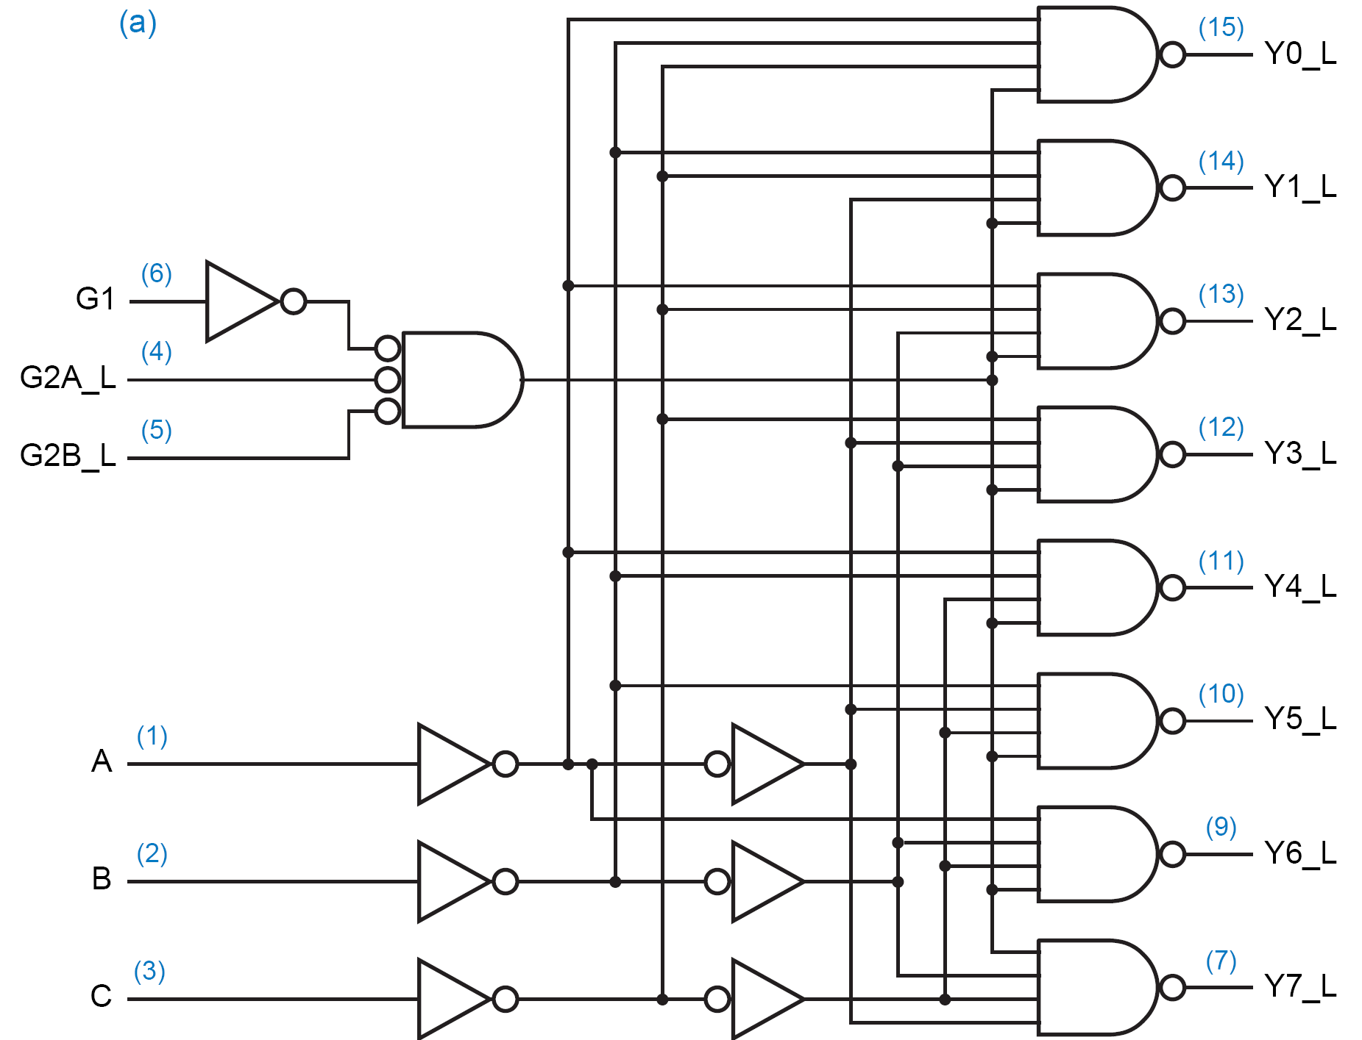
74x138 3-8 Decoder

Slide 9
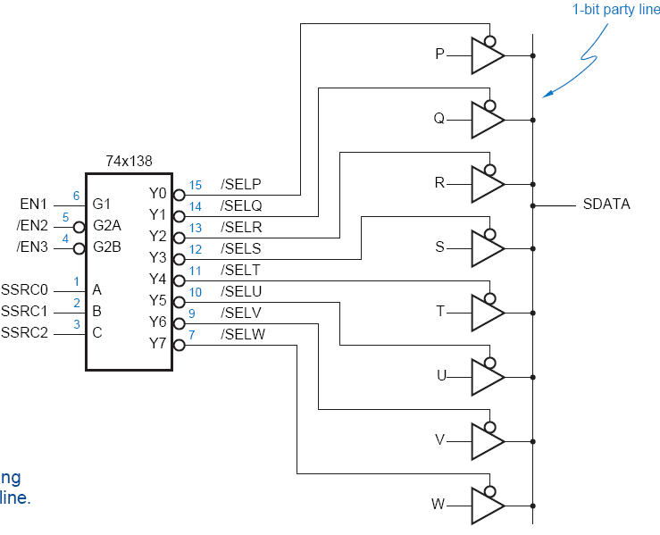
Using 3-State Buffers
  Can use 3-state buffers to share a single line for several devices.
Decoder guarantees that no two buffers are on simultaneously.
Some decoders have hi-Z outputs.

Slide 10
Decoders
  Can build a decoder by smaller decoders
A
O₀
0
B
S₂
O₁
1
B
C
S₁
O₂
3:8
O₃
2
D
S₀
dec
O₄
3
O₅
A
S₃
4
O₆
5
Enb
O₇
B
S₂
6
4:16
7
C
S₁
dec
8
C
9
O₀
D
S₀
10
B
S₂
O₁
1
1
O₂
12
C
S₁
3:8
O₃
13
D
S₀
dec
O₄
14
O₅
15
D
Enb
O₆
O₇
Enb

Slide 11
Decoders
  How to build a 5-32 decoder by using 4-16 and 2-4 decoders?

Slide 12
Decoders
Decoder: a more general term
  Our focus was on “binary decoders”

Slide 13
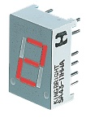
7-Segment Decoder
Seven-segment display:
  7 LEDs (light emitting diodes), each one controlled by an input
  1 means “on”, 0 means “off”
  Display digit “3”?
    Set a, b, c, d, g to 1
    Set e, f to 0
a
f
b
g
e
c
d

Slide 14
7-Segment Decoder
C
0
C
C
5
C
6
1
C
C
4
2
C
3
C
C
C
C
C
C
C
0
1
2
3
4
5
6
BCD-to-7-segment
control signal
decoder
A
B
C
D

Slide 15
7-Segment Decoder
7-Segment Decoder:
  Input is a 4-bit BCD code → 4 inputs (A, B, C, D).
  Output is a 7-bit code (a,b,c,d,e,f,g) that allows for the decimal equivalent to be displayed.
Example:
  Input: 0000_{BCD}
  Output: 1111110
  (a=b=c=d=e=f=1, g=0)
a
f
b
g
e
c
d

Slide 16
BCD-to-7Segment Truth Table
Digit
ABCD
abcdefg
Digit
ABCD
abcdefg
0
0000
1111110
8
1000
1111111
1110011
1
0001
0110000
9
1001
111X011
1010
XXXXXXX
2
0010
1101101
1011
XXXXXXX
3
0011
1111001
1100
XXXXXXX
4
0100
0110011
1101
XXXXXXX
5
0101
1011011
1110
XXXXXXX
6
0110
1011111
1111
XXXXXXX
X011111
7
0111
11100X0
1110000
??

Slide 17
K-maps
AB
A
AB
A
AB
A
CD
00
01
11
10
CD
00
01
11
10
CD
00
01
11
10
00
1
0
X
1
00
1
1
X
1
00
1
1
X
1
01
0
1
X
1
01
1
0
X
1
01
1
1
X
1
D
D
D
11
1
1
X
X
11
1
1
X
X
11
1
1
X
X
C
C
C
10
1
1
X
X
10
1
0
X
X
10
0
1
X
X
B
B
B
K-map for
a
K-map for
b
K-map for
c
A
AB
A
AB
A
AB
A
AB
CD
00
01
11
10
CD
00
01
11
10
CD
00
01
11
10
CD
00
01
11
10
00
1
0
X
1
00
1
0
X
1
00
1
1
X
1
00
0
1
X
1
01
0
1
X
0
01
0
0
X
0
01
0
1
X
1
01
0
1
X
1
D
D
D
D
11
1
0
X
X
11
0
0
X
X
11
0
0
X
X
11
1
0
X
X
C
C
C
C
10
1
1
X
X
10
1
1
X
X
10
0
1
X
X
10
1
1
X
X
B
B
B
B
K-map for
d
K-map for
e
K-map for
f
K-map for
g
a = A + B D + C + B' D'
b = A + C' D' + C D + B'
c = A + B + C' + D
d = B' D' + C D' + B C' D + B' C
e = B' D' + C D
f = A + C' D' + B D' + B C'
g = A + C D' + B C' + B' C

Slide 18
Encoder

Slide 19
Encoder
Encoder:
  the inverse operation of a decoder.
  Has 2^{n} input lines and n output lines.
  The output lines generate the binary equivalent of the input line whose value is 1.
I0
z1
4-2
Binary
Encoder
I1
I2
z2
I3

Slide 20
Encoder
O₀
I₀
A
S₂
O₁
I₁
Z₂
A
O₂
I₂
B
S₁
3:8
O₃
I₃
8:3
Z₁
B
C
decoder
O₄
I₄
encoder
C
S₀
Z₀
O₅
I₅
O₆
I₆
O₇
I₇

Slide 21
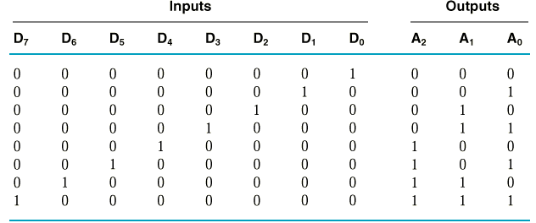
Encoder Circuit Design
Example:
  8-3 Binary Encoder
A₀ = D₁ + D₃ + D₅ + D₇
A₁ = D₂ + D₃ + D₆ + D₇
A₂ = D₄ + D₅ + D₆ + D₇

Slide 22
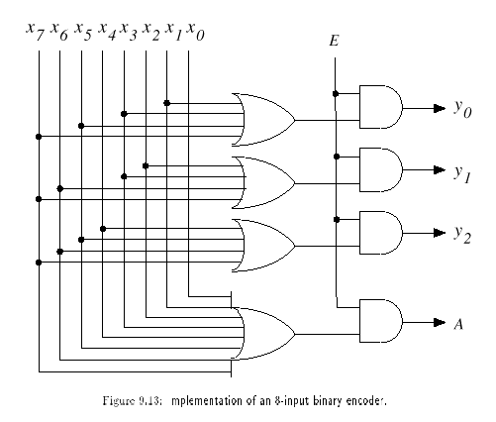
Encoder Circuit
With Enable
With Acknowledge

Slide 23
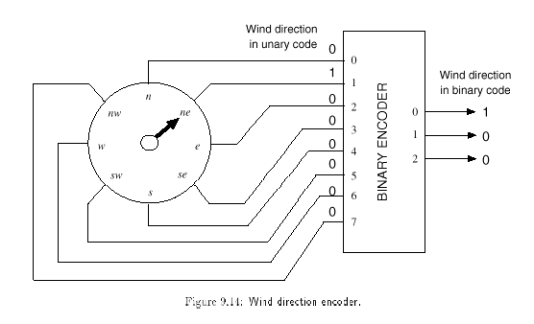
Application
The number of inputs: large
→ fewer lines

Slide 24
Encoder Design Issues
  Only one input can be active at any given time.
    If two inputs are active simultaneously, the output produces an undefined combination
      (for example, if D₃ and D₆ are 1 simultaneously, the output of the encoder will be 111.
A₀ = D₁ + D₃ + D₅ + D₇
A₁ = D₂ + D₃ + D₆ + D₇
A₂ = D₄ + D₅ + D₆ + D₇

Slide 25
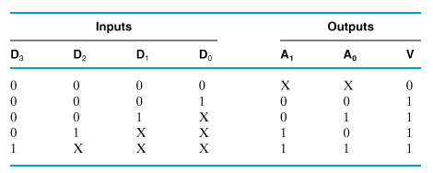
Priority Encoder
  Multiple asserted inputs are allowed; one has priority over all others.

Slide 26
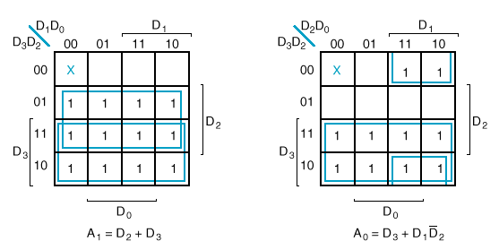
K-Maps

Slide 27
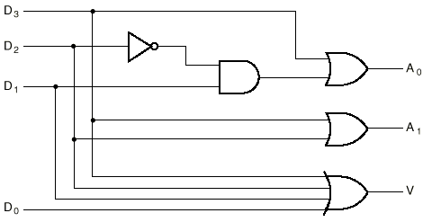
Circuit

Slide 28
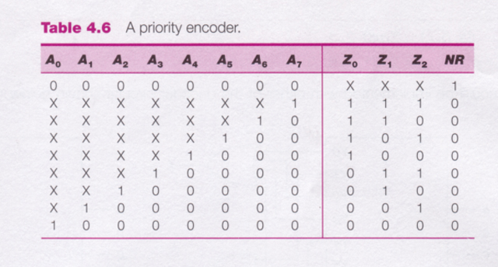
8-3 Priority Encoder

Slide 29
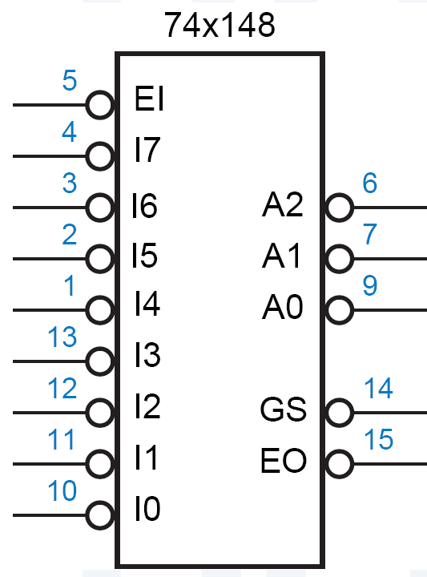
74x148
Features:
  inputs and outputs are active low.
  EI_L must be asserted for any of its outputs to be asserted.
  GS_L is asserted when the device is enabled and one or more of the request inputs is asserted. (“Group Select” or “Got Something.” )
  EO_L is an enable output designed to be connected to the EI_L input of another ’148 that handles lower-priority requests.
    It is asserted if EI_L is asserted but no request input is asserted; thus, a lower-priority ’148 may be enabled.

Slide 30
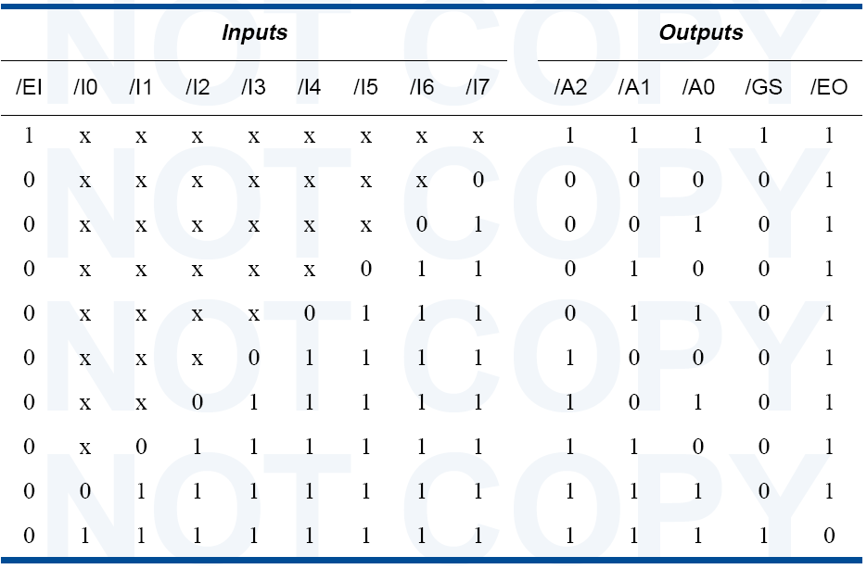
74x148 Truth Table

Slide 31
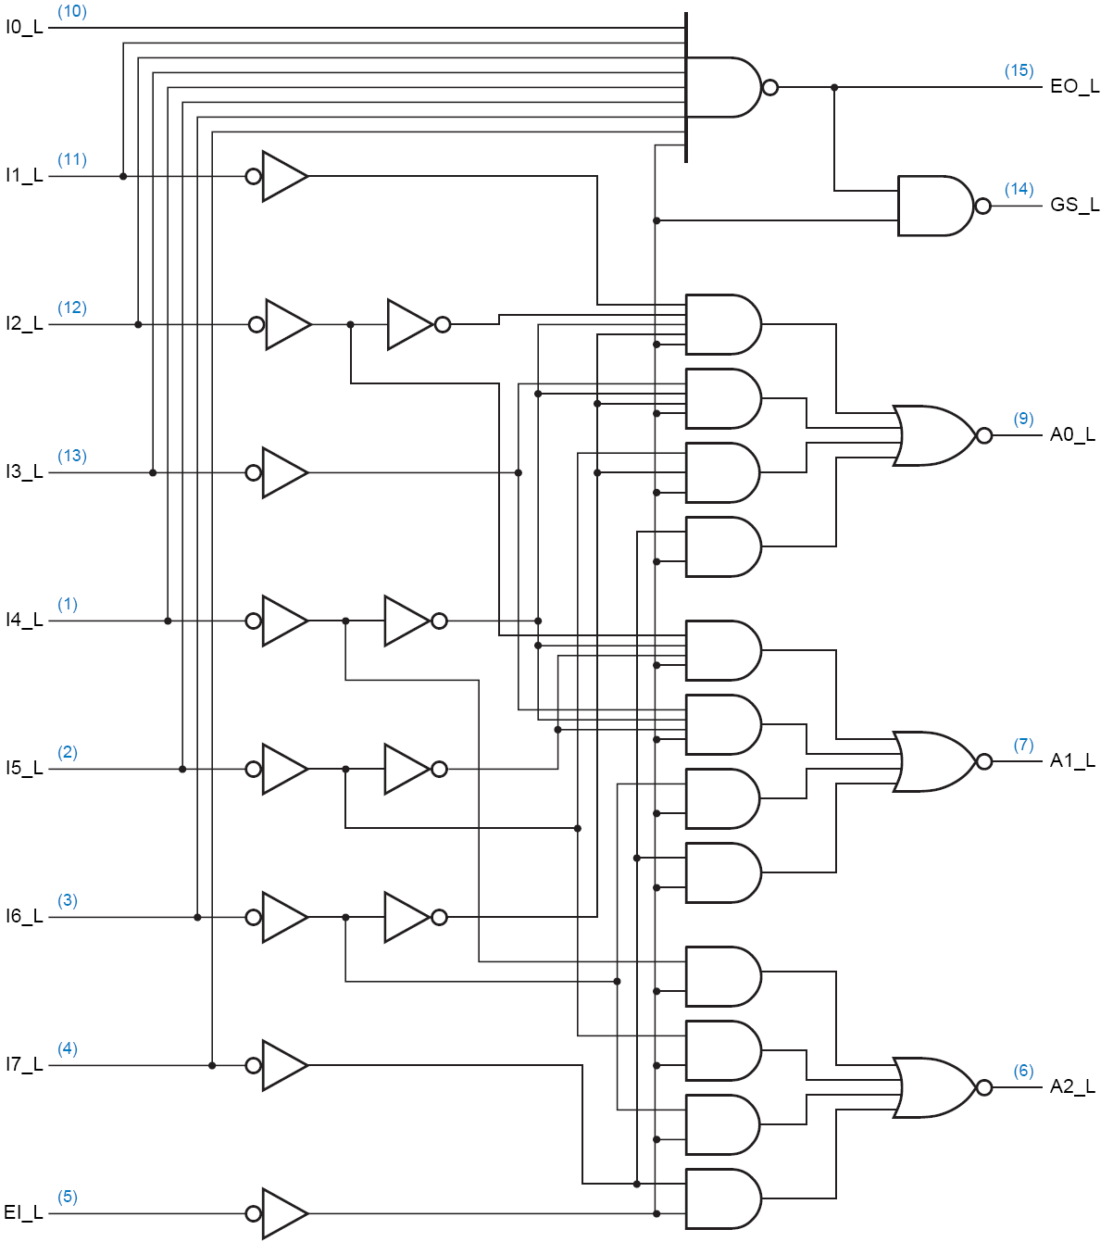
Circuit Diagram

Slide 32
Datasheets
  http://www.techlearner.com/C&D/index.htm
  http://users.otenet.gr/~athsam/database.htm
  Some sample datasheets in the course site.

