Slide 1

Embedded and Real-Time Systems Spring 2021
Hamed Farbeh
farbeh@aut.ac.ir
Department of Computer Engineering
Amirkabir University of Technology
Lecture 3

Slide 2
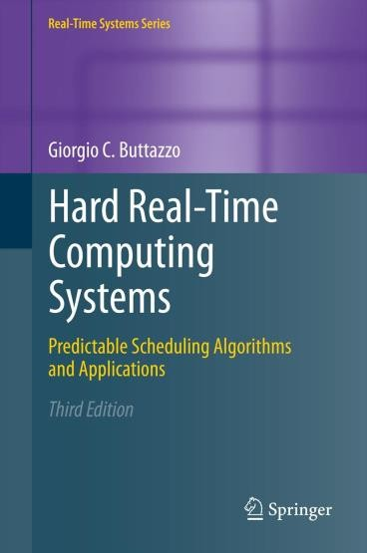
Copyright Notice
This lecture is adopted from
IN4343 Real-Time Systems Course 2018 – 2019, Mitra Nasri,
Delft University of Technology
Online Scheduling
Buttazzo’s book, chapter 2
Embedded and Real-Time Systems, Spring 2021, AUT, Tehran, Iran

Slide 3

Agenda
Modeling real-time systems
Real-time tasks: formal definitions
Online scheduling
If you want to remember something
from the course, it should be this section.
Tip: to secure a good grade, learn this section very well.
Embedded and Real-Time Systems, Spring 2021, AUT, Tehran, Iran

Slide 4
Definitions: Schedule
Schedule is a particular assignment of tasks to the processor(s) and time intervals. It determines the task execution sequence.
Formally, given a task set 𝜏 ={𝜏₁, 𝜏₂, …, 𝜏_{𝑛}}, a schedule is a function 𝜎: ℝ⁺ →ℕ that associates an integer 𝑘 to each interval of time [𝑡_{𝑖} , 𝑡_{𝑖+1}) with the following meaning:
𝑘 = 0
in [𝑡_{𝑖} , 𝑡_{𝑖+1}) the processor is IDLE
𝑘 > 0
in [𝑡_{𝑖} , 𝑡_{𝑖+1}) the processor is executing task 𝜏_{𝑘}
Embedded and Real-Time Systems, Spring 2021, AUT, Tehran, Iran

Slide 5
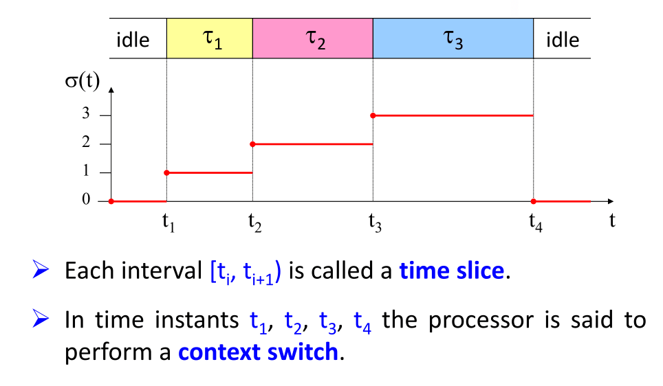
Example: Schedule
Embedded and Real-Time Systems, Spring 2021, AUT, Tehran, Iran

Slide 6
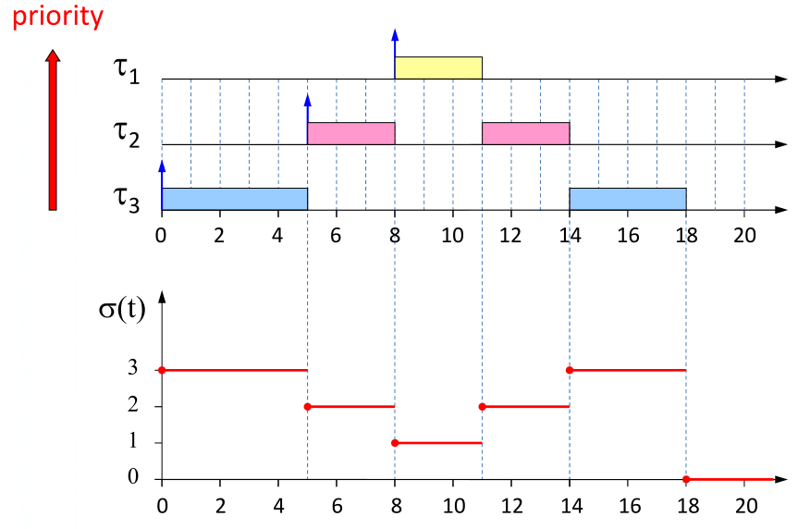
Preemptive scheduling
Embedded and Real-Time Systems, Spring 2021, AUT, Tehran, Iran

Slide 7
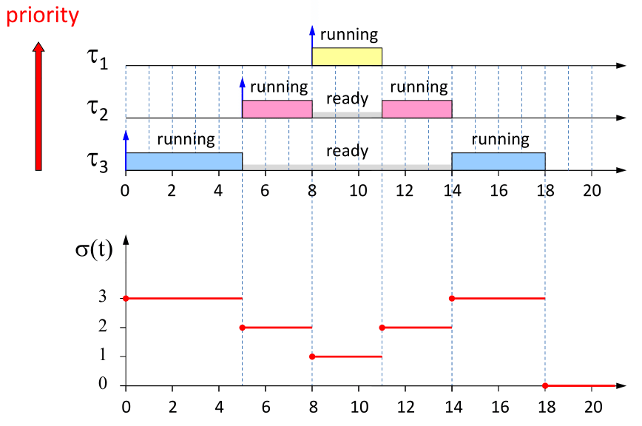
Example: task states in preemptive scheduling
Embedded and Real-Time Systems, Spring 2021, AUT, Tehran, Iran

Slide 8
Definitions
A schedule 𝜎 is said to be feasible if and only if it satisfies all given requirements, for example, “no deadline is missed in 𝜎”.
A task set 𝜏 is said to be feasible,
If and only if there exists a feasible schedule for 𝜏.
A task set 𝜏 is said to be schedulable with an algorithm 𝐴,
if and only if 𝑨 generates a feasible schedule for 𝜏.
Embedded and Real-Time Systems, Spring 2021, AUT, Tehran, Iran

Slide 9







Online scheduling
Online scheduler
Ready queue
Recall:
dispatching
CPU
Task completion
Task activation (release)
pending queue
Preemption or suspension
Scheduling alg.
What scheduling policies (or algorithms) do you know?
Embedded and Real-Time Systems, Spring 2021, AUT, Tehran, Iran

Slide 10
Some well-known scheduling algorithms
First-in-first-out scheduling (FIFO)
= First-come-first-serve (FCFS)
Round robin
Shortest-job first
Earliest deadline first (EDF)
Fixed-priority scheduling (FP)
Embedded and Real-Time Systems, Spring 2021, AUT, Tehran, Iran

Slide 11
Example: FIFO
𝜏₁
𝜏₂
𝜏_{𝑖} | 𝐶_{𝑖} | a_{𝑖} | 𝑑_{𝑖}
𝜏₁ | 8 | 5 | 14
𝜏₂ | 3 | 10 | 14
𝜏₃ | 4 | 2 | 17
5
14
10
14
𝜏₃
2
17
What would be the schedule?
Embedded and Real-Time Systems, Spring 2021, AUT, Tehran, Iran

Slide 12










Example: FIFO
𝜏₁
𝜏_{𝑖} | 𝐶_{𝑖} | a_{𝑖} | 𝑑_{𝑖}
𝜏₁ | 8 | 5 | 14
𝜏₂ | 3 | 10 | 14
𝜏₃ | 4 | 2 | 17
5 6
14
3
miss
𝜏
2
10
14
17
𝜏₃
2
17
Let’s see how this schedule is produced
Embedded and Real-Time Systems, Spring 2021, AUT, Tehran, Iran

Slide 13







Example: FIFO
𝜏₁
𝜏₂
𝜏₃
𝜏_{𝑖} | 𝐶_{𝑖} | a_{𝑖} | 𝑑_{𝑖}
𝜏₁ | 8 | 5 | 14
𝜏₂ | 3 | 10 | 14
𝜏₃ | 4 | 2 | 17
2
17
Online scheduler
Ready queue
At time 2:
𝜏₃
dispatching
CPU
Task completion
Task activation (release)
pending queue
Preemption or suspension
Scheduling alg.
Embedded and Real-Time Systems, Spring 2021, AUT, Tehran, Iran

Slide 14


Example: FIFO
What is this 𝝐 for?
Answer: context switch and the runtime of the scheduler
𝜏₁
𝜏₂
𝜏₃
𝜏_{𝑖} | 𝐶_{𝑖} | a_{𝑖} | 𝑑_{𝑖}
𝜏₁ | 8 | 5 | 14
𝜏₂ | 3 | 10 | 14
𝜏₃ | 4 | 2 | 17
2
17
Online scheduler
Ready queue
from 2+𝜖 until 5:
dispatching
CPU
Task completion
Task activation (release)
pending queue
𝜏₃
Preemption or suspension
Scheduling alg.
Embedded and Real-Time Systems, Spring 2021, AUT, Tehran, Iran

Slide 15






Example: FIFO
𝜏₁
𝜏₂
𝜏_{𝑖} | 𝐶_{𝑖} | a_{𝑖} | 𝑑_{𝑖}
𝜏₁ | 8 | 5 | 14
𝜏₂ | 3 | 10 | 14
𝜏₃ | 4 | 2 | 17
5
14
𝜏₃
2
17
Online scheduler
Ready queue
From 5+𝜖 until 6:
𝜏₁
dispatching
CPU
Task completion
Task activation (release)
pending queue
𝜏₃
Preemption or suspension
Scheduling alg.
Embedded and Real-Time Systems, Spring 2021, AUT, Tehran, Iran

Slide 16







Example: FIFO
𝜏₁
𝜏₂
𝜏_{𝑖} | 𝐶_{𝑖} | a_{𝑖} | 𝑑_{𝑖}
𝜏₁ | 8 | 5 | 14
𝜏₂ | 3 | 10 | 14
𝜏₃ | 4 | 2 | 17
5 6
14
10
14
𝜏₃
2
17
Online scheduler
Ready queue
From 10+𝜖 until 14:
𝜏₂
dispatching
CPU
Task completion
Task activation (release)
pending queue
𝜏₁
Preemption or suspension
Scheduling alg.
Embedded and Real-Time Systems, Spring 2021, AUT, Tehran, Iran

Slide 17




Example: FIFO
𝜏₁
𝜏_{𝑖} | 𝐶_{𝑖} | a_{𝑖} | 𝑑_{𝑖}
𝜏₁ | 8 | 5 | 14
𝜏₂ | 3 | 10 | 14
𝜏₃ | 4 | 2 | 17
5 6
14
3
miss
𝜏
2
10
14
17
𝜏₃
2
17
Online scheduler
Ready queue
From 14+𝜖 until 17:
dispatching
CPU
Task completion
Task activation (release)
pending queue
𝜏₂
Preemption or suspension
Scheduling alg.
Embedded and Real-Time Systems, Spring 2021, AUT, Tehran, Iran

Slide 18






Is the task set feasible?
𝜏₁
𝜏₂
𝜏_{𝑖} | 𝐶_{𝑖} | a_{𝑖} | 𝑑_{𝑖}
𝜏₁ | 8 | 5 | 14
𝜏₂ | 3 | 10 | 14
𝜏₃ | 4 | 2 | 17
5
14
miss
10
14
16
𝜏₃
2
17
Why?
Because whatever you do, you cannot find a solution without a deadline miss. Try!
In general, this claim needs a proof!
Embedded and Real-Time Systems, Spring 2021, AUT, Tehran, Iran

Slide 19
Is the task set feasible?
𝜏₁
𝜏₂
𝜏_{𝑖} | 𝐶_{𝑖} | a_{𝑖} | 𝑑_{𝑖}
𝜏₁ | 8 | 5 | 14
𝜏₂ | 3 | 10 | 14
𝜏₃ | 4 | 2 | 17
5
14
miss
10
14
16
𝜏₃
2
17
What would be the maximum number of deadline misses that this task set may have for “any imaginable” scheduling algorithm?
3
Embedded and Real-Time Systems, Spring 2021, AUT, Tehran, Iran

Slide 20







How?
My “just-invented-scheduling-policy-for-fun” (JISPFF) schedules each task 𝜏_{𝑖} at time 𝑖 × 10
miss
𝜏₁
5
10
14
18
miss
23
𝜏₂
10
14
20
𝜏₃
miss
34
2
17
30
Embedded and Real-Time Systems, Spring 2021, AUT, Tehran, Iran

Slide 21

It is easy to mess up!
Never under estimate the power of a BAD scheduling algorithm!
Embedded and Real-Time Systems, Spring 2021, AUT, Tehran, Iran

Slide 22



Quiz
What is the response time of Task 1?
9 = 14-5
8
Task 1
5
6
14
3
Task 2
10
14
17
4
Task 3
2
6
17
Embedded and Real-Time Systems, Spring 2021, AUT, Tehran, Iran

Slide 23



Quiz
With a FIFO schedule, what is the earliest time at which a task
completes?
Task 1
𝐶₁ = 5
5
17
Task 2
𝐶₂ = 10
4
15
Task 3
𝐶₃ = 1
7
10
Task 1
𝐶₁ = 5
5
17
19
Task 2
𝐶₂ = 10
14
4
15
Task 3
𝐶₃ = 1
7
10
20
Embedded and Real-Time Systems, Spring 2021, AUT, Tehran, Iran

Slide 24
Quiz
How many deadline misses in the FIFO schedule?
2
Task 1
𝐶₁ = 5
5
17
Task 2
𝐶₂ = 10
4
15
Task 3
𝐶₃ = 1
7
10
Task 1
miss
𝐶₁ = 5
5
17
19
Task 2
𝐶₂ = 10
4
15
miss _{𝐶3 = 1}
20
Task 3
7
10
Embedded and Real-Time Systems, Spring 2021, AUT, Tehran, Iran

Slide 25
Quiz
What is the response time of Task 1 in the FIFO schedule?
Task 1
𝐶₁ = 2
5
17
Completion time of Task 1
𝑓₁ = 19
Task 2
𝐶₂ = 10
4
15
Task 3
𝐶₃ = 1
Response time of Task 1
𝑅₁ = 𝑓₁ − 𝑎₁ = 19 − 5 = 14
7
10
Task 1
𝐶₁ = 2
5
14
17
19
Task 2
𝐶₂ = 10
4
15
Task 3
𝐶₃ = 1
7
10
Embedded and Real-Time Systems, Spring 2021, AUT, Tehran, Iran

Slide 26








Is this task set feasible?
Task 1
𝐶₁ = 2
5
17
Task 2
𝐶₂ = 10
4
15
Task 3
𝐶₃ = 1
7
10
Yes! Here is one feasible schedule for it:
Task 1
𝐶₁ = 2
5
17
Task 2
𝐶₂ = 10
4
15
Task 3
𝐶₃ = 1
7
10
Embedded and Real-Time Systems, Spring 2021, AUT, Tehran, Iran

Slide 27








In a feasible schedule, which task(s) might be executing at time 14? (Think carefully)
Task 1
𝐶₁ = 2
5
17
Task 2
𝐶₂ = 10
4
15
Task 3
𝐶₃ = 1
7
10
Task 1
𝐶₁ = 2
5
17
Only Task 2.
If at time 14, any other task than Task 2 is executing, that schedule will not be feasible!
Task 2
𝐶₂ = 10
4
15
Task 3
𝐶₃ = 1
7
10
Embedded and Real-Time Systems, Spring 2021, AUT, Tehran, Iran

Slide 28
Summary
Modeling timing behavior of a task
Understanding the title of the course
Learning about online scheduling
Learning the difference between “feasible” and “schedulable”
Embedded and Real-Time Systems, Spring 2021, AUT, Tehran, Iran

