Slide 1

Embedded and Real-Time Systems Spring 2021
Hamed Farbeh
farbeh@aut.ac.ir
Department of Computer Engineering
Amirkabir University of Technology
Lecture 4

Slide 2
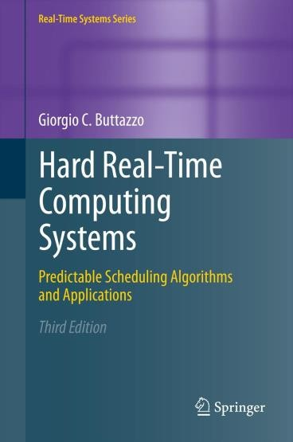
Copyright Notice
This lecture is adopted from
IN4343 Real-Time Systems Course 2018 – 2019, Mitra Nasri,
Delft University of Technology
Online Scheduling of Aperiodic Tasks
Buttazzo’s book, chapter 3
Embedded and Real-Time Systems, Spring 2021, AUT, Tehran, Iran

Slide 3



Summary of the previous quiz
How many deadline misses in the FIFO schedule?
Task 1
𝐶₁ = 5
𝐶₂ = 10
𝐶₃ = 1
5
17
Task 2
4
15
Task 3
7
10
miss
2
Task 1
𝐶₁ = 5
5
17
19
Task 2
𝐶₂
miss
𝐶₃
20
= 10
4
15
Task 3
= 1
7
10
Embedded and Real-Time Systems, Spring 2021, AUT, Tehran, Iran

Slide 4

FIFO: the judgment day
Disadvantages of FIFO
Creates a non-preemptive schedule
Ignores task’s deadline and priority
Response times heavily depend on the arrival times
Low schedulability
Schedulability: the ability of the scheduling algorithm to generate feasible schedules for various task sets
Advantages of FIFO
Fast
Simple implementation (easily implementable on hardware or software using a queue)
Low runtime overhead
Wide applicability in network systems (almost everywhere
you have a queue)
Embedded and Real-Time Systems, Spring 2021, AUT, Tehran, Iran

Slide 5





Summary of the previous quiz
Is the task set feasible?
Task 1
𝐶₁ = 2
𝐶₂ = 10
𝐶₃ = 1
5
17
Task 2
4
15
Task 3
7
10
Yes! Here is one feasible schedule for it:
Task 1
𝐶₁ = 2
5
17
Task 2
𝐶₂ = 10
4
15
Task 3
𝐶₃ = 1
7
10
Embedded and Real-Time Systems, Spring 2021, AUT, Tehran, Iran

Slide 6
Summary of the previous quiz
What scheduling policy do you think it is?
Earliest deadline first (EDF)
Yes! Here is one feasible schedule for it:
Task 1
𝐶₁ = 2
5
17
Task 2
𝐶₂ = 10
4
15
Task 3
𝐶₃ = 1
7
10
Embedded and Real-Time Systems, Spring 2021, AUT, Tehran, Iran

Slide 7





Summary of the previous quiz
No! There can be more:
Task 1
𝐶₁ = 2
5
17
Is it the only possible feasible schedule?
Task 2
𝐶₂ = 10
4
15
Task 3
𝐶₃ = 1
7
8
10
Yes! Here is one feasible schedule for it:
Task 1
𝐶₁ = 2
5
17
Task 2
𝐶₂ = 10
4
15
Task 3
𝐶₃ = 1
7
10
Embedded and Real-Time Systems, Spring 2021, AUT, Tehran, Iran

Slide 8
Agenda
Scheduling complexity
Online scheduling policies and their properties
Embedded and Real-Time Systems, Spring 2021, AUT, Tehran, Iran

Slide 9













Feasibility vs. schedulability
Space of all task sets
Infeasible
task sets
feasible task sets
Task sets schedulable by algorithm A
Task sets schedulable by algorithm B
Embedded and Real-Time Systems, Spring 2021, AUT, Tehran, Iran

Slide 10













General scheduling problem
Given a set 𝜏 of 𝑛 tasks, a set 𝑷 of 𝑝 processors, and a set
𝑹 of 𝑟 resources, find an assignment of 𝑷 and 𝑹 to 𝜏
that produces a feasible schedule under a set of constraints.
𝑅
𝑃
𝜏
Scheduling algorithm
𝜎
feasible
constraints
Embedded and Real-Time Systems, Spring 2021, AUT, Tehran, Iran

Slide 11
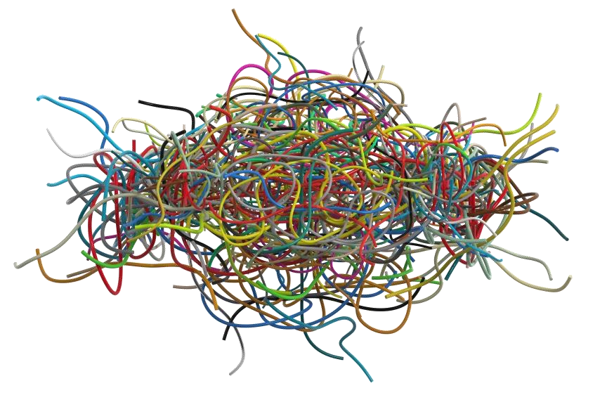




Complexity
In 1975, Garey and Johnson showed that the general scheduling problem is NP hard.
In practice, it means that the time for finding a feasible schedule grows exponentially with the number of tasks.
𝑛=5
𝑛=2
Fortunately, polynomial time algorithms can be found under particular conditions.
Embedded and Real-Time Systems, Spring 2021, AUT, Tehran, Iran

Slide 12




Why do we care about complexity?
Let’s consider an application with 𝒏 = 30 tasks on a processor in which the elementary step takes 1 𝝁𝒔
(one microseconds = 10⁻⁶𝑠)
Consider 3 algorithms with the following complexity:
𝑨_{𝟏}: 𝑶 𝒏
𝑨_{𝟐}: 𝑶 𝒏^{𝟖}
𝑨_{𝟑}: 𝑶 𝟖^{𝒏}
30𝜇𝑠 182 hours
40,000
billion years
Embedded and Real-Time Systems, Spring 2021, AUT, Tehran, Iran

Slide 13


Complexity
Textbooks:
“Complexity” (e.g., the big O) is a very important factor for choosing the right algorithm.
Yes! Complexity matters! A lot! It MATTERS! MMMAAATTERRRSS!
I agree, but what else?
Hmmm, If you insist, you can consider memory too: “Memory Complexity”!
As a real-time and embedded system engineer, what else should you consider?
Embedded and Real-Time Systems, Spring 2021, AUT, Tehran, Iran

Slide 14













Complexity, what else?
runtime
hardware platform capabilities
memory consumption
memory limits
….
Embedded and Real-Time Systems, Spring 2021, AUT, Tehran, Iran

Slide 15

Things you need to know about “complexity”
Different implementations can have different runtime but similar complexity!
Algorithm A (input: n)
{
a = now(); b = a + 10;
If(b > ready_queue.head()->deadline)
Return ready_queue.head();
Return IDLE_TASK;
}
Algorithm B (input: n)
{
Return ready_queue.head();
}
They are both O(1), but Algorithm A is much slower than B
Embedded and Real-Time Systems, Spring 2021, AUT, Tehran, Iran

Slide 16
Things you need to know about “complexity”
Different implementations can have different runtime but similar complexity!
Algorithm A (input: n)
{
-----
-----
b = a * 3.14;
-----
}
Algorithm B (input: n)
{
-----
-----
b = a + 3000;
-----
}
“addition” is much faster in most microcontrollers than multiplication
Integer operations are usually much faster than floating-point operations
Embedded and Real-Time Systems, Spring 2021, AUT, Tehran, Iran

Slide 17
Things you need to know about “complexity”
Different implementations can have different runtime but similar complexity!
Runtime of an algorithm depends not only on how many instructions you have to execute, but also on how the hardware platform executes it!
Some microcontrollers are very
slow in floating-point operations
Microcontrollers support a limited set of instructions
Example: Arduino does not support “the most significant bit” instruction
Embedded and Real-Time Systems, Spring 2021, AUT, Tehran, Iran

Slide 18
Agenda
Scheduling complexity
Online scheduling policies and their properties
Embedded and Real-Time Systems, Spring 2021, AUT, Tehran, Iran

