Slide 1

Embedded and Real-Time Systems Spring 2021
Hamed Farbeh
farbeh@aut.ac.ir
Department of Computer Engineering
Amirkabir University of Technology
Lecture 5

Slide 2
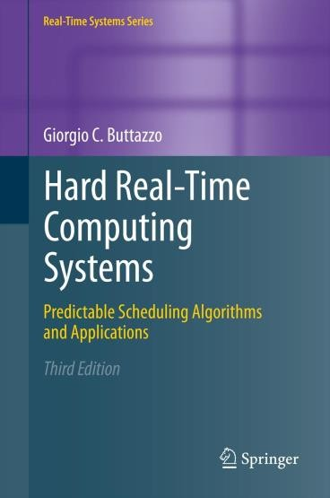
Copyright Notice
This lecture is adopted from
IN4343 Real-Time Systems Course 2018 – 2019, Mitra Nasri,
Delft University of Technology
Online Scheduling of Aperiodic Tasks
Buttazzo’s book, chapter 3
Embedded and Real-Time Systems, Spring 2021, AUT, Tehran, Iran

Slide 3
Agenda
Scheduling complexity
Online scheduling policies and their properties
Embedded and Real-Time Systems, Spring 2021, AUT, Tehran, Iran

Slide 4
Simplifying assumptions
Single processor
Fully preemptive tasks
No precedence constraints
No shared resource or resource constraints
No self-suspension
Homogeneous task sets
(all tasks has the same type of activation, e.g., all are periodic, or all are aperiodic)
Embedded and Real-Time Systems, Spring 2021, AUT, Tehran, Iran

Slide 5
Properties of scheduling algorithms
Preemptive v.s. non-preemptive
Work-conserving v.s. non-work-conserving
Static v.s. dynamic
Offline v.s. online
Optimal v.s. non-optimal (e.g., heuristic)
Embedded and Real-Time Systems, Spring 2021, AUT, Tehran, Iran

Slide 6
Work-conserving v.s. non-work-conserving
Work-conserving
Such algorithm does not leave the processor idle as long as there is a ready task in the system (a task is in the ready queue).
Non-work conserving
Such algorithm may leave the processor idle even if there is a ready task in the system.
Embedded and Real-Time Systems, Spring 2021, AUT, Tehran, Iran

Slide 7





Work-conserving v.s. non-work-conserving
Task 1
𝐶₁ = 1
5
Task 2
𝐶₂ = 10
4
6
16
Task 3
𝐶₃ = 4
3
20
23
The processor is left idle in 𝟑, 𝟓 even though Tasks 2 and 3 are in the ready queue
Embedded and Real-Time Systems, Spring 2021, AUT, Tehran, Iran

Slide 8
Static v.s. dynamic
Static
scheduling decisions are taken based on fixed parameters, statically assigned to tasks before activation.
Dynamic
scheduling decisions are taken based on parameters that
can change with time.
Example:
remaining execution time
absolute deadline
Embedded and Real-Time Systems, Spring 2021, AUT, Tehran, Iran

Slide 9
Offline v.s. online
Offline
all scheduling decisions are taken before task activation: the schedule is stored in a table (table-driven scheduling).
Online
scheduling decisions are taken at run time on the set of active tasks.
Embedded and Real-Time Systems, Spring 2021, AUT, Tehran, Iran

Slide 10
Optimal v.s. heuristic
Optimal
They generate a schedule that minimizes a cost function, defined based on an optimality criterion.
Non-optimal (heuristic)
They generate a schedule according to a heuristic function that tries to satisfy an optimality criterion, but there is no guarantee of success.
Embedded and Real-Time Systems, Spring 2021, AUT, Tehran, Iran

Slide 11
Optimality Criteria
Examples
Feasibility: Find a feasible schedule if there exists one.
Minimize the maximum lateness (also known as makespan)
Minimize the number of deadline miss
Assign a value to each task, then maximize the cumulative value of the feasible tasks
Embedded and Real-Time Systems, Spring 2021, AUT, Tehran, Iran

Slide 12
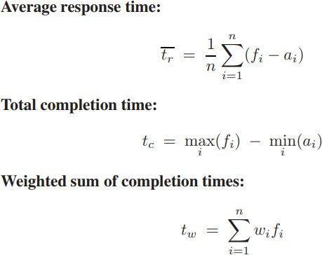
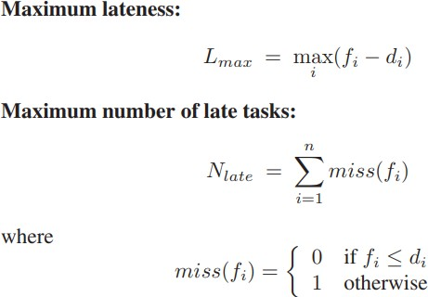
Common definitions for optimality criteria
Reference: Giorgio’s book, chapter 2, page 40
Embedded and Real-Time Systems, Spring 2021, AUT, Tehran, Iran

Slide 13

Let’s see how some of the scheduling algorithms work
Embedded and Real-Time Systems, Spring 2021, AUT, Tehran, Iran

Slide 14
Shortest-job first (SJF)
It selects the ready task with the
shortest computation time.
Kind-of Static (if 𝐶_{𝑖} is a constant parameter)
It can be used online or offline
Can be preemptive or non-preemptive
It minimizes the average response time
Note: Wikipedia says that the most common version of SFJ is “non-preemptive”. The following proof about average response time is also for non-preemptive tasks.
Embedded and Real-Time Systems, Spring 2021, AUT, Tehran, Iran

Slide 15
Optimality of SJF
After checking the book of Buttazzo, I noticed that the proof is not there.
Here are the assumptions for which the proof and hence the claim hold:
SJF is non-preemptive (according to Wikipedia)
The story of the proof (since it does not exist in the book):
𝜎 is a given schedule that is NOT compliant with SJF → Hence, it should have at least two tasks Task L and Task S that are scheduled with an order that is different from what SJF would have scheduled them. (Note: since SJF could have scheduled them differently, executing Task S before Task L must have been possible, namely, both tasks must have been released before the start time of Task L in 𝜎).
Now, we create 𝜎′ by swapping these two tasks in the schedule and we show that 𝜎′ (that is more similar to an SJF schedule) has a smaller average response time
Embedded and Real-Time Systems, Spring 2021, AUT, Tehran, Iran

Slide 16
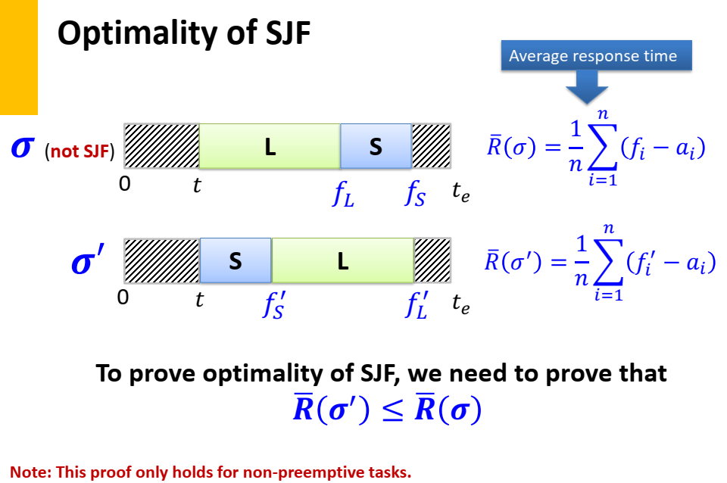
Optimality of SJF
Embedded and Real-Time Systems, Spring 2021, AUT, Tehran, Iran

Slide 17
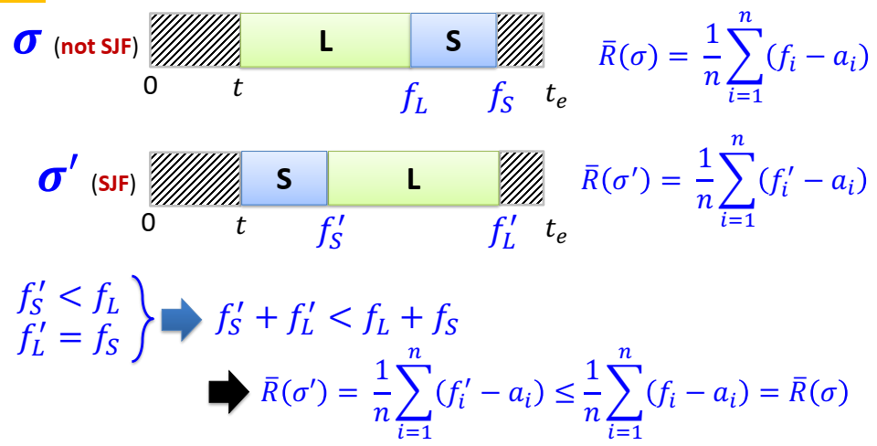
Optimality of SJF
Embedded and Real-Time Systems, Spring 2021, AUT, Tehran, Iran

Slide 18
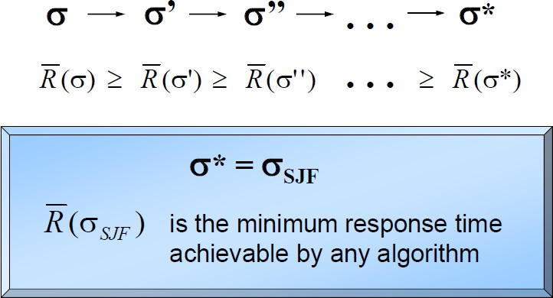
Optimality of SJF
Proof by induction
Highlight: from any given schedule 𝜎 we can make one that is more similar to SJF (by swapping two jobs that are not scheduled according to SJF)
Embedded and Real-Time Systems, Spring 2021, AUT, Tehran, Iran

Slide 19
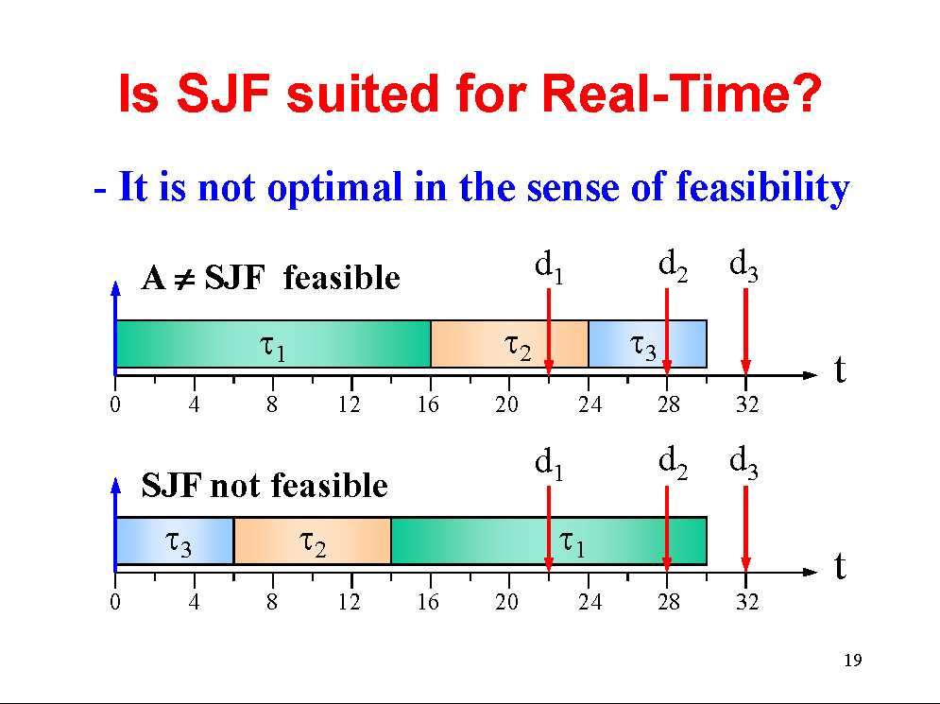
Optimality of SJF
Embedded and Real-Time Systems, Spring 2021, AUT, Tehran, Iran

Slide 20








Fixed-priority scheduling
Each task has a priority 𝑃_{𝑖} , typically 𝑃_{𝑖} ∈ [0, 255]
(𝑃_{𝑖} < 𝑃_{𝑗} means Task 𝜏_{𝑖} has a higher priority than task 𝜏_{𝑗} )
The task with the highest priority is selected for execution.
Tasks with the same priority are served FIFO order
𝑷_{𝟏} < 𝑷_{𝟐} < 𝑷_{𝟑}
Task 1
𝐶₁ =1
10
17
𝐶₂ = 8
𝐶₃ = 4
Task 2
4
13
22
Task 3
7
17
20
Embedded and Real-Time Systems, Spring 2021, AUT, Tehran, Iran

Slide 21
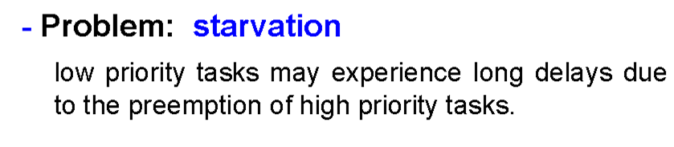
Fixed-priority scheduling
Embedded and Real-Time Systems, Spring 2021, AUT, Tehran, Iran

Slide 22
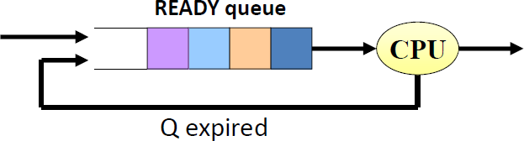
Round robin
The ready queue is served with FIFO, but ...
Each task 𝜏_{𝑖} cannot execute for more than Q time units (Q = time quantum).
When Q expires, 𝝉_{𝒊} is put back in the queue.
Embedded and Real-Time Systems, Spring 2021, AUT, Tehran, Iran

Slide 23


























Round robin
n = number of task in the ready queue
Round robin creates “rounds” that are as long as 𝒏 ⋅ 𝑸
Assume 𝑸 = 𝟏
𝐶₁ = 3
𝐶₂ = 4
𝐶₃ = 3
Task 1
8
16
Task 2
4
14
Task 3
6
13
2 | 2
1 | 2
2
3
2
3 | 1 | 3 | 1 | 1
4 |  | 5 |  | 6
CPU
Round
3
Embedded and Real-Time Systems, Spring 2021, AUT, Tehran, Iran

Slide 24
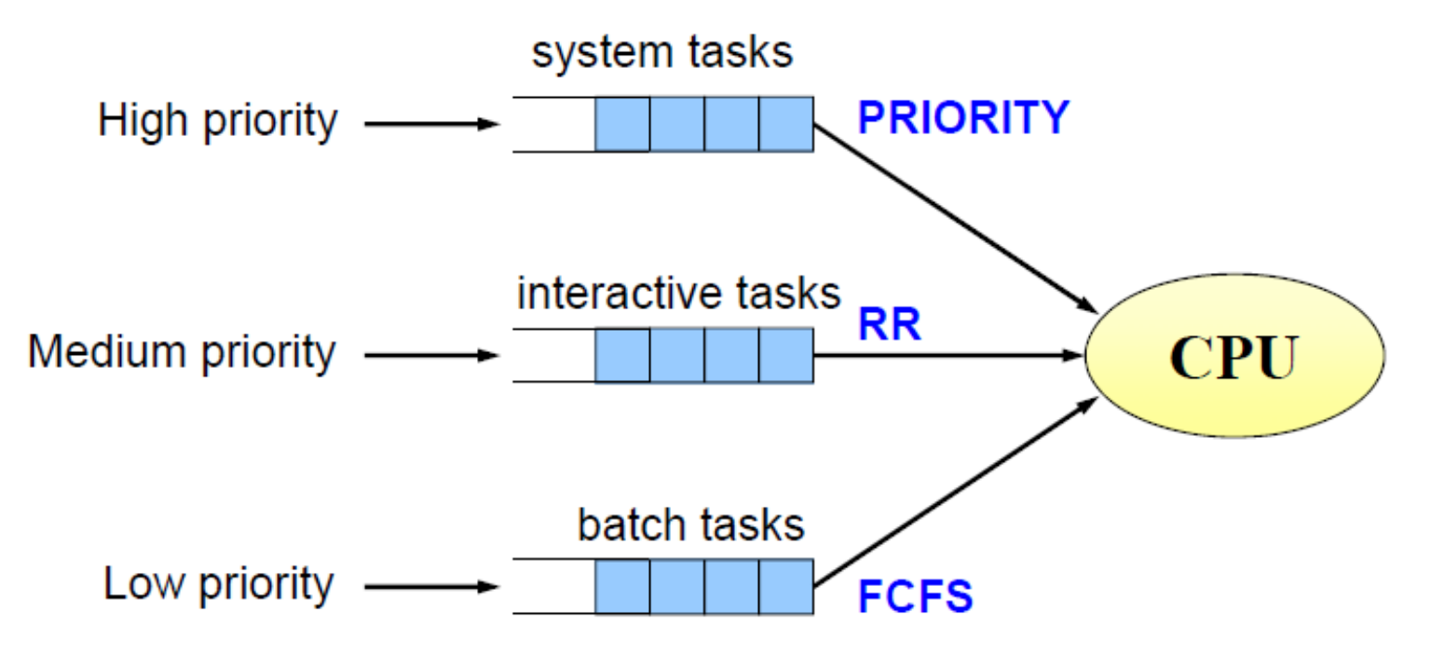
Multi-level scheduling
Embedded and Real-Time Systems, Spring 2021, AUT, Tehran, Iran

Slide 25
Summary
Complexity matters, but it is not the only thing that matter
FIFO is fast and simple to implement, but bad at guaranteeing deadlines
Non-preemptive SJF minimizes the average response time of the tasks
Fixed-priority scheduling may starve low priority tasks
Round robin has a large number of preemptions
Embedded and Real-Time Systems, Spring 2021, AUT, Tehran, Iran

