Slide 1

Embedded and Real-Time Systems Spring 2021
Hamed Farbeh
farbeh@aut.ac.ir
Department of Computer Engineering
Amirkabir University of Technology
Lecture 6

Slide 2
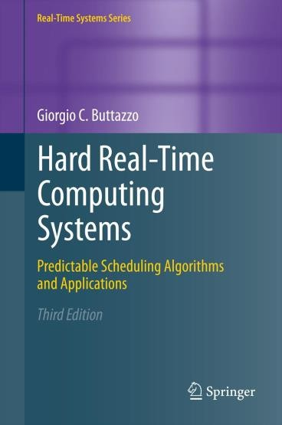
Copyright Notice
This lecture is adopted from
IN4343 Real-Time Systems Course 2018 – 2019, Mitra Nasri,
Delft University of Technology
Online Scheduling of Aperiodic Tasks
Buttazzo’s book, chapter 3
Embedded and Real-Time Systems, Spring 2021, AUT, Tehran, Iran

Slide 3
Agenda
Online scheduling algorithms for real-time systems (chapter 3):
What do we cover?
EDF
Table-driven scheduling
Non-preemptive scheduling
Proof of non-optimality of EDF (from 2016)
Embedded and Real-Time Systems, Spring 2021, AUT, Tehran, Iran

Slide 4




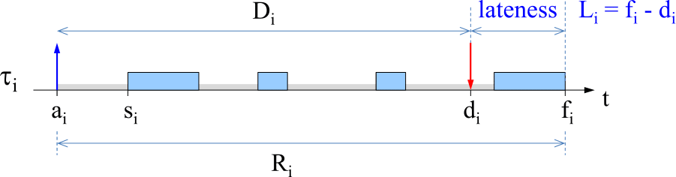




Recall: absolute deadline v.s. relative deadline
relative deadline
Response time:
Absolute deadline
Maximum lateness = 𝐿_{𝑚𝑎𝑥} = max 𝐿_{𝑖} | ∀𝜏_{𝑖}
If 𝐿_{𝑚𝑎𝑥} ≤ 0, then there is no deadline miss
Embedded and Real-Time Systems, Spring 2021, AUT, Tehran, Iran

Slide 5
Earliest Deadline First (EDF)
Algorithm [Horn 74]
Order the ready queue by increasing absolute deadline.
Assumptions
Horn’s algorithm is preemptive and is for independent tasks
Note: the “EDF” that is known today (2019) can be preemptive or non-preemptive.
dynamic (𝑑_{𝑖} depends on the activation time of the task)
Property
Under the assumptions above, EDF minimizes
the maximum lateness (𝑳_{𝒎𝒂𝒙})
Embedded and Real-Time Systems, Spring 2021, AUT, Tehran, Iran

Slide 6
EDF exercise
Check whether EDF produces a feasible schedule
 | 𝑪_{𝒊} | 𝑫_{𝒊} | 𝒂_{𝒊}
𝜏₁ | 4 | 7 | 2
𝜏₂ | 5 | 11 | 0
𝜏₃ | 2 | 4 | 5
𝜏₄ | 3 | 7 | 8
What is the maximum lateness?
Embedded and Real-Time Systems, Spring 2021, AUT, Tehran, Iran

Slide 7









EDF exercise
Task 1
2
6
9
Task 2
0
11
Task 3
5
9
Task 4
8
11
14 15
Note the difference between 𝐷_{𝑖} and 𝑑_{𝑖}
Embedded and Real-Time Systems, Spring 2021, AUT, Tehran, Iran

Slide 8
Online admission test
How can we design an online test for EDF that tells if we can
safely add a new task to the system at time 𝒕?
This is called an online admission test
Safely = not causing a deadline miss for the tasks that execute in the system?
Embedded and Real-Time Systems, Spring 2021, AUT, Tehran, Iran

Slide 9
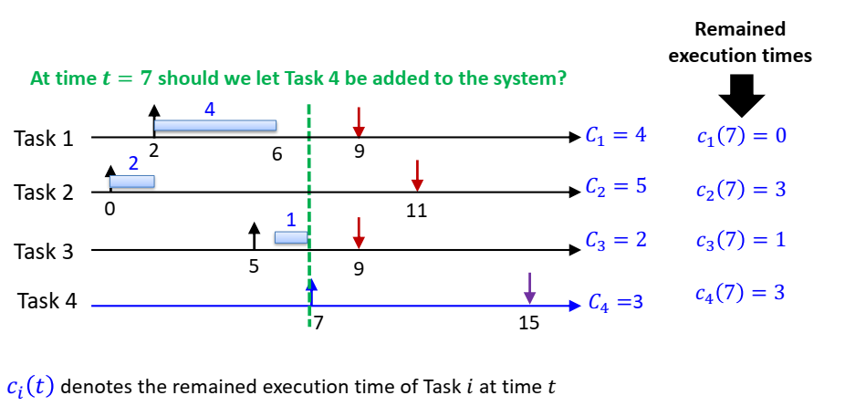
An online admission test for EDF
How should we make a test?
Embedded and Real-Time Systems, Spring 2021, AUT, Tehran, Iran

Slide 10
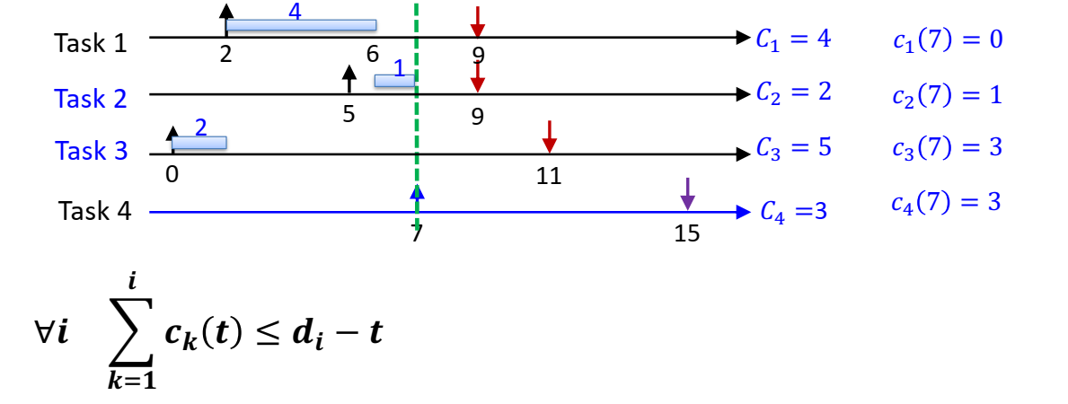
An online admission test for EDF
Sort and re-index tasks by their deadlines (only tasks with 𝑑_{𝑖} ≥ 𝑡)
Check if there is enough time to finish the tasks for each of the deadlines
At time 𝒕 = 𝟕 should we let Task 4 be added to the system?
Important note: the equation above works only if you have re-labeled your tasks after sorting them by their absolute deadline!
Embedded and Real-Time Systems, Spring 2021, AUT, Tehran, Iran

Slide 11
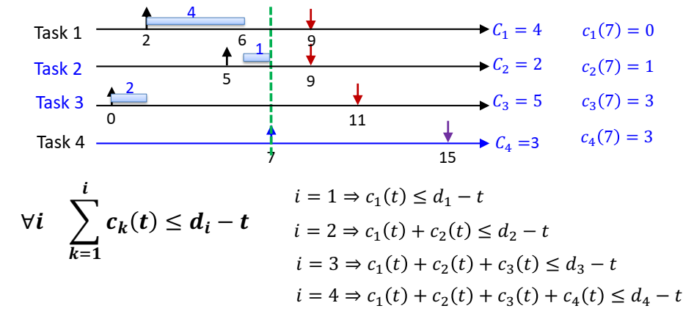
An online admission test for EDF
Sort and re-index tasks by their deadlines (only tasks with 𝑑_{𝑖} ≥ 𝑡)
Check if there is enough time to finish the tasks for each of the deadlines
At time 𝒕 = 𝟕 should we let Task 4 be added to the system?
Embedded and Real-Time Systems, Spring 2021, AUT, Tehran, Iran

Slide 12
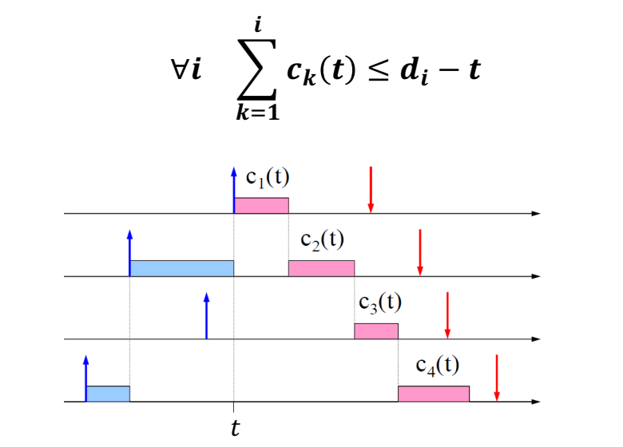
An online admission test for EDF
Embedded and Real-Time Systems, Spring 2021, AUT, Tehran, Iran

Slide 13
What next?
Good news!
We can prove that EDF is optimal
(in the sense of feasibility)
Namely:
If a task set is feasible, then EDF can also
generate a feasible schedule for it!
Embedded and Real-Time Systems, Spring 2021, AUT, Tehran, Iran

Slide 14
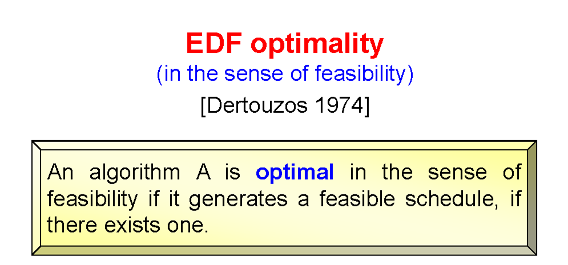
Feasibility Optimality
How can we prove the optimality of EDF?
Embedded and Real-Time Systems, Spring 2021, AUT, Tehran, Iran

Slide 15




A property of optimal algorithms
If a task set is not schedulable by an optimal algorithm, then it cannot be scheduled by any other algorithm.
If an algorithm A minimizes 𝑳_{𝒎𝒂𝒙} then A is also optimal
in the sense of feasibility.
The opposite is not true.
Embedded and Real-Time Systems, Spring 2021, AUT, Tehran, Iran

Slide 16
Table-driven scheduling
Store the schedule in a table that is prepared offline
Dispatch jobs according to the table
Example (for interested students):
Table-driven scheduling in LitmusRT (a Linux-based operating system for real-time systems): https://github.com/LITMUS-RT/liblitmus/blob/master/doc/table-driven-scheduling.md
Embedded and Real-Time Systems, Spring 2021, AUT, Tehran, Iran

Slide 17

Table-driven scheduling
Store the schedule in a table that is prepared offline
Dispatch jobs according to the table
Task | Start time
1 | 0
2 | 10
3 | 12
1 | 20
4 | 30
Timer interrupt handler:
1. Dispatcher reads the table entry at the current index 𝑖 and dispatches the task
𝑖 = 0
Embedded and Real-Time Systems, Spring 2021, AUT, Tehran, Iran

Slide 18
Table-driven scheduling
Store the schedule in a table that is prepared offline
Dispatch jobs according to the table
Task | Start time
1 | 0
2 | 10
3 | 12
1 | 20
4 | 30
Dispatcher reads the table entry at the current index 𝑖 and dispatches the task
Increments 𝑖
Sets the timer interrupt to the “start time” of the current table entry at index 𝑖
𝑖 = 1
Embedded and Real-Time Systems, Spring 2021, AUT, Tehran, Iran

Slide 19
Advantages of table-driven scheduling
Extremely predictable
Provides full knowledge about when the tasks will be executing
Hence, you can analyze the performance of your control system, for example
Easy to certify
Avionics industry uses table-driven scheduling
Extremely flexible for schedule optimizations
It is easy to include optimization techniques while building the schedule
Can handle various system constraints such as precedence constraints, etc.
Low runtime overhead
A true O(1) algorithm for scheduling on most hardware platforms
Very small “code” footprint
Only requires a few instructions to implement
Embedded and Real-Time Systems, Spring 2021, AUT, Tehran, Iran

Slide 20

So do we even need the real-time systems course?!!
Animation: the Incredibles
Embedded and Real-Time Systems, Spring 2021, AUT, Tehran, Iran

Slide 21

Disadvantages of table-driven scheduling
Requires concrete knowledge of task activation times
Cannot be applied on event-based systems or dynamic workloads
Building an optimal schedule might be tractably hard
recall: the general scheduling problem is NP-Hard
What else?
Embedded and Real-Time Systems, Spring 2021, AUT, Tehran, Iran

Slide 22

It eats up a large amount of memory!
Example:
For a system with 6 periodic tasks, less than 1000 jobs per hyperperiod, and 10 bits to store a table entry, a table can become as big as 10KB
An Arduino Mega has only 6KB RAM
Embedded and Real-Time Systems, Spring 2021, AUT, Tehran, Iran

Slide 23
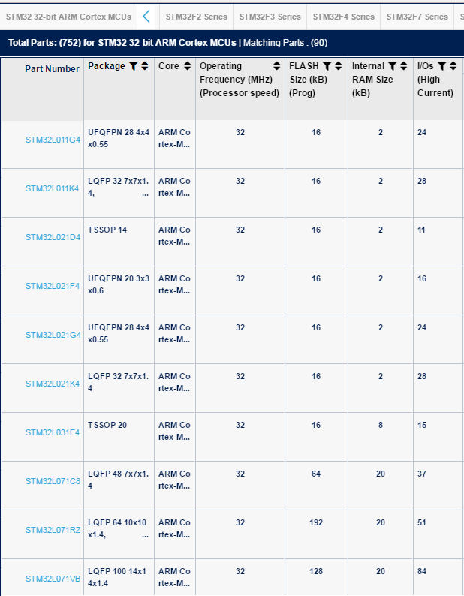



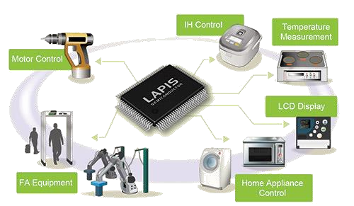
Memory is money!
Arm Cortex MCU family
Many embedded systems have a limited processing power and memory because
memory is expensive
consumes a lot of energy
23 | 55
Embedded and Real-Time Systems, Spring 2021, AUT, Tehran, Iran

Slide 24
Agenda
Online scheduling algorithms for real-time systems (chapter 3):
What do we cover?
EDF
An interesting yet long “proof of optimality” (from 1974)
Table-driven scheduling
Non-preemptive scheduling
Proof of non-optimality of EDF (from 2016)
Embedded and Real-Time Systems, Spring 2021, AUT, Tehran, Iran

Slide 25




Non-preemptive scheduling
Task 1
𝐶₁ = 1
5
Task 2
𝐶₂ = 10
4
6
16
Task 3
𝐶₃ = 4
5
20 23
Is this task set feasible?
Yes! It is feasible using a non-work-conserving schedule
Embedded and Real-Time Systems, Spring 2021, AUT, Tehran, Iran

Slide 26


Non-preemptive scheduling
miss
15
Task 1
𝐶₁ = 1
5
Task 2
𝐶₂ = 10
4
14
16
Task 3
𝐶₃ = 4
5
15
19
23
Is this task set schedulable by non-preemptive EDF?
NO
Embedded and Real-Time Systems, Spring 2021, AUT, Tehran, Iran

Slide 27
Non-preemptive scheduling
Non-preemptive EDF is not optimal for non-preemptive scheduling
There does not exist any optimal work-conserving scheduling policy for non-preemptive tasks!
Embedded and Real-Time Systems, Spring 2021, AUT, Tehran, Iran

Slide 28
How about “work-conserving” policies?
Is non-preemptive EDF the best choice we have under work-conserving policies?
Formally: Can any task set that can be feasibly scheduled by a work-conserving policy, be also feasibly scheduled by
non-preemptive EDF?
Embedded and Real-Time Systems, Spring 2021, AUT, Tehran, Iran

Slide 29
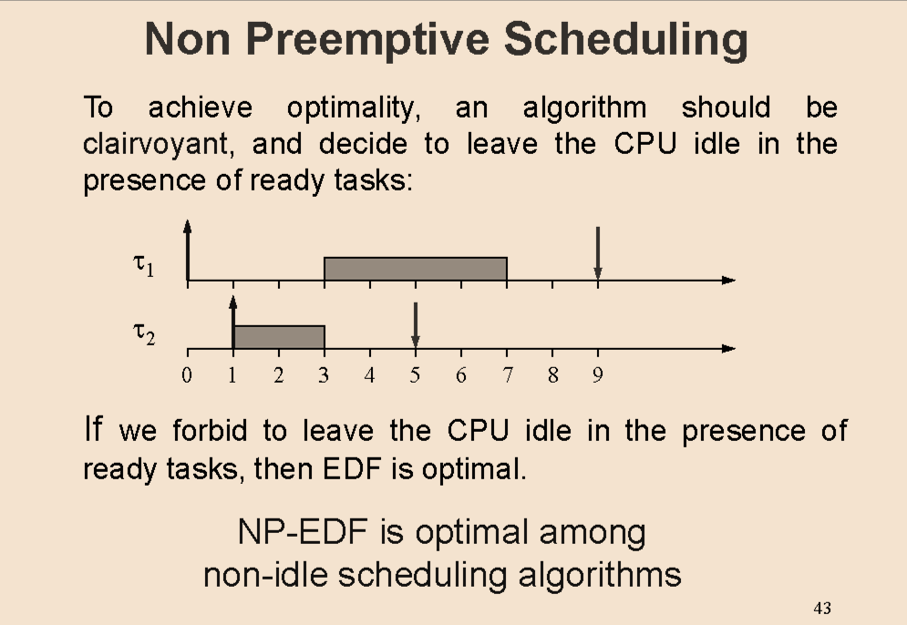






For a long time, researchers believed so
It was only in 2016 that a counter example was found!
Embedded and Real-Time Systems, Spring 2021, AUT, Tehran, Iran

Slide 30
EDF is good, but not THAT good!
Non-preemptive EDF (work-conserving)
𝜏_{𝑖} (𝐶_{𝑖} , 𝑇_{𝑖} )
𝜏₃ (17, 60)
𝜏₂ (8, 30)
𝜏₁ (1, 10)
missed
10
20
27 30
40
50
60
Lateness = 7
Non-preemptive fixed priority (work-conserving): 𝑷_{𝟏} < 𝑷_{𝟑} < 𝑷_{𝟐}
τ₃
τ₂ τ₁
18
10 20 30 40 50 60
ECRTS’2016 conference:
Mitra Nasri and Gerhard Fohler, "Non-Work-Conserving Non-preemptive Scheduling: Motivations, Challenges, and Potential Solutions," in the Euromicro Conference on Real-Time Systems (ECRTS), 2016, pp. 165-175.
Embedded and Real-Time Systems, Spring 2021, AUT, Tehran, Iran

Slide 31

Take-away message
EDF is a good policy for preemptive tasks but not non-preemptive tasks!
It is not an optimal policy among work-conserving scheduling policies for non-preemptive tasks
How good is non-preemptive EDF (NP-EDF) in practice?
Wait for the surprise in our lecture on “non-preemptive scheduling”
of NP-EDF
Embedded and Real-Time Systems, Spring 2021, AUT, Tehran, Iran

