Slide 1

Embedded and Real-Time Systems Spring 2021
Hamed Farbeh
farbeh@aut.ac.ir
Department of Computer Engineering
Amirkabir University of Technology
Lecture 7

Slide 2
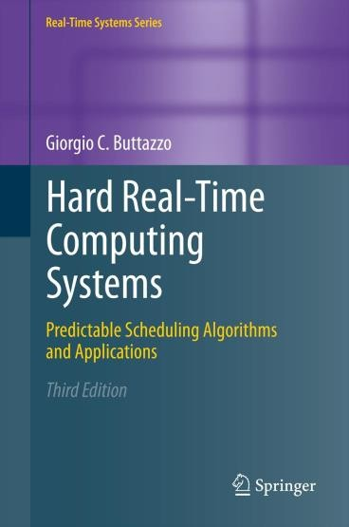
Copyright Notice
This lecture is adopted from
IN4343 Real-Time Systems Course 2018 – 2019, Mitra Nasri,
Delft University of Technology
Online scheduling of periodic tasks
Buttazzo’s book, chapter 4
Embedded and Real-Time Systems, Spring 2021, AUT, Tehran, Iran

Slide 3

Agenda
Scheduling algorithms for periodic real-time systems (chapter 4):
Processor sharing
Cyclic scheduling
Fixed-priority scheduling
Rate monotonic priority assignment method (RM)
Deadline monotonic priority assignment method (DM)
Dynamic-priority scheduling (will be discussed in the next lecture)
EDF
RM schedulability tests
Necessary v.s. sufficient tests
Liu and Layland’s test [1973]
Hyperbolic bound [2000]
If you want to pass the course, learn this lecture very well
Embedded and Real-Time Systems, Spring 2021, AUT, Tehran, Iran

Slide 4







Definitions
We consider a computing system that has to execute a set 𝜏 of n periodic real-time tasks:
𝜏 = {𝜏₁, 𝜏₂, 𝜏₃, … , 𝜏_{𝑛}}
𝑇_{𝑖} = period
𝐶_{𝑖} = worst-case execution time (WCET)
𝐷_{𝑖} = relative deadline
𝜙_{𝑖} = offset (or phase)
What are 𝑻_{𝟏} and 𝑻_{𝟐}? What are 𝑫_{𝟏} and 𝑫_{𝟐}?
What are 𝝓_{𝟏} and 𝝓_{𝟐}?
𝐶
𝑈 =
𝑖
= utilization
𝑖
𝑇_{𝑖}
^{𝐽}2,1
^{𝐽}2,2
^{𝐽}2,3
^{𝐽}2,4
𝜏₂
𝐶₂ = 5
2
7
12
17
^{𝐽}1,2
20
22
27
30
32
10
^{𝐽}1,1
^{𝐽}1,3
𝜏₁
𝐶₁ = 7
0
15
22
29 30
Embedded and Real-Time Systems, Spring 2021, AUT, Tehran, Iran

Slide 5
Assumptions
For this lecture, we assume
A1. 𝑪_{𝒊} and 𝑻_{𝒊} are constant for every job of 𝜏_{𝑖}
A2. Tasks are fully preemptive
A3. Context switch, preemption, and scheduling overheads are zero
A4. Tasks are independent:
no precedence relations
no resource constraints
no blocking on I/O operations
no self suspension
Embedded and Real-Time Systems, Spring 2021, AUT, Tehran, Iran

Slide 6

Formulating the arrival time and absolute deadline
What is the arrival time of the third job (𝐽_{𝑖,3}) of the following task?
𝜏_{𝑖} = (𝐶_{𝑖} = 3, 𝑇_{𝑖} = 10, 𝐷_{𝑖} = 7, 𝜙_{𝑖} = 2)
𝑎_{𝑖,3} = 22
Build a formula for the arrival time and absolute deadline of the 𝑘^{𝑡ℎ} job of 𝜏_{𝑖} = (𝐶_{𝑖} , 𝑇_{𝑖} , 𝐷_{𝑖} , 𝜙_{𝑖}), i.e., 𝐽_{𝑖,𝑘} :
^{𝑎}𝑖,𝑘 ^{= 𝜙}𝑖 ⁺
^{𝑑}𝑖,𝑘 ^{= 𝜙}𝑖 ⁺
(𝑘 − 1)
(𝑘 − 1)
. 𝑇_{𝑖}
. 𝑇_{𝑖} + 𝐷_{𝑖}
What about 𝑼_{𝒊,𝒌}?
Utilization is defined for the
task not for the job: 𝑼
₌ 𝑪_{𝒊}
𝒊
𝑻_{𝒊}
Embedded and Real-Time Systems, Spring 2021, AUT, Tehran, Iran

Slide 7




Feasibility of a periodic task set
A periodic task set 𝜏 is feasible if and only if there exists a schedule in which each task 𝜏_{𝑖} ∈ 𝜏 can execute for 𝐶_{𝑖} units of time within every interval [𝑎_{𝑖,𝑘}, 𝑑_{𝑖,𝑘}) for all 𝑘 ∈ ℕ.
^{𝐽}𝑖,1
^{𝐽}𝑖,2
𝜏_{𝑖}
^{𝑎}𝑖,1
^{𝑑}𝑖,1
^{𝑎}𝑖,2
^{𝑑}𝑖,2
Embedded and Real-Time Systems, Spring 2021, AUT, Tehran, Iran

Slide 8
Scheduling solutions for periodic tasks
Proportional share algorithm
Cyclic scheduling (a.k.a. timeline scheduling, table-driven scheduling)
Online scheduling policies
Fixed-priority policy
Rate monotonic (RM)
Deadline monotonic (DM)
Dynamic policy
EDF
Embedded and Real-Time Systems, Spring 2021, AUT, Tehran, Iran

Slide 9
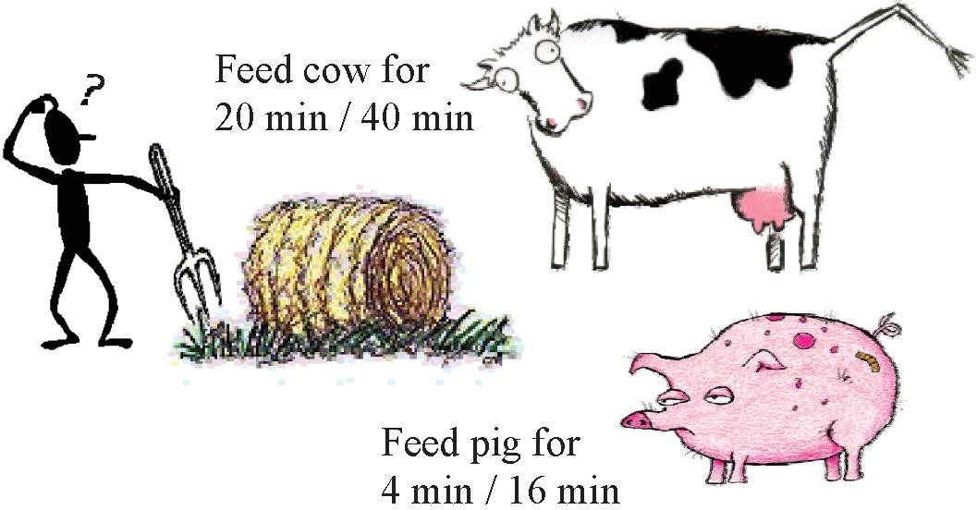
Proportional sharing
^{C}_{cow}^{/ T}_{cow} = 0.5
𝐶_{𝑝𝑖𝑔}/𝑇_{𝑝𝑖𝑔} = 0.25
Embedded and Real-Time Systems, Spring 2021, AUT, Tehran, Iran

Slide 10
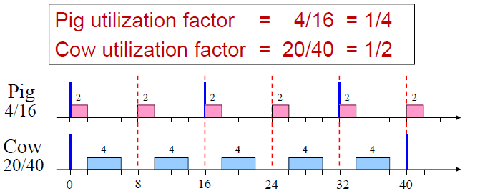
Proportional share algorithm
Basic idea
Divide the timeline into slots of equal length.
Within each slot serve each task for a time proportional to its utilization:
Slot length: 𝚫 = 𝐆𝐂𝐃 (𝑻_{𝒊}, ∀𝒊)
Task share in each slot: 𝜹_{𝒊} = 𝑼_{𝒊} ⋅ 𝚫
If a task set is feasible, then proportional sharing can also schedule it as long as there is no context switch overhead and D = T.
Embedded and Real-Time Systems, Spring 2021, AUT, Tehran, Iran

Slide 11




Downside of proportional share algorithm
if periods are not harmonic, then Δ = 𝐺𝐶𝐷 (𝑇₁, 𝑇₂, … , 𝑇_{𝑛})
𝑇_{𝑖}
is small and a task is fragmented into many chunks ( ) of
Δ
small duration 𝛿_{𝑖} = 𝑈_{𝑖} Δ
Not practical
Can lead to a huge number of context switches
Embedded and Real-Time Systems, Spring 2021, AUT, Tehran, Iran

Slide 12



Cyclic scheduling
Also known as timeline scheduling, it has been used for 30 years in military systems, navigation, and monitoring systems.
Examples
Air traffic control systems
Space Shuttle
Boeing 777
Airbus navigation system
An extension of table-driven scheduling
Embedded and Real-Time Systems, Spring 2021, AUT, Tehran, Iran

Slide 13
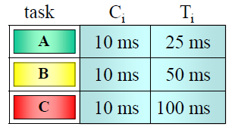
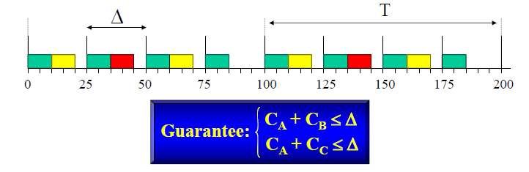
Cyclic scheduling
The time axis is divided in intervals of equal length (time slots).
Each task is statically allocated in a slot in order to meet the desired request rate.
The execution in each slot is activated by a timer.
Example:
Step 1: obtain the length of
minor and major cycles:
Δ = 𝐺𝐶𝐷 (𝑇_{𝑖} , ∀𝑖)
𝑇 = 𝐿𝐶𝑀 (𝑇_{𝑖} , ∀𝑖)
Step 2: assign tasks to time slots:
Embedded and Real-Time Systems, Spring 2021, AUT, Tehran, Iran

Slide 14
Cyclic scheduling
Problems of cyclic scheduling during overload
What to do during task overruns?
Let the task continue
we can have a domino effect on all the other tasks (timeline break)
Abort the task
the system can remain in inconsistent states.
Summarizing cyclic scheduling: Advantages
Disadvantages
Simple implementation (no RTOS is required)
Low run-time overhead
All tasks run with very low jitter
It is not robust during overloads.
It is difficult to expand the schedule.
It is difficult to update the code since it may totally change the schedule
It is not easy to handle aperiodic activities.
Embedded and Real-Time Systems, Spring 2021, AUT, Tehran, Iran

Slide 15
Agenda
Scheduling algorithms for periodic real-time systems (chapter 4):
Processor sharing
Cyclic scheduling Quiz
Rate monotonic (RM)
Deadline monotonic (DM)
(EDF will be discussed in the next lecture)
RM schedulability tests
Necessary v.s. sufficient tests
Liu and Layland’s test [1973]
Hyperbolic bound [2000]
If you want to pass the course, learn this lecture very well
Embedded and Real-Time Systems, Spring 2021, AUT, Tehran, Iran

