Slide 1

Embedded and Real-Time Systems Spring 2021
Hamed Farbeh
farbeh@aut.ac.ir
Department of Computer Engineering
Amirkabir University of Technology
Lecture 8

Slide 2
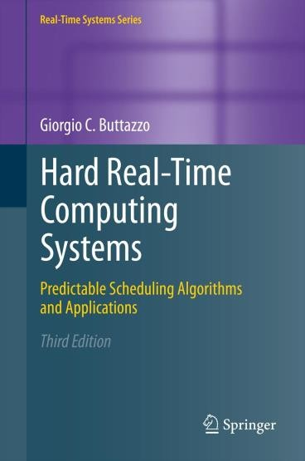
Copyright Notice
This lecture is adopted from
IN4343 Real-Time Systems Course 2018 – 2019, Mitra Nasri,
Delft University of Technology
Online scheduling of periodic tasks
Buttazzo’s book, chapter 4
Embedded and Real-Time Systems, Spring 2021, AUT, Tehran, Iran

Slide 3

Agenda
Scheduling algorithms for periodic real-time systems (chapter 4):
Processor sharing
Cyclic scheduling Quiz
Rate monotonic (RM)
Deadline monotonic (DM)
(EDF will be discussed in the next lecture)
RM schedulability tests
Necessary v.s. sufficient tests
Liu and Layland’s test [1973]
Hyperbolic bound [2000]
If you want to pass the course, learn this lecture very well
Embedded and Real-Time Systems, Spring 2021, AUT, Tehran, Iran

Slide 4
Fixed-priority scheduling
Method
Assign priorities to each task based on its timing constraints
Rate monotonic
Deadline monotonic
Verify the feasibility of the schedule using analytical techniques
Execute tasks on a priority-based kernel
Embedded and Real-Time Systems, Spring 2021, AUT, Tehran, Iran

Slide 5
Priority assignment for fixed-priority scheduling
Rate monotonic
Assign priorities monotonically with the activation frequency, a.k.a., rate
(~1 / 𝑇) such that a task with a smaller period gets a higher priority
Example: 𝑇 = 10 ⇒ 𝑟𝑎𝑡𝑒 =1/10
𝝉_{𝒊} | 𝑪_{𝒊} | 𝑻_{𝒊} | 𝑫_{𝒊} | 𝑼_{𝒊}
𝝉_{𝟏} | 1 | 5 | 5 | 0.2
𝝉_{𝟐} | 10 | 40 | 15 | 0.25
𝝉_{𝟑} | 1 | 20 | 20 | 0.05
Priority ordering?
P1 < P3 < P2
𝝉_{𝟏}
𝝉_{𝟐}
𝝉_{𝟑}
3
4
3
15
0
20
40
Embedded and Real-Time Systems, Spring 2021, AUT, Tehran, Iran

Slide 6

Priority assignment for fixed-priority scheduling
Deadline monotonic
Assign priorities monotonically with the relative deadline of the task, (~1 / 𝐷)
such that a task with a smaller relative deadline gets a higher priority
Priority ordering?
P1 < P2 < P3
𝝉_{𝒊} | 𝑪_{𝒊} | 𝑻_{𝒊} | 𝑫_{𝒊} | 𝑼_{𝒊}
𝜏₁ | 1 | 5 | 5 | 0.2
𝜏₂ | 10 | 40 | 15 | 0.25
𝜏₃ | 1 | 20 | 20 | 0.05
𝝉_{𝟏}
𝝉_{𝟐}
𝝉_{𝟑}
4
4
2
15
0
20
40
Embedded and Real-Time Systems, Spring 2021, AUT, Tehran, Iran

Slide 7










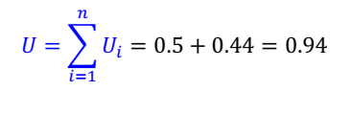
Is rate-monotonic an optimal scheduling policy (in the sense of feasibility)?
Is this task set feasible? (∀𝒊, 𝑫_{𝒊} = 𝑻_{𝒊}) Is this task set schedulable by EDF?
Is this task set schedulable by RM?
Yes!
Yes! (the schedule shown here is EDF)
𝜏₁
3
3
3
𝝉_{𝒊} | 𝑪_{𝒊} | 𝑻_{𝒊} | 𝑫_{𝒊} | 𝑼_{𝒊}
𝜏₁ | 3 | 6 | 6 | 0.5
𝜏₂ | 4 | 9 | 9 | 0.44
6
12
𝜏₂
4
4
0
9
18
Embedded and Real-Time Systems, Spring 2021, AUT, Tehran, Iran

Slide 8









Is rate-monotonic an optimal scheduling policy (in the sense of feasibility)?
Is this task set feasible? (∀𝒊, 𝑫_{𝒊} = 𝑻_{𝒊}) Is this task set schedulable by EDF?
Is this task set schedulable by RM?
Yes!
Yes! (the schedule shown here is EDF)
No!
𝜏₁
3
3
3
𝝉_{𝒊} | 𝑪_{𝒊} | 𝑻_{𝒊} | 𝑫_{𝒊} | 𝑼_{𝒊}
𝜏₁ | 3 | 6 | 6 | 0.5
𝜏₂ | 4 | 9 | 9 | 0.44
6
3 1 2
Deadline miss ⁹
12
𝜏₂
2
0
18
Embedded and Real-Time Systems, Spring 2021, AUT, Tehran, Iran

Slide 9
Fixed-priority scheduling with RM priorities is not an optimal
scheduling policy (in the sense of feasibility)
However, if ∀𝒊, 𝑫_{𝒊} = 𝑻_{𝒊} then
the rate monotonic priority assignment is an optimal priority assignment among all other priority assignment methods
Embedded and Real-Time Systems, Spring 2021, AUT, Tehran, Iran

Slide 10
Rate monotonic is optimal
RM is optimal among all fixed priority algorithms (if Di = T_{i}):
If there exists a fixed priority assignment which leads to a feasible schedule for τ, then the RM assignment is feasible for τ
If τ is not schedulable by RM, then is cannot be scheduled by any fixed priority assignment
Embedded and Real-Time Systems, Spring 2021, AUT, Tehran, Iran

Slide 11
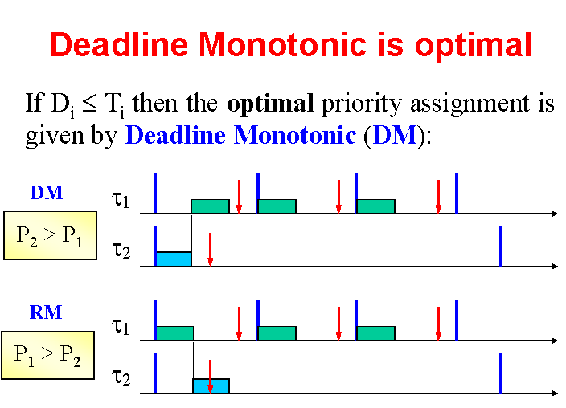
Deadline Monotonic is optimal If D_{i} ≤ T_{i} then the optimal priority assignment is given by Deadline Monotonic (DM)
Embedded and Real-Time Systems, Spring 2021, AUT, Tehran, Iran

Slide 12
EDF optimality
EDF is optimal among all algorithms:
If there exists a feasible schedule for τ, then EDF will generates a feasible schedule for τ
If τ is not schedulable by EDF, then is cannot be scheduled by any algorithm
Embedded and Real-Time Systems, Spring 2021, AUT, Tehran, Iran

Slide 13
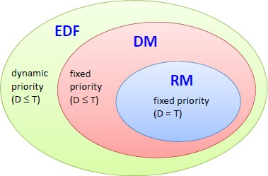
Optimality
Embedded and Real-Time Systems, Spring 2021, AUT, Tehran, Iran

Slide 14
Agenda
Scheduling algorithms for periodic real-time systems (chapter 4):
Processor sharing
Cyclic scheduling Quiz
Rate monotonic (RM)
Deadline monotonic (DM)
(EDF will be discussed in the next lecture)
RM schedulability tests
Necessary v.s. sufficient tests
Liu and Layland’s test [1973]
Hyperbolic bound [2000]
If you want to pass the course, learn this lecture very well
Embedded and Real-Time Systems, Spring 2021, AUT, Tehran, Iran

