Slide 1

Embedded and Real-Time Systems Spring 2021
Hamed Farbeh
farbeh@aut.ac.ir
Department of Computer Engineering
Amirkabir University of Technology
Lecture 9

Slide 2
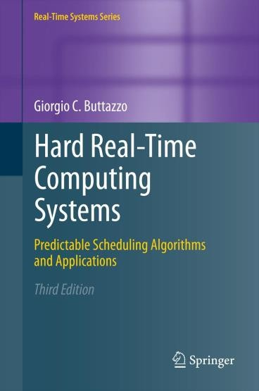
Copyright Notice
This lecture is adopted from
IN4343 Real-Time Systems Course 2018 – 2019, Mitra Nasri,
Delft University of Technology
Online scheduling of periodic tasks
Buttazzo’s book, chapter 4
Embedded and Real-Time Systems, Spring 2021, AUT, Tehran, Iran

Slide 3

Agenda
Scheduling algorithms for periodic real-time systems (chapter 4):
Processor sharing
Cyclic scheduling Quiz
Rate monotonic (RM)
Deadline monotonic (DM)
(EDF will be discussed in the next lecture)
RM schedulability tests
Necessary v.s. sufficient tests
Liu and Layland’s test [1973]
Hyperbolic bound [2000]
If you want to pass the course, learn this lecture very well
Embedded and Real-Time Systems, Spring 2021, AUT, Tehran, Iran

Slide 4
Necessary and sufficient tests
Necessary test (checks the feasibility):
If the condition in the test is NOT satisfied, then the task set is not feasible (it is impossible to find any feasible schedule for the task set)
Sufficient schedulability test for algorithm A:
If the condition in the test is satisfied, then the task set is certainly schedulable by the given scheduling algorithm
Embedded and Real-Time Systems, Spring 2021, AUT, Tehran, Iran

Slide 5

Utilization-based schedulability tests
A utilization-based schedulability test for an algorithm A
is a test that checks whether or not a specific relation 𝑓_{𝐴} holds
between the utilization values of the tasks in the task set.
If that relation is satisfied, then the task set is schedulable by the given scheduling algorithm
Example of a utilization-based test for EDF:
This test is both necessary and sufficient for EDF algorithm (proof in the next lecture)
Embedded and Real-Time Systems, Spring 2021, AUT, Tehran, Iran

Slide 6
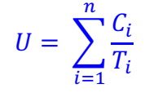
Why utilization?
Each task uses the processor for a fraction of time:
𝐶
𝑈 =
𝑖
𝑖
𝑇_{𝑖}
Hence the total processor utilization is:
𝑈 is a measure of the processor load
It is easy to use in the early
stages of system design
Embedded and Real-Time Systems, Spring 2021, AUT, Tehran, Iran

Slide 7

First bound: can we find a feasible schedule for a task set with 𝑼 > 𝟏 ?
A: yes C: depends on the task set
B: depends on the scheduling policy D: no
If 𝑈 > 1, then the amount of work need to be done per unit of time (= 𝑈) is larger than the unit of time itself!
Embedded and Real-Time Systems, Spring 2021, AUT, Tehran, Iran

Slide 8

















A necessary condition
A necessary condition for having a feasible schedule is that 𝑼 ≤𝟏.
Is that enough to ensure RM schedulability?
No
𝜏
3
3
3
𝝉_{𝒊} | 𝑪_{𝒊} | 𝑻_{𝒊} | 𝑫_{𝒊} | 𝑼_{𝒊}
𝜏₁ | 3 | 6 | 6 | 0.5
𝜏₂ | 4 | 9 | 9 | 0.44
1
6
3 1 2
Deadline miss ⁹
12
𝜏₂
2
0
18
Embedded and Real-Time Systems, Spring 2021, AUT, Tehran, Iran

Slide 9

















Let’s have a look at RM scheduling
𝜏
3
3
3
𝝉_{𝒊} | 𝑪_{𝒊} | 𝑻_{𝒊} | 𝑫_{𝒊} | 𝑼_{𝒊}
𝜏₁ | 3 | 6 | 6 | 0.5
𝜏₂ | 4 | 9 | 9 | 0.44
1
6
3 1 2
Deadline miss 9
12
𝜏₂
2
0
18
𝑈 = 0.94
𝑼 = 𝟎. 𝟗𝟒 (smaller than 1) but not schedulable!
𝜏₁
3
3
𝝉_{𝒊} | 𝑪_{𝒊} | 𝑻_{𝒊} | 𝑫_{𝒊} | 𝑼_{𝒊}
𝜏₁ | 3 | 5 | 5 | 0.5
𝜏₂ | 4 | 10 | 10 | 0.5
5
10
𝜏₂
2
2
0
10
𝑈 = 1
𝑼 = 𝟏, but it is schedulable by RM!
Embedded and Real-Time Systems, Spring 2021, AUT, Tehran, Iran

Slide 10


So, how to design a utilization-based schedulability test for RM?
Try to find a utilization threshold (lower bound) such that ANY task set with utilization lower than that bound is CERTAINLY schedulable
Embedded and Real-Time Systems, Spring 2021, AUT, Tehran, Iran

Slide 11

















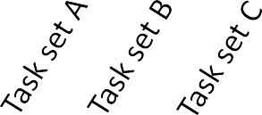



The simplest utilization-based test
For a given task set, check whether or not
𝑼 ≤ 𝑼_{𝒍𝒃}
where 𝑈_{𝑙𝑏} is the largest utilization such that any task set with 𝑼 ≤ 𝑼_{𝒍𝒃} is
always schedulable by RM.
U
1.1
1
Necessary condition
0.92
0.8
^{𝑼}𝒍𝒃
Sufficient condition
0.6
0.5
0.3
Task sets
Embedded and Real-Time Systems, Spring 2021, AUT, Tehran, Iran

Slide 12
Liu and Layland test for RM
Liu and Layland [1973] derived the largest value for 𝑈_{𝑙𝑏} for the rate monotonic scheduling under certain assumptions:
A1. 𝑪_{𝒊} and 𝑻_{𝒊} are constant for every job of 𝜏_{𝑖}
A2. For each task, 𝑻_{𝒊} = 𝑫_{𝒊}
A3. Tasks are fully preemptive
A4. Context switch, preemption, and scheduling overheads are zero
A5. Tasks are independent:
no precedence relations
no resource constraints
no blocking on I/O operations
no self suspension
Hint for the exam: remember the assumptions
Embedded and Real-Time Systems, Spring 2021, AUT, Tehran, Iran

Slide 13



Liu and Layland’s test for RM
₂1/𝑛 ₋ ₁
𝑈 ≤ 𝑛 ⋅
𝑛 → ∞
𝑈 → ?
𝑛 → ∞
𝑈 → ln 2 ~ 0.691
𝑛 → 2
𝑈 → ?
𝑛 → 2
𝑈 → 0.83
Embedded and Real-Time Systems, Spring 2021, AUT, Tehran, Iran

Slide 14
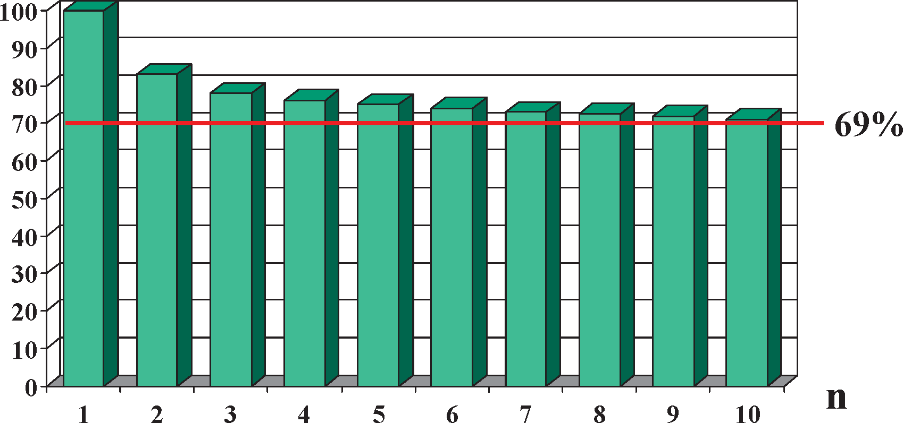
Liu and Layland (L&L) test for RM
Utilization (%)
Liu and Layland’s test accepts more task sets when 𝑛 is small
Embedded and Real-Time Systems, Spring 2021, AUT, Tehran, Iran

Slide 15









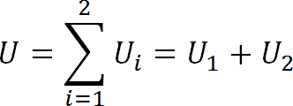
How happy are we with the L&L RM test?
𝑈 ≤ 1 is necessary and sufficient for EDF schedulability
U₂
1
𝑼 ≤ 𝟏
0.95
0.85
1
0.50
0.45
0.20
0.88
0.15
U₁
0.10
0.25 0.50
0.73
1
Embedded and Real-Time Systems, Spring 2021, AUT, Tehran, Iran

Slide 16










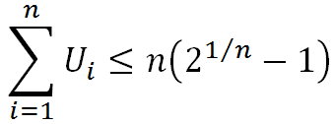







How happy are we with the L&L RM test?
The test rejects any task set with U> 0.83
U₂
1
EDF bound
0.95
L&L bound (RM)
L&L Test for RM:
0.83
1
0.45
0.25
0.50
0.88
0.25
U₁
1
Embedded and Real-Time Systems, Spring 2021, AUT, Tehran, Iran

Slide 17
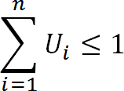


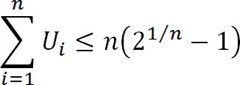




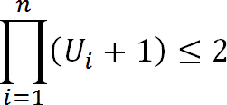





Hyperbolic bound
U₂
EDF bound
1
L&L bound
0.83
Hyperbolic bound
U₁
1
Embedded and Real-Time Systems, Spring 2021, AUT, Tehran, Iran

Slide 18
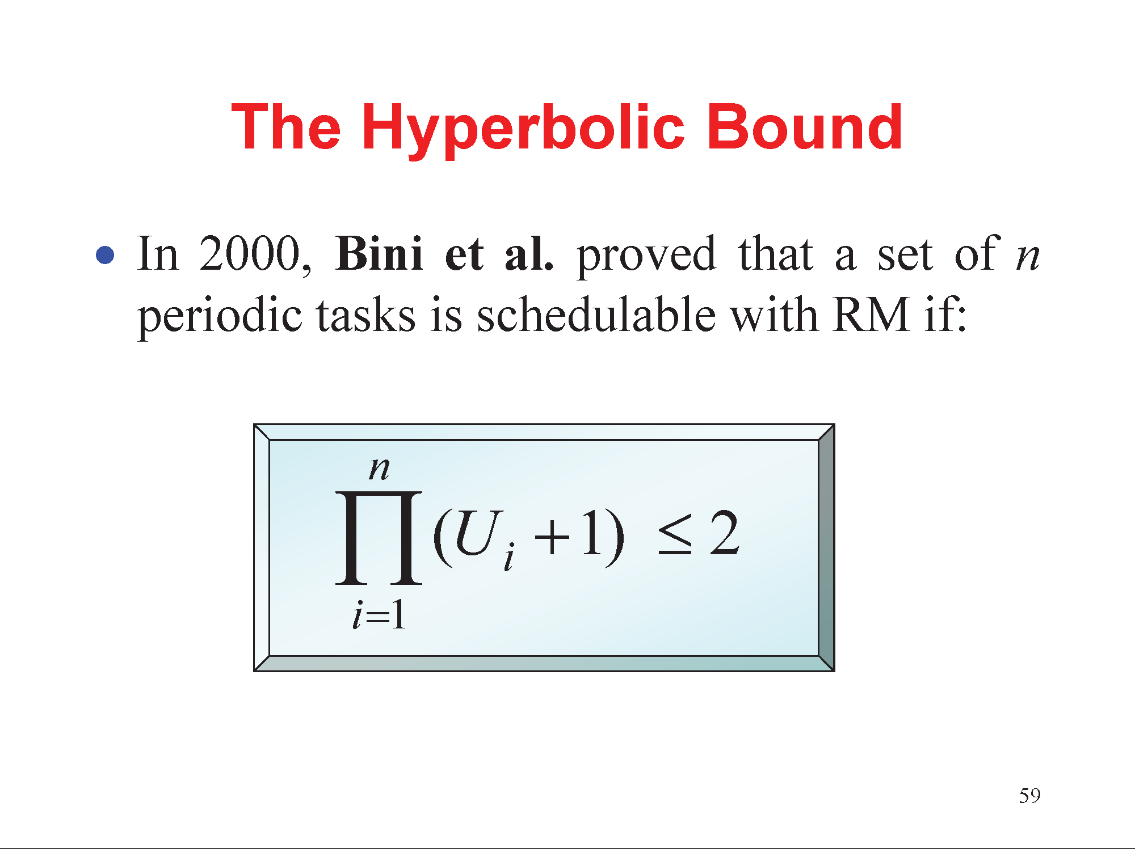
The hyperbolic bound
In 2000, Bini et al. proved that a set on n periodic tasks is schedulable with RM if:
Embedded and Real-Time Systems, Spring 2021, AUT, Tehran, Iran

Slide 19
Example
Is the task set feasible?
Yes 𝑼 ≤ 𝟏
𝝉_{𝒊} | 𝑪_{𝒊} | 𝑻_{𝒊} | 𝑫_{𝒊} | 𝑼_{𝒊}
𝜏₁ | 8 | 10 | 10 | 0.8
𝜏₂ | 0.9 | 18 | 18 | 0.05
Does the task set pass the Liu & Layland’s test?
No because 𝑼 = 𝟎. 𝟖𝟓 > 𝟐 (𝟐^{𝟏/𝟐} − 𝟏) ~ 𝟎. 𝟖𝟑
𝑈 = 0.85
Does the task set pass the hyperbolic-bound test?
Yes because 𝟎. 𝟖 + 𝟏 × 𝟎. 𝟎𝟓 + 𝟏 = 𝟏. 𝟖𝟗 < 𝟐
Is the task set schedulable by RM?
Yes!
necessary
Liu and Layland test
Hyperbolic bound
Embedded and Real-Time Systems, Spring 2021, AUT, Tehran, Iran

Slide 20
Example
Is the task set feasible?
Yes 𝑼 ≤ 𝟏
𝝉_{𝒊} | 𝑪_{𝒊} | 𝑻_{𝒊} | 𝑫_{𝒊} | 𝑼_{𝒊}
𝜏₁ | 3 | 5 | 5 | 0.6
𝜏₂ | 4 | 10 | 10 | 0.4
Does the task set pass the Liu & Layland’s test?
No because 𝑼 > 𝟐 (𝟐^{𝟏/𝟐} − 𝟏) ~ 𝟎. 𝟖𝟑
𝑈 = 1
Does the task set pass the hyperbolic-bound test?
No because 𝟎. 𝟒 + 𝟏 × 𝟎. 𝟔 + 𝟏 = 𝟐. 𝟐𝟒 > 𝟐
Is the task set schedulable by RM (according to your brain)?
Yes!
necessary
Liu and Layland test
Hyperbolic bound
Embedded and Real-Time Systems, Spring 2021, AUT, Tehran, Iran

