Slide 1
Data Structure & Algorithms
Graph

Slide 2
What is graph?
A graph is a pictorial representation of a set of objects where some pairs of objects are connected by links.
The interconnected objects are represented by points termed as vertices, and the links that connect the vertices are called edges.
Formally, a graph is a pair of sets (V, E), where V is the set of vertices and E is the set of edges, connecting the pairs of vertices.
Take a look at this example:
B
V = { A, B, C, D}
E = { (A,B) , (B,D) , (A,D) , (B,C) , (C,D) }
A
C
D

Slide 3
Graph Terminology
Path:
Path represents a sequence of edges between the two vertices. In the previous example, ADBC represents a path from A to C.
Cycle:
A cycle is a non-empty trail in which the only repeated vertices are the first and last vertices. In the previous example, ABDA represents a cycle.
Adjacency:
Two vertices are adjacent if they are connected to each other through an edge. In the previous example, B is adjacent to A and C.

Slide 4
Graph Terminology - continue
Degree:
The degree of a vertex is the number of edges that are connected with that vertex. In the previous example, degree of B is 3 and we write: d(B) = 3
In a directed graph, each vertex has an indegree and an outdegree. Indegree of a vertex is the number of edges which are coming into that vertex and Outdegree of a vertex is the number of edges which are going out from that vertex. See the example below:
B
indegree(B) = 2
outdegree(C) = 2
A
C

Slide 5
Types of Graph
Directed Graph:
In a directed graph, nodes are connected by directed edges – they only go in one direction. For example, if an edge connects node 1 and 2, but the arrow head points towards 2, we can only traverse from node 1 to node 2 – not in the opposite direction.
Undirected Graph:
In an undirected graph, nodes are connected by edges that are all bidirectional. For example if an edge connects node 1 and 2, we can traverse from node 1 to node 2, and from node 2 to 1.
1
2
1
2

Slide 6
Types of Graph
Weighted Graph:
A weight is a numerical value attached to each individual edge. In a weighted graph relationships between nodes have a magnitude and this magnitude is important to the relationship we’re studying. For example, consider that we want to show the distances between 2 cities:
Unweighted Graph:
If the edges do not have weights, the graph is said to be unweighted.
Isfahan
500 km
Tehran

Slide 7
Types of Graph
Connected Graph:
A graph is said to be connected if there is a path between every pair of vertex. In other words, from every vertex to any other vertex, there should be at least one path to traverse.
Example:

Slide 8
Types of Graph
Disconnected Graph:
A graph where the vertices separate into two or more distinct groups, where you cannot link a vertex in one group to a vertex in another by traversing along a series of edges.
In simple words, a graph is disconnected if at least two vertices of the graph are not connected by a path.
Example:

Slide 9
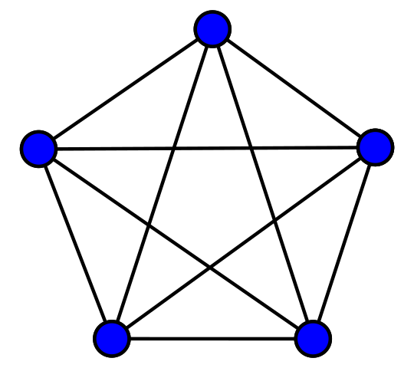
Types of Graph
Complete Graph:
A complete graph is an undirected graph in which every pair of vertices is connected by a unique edge.
Example:

Slide 10
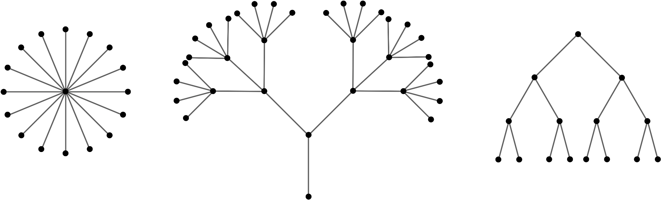
Types of Graph - Tree
Tree:
A tree is a connected graph without any cycle, which means any two vertices are connected by exactly one path.
Examples:

Slide 11
Types of Graph - Tree
Rooted Tree:
A rooted tree is a tree in which one vertex has been designated the root.
The edges of a rooted tree can be assigned a natural orientation, either away from or towards the root, in which case the structure becomes a directed rooted tree.
When a directed rooted tree has an orientation away from the root, it is called an out-tree; when it has an orientation towards the root, it is called an in-tree.

Slide 12
Types of Graph - Tree
Examples:
root
root
In- tree
out- tree

Slide 13
Graph Representation
Graphs can be represented in two specific ways:
1. by using an adjacency matrix
2. by using an adjacency list

Slide 14
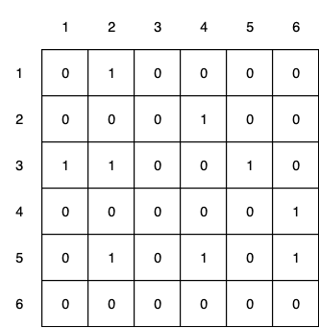
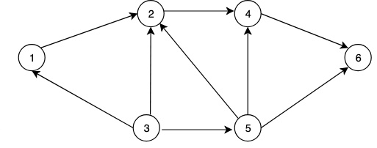
Adjacency Matrix
Adjacency Matrix is a 2D array of size V x V where V is the number of vertices in a graph.
Let the 2D array be adj[][], a slot adj[i][j] = 1 indicates that there is an edge from vertex i to vertex j.
Consider the following example:

Slide 15
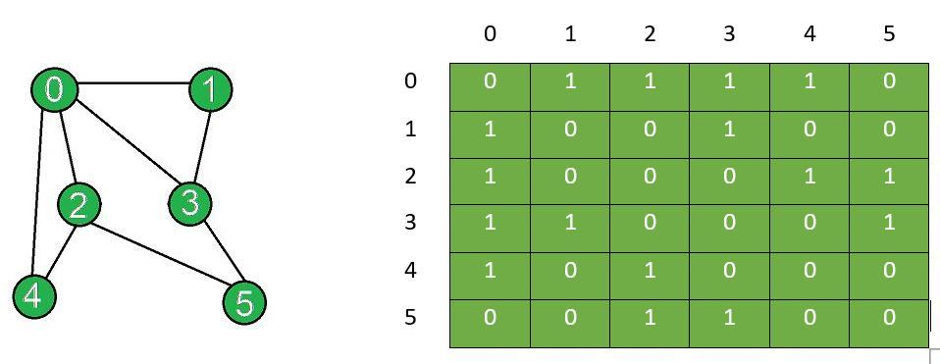
Adjacency Matrix
Adjacency matrix for undirected graph is always symmetric. Because a[i][j] and a[j][i] are both equal to 1.
Example:

Slide 16
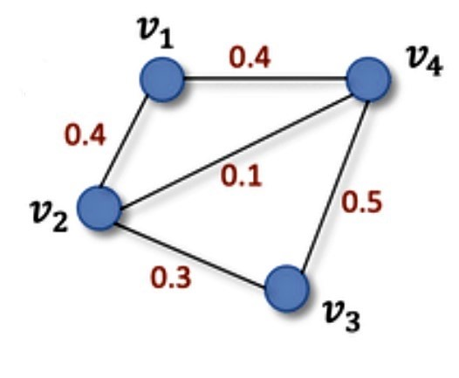
Adjacency Matrix
Adjacency Matrix is also used to represent weighted graphs. If adj[i][j] = w, then there is an edge from vertex i to vertex j with weight w.
Example:
V1
V2
V3
V4
V1
0 | 0.4 | 0 | 0.4
0.4 | 0 | 0.3 | 0.1
0 | 0.3 | 0 | 0.5
0.4 | 0.1 | 0.5 | 0
V2
V3
V4

Slide 17
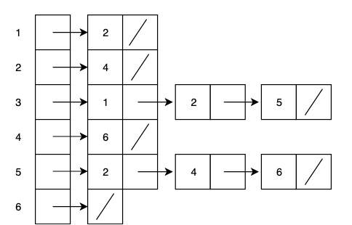
Adjacency List
In adjacency list representation we have a list of size V where V is the number of vertices in a graph. Each entry of the list contains another list, which is the set of all the vertices adjacent to the current vertex.
Consider the following example:

Slide 18
Adjacency List
For a weighted graph, we will add an extra weight parameter to the adjacency list representation.
Example:
A
B | 8
D | 3
A
8
B
C | 9
A | 8
B
3
9
C
B | 9
D
C
C
D
A | 3

Slide 19
Comparison between adj matrix and adj list
Space Complexity:
- Adjacency matrix makes use of VxV matrix, so the required space is O(|V|^2).
- In Adjacency list, O(V) is required for storing the vertices and O(E) is required for storing neighbours corresponding to every vertex. Thus, overall space complexity is O(|V|+|E|). ( Note: in a connected graph, |E| = |V|*(|V|-1) / 2. So in worst case the required space for adjacency list is also O(|V|^2).)

Slide 20
Comparison between adj matrix and adj list
Time Complexity:
In order to find an existing edge:
- In adjacency matrix, given two vertices say i and j matrix[i][j] can be checked in O(1) time.
- In adjacency list, in order to check for an edge we need to check for vertices adjacent to given vertex. A vertex can have at most O(|V|) neighbours and in worst case we would have to check for every adjacent vertex. Therefore, time complexity is O(|V|) .

