Slide 1
Data Structure & Algorithms
BST (Binary Search Tree)
Insertion and Deletion

Slide 2
Operation : Insert
Insert a node z into a binary search tree T
After insertion, T must remain a binary search tree

Slide 3
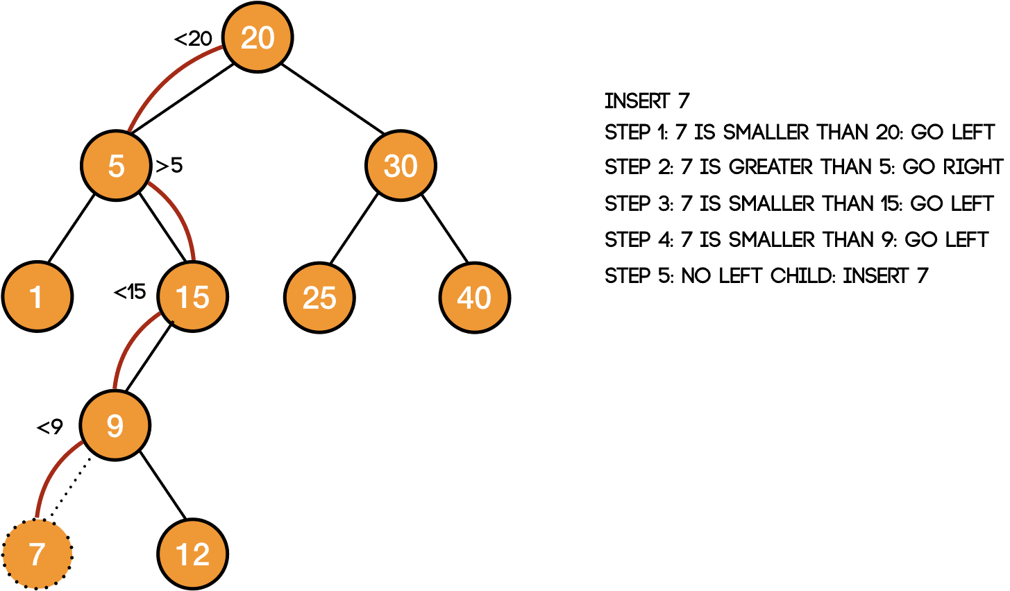
Example - Insert

Slide 4
Example – Insert

Slide 5
Insert – Alogrithm
Tree-Insert(T, z) 1 y = NIL 2 x = T.root 3 while x != NIL 4 y = x 5 if z.key < x.key 6 x = x.left 7 else x = x.right 8 z.p = y 9 if y == NIL 10 T.root = z // tree T was empty 11 elseif z.key < y.key 12 y.left = z 13 else y.right = z

Slide 6
Insert – Code
/* A utility function to insert a new node with given key in * BST */ struct node* insert(struct node* node, int key) { /* If the tree is empty, return a new node */ if (node == NULL) return newNode(key); /* Otherwise, recur down the tree */ if (key < node->key) node->left = insert(node->left, key); else if (key > node->key) node->right = insert(node->right, key); /* return the (unchanged) node pointer */ return node; }

Slide 7

Insert – Time Complexity
For each level of tree it takes constant time (according to code) → Total time will be:
Height of tree * Constant Time
Overall: $T\left(n\right)∈O\left(h\right)$ → $T\left(n\right)∈O(logn)$

Slide 8
Operation - Delete
Delete a node z from a binary search tree T
After delete, T must remain a binary search tree
Cases:
Z has no child.
Z has one child.
Z has two child.

Slide 9
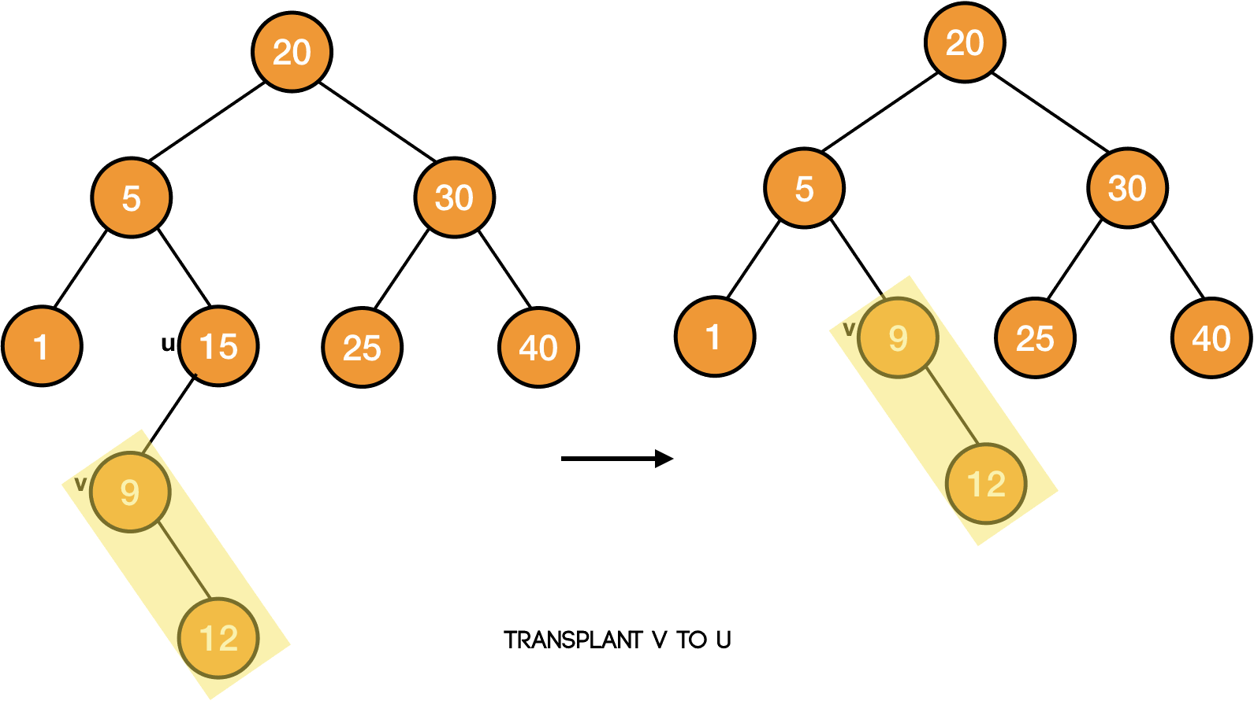
Example - Delete

Slide 10
Transplant
As we are going to use this technique in our delete procedure, so let's first write the code to transplant a subtree rooted at node v in place of the subtree rooted at node u.
we want to place the subtree rooted at node v in place of the subtree rooted at node u. It means that we need to make v the child of the parent of u i.e., if u is the left child, then v will become the left child of u's parent. Similarly, if u is the right child, then v will become the right child of u's parent.

Slide 11
Transplant
It is also possible that u doesn't have any parent i.e., u is the root of the tree T. In that case, we will simply make v as the root of the tree.

Slide 12
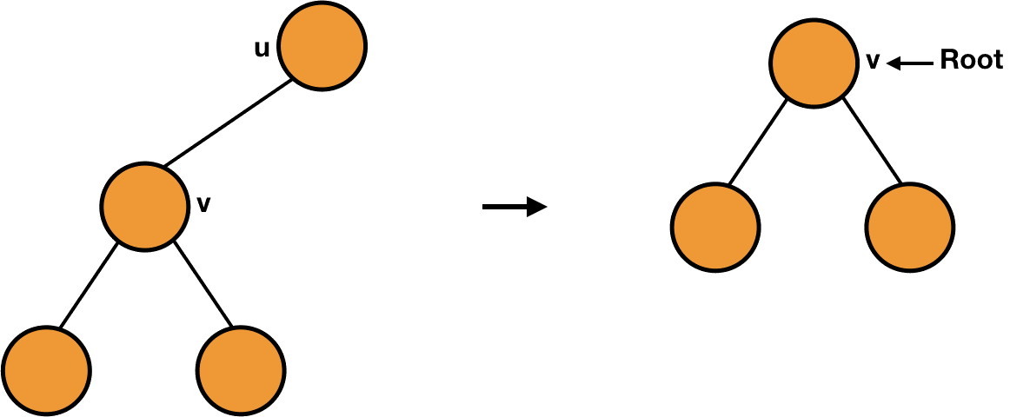
Example - Transplant

Slide 13
BST Delete – Transplant
Transplant(T, u, v) 1 if u.p == NIL 2 T.root = v 3 elseif u == u.p.left 4 e.p.keft = v 5 else u.p.right = v 6 if v != NIL 7 v.p = u.p

Slide 14
Tree Delete – case 1 (no child)
Suppose the node to be deleted is a leaf, we can easily delete that node by pointing the parent of that node to NIL
We can also say that we are transplanting the right or the left child (both are NIL) to the node to be deleted.

Slide 15
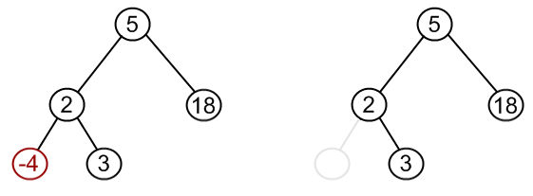
Tree Delete – case 1 (no child)

Slide 16
Tree Delete – case 2 (one child)
We can also delete a node with only one child by transplanting its child to the node and it will not affect the property of the binary search tree.

Slide 17
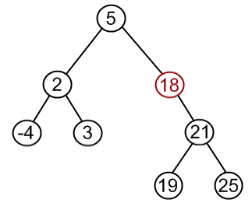
Tree Delete – case 2 (one child)

Slide 18
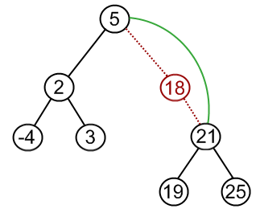
Tree Delete – case 2 (one child)

Slide 19
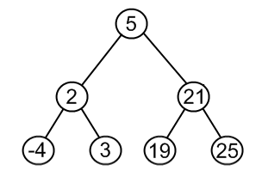
Tree Delete – case 2 (one child)

Slide 20
Tree Delete – case 3 (two children)
But things will become a bit little complicated when the node to be deleted has both the children.
In this case, we can find the smallest element of the right subtree of the node to be deleted (element with no left child in the right subtree) and replace its content with the node to be deleted.

Slide 21
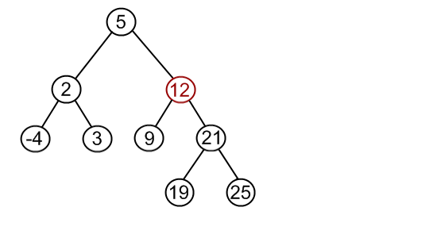
Tree Delete – case 3 (two children)

Slide 22
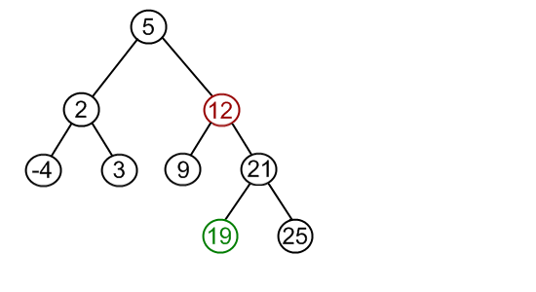
Tree Delete – case 3 (two children)

Slide 23
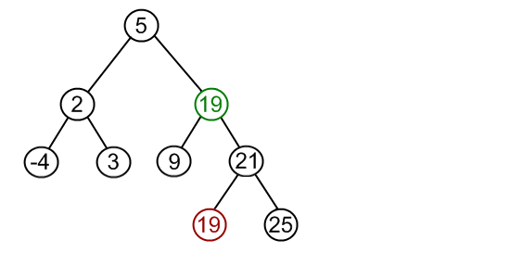
Tree Delete – case 3 (two children)

Slide 24
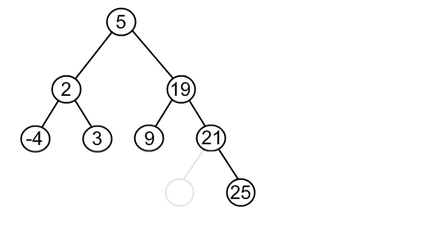
Tree Delete – case 3 (two children)

Slide 25
Tree Delete – case 3 (two children)
Doing so is not going to affect the property of binary search tree because it is the smallest element of the right subtree, so all the elements in the right subtree are still greater than it. Also, all the elements in the left subtree were smaller than it because it was in the right subtree, so they are still smaller.

Slide 26
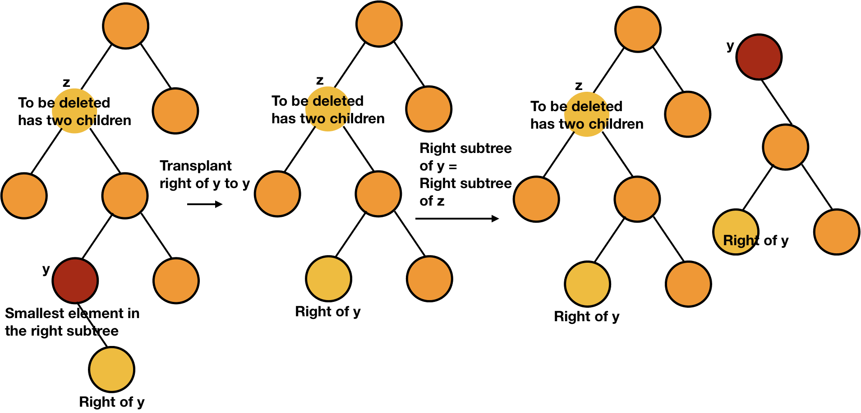
Smallest element of the right subtree
The smallest element of the right subtree will have either have no child or one child because if it has left child, then it will not be the smallest element. So, we can delete this node easily as discussed in the first two cases.

Slide 27
Tree Delete code
Case 1 & 2:
we have to check the number of children of the node z. We will first check if the left child of the node z is NULL or not. If the left child is NULL, then either it has only one child (right one) or none. In both the cases, we can transplant its right child to it.
Else we will next check if the right child is NULL or not.

Slide 28
Tree Delete code
Case 3:
If the node z has both children, we will find the minimum in the right subtree (y). Now, we have to put this minimum node (y) in the place of z.
transplant the right of y to y
take the right subtree of z and make it the right subtree of y.
transplant y to z.
change the left child of y to the left child of z. (y’s left child is NIL)

Slide 29
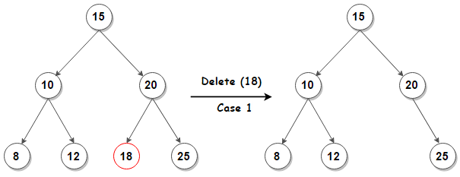
Tree Delete case 1

Slide 30
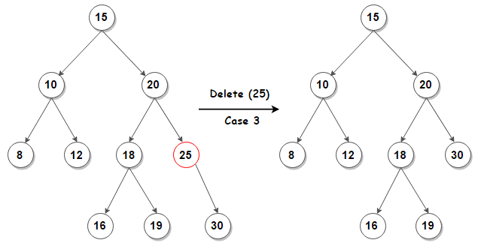
Tree Delete case 2

Slide 31
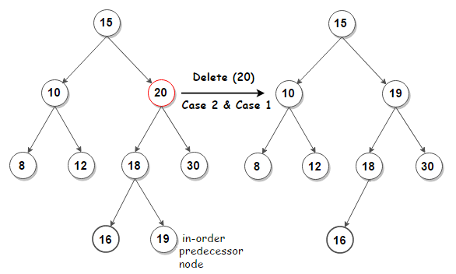
Tree Delete case 3

Slide 32
Case 3 code – Example 1
20
20
20
14
14
14
15
22
22
22
17
8
17
8
17
8
17
16
19
15
19
16
19
16
19
16

Slide 33
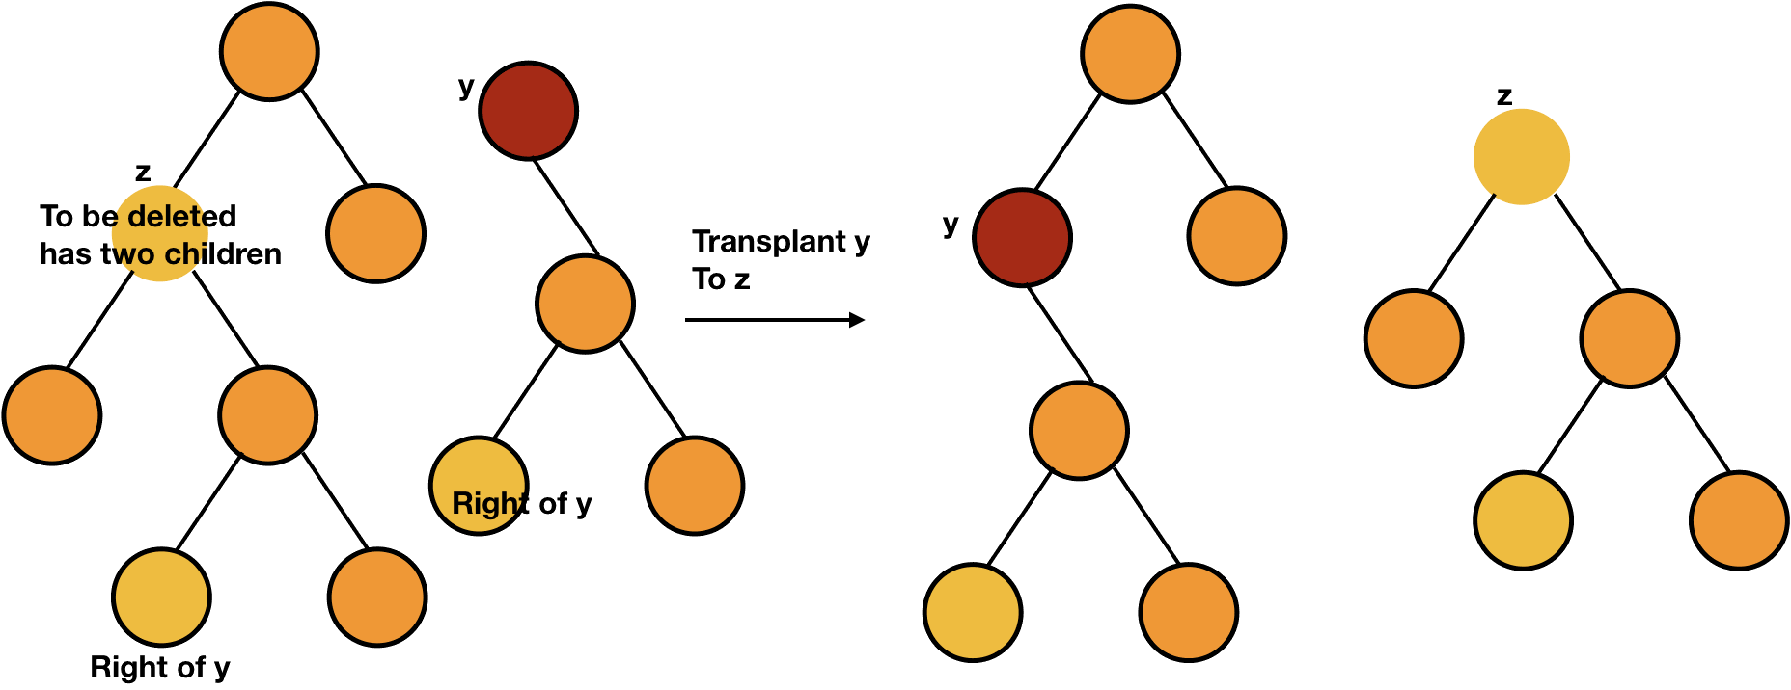
Case 3 code – Example 1
20
20
14
15
14
22
15
22
17
8
17
8
17
17
16
19
16
19
16
19
16
19

Slide 34
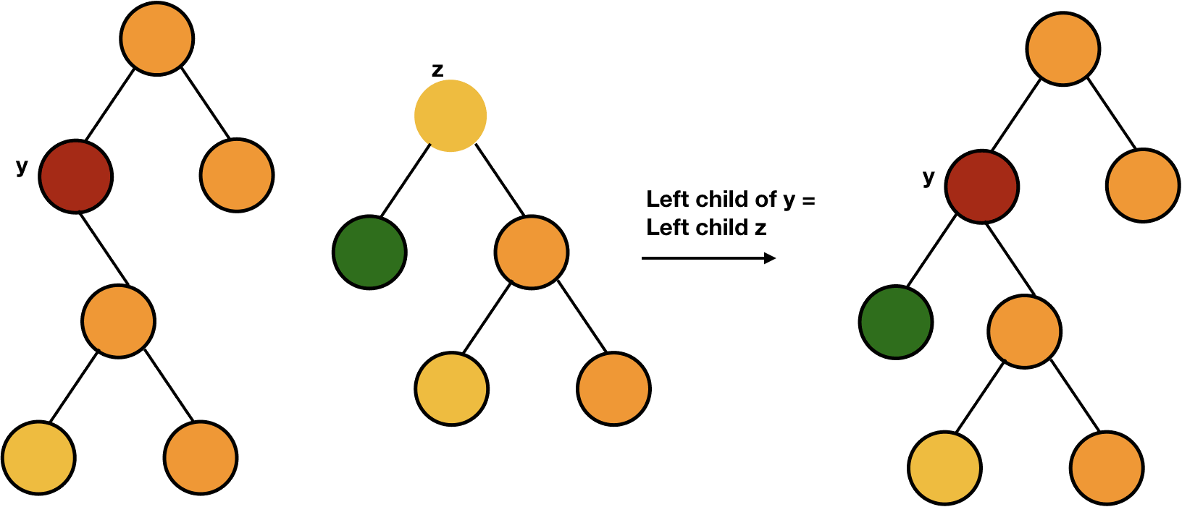
Case 3 code – Example 1
20
20
14
15
22
22
15
8
17
17
8
17
16
19
16
19
16
19

Slide 35
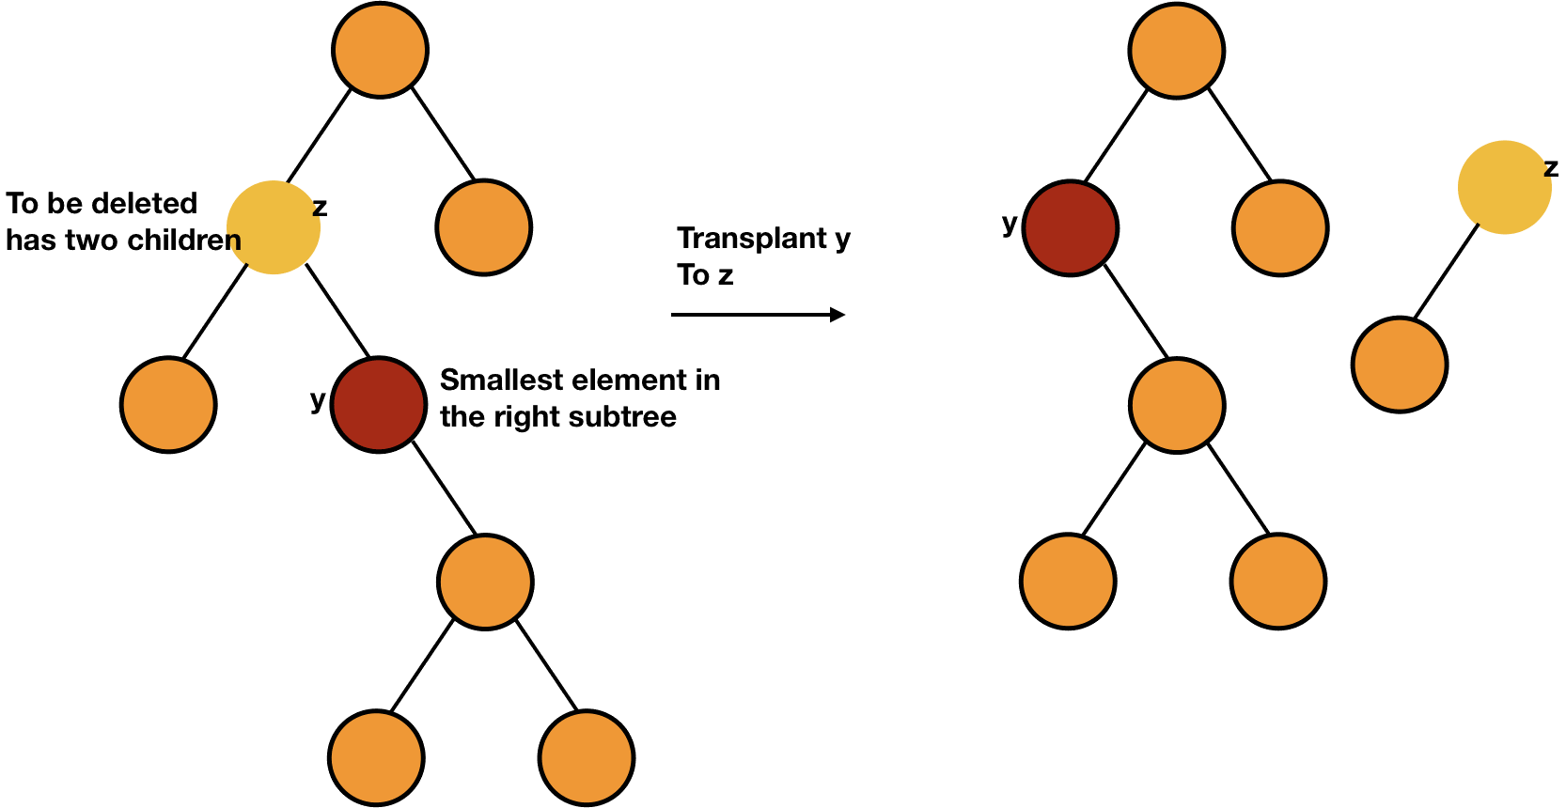
Case 3 code – Example 2
20
20
12
12
22
16
22
3
3
16
18
18
17
19
17
19

Slide 36
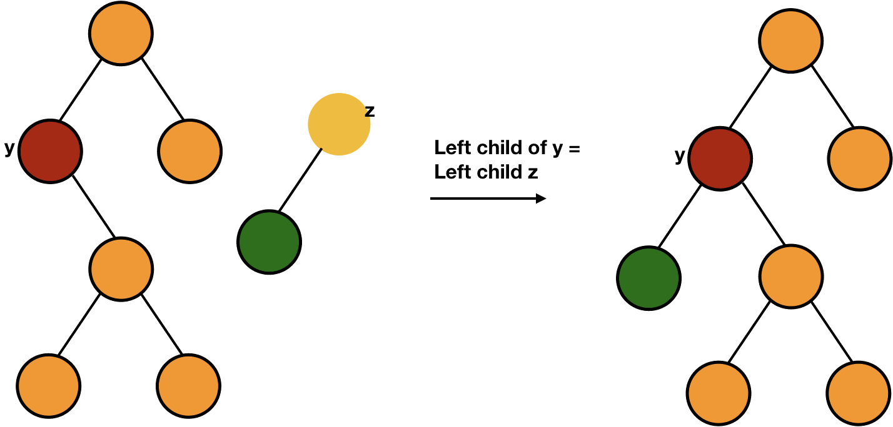
Case 3 code – Example 2
20
20
12
16
22
16
22
3
18
18
3
17
19
17
19

Slide 37
Delete - Algorithm
DELETE(T, z) 1 if z.left == NIL 2 TRANSPLANT(T, z, z.right) 3 elseif z.right == NIL 4 TRANSPLANT(T, z, z.left) 5 else 6 y = MINIMUM(z.right) //minimum element in right subtree 7 if y.parent != z //z is not direct child 8 TRANSPLANT(T, y, y.right) 9 y.right = z.right 10 y.right.parent = y 11 TRANSPLANT(T, z, y) 12 y.left = z.left 13 y.left.parent = y

Slide 38
Delete – Code
// funnction to delete a node struct node* delete(struct node *root, int x) { //searching for the item to be deleted if(root==NULL) return NULL; if (x>root->data) root->right_child = delete(root->right_child, x); else if(x<root->data) root->left_child = delete(root->left_child, x); else { //No Children if(root->left_child==NULL && root->right_child==NULL) { free(root); return NULL; }

Slide 39
Delete – Code
//One Child else if(root->left_child==NULL || root->right_child==NULL) { struct node *temp; if(root->left_child==NULL) temp = root->right_child; else temp = root->left_child; free(root); return temp; } //Two Children else { struct node *temp = find_minimum(root->right_child); root->data = temp->data; root->right_child = delete(root->right_child, temp->data); } } return root; }

Slide 40
BST Delete
The previous implementation of BST Delete considered replacing the deleted node z with its successor
Another similar solution is to replace the deleted node z with its predecessor

Slide 41
Delete – Time Complexity
For each level of tree it takes constant time (according to code) → Total time will be:
Height of tree * Constant Time
Overall: $T\left(n\right)∈O\left(h\right)$ → $T\left(n\right)∈O(logn)$

