Slide 1
Data Structure & Algorithms
Heap

Slide 2
Heap
A heap is a data structure which uses a binary tree for its implementation. It is the base of the algorithm heapsort and is also used to implement priority queue. It is basically a complete binary tree and generally implemented using an array.
The root of the tree is the first element of the array.

Slide 3
Complete Binary Tree
A binary tree which is completely filled with a possible exception at the bottom level i.e., the last level may not be completely filled and the bottom level is filled from left to right.

Slide 4
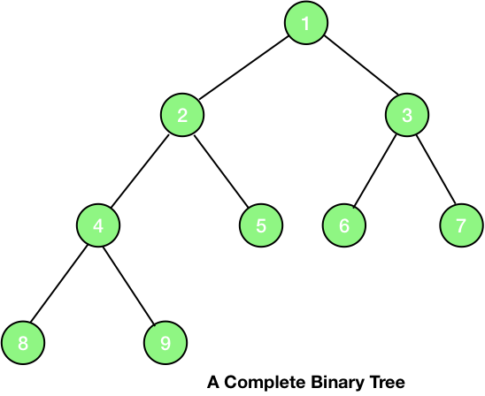
Complete Binary Tree – Example

Slide 5
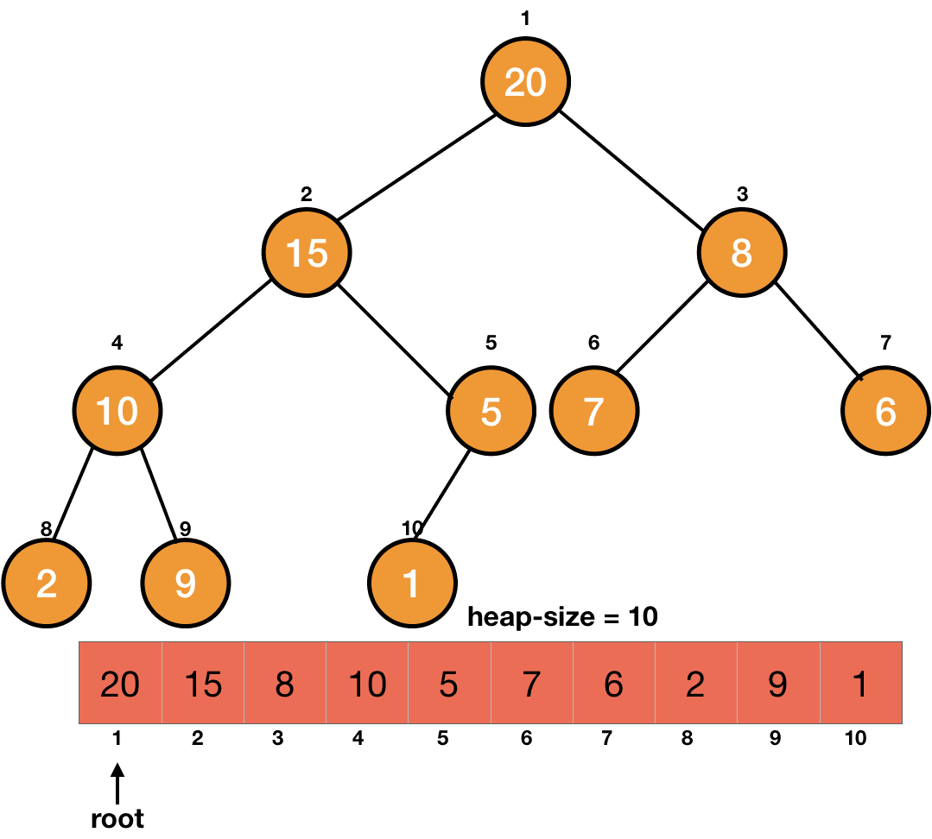
Heap – Example

Slide 6
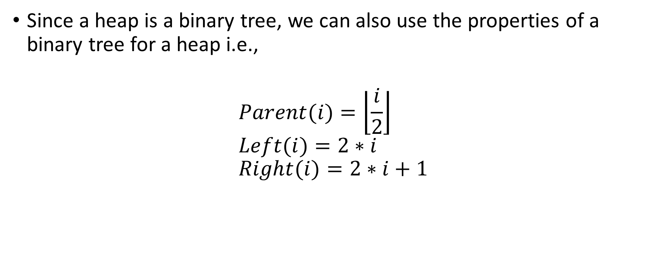
Heap – Cont.
Since a heap is a binary tree, we can also use the properties of a binary tree for a heap i.e.,
$$Parent(i)=\left\lfloor \frac{i}{2}\right\rfloor \\ Left(i)=2∗i \\ Right(i)=2∗i+1$$

Slide 7
Heap – Cont.
We declare the size of the heap explicitly and it may differ from the size of the array. For example, for an array with a size of Array.length, a heap will only contain the elements which are within the declared size of the heap.

Slide 8
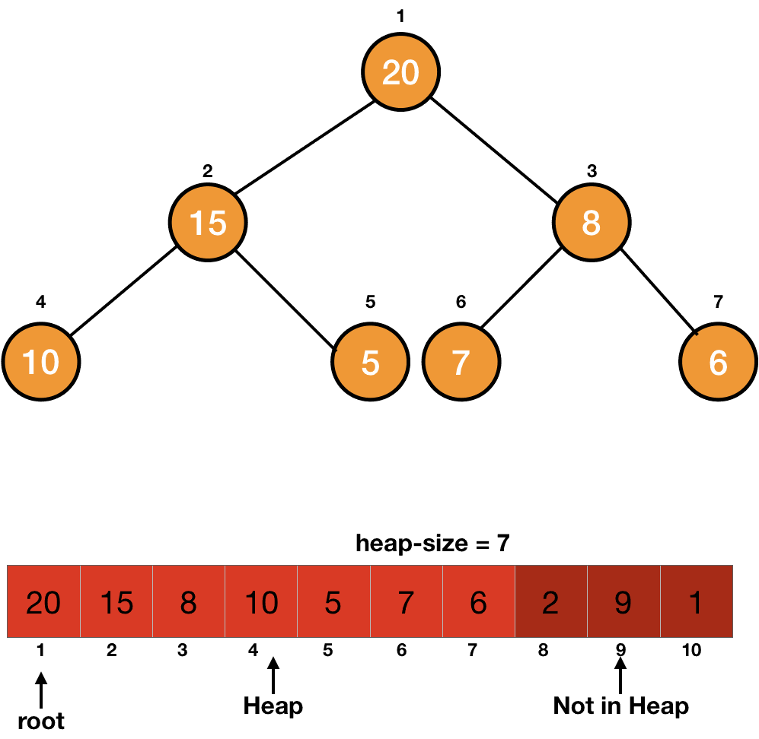
Heap – Example

Slide 9
Properties of a Heap
Basically, we implement two kinds of heaps:
Max Heap
Min Heap

Slide 10

Max Heap
In a max-heap, the value of a node is either greater than or equal to the value of its children.
$A\left[Parent\left[i\right]\right]≥A[i]$for all nodes $i > 1$

Slide 11
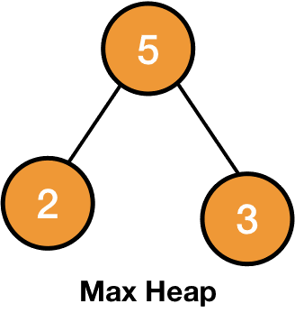
Max Heap – Cont.

Slide 12

Min Heap
The value of a node is either smaller than or equal to the value of its children.
$A[Parent[i]] ≤ A[i]$for all $nodes i > 1$

Slide 13
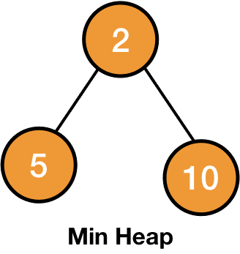
Min Heap – Cont.

Slide 14
Max Heap & Min Heap
Thus in a max-heap, the largest element is at the root and in a min-heap, the smallest element is at the root.

Slide 15
Heap Tree Representation
There are 3 ways in which we represent a Heap data-structure
Adjacency Matrix or Adjacency List
Binary Tree
One-dimensional Arrays

Slide 16
Representation of Heap in One-dimensional Array

Slide 17
Heapify
Heapify is an operation applied on a node of a heap to maintain the heap property. It is applied on a node when its children (left and right) are heap (follow the property of heap) but the node itself may be violating the property.

Slide 18
Max-Heapify
Max-heapify is a process of arranging the nodes in correct order so that they follow max-heap property.

Slide 19
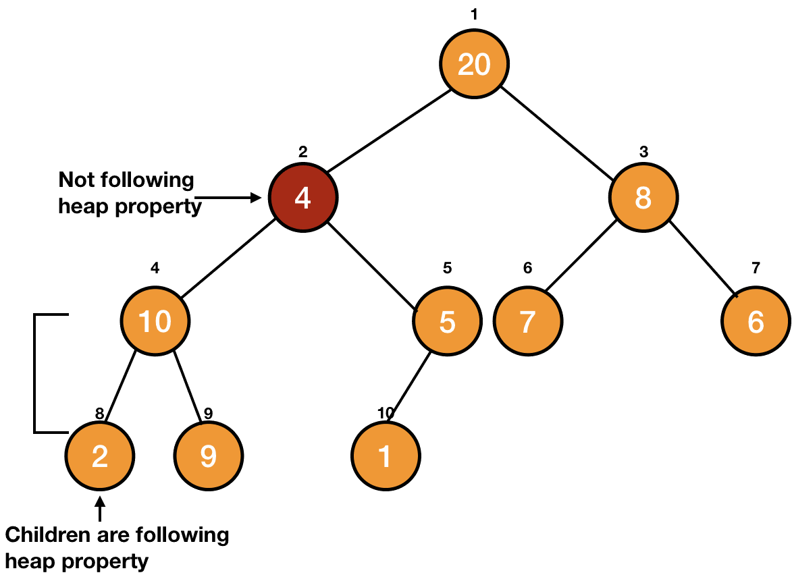
Max-Heapify – Example

Slide 20
Max-Heapify – Cont.
We simply make the node travel down the tree until the property of the heap is satisfied. It is illustrated on a max-heap in the picture given below.

Slide 21
Max-Heapify – Example

Slide 22
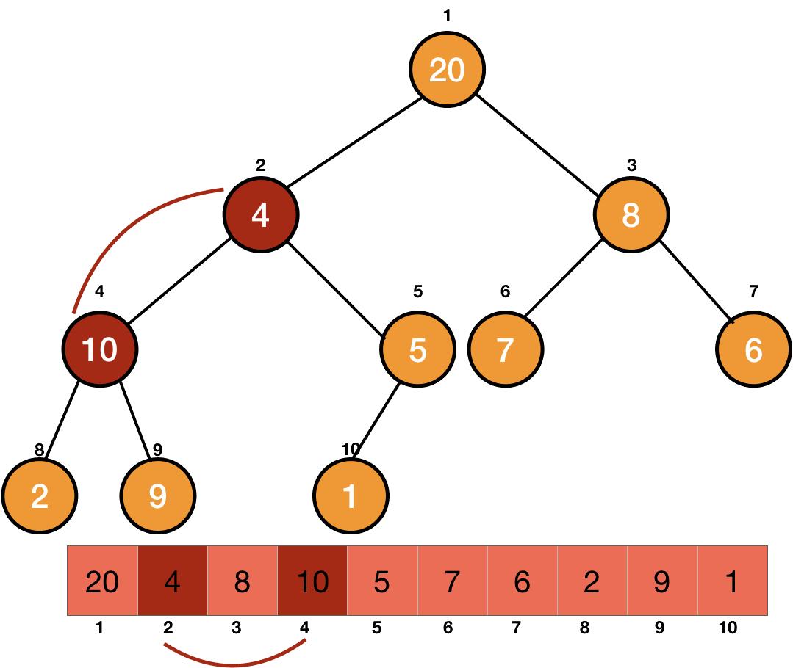
Max-Heapify – step by step

Slide 23
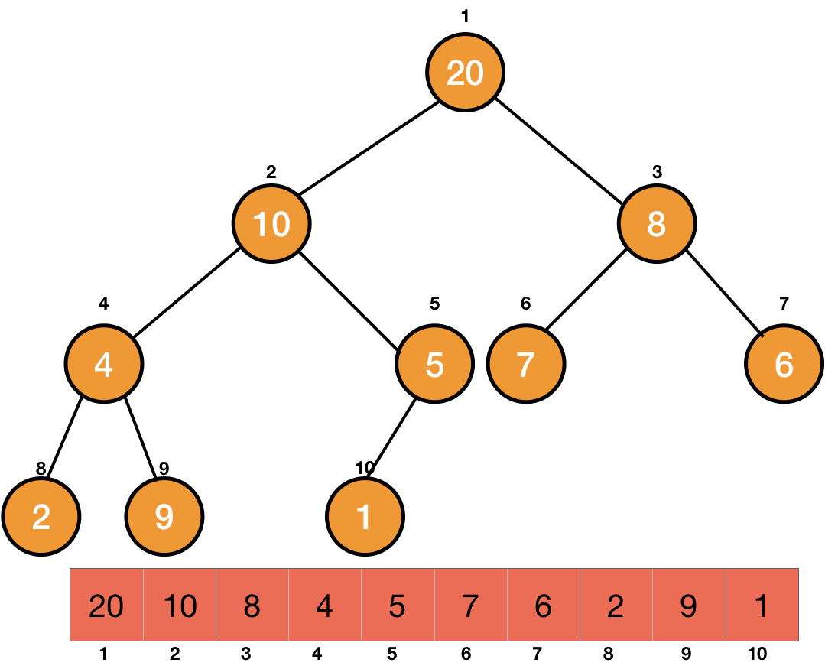
Max-Heapify – step by step

Slide 24
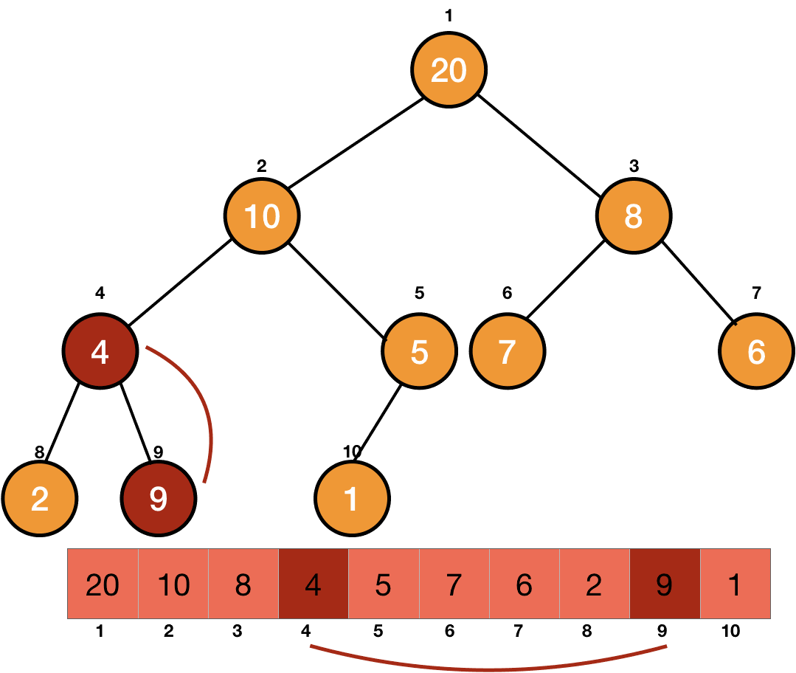
Max-Heapify – step by step

Slide 25

Max-Heapify – step by step

Slide 26
Max-Heapify Algorithm
MAX-HEAPIFY(A, i) left = 2i right = 2i + 1 // checking for largest among left, right and node i largest = i if left <= heap_size if (A[left] > A[largest]) largest = left if right <= heap_size if(A[right] > A[largest]) largest = right if largest != i //node is not the largest, we need to swap swap(A[i], A[largest]) MAX-HEAPIFY(A, largest) // child after swapping might be violating max-heap property

Slide 27

Max-Heapify Complexity
Since the node on which we are applying Heapify is coming down and in the worst case, it may become a leaf. So, the worst-case running time will be the order of the height of the tree i.e.,$O(\log{n}).$

Slide 28
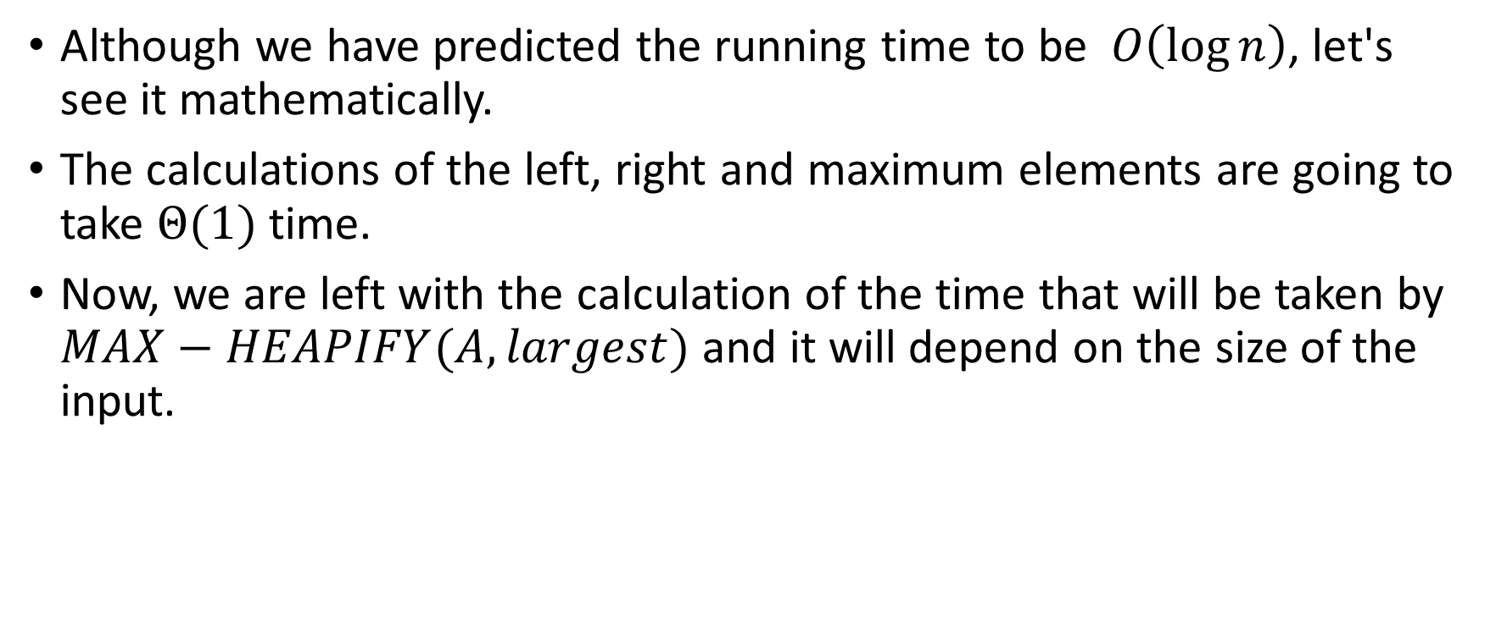
Analysis of Heapify
Although we have predicted the running time to be $O\left(\log{n}\right)$, let's see it mathematically.
The calculations of the left, right and maximum elements are going to take $Θ(1)$time.
Now, we are left with the calculation of the time that will be taken by $MAX−HEAPIFY(A, largest)$and it will depend on the size of the input.

Slide 29

Analysis of Heapify
The tree is divided into two subtrees. $MAX−HEAPIFY$is dependent on the size of the tree (or subtree in recursive calls).
In the worst case, this size will be maximum. This will happen when the last level of the tree is half full.

Slide 30
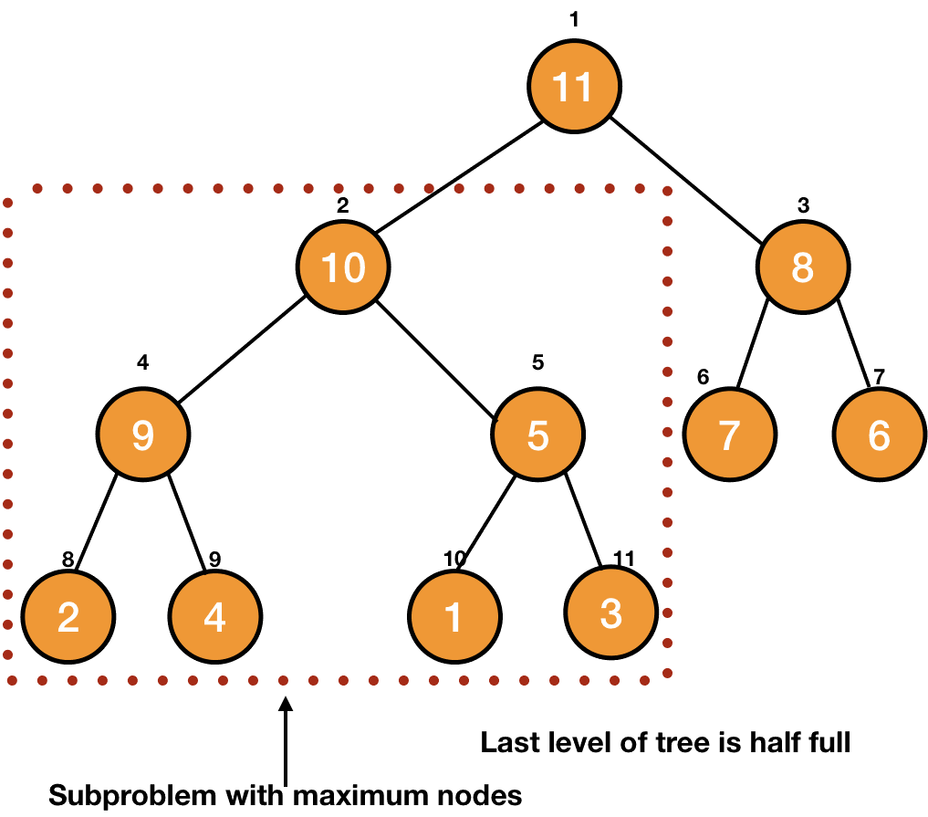
Analysis of Heapify
The other half of the tree has 0 nodes. Thus the left subtree has 1 more level than the right subtree.

Slide 31

Analysis of Heapify
In this case, one of the subtrees will have one level more than the other one. This will maximize the number of nodes in the subtree for a fixed number of nodes $n$ in the complete binary tree.

Slide 32
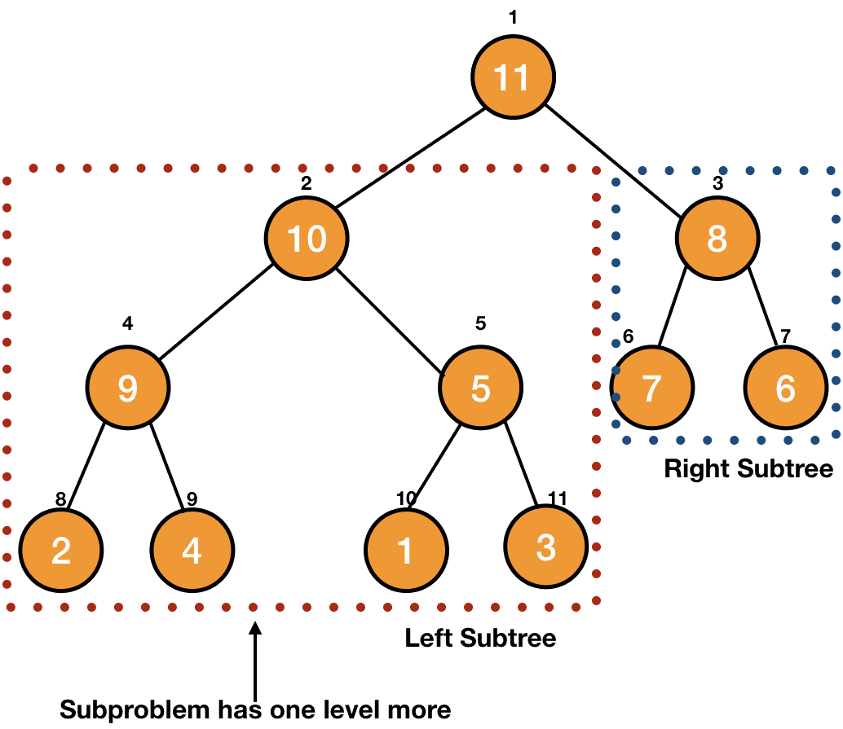
Analysis of Heapify

Slide 33
Maximum Number of Nodes
To construct a binary tree of level n with the maximum number of nodes, we need to make sure all the internal nodes have two children. In addition, all the leaf nodes must be at the level n.
For example, at level 0, we only have the root node. At level 1, we have 2 nodes that are the children of the root. Similarly, we have 4 nodes at level 2 who are the children of the nodes in level 1:

Slide 34
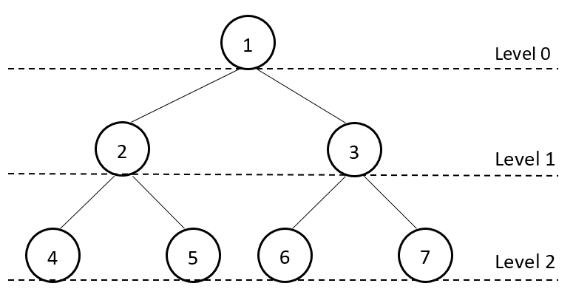
Maximum Number of Nodes

Slide 35
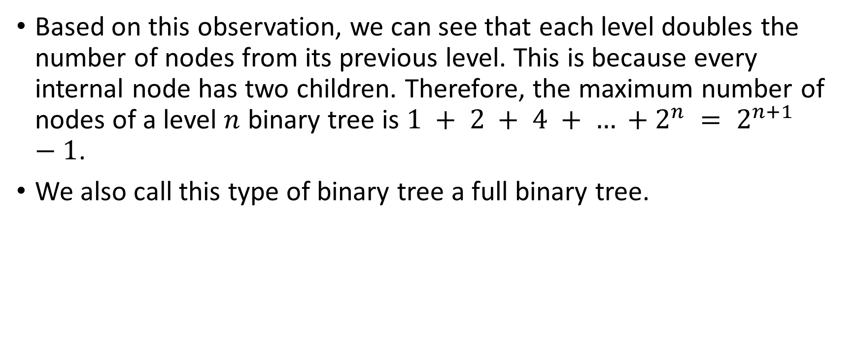
Maximum Number of Nodes
Based on this observation, we can see that each level doubles the number of nodes from its previous level. This is because every internal node has two children. Therefore, the maximum number of nodes of a level $n$ binary tree is $1 + 2 + 4 + … +2^{n} = 2^{n+1}−1$.
We also call this type of binary tree a full binary tree.

Slide 36
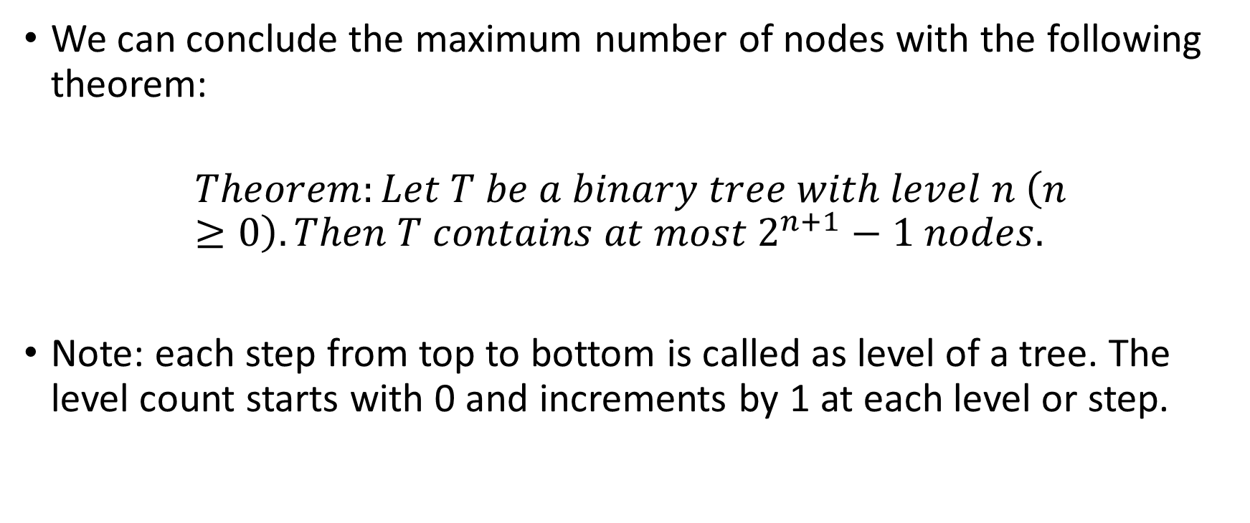
Maximum Number of Nodes
We can conclude the maximum number of nodes with the following theorem:
$$Theorem:Let T be a binary tree with level n \left(n≥0\right). Then T contains at most 2^{n+1}−1 nodes.$$
Note: each step from top to bottom is called as level of a tree. The level count starts with 0 and increments by 1 at each level or step.

Slide 37
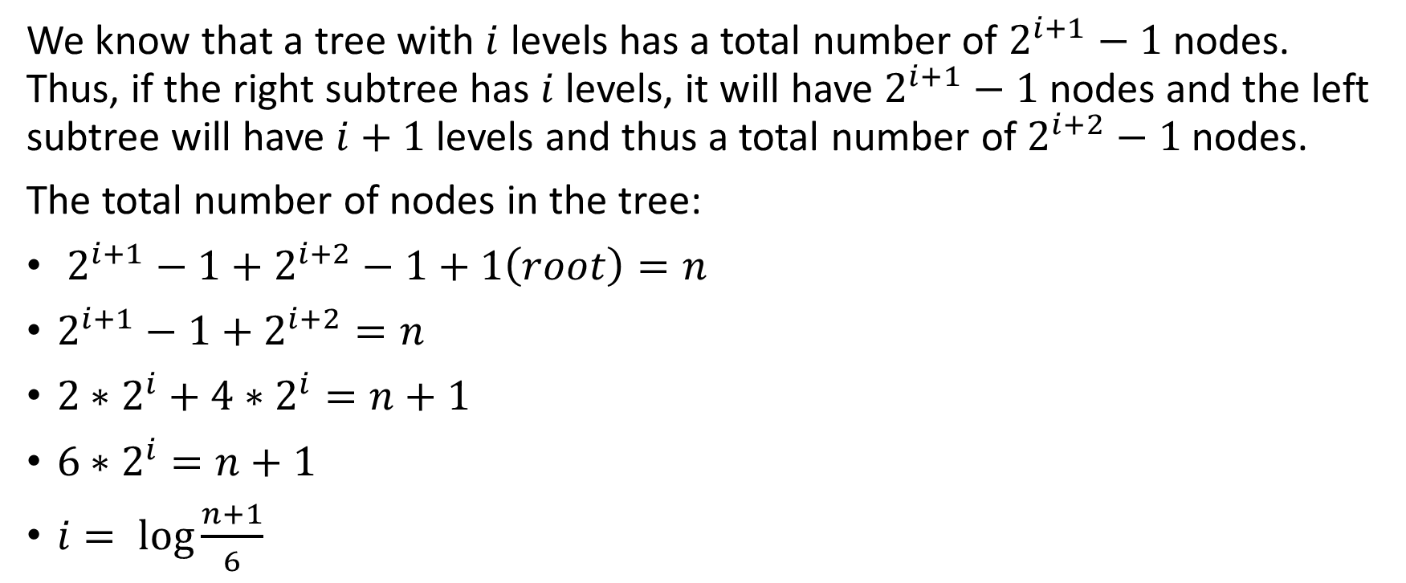
Analysis of Heapify
We know that a tree with $i$ levels has a total number of $2^{i+1}−1$ nodes. Thus, if the right subtree has $i$ levels, it will have $2^{i+1}−1$ nodes and the left subtree will have $i+1$levels and thus a total number of $2^{i+2}−1$ nodes.
The total number of nodes in the tree:
$2^{i+1}−1+2^{i+2}−1+1\left(root\right)=n$
$2^{i+1}−1+2^{i+2}=n$
${2∗2}^{i}+{4∗2}^{i}=n+1$
${6∗2}^{i}=n+1$
$i= \log{\frac{n+1}{6}}$

Slide 38

Analysis of Heapify
Now, the total number of nodes in the left subtree:
$2^{i+2}−1=4 ∗2^{i} −1= \frac{4\left(n+1\right)}{6}−1= \frac{2\left(n+1\right)}{3} −1= \frac{2n}{3} − \frac{1}{3}$
$\frac{2n}{3} − \frac{1}{3} ≤\frac{2n}{3}$

Slide 39

Analysis of Heapify
We can now use $\frac{2n}{3}$ as its upper bound and write the recurrence equation as $T(n)≤T(2n3)+Θ(1)$
By using Master's theorem, we can easily find out the running time of the algorithm to be $O(\log{n})$.

Slide 40
Build a Heap
We are left with one final task, to make a heap by the array provided to us. We know that Heapify when applied to a node whose children are heaps, makes the node also a heap. The leaves of a tree don't have any child, so they follow the property of a heap and are already heap.

Slide 41
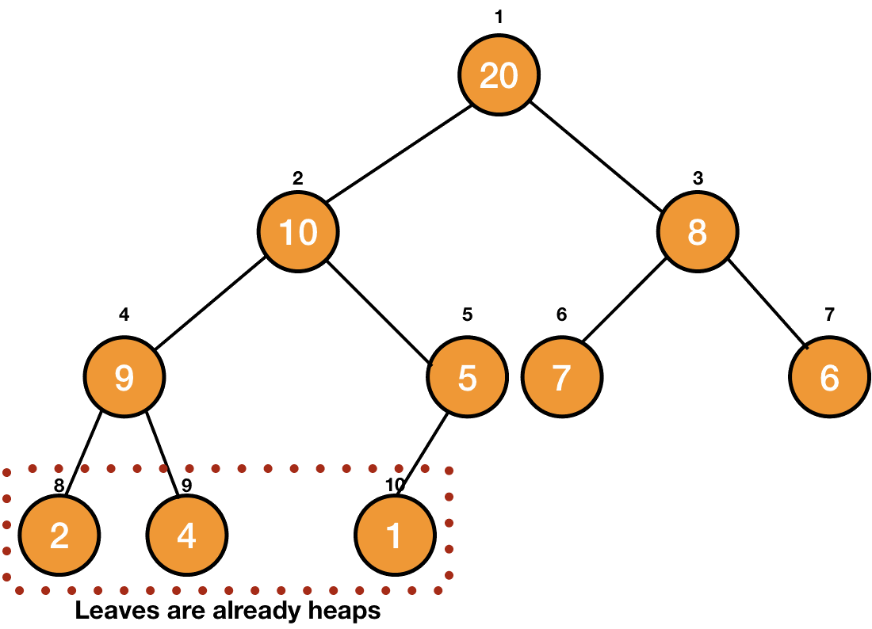
Build a Heap

Slide 42
Build a Heap
We can implement the Heapify operation on the parent of these leaves to make them heaps.

Slide 43
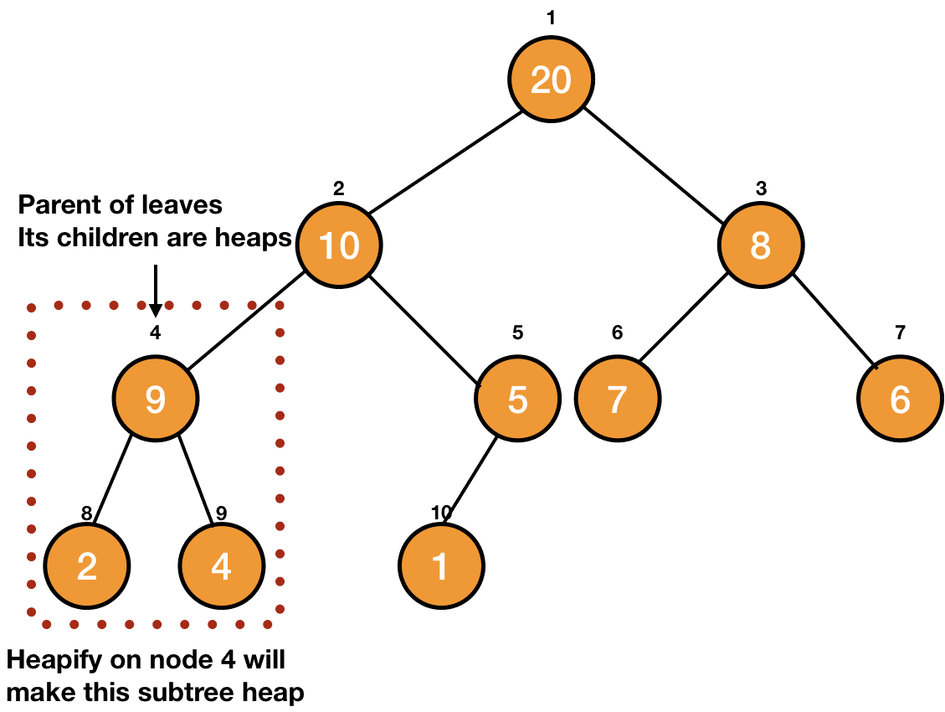
Build a Heap

Slide 44
Build a Heap
We can simply iterate up to root and use the Heapify operation to make the entire tree a heap.

Slide 45
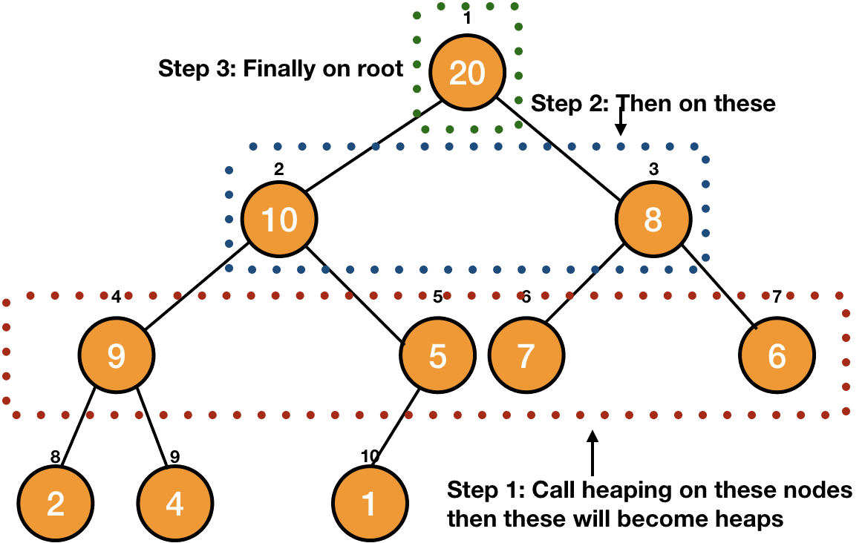
Build a Heap

Slide 46
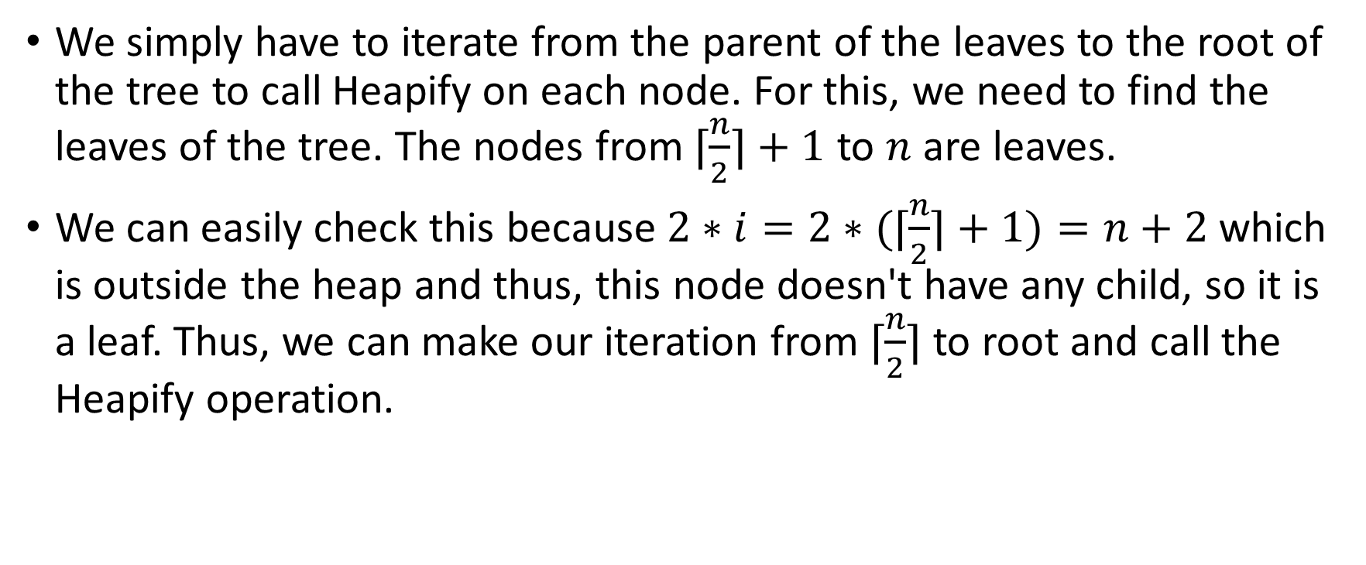
Build a Heap – Algorithm
We simply have to iterate from the parent of the leaves to the root of the tree to call Heapify on each node. For this, we need to find the leaves of the tree. The nodes from $⌈\frac{n}{2}⌉+1$ to $n$ are leaves.
We can easily check this because $2∗i=2∗(⌈\frac{n}{2}⌉+1)=n+2$ which is outside the heap and thus, this node doesn't have any child, so it is a leaf. Thus, we can make our iteration from $⌈\frac{n}{2}⌉$ to root and call the Heapify operation.

Slide 47
Build a Heap – Algorithm
BUILD-HEAP(A): for i in floor(A.length/2) downto 1 MAX-HEAPIFY(A, i)

Slide 48

Analysis of Build-Heap
We know that Heapify takes $O(\log{n})$time and there are $O(n)$ such calls. Thus a total of $O(n\log{n})$time.
This gives us an upper bound for our operation but we can reduce this upper bound and get a more precise running time of $O(n)$.

Slide 49

A More Precise Analysis
We know that the Heapify makes a node travel down the tree, so it will take $O(h)$time, where h is the height of the node.
Definition: The maximum distance of any node from the root. If a tree has only one node (the root), the height is zero.

Slide 50
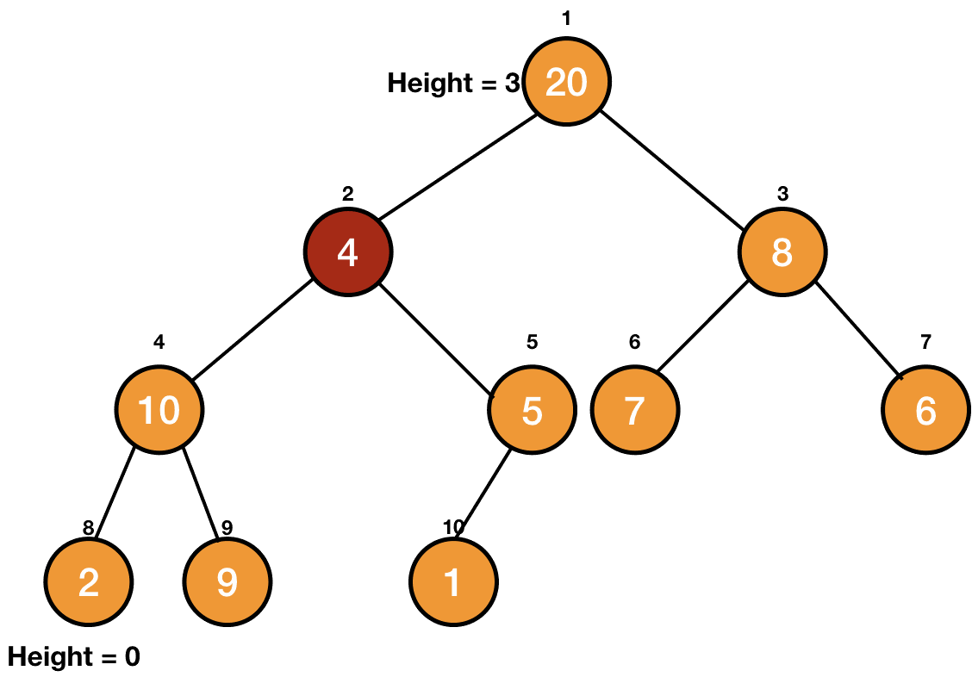
A More Precise Analysis
0
3

Slide 51
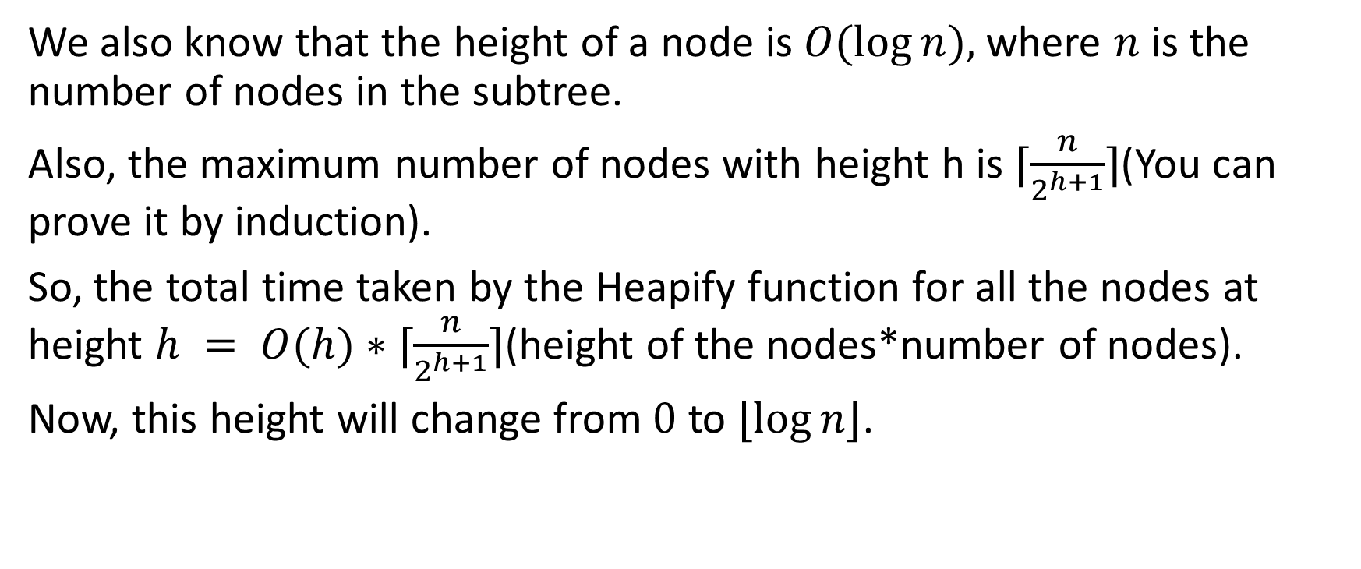
A More Precise Analysis
We also know that the height of a node is $O(\log{n}),$where $n$ is the number of nodes in the subtree.
Also, the maximum number of nodes with height h is $⌈\frac{n}{2^{h+1}}⌉$(You can prove it by induction).
So, the total time taken by the Heapify function for all the nodes at height $h = O(h)∗⌈\frac{n}{2^{h+1}}⌉$(height of the nodes*number of nodes).
Now, this height will change from $0$ to $⌊\log{n}⌋$.

Slide 52
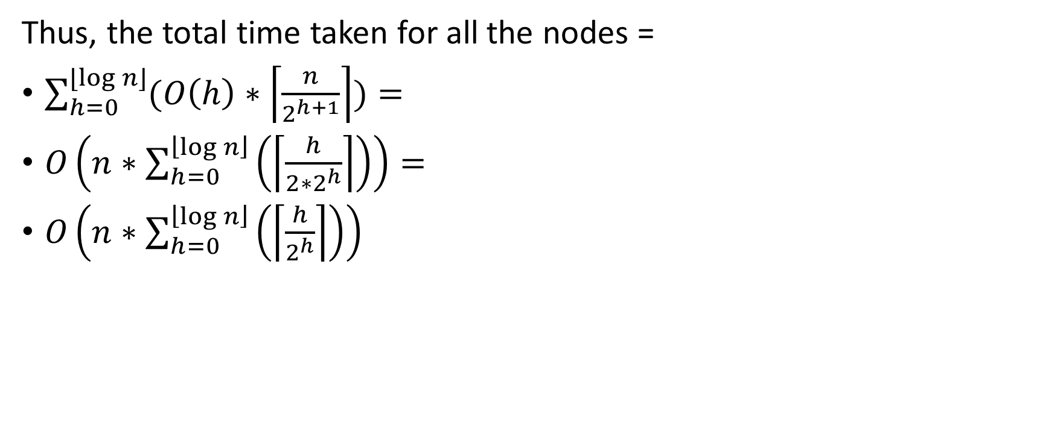
A More Precise Analysis
Thus, the total time taken for all the nodes =
$\sum_{h=0}^{⌊\log{n}⌋}{(O\left(h\right)∗\left\lceil \frac{n}{2^{h+1}}\right\rceil )}=$
$O\left(n∗\sum_{h=0}^{\left\lfloor \log{n}\right\rfloor }{\left(\left\lceil \frac{h}{2∗2^{h}}\right\rceil \right)}\right)=$
$O\left(n∗\sum_{h=0}^{\left\lfloor \log{n}\right\rfloor }{\left(\left\lceil \frac{h}{2^{h}}\right\rceil \right)}\right)$

Slide 53

A More Precise Analysis
Taking the term $\sum_{h=0}^{\left\lfloor \log{n}\right\rfloor }{\left(\left\lceil \frac{h}{2^{h}}\right\rceil \right)}$.
$\sum_{h=0}^{\left\lfloor \log{n}\right\rfloor }{\left(\left\lceil \frac{h}{2^{h}}\right\rceil \right)} < \sum_{h=0}^{∞}{\left(\left\lceil \frac{h}{2^{h}}\right\rceil \right)}$
$Let S= \sum_{h=0}^{∞}{\left(\left\lceil \frac{h}{2^{h}}\right\rceil \right)}$
$or, S=1+ \frac{1}{2}+\frac{2}{2^{2}}$ $+\frac{3}{2^{3}}+…$
$2S=2+1+ \frac{2}{2}+\frac{3}{2^{2}}$ $+\frac{4}{2^{3}}+…$
$2S −S,$

Slide 54

A More Precise Analysis
$2S=2+1+ \frac{2}{2}+\frac{3}{2^{2}}+\frac{4}{2^{3}}+…$
$S=0+1+ \frac{1}{2}+\frac{2}{2^{2}}$ $+\frac{3}{2^{3}}+…$
$2S −S=S=2+0+\frac{1}{2}+\frac{1}{2^{2}}+\frac{1}{2^{3}}+…$

Slide 55

A More Precise Analysis
The above equation is an infinite G.P. as $\frac{1}{2}$ as the first term as well as the common ratio.
$$S=2+ \frac{\frac{1}{2}}{1 − \frac{1}{2}}=2$$

Slide 56
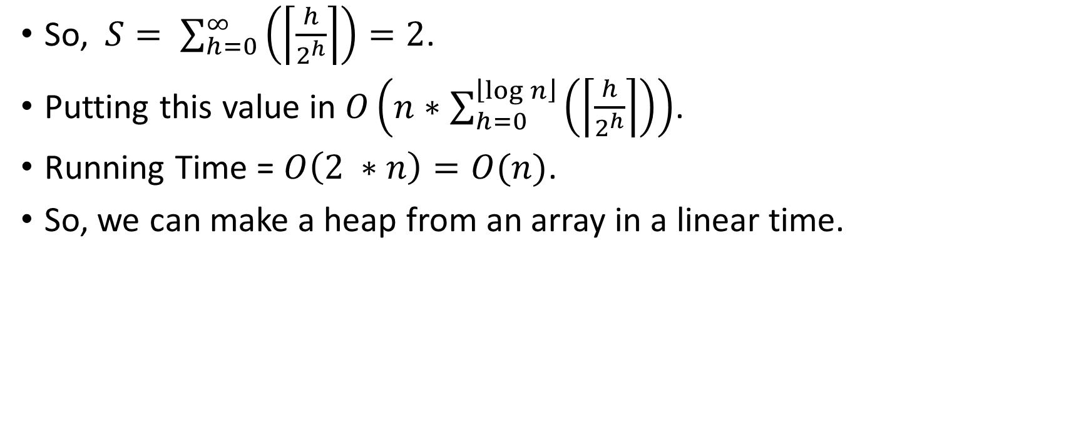
A More Precise Analysis
So, $S= \sum_{h=0}^{∞}{\left(\left\lceil \frac{h}{2^{h}}\right\rceil \right)=2}$.
Putting this value in $O\left(n∗\sum_{h=0}^{\left\lfloor \log{n}\right\rfloor }{\left(\left\lceil \frac{h}{2^{h}}\right\rceil \right)}\right)$.
Running Time = $O\left(2 ∗n\right)=O(n)$.
So, we can make a heap from an array in a linear time.

Slide 57
Codes in C – Build Max Heap
void build_max_heap(int A[]) { int i; for(i=heap_size/2; i>=1; i--) { max_heapify(A, i); } }

Slide 58
Codes in C – Max Heapify
void max_heapify(int A[], int index) { int left_child_index = get_left_child(A, index); int right_child_index = get_right_child(A, index); // finding largest among index, left child and right child int largest = index; if ((left_child_index <= heap_size) && (left_child_index>0)) { if (A[left_child_index] > A[largest]) { largest = left_child_index; } } if ((right_child_index <= heap_size && (right_child_index>0))) { if (A[right_child_index] > A[largest]) { largest = right_child_index; } }

Slide 59
Codes in C – Max Heapify
// largest is not the node, node is not a heap if (largest != index) { swap(&A[index], &A[largest]); max_heapify(A, largest); } }

Slide 60
Codes in C – get right/left child
//function to get right child of a node of a tree int get_right_child(int A[], int index) { if((((2*index)+1) < tree_array_size) && (index >= 1)) return (2*index)+1; return -1; } //function to get left child of a node of a tree int get_left_child(int A[], int index) { if(((2*index) < tree_array_size) && (index >= 1)) return 2*index; return -1; }

Slide 61
Codes in C – swap/get parent
void swap( int *a, int *b ) { int t; t = *a; *a = *b; *b = t; } //function to get the parent of a node of a tree int get_parent(int A[], int index) { if ((index > 1) && (index < tree_array_size)) { return index/2; } return -1; }

