Slide 1
Data Structure & Algorithms
Balanced Binary Tree

Slide 2
Definition
A balanced binary tree is a binary tree in which the difference between the height of the left subtree and right subtree of each node is not more than 1.
A balanced binary tree is also known as a height balanced tree.
In a balanced binary tree, the tree height is O(logN), where N is the number of nodes.

Slide 3
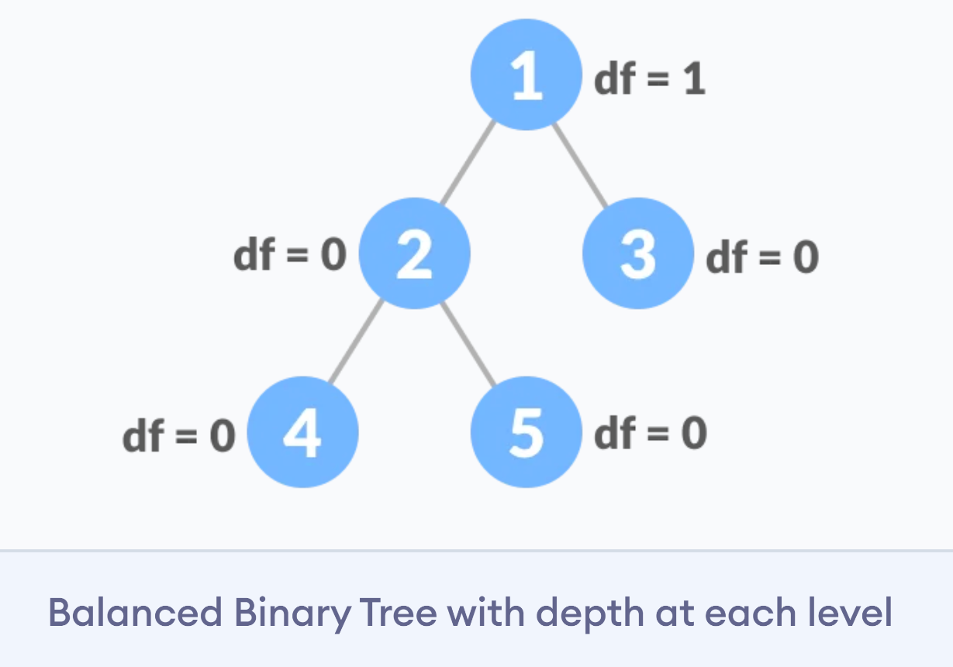
Example
df = depth = |height of left child - height of right child|

Slide 4
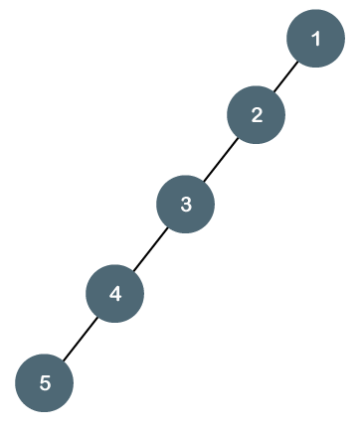
Example
An example of a non-balanced binary tree is a degenerate tree where every parent node has only one child node:

Slide 5
Why is it important that a binary tree be balanced?
We have seen that the efficiency of many important operations on trees is related to the Height of the tree - for example searching, inserting, and deleting in a BST are all O(Height).
In general, the relation between Height (H) and the number of nodes (N) in a tree can vary from H = N (degenerate tree) to H = log(N) (balanced binary tree).
For efficiency's sake, we would like to guarantee that H equals to O(logN).

Slide 6
Self-balancing binary search tree
Self-Balancing Binary Search Trees are height-balanced binary search trees that automatically keeps height as small as possible when insertion and deletion operations are performed on tree. The height is typically maintained in order of Log n so that all operations take O(Log n) time on average.
A red-black tree is a kind of self-balancing binary search tree.

