Slide 1
Data Structure & Algorithms
Red Black Trees Insertion

Slide 2
Properties of Red-Black Trees – Review
Every node is colored either red or black.
Root of the tree is black.
All leaves are black.
Both children of a red node are black i.e., there can't be consecutive red nodes.
All the simple paths from a node to descendant leaves contain the same number of black nodes.

Slide 3
Insertion
We insert a new node to a red-black tree in a similar way as we do in a normal binary search tree. We just call a function at the last to fix any kind of violations that could have occurred in the process of insertion.
We color any newly inserted node to red.
Doing so can violate the property 4 of red-black trees which we will fix after the insertion process as stated above.
There can be a violation of second property, but it can be easily fixed by coloring the root black. Also, there can't be any other violations.

Slide 4
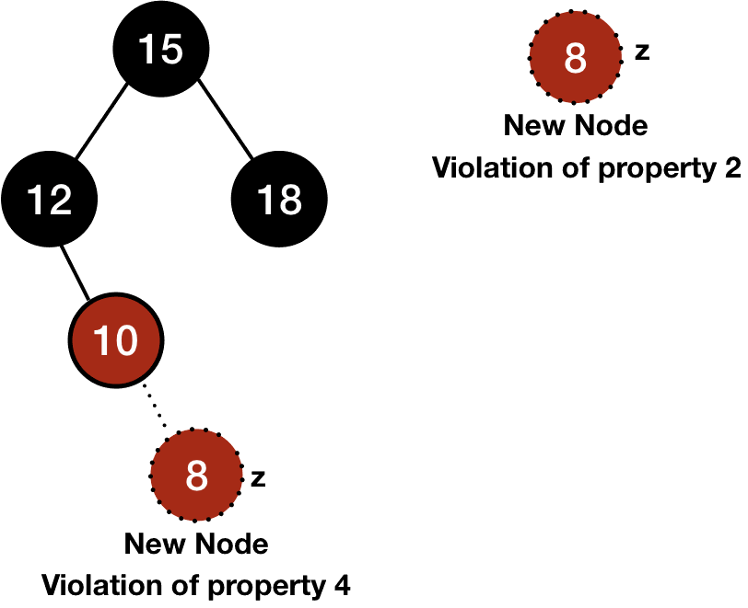
Insertion

Slide 5
Insertion
Since there can't be consecutive red nodes, the changes that this violation could happen is half. Also, fixing the violation of property 4 is easy. Think of a case when the newly inserted node is black. This would affect the black height and fixing that would be difficult. This is the reason why we don't color any new node to black.

Slide 6
Code for Insertion
INSERT(T, n) y = T.NIL temp = T.root while temp != T.NIL y = temp if n.data < temp.data temp = temp.left else temp = temp.right n.parent = y if y==T.NIL T.root = n else if n.data < y.data y.left = n else y.right = n n.left = T.NIL n.right = T.NIL n.color = RED INSERT_FIXUP(T, n)

Slide 7
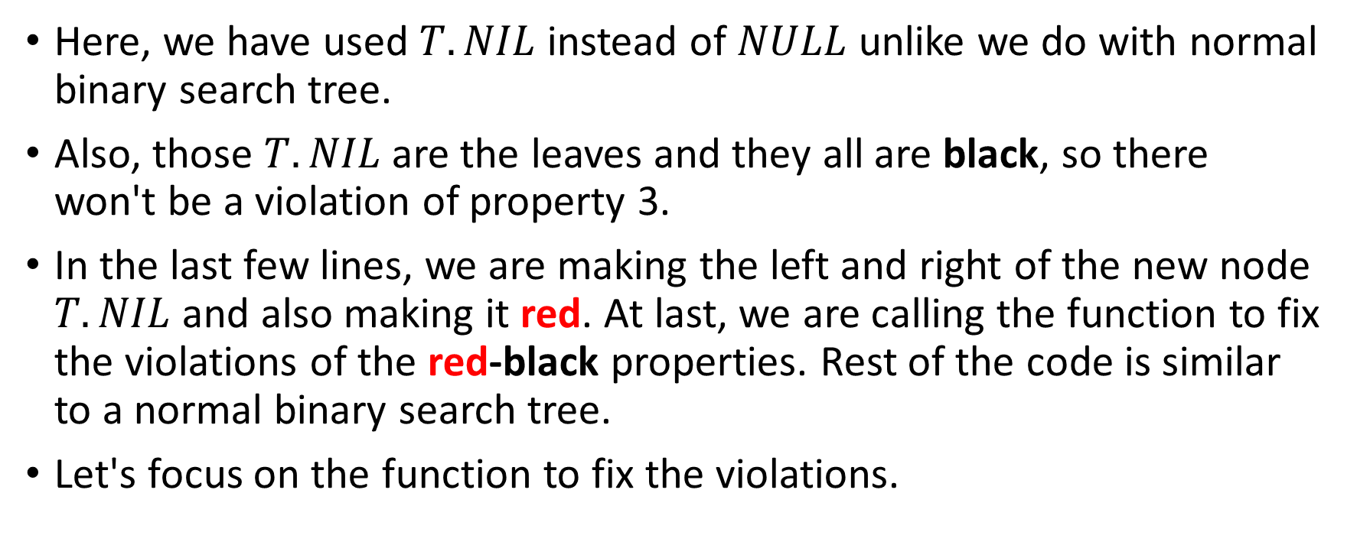
Insertion Code
Here, we have used $T.NIL$instead of $NULL$ unlike we do with normal binary search tree.
Also, those $T.NIL$are the leaves and they all are black, so there won't be a violation of property 3.
In the last few lines, we are making the left and right of the new node $T.NIL$and also making it red. At last, we are calling the function to fix the violations of the red-black properties. Rest of the code is similar to a normal binary search tree.
Let's focus on the function to fix the violations.

Slide 8
Insertion Fixup
The property 4 will be violated when the parent of the inserted node is red. So, we will fix the violations if the parent of the new node is red. At last, we will color the root black and that will fix the violation of property 2 if it is violated.
In the case of violation of 4th property (when the parent of the new node is red), the grandparent will be black.

Slide 9
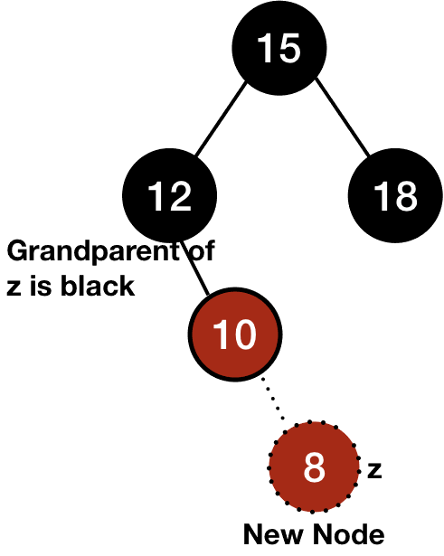
Insertion Fixup

Slide 10
Insertion Fixup
There can be six cases in the case of violation of the property 4.
assuming that the parent of the node z (AKA the new node) is a left child of its parent which gives us the first three cases.
The other three cases will be symmetric when the node z will be the right child of its parent.

Slide 11
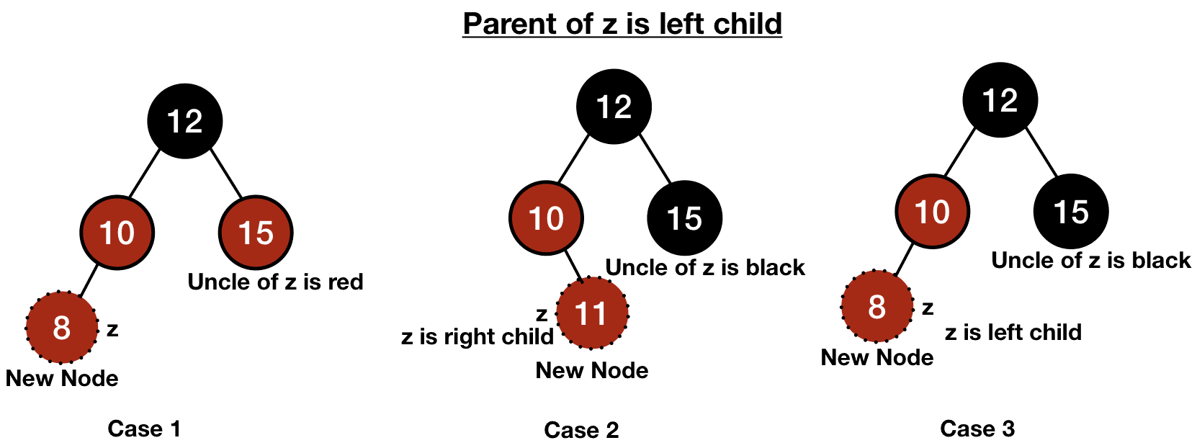
Insertion Fixup – Parent of Z is the left child

Slide 12
Insertion Fixup – Case 1
The first case is when the uncle of z is also red.
In this case, we will shift the red color upward until there is no violation.
Otherwise, if it reaches to the root, we can just color it black without any consequences.

Slide 13
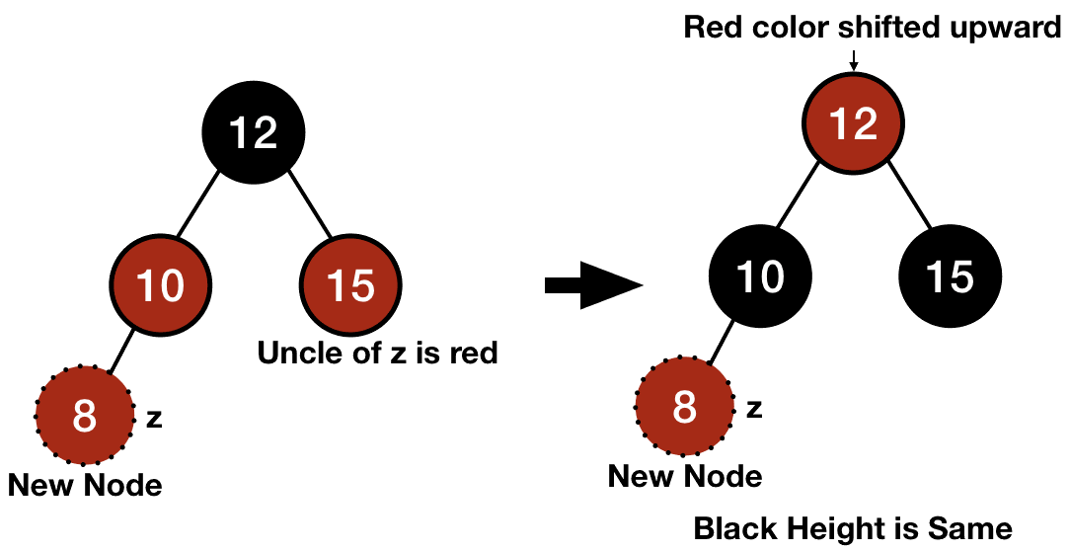
Insertion Fixup – Case 1

Slide 14
Insertion Fixup – Case 1
the process is to make both the parent and the uncle of z black and its grandparent red. In this way, the black height of any node won't be affected and we can successfully shift the red color upward.
However, making the grandparent of z red might cause violation of the 4th property. So, we will do the fixup again on that node.

Slide 15
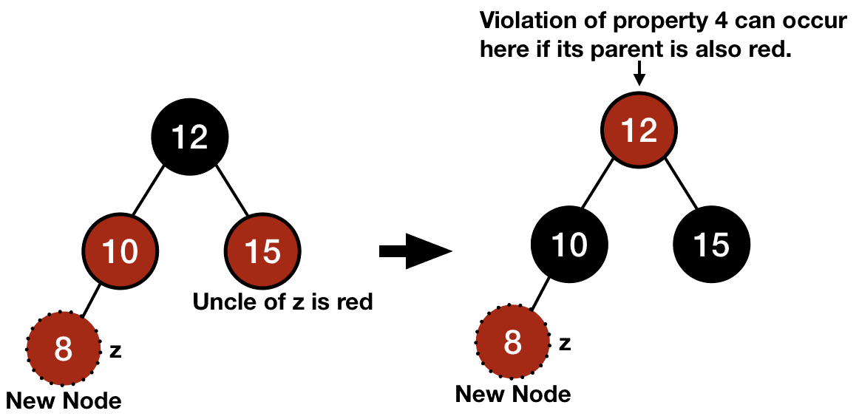
Insertion Fixup – Case 1

Slide 16
Insertion Fixup – Case 2
In the second case, the uncle of the node z is black and the node z is the right child.

Slide 17
Insertion Fixup – Case 3
In the third case, the uncle of the node z is black and the node z is the left child.

Slide 18
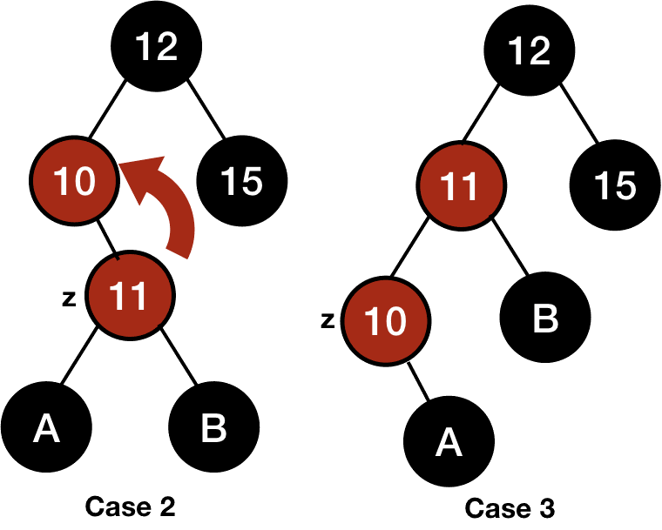
Insertion Fixup – Case 2 & 3
We can transform the second case into the third one by performing left rotation on the parent of the node z.
Since both z and its parent are red, so rotation won't affect the black height.

Slide 19
Insertion Fixup – Case 3
In case 3, we first color the parent of the node z black and its grandparent red and then do a right rotation on the grandparent of the node z.
This fixes the violation of properties completely.

Slide 20
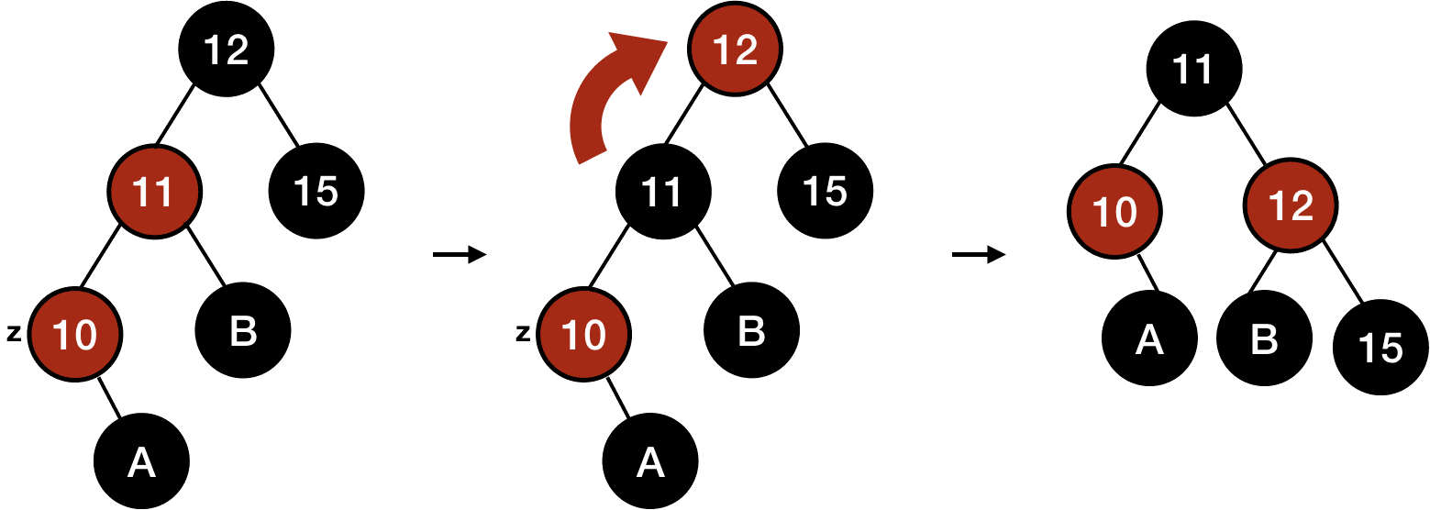
Insertion Fixup – Case 3

Slide 21
Insertion Fixup – Example
Since we are making the parent of z black in both case 2 and case 3, the loop will stop in these two cases.

Slide 22
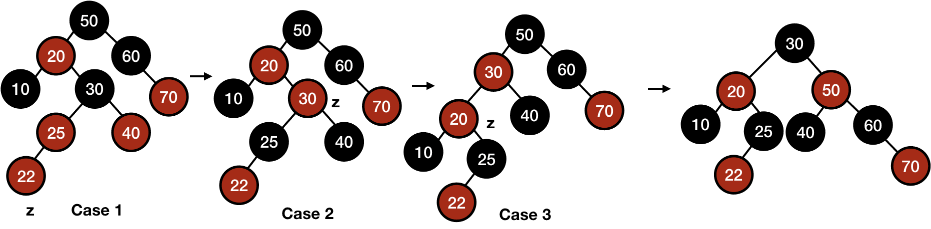
Insertion Fixup – Example

Slide 23
Insertion Fixup
Similarly, there will be three cases when the parent of z will be the right child but those cases will be symmetric to the above cases only with left and right exchanged.

Slide 24
Code for Fixup
INSERT_FIXUP(T, z) while z.parent.color == red if z.parent == z.parent.parent.left //z.parent is left child y = z.parent.parent.right //uncle of z if y.color == red //case 1 z.parent.color = black y.color = black z.parent.parent.color = red z = z.parent.parent else //case 2 or 3 if z == z.parent.right //case 2 z = z.parent //marked z.parent as new z LEFT_ROTATE(T, z) //rotated parent of original z //case 3 z.parent.color = black // made parent black z.parent.parent.color = red // made grandparent red RIGHT_ROTATE(T, z.parent.parent) // right rotation on grandparent else // z.parent is right child code will be symmetric //DIY (Do It Yourself!) T.root.color = black

Slide 25
RBT Code in C
enum COLOR {Red, Black}; typedef struct tree_node { int data; struct tree_node *right; struct tree_node *left; struct tree_node *parent; enum COLOR color; } tree_node; typedef struct red_black_tree { tree_node *root; tree_node *NIL; } red_black_tree;

Slide 26
RBT Code in C – New Node
tree_node* new_tree_node(int data) { tree_node* n = malloc(sizeof(tree_node)); n->left = NULL; n->right = NULL; n->parent = NULL; n->data = data; n->color = Red; return n; } red_black_tree* new_red_black_tree() { red_black_tree *t = malloc(sizeof(red_black_tree)); tree_node *nil_node = malloc(sizeof(tree_node)); nil_node->left = NULL; nil_node->right = NULL; nil_node->parent = NULL; nil_node->color = Black; nil_node->data = 0; t->NIL = nil_node; t->root = t->NIL; return t; }

Slide 27
RBT Code in C – Left Rotation
void left_rotate(red_black_tree *t, tree_node *x) { tree_node *y = x->right; x->right = y->left; if(y->left != t->NIL) { y->left->parent = x; } y->parent = x->parent; if(x->parent == t->NIL) { //x is root t->root = y; } else if(x == x->parent->left) { //x is left child x->parent->left = y; } else { //x is right child x->parent->right = y; } y->left = x; x->parent = y; }

Slide 28
RBT Code in C – Right Rotation
void right_rotate(red_black_tree *t, tree_node *x) { tree_node *y = x->left; x->left = y->right; if(y->right != t->NIL) { y->right->parent = x; } y->parent = x->parent; if(x->parent == t->NIL) { //x is root t->root = y; } else if(x == x->parent->right) { //x is left child x->parent->right = y; } else { //x is right child x->parent->left = y; } y->right = x; x->parent = y; }

Slide 29
RBT Code in C – Insertion Fixup
void insertion_fixup(red_black_tree *t, tree_node *z) { while(z->parent->color == Red) { if(z->parent == z->parent->parent->left) { //z.parent is the left child tree_node *y = z->parent->parent->right; //uncle of z if(y->color == Red) { //case 1 z->parent->color = Black; y->color = Black; z->parent->parent->color = Red; z = z->parent->parent; } else { //case2 or case3 if(z == z->parent->right) { //case2 z = z->parent; //marked z.parent as new z left_rotate(t, z); } //case3 z->parent->color = Black; //made parent black z->parent->parent->color = Red; //made parent red right_rotate(t, z->parent->parent); } } //end of z.parent is the left child

Slide 30
RBT Code in C – Insertion Fixup (cont.)
else { //z.parent is the right child tree_node *y = z->parent->parent->left; //uncle of z if(y->color == Red) { z->parent->color = Black; y->color = Black; z->parent->parent->color = Red; z = z->parent->parent; } else { if(z == z->parent->left) { z = z->parent; //marked z.parent as new z right_rotate(t, z); } z->parent->color = Black; //made parent black z->parent->parent->color = Red; //made parent red left_rotate(t, z->parent->parent); } } //end of z.parent is the right child } //end of while t->root->color = Black; } //end of function

Slide 31
RBT Code in C – Insert
void insert(red_black_tree *t, tree_node *z) { tree_node* y = t->NIL; //variable for the parent of the added node tree_node* temp = t->root; while(temp != t->NIL) { y = temp; if(z->data < temp->data) temp = temp->left; else temp = temp->right; } z->parent = y; if(y == t->NIL) { //newly added node is root t->root = z; } else if(z->data < y->data) //data of child is less than its parent, left child y->left = z; else y->right = z; z->right = t->NIL; z->left = t->NIL; insertion_fixup(t, z); }

Slide 32
RBT Code in C – Inroder
void inorder(red_black_tree *t, tree_node *n) { if(n != t->NIL) { inorder(t, n->left); printf("%d\n", n->data); inorder(t, n->right); } }

