Slide 1
Data Structure & Algorithms
Introduction

Slide 2
1.1 Some Definitions
Algorithm
Data Structure
Time Complexity

Slide 3
Algorithm
Algorithm is a step-by-step procedure, which defines a set of instructions to be executed in a certain order to get the desired output.
Algorithms are generally created independent of underlying languages, i.e. an algorithm can be implemented in more than one programming language.

Slide 4
Algorithm
From the data structure point of view (more on that later), the following are some important categories of algorithms −
Search − Algorithm to search an item in a data structure.
Sort − Algorithm to sort items in a certain order.
Insert − Algorithm to insert item in a data structure.
Update − Algorithm to update an existing item in a data structure.
Delete − Algorithm to delete an existing item from a data structure.

Slide 5
Data Structure
a data structure is a data organization, management, and storage format that enables efficient access and modification. More precisely, a data structure is a collection of data values, the relationships among them, and the functions or operations that can be applied to the data, i.e., it is an algebraic structure about data.
Some examples of Data Structures are arrays, Linked List, Stack, Queue, etc.
Data Structures are widely used in almost every aspect of Computer Science i.e. Operating System, Compiler Design, Artificial intelligence, Graphics and many more.

Slide 6
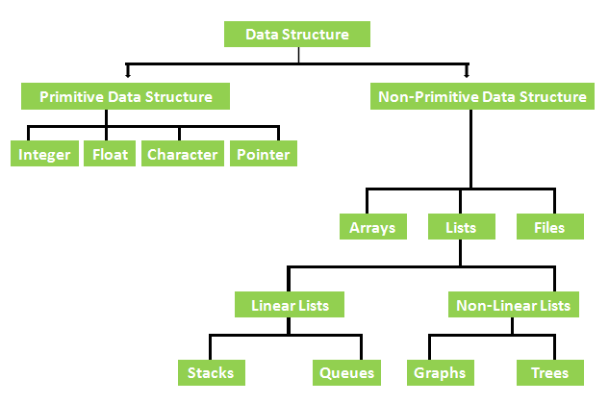
Types of Data Structure

Slide 7
1.2 How To Write An Algorithm
Algorithms are never written to support a particular programming code.
basic code constructs like loops (do, for, while), flow-control (if-else), etc can be used.
We write algorithms in a step-by-step manner.
Notes:
There are no well-defined standards for writing algorithms. Rather, it is problem and resource dependent. Algorithms are never written to support a particular programming code.
As we know, all programming languages share basic code constructs like loops (do, for, while), flow-control (if-else), etc. These common constructs can be used to write an algorithm.
We write algorithms in a step-by-step manner, but it is not always the case. Algorithm writing is a process and is executed after the problem domain is well-defined. That is, we should know the problem domain, for which we are designing a solution.

Slide 8
Example
Let's try to learn algorithm-writing by using an example.
Problem − Design an algorithm to add two numbers and display the result.
Step 1 − START Step 2 − declare three integers a, b & c Step 3 − define values of a & b Step 4 − add values of a & b Step 5 − store output of step 4 to c Step 6 − print c Step 7 − STOP

Slide 9
Example (cont.)
Algorithms tell the programmers how to code the program. Alternatively, the algorithm can be written as −
In design and analysis of algorithms, usually the second method is used to describe an algorithm. It makes it easy for the analyst to analyze the algorithm ignoring all unwanted definitions. He can observe what operations are being used and how the process is flowing.
Writing step numbers is optional.
We design an algorithm to get a solution for a given problem. A problem can be solved in more than one way.
Step 1 − START ADD Step 2 − get values of a & b Step 3 − c ← a + b Step 4 − display c Step 5 − STOP

Slide 10
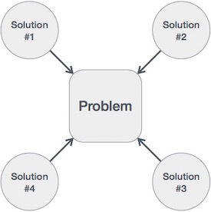
Hence, many solution algorithms can be derived for a given problem. The next step is to analyze those proposed solution algorithms and implement the best suitable solution.

Slide 11
Time Complexity
the time complexity is the computational complexity that describes the amount of computer time it takes to run an algorithm.
Time complexity is commonly estimated by counting the number of elementary operations performed by the algorithm, supposing that each elementary operation takes a fixed amount of time to perform.

Slide 12
Step count method
The step count method is one of the method to analyze the algorithm.
In this method, we count number of times one instruction is executing. From that we will try to find the complexity of the algorithm.

Slide 13
Example
Suppose we have one algorithm to perform sequential search. Suppose each instruction will take c1, c2, …. amount of time to execute, then we will try to find out the time complexity of this algorithm
Algorithm | Number of times | Cost
seqSearch(arr, n, key) i <- 1 while i <= n if arr[i++] == key break return i | 1 n+1 n 0/1 1 | c1 c2 c3 c4 c5

Slide 14
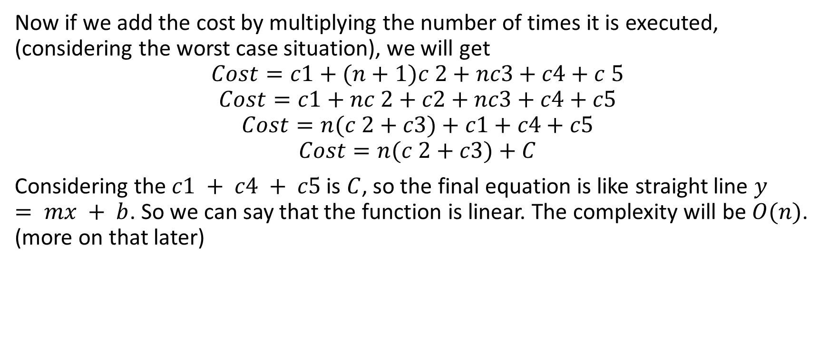
Example (cont.)
Now if we add the cost by multiplying the number of times it is executed, (considering the worst case situation), we will get
$$Cost=c1+(n+1)c 2+nc3+c4+c 5$$
$$Cost=c1+nc 2+c2+nc3+c4+c5$$
$$Cost=n(c 2+c3)+c1+c4+c5$$
$$Cost=n(c 2+c3)+C$$
Considering the $c1 + c4 + c5$is $C$, so the final equation is like straight line $y = mx + b$. So we can say that the function is linear. The complexity will be $O(n)$. (more on that later)

Slide 15
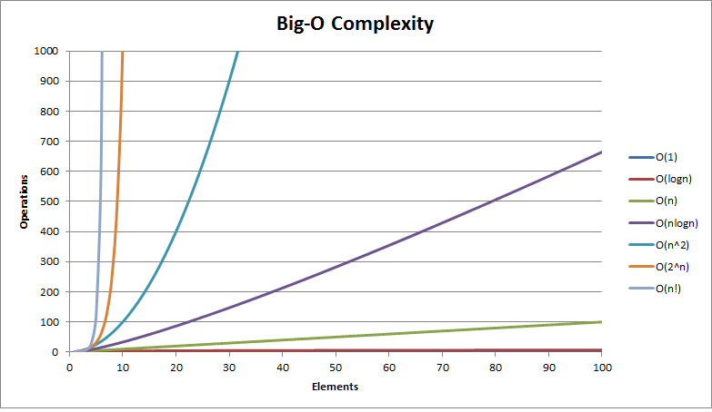
Example

Slide 16
1.3 Sorting Algorithm
A sorting algorithm is used to rearrange a given array or list of elements according to a comparison operator on the elements. The comparison operator is used to decide the new order of the element in the respective data structure.
Input: A sequence of n numbers (A₁, A₂, … , A_{n})
Output: A premutation (recording) of the input sequence (A’₁, A’₂, … , A’_{n}) such that A’₁ ≤ A’₂ ≤ … ≤ A’_{n}

Slide 17
Example

Slide 18
Sorting Algorithm (cont.)
The sorting problem → a problem
Insertion sort → an algorithm (solution)
Bubble sort → an algorithm (solution)

Slide 19
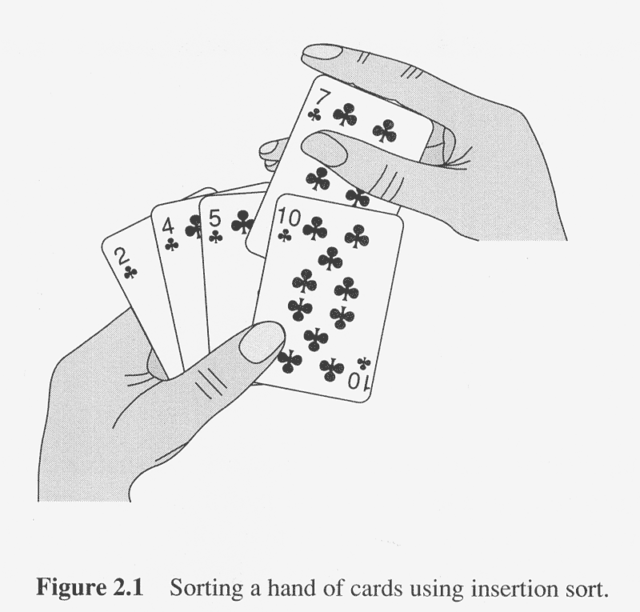
Insertion sort

Slide 20
Insertion sort
A good algorithm for sorting small sets of numbers
Exactly the same way you arrange a hand of cards
First, all the cards are on the back of the table and your left hand is empty
Take a card off the table and place it in the appropriate sorted place in your left hand
To find the right place for the next card, compare it with all the cards in the left hand one by one (from right to left)
All the cards in your left hand are sorted at any time

Slide 21
Example

Slide 22
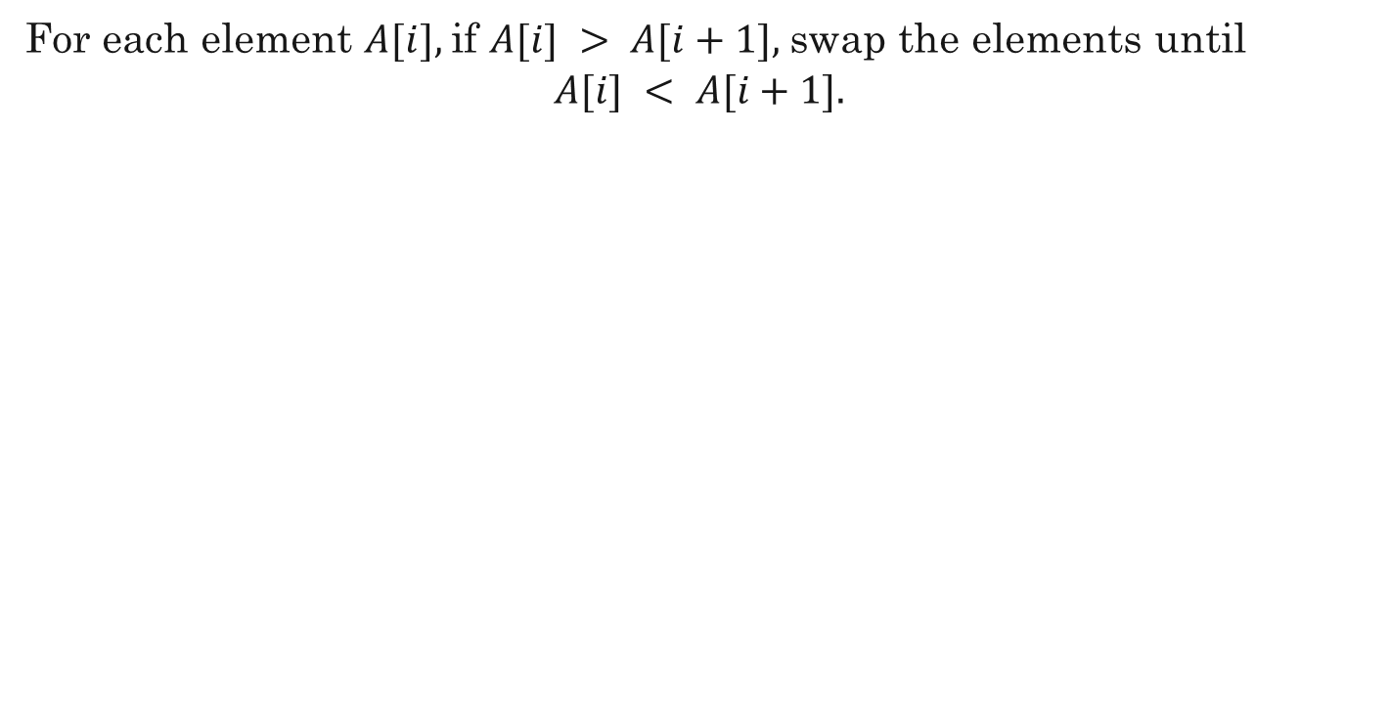
Algorithm
For each element $A[i],$if $A[i] > A[i+1],$swap the elements until
$$A[i] < A[i+1].$$

Slide 23
Pseudocode
Insertion_Sort(A) 1 for j <- 2 to length[A] 2 do key <- A[j] 3 Insert A[j] into the stored sequence A[1 ... j - 1] 4 i <- j - 1 5 while i > 0 and A[i] > key 6 do A[i+1] <- A[i] 7 i <- i - 1 8 A[i+1] <- key

Slide 24
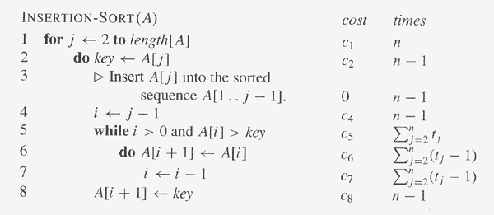
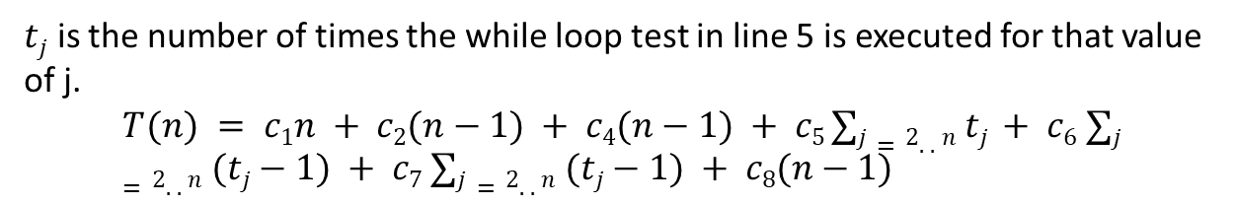
Complexity
$tj$ is the number of times the while loop test in line 5 is executed for that value of j.
$$T(n) = c1n + c2(n−1) + c4(n−1) + c5 ∑j=2..n tj + c6 ∑j=2..n (tj−1) + c7 ∑j=2..n (tj−1) + c8(n−1)$$

Slide 25
Question
What are the best-case and worst-case running times of INSERTION-SORT?
How about average-case?

Slide 26
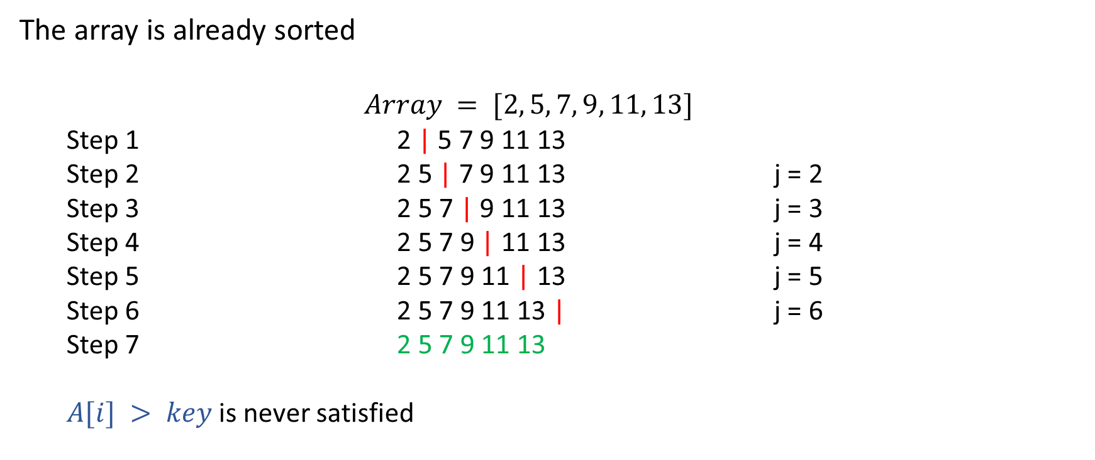
Best case
The array is already sorted
$$Array = [2, 5, 7, 9, 11, 13]$$
Step 1 2 | 5 7 9 11 13
Step 2 2 5 | 7 9 11 13 j = 2
Step 3 2 5 7 | 9 11 13 j = 3
Step 4 2 5 7 9 | 11 13 j = 4
Step 5 2 5 7 9 11 | 13 j = 5
Step 6 2 5 7 9 11 13 | j = 6
Step 7 2 5 7 9 11 13
$A[i] > key$is never satisfied

Slide 27
Best case (cont.)
It scans through the list, comparing each pair of elements, and it swaps elements if they are out of order. Each operation contributes to the running time of the algorithm. If the input array is already in sorted order, insertion sort compares n elements and performs no swaps. Therefore, in the best-case, insertion sort runs in n time.

Slide 28
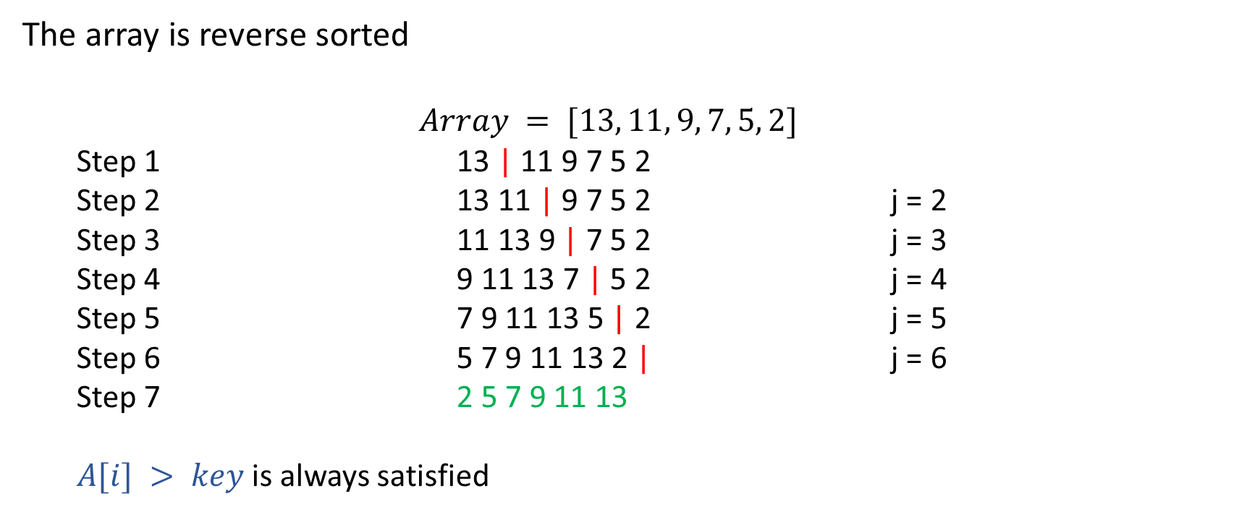
Worst case
The array is reverse sorted
$$Array = [13, 11, 9, 7, 5, 2]$$
Step 1 13 | 11 9 7 5 2
Step 2 13 11 | 9 7 5 2 j = 2
Step 3 11 13 9 | 7 5 2 j = 3
Step 4 9 11 13 7 | 5 2 j = 4
Step 5 7 9 11 13 5 | 2 j = 5
Step 6 5 7 9 11 13 2 | j = 6
Step 7 2 5 7 9 11 13
$A[i] > key$is always satisfied

Slide 29
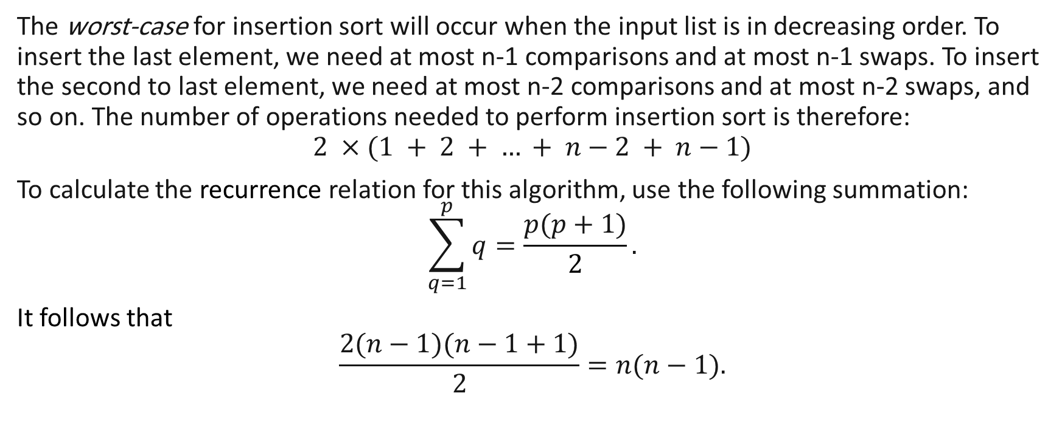
Worst case (cont.)
The worst-case for insertion sort will occur when the input list is in decreasing order. To insert the last element, we need at most n-1 comparisons and at most n-1 swaps. To insert the second to last element, we need at most n-2 comparisons and at most n-2 swaps, and so on. The number of operations needed to perform insertion sort is therefore:
$$2 ×(1 + 2 + … + n−2 + n−1)$$
To calculate the recurrence relation for this algorithm, use the following summation:
$$\sum_{q=1}^{p}{q}=\frac{p(p+1)​}{2}.$$
It follows that
$$\frac{2(n−1)(n−1+1)}{2}=n(n−1).$$

Slide 30

Average-case
When analyzing algorithms, the average-case often has the same complexity as the worst case. So insertion sort, on average, takes $n^{2}$ time.

Slide 31
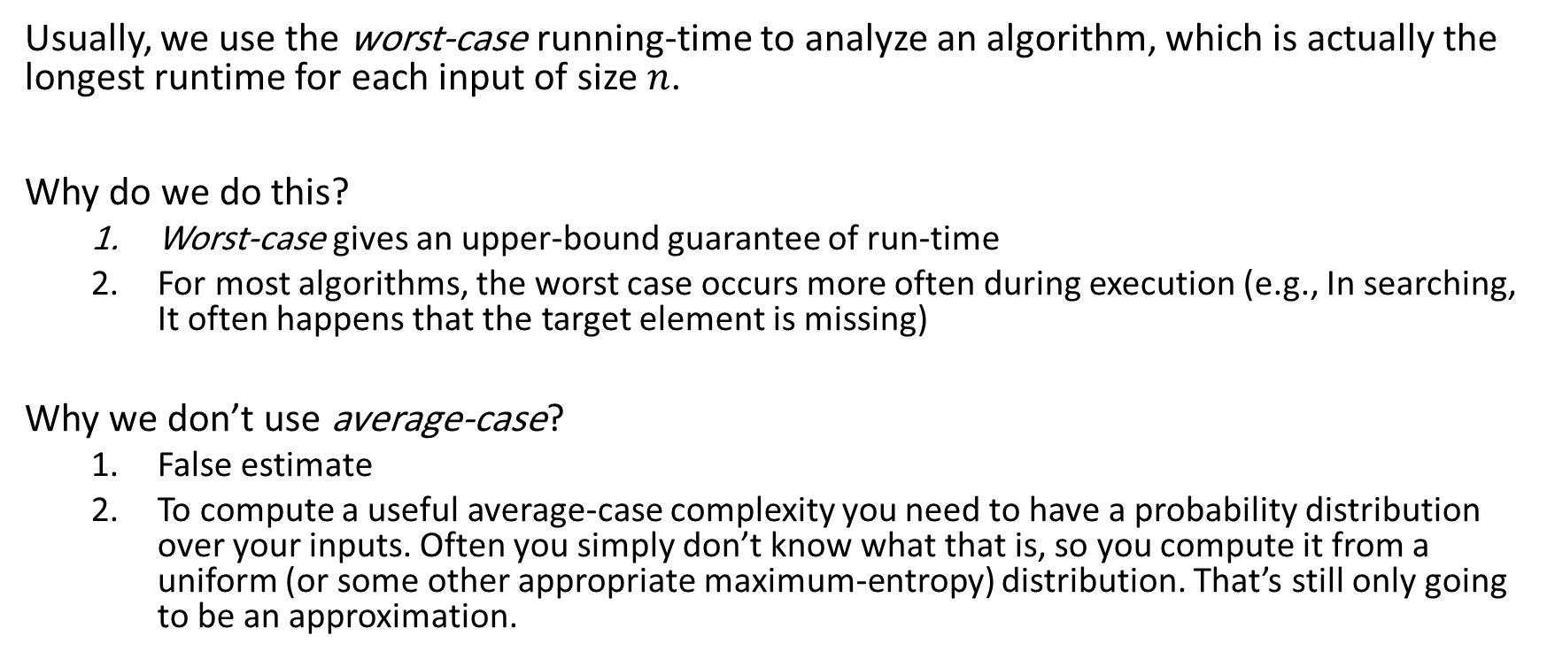
Worst-case and average-case analysis
Usually, we use the worst-case running-time to analyze an algorithm, which is actually the longest runtime for each input of size $n$.
Why do we do this?
Worst-case gives an upper-bound guarantee of run-time
For most algorithms, the worst case occurs more often during execution (e.g., In searching, It often happens that the target element is missing)
Why we don’t use average-case?
False estimate
To compute a useful average-case complexity you need to have a probability distribution over your inputs. Often you simply don’t know what that is, so you compute it from a uniform (or some other appropriate maximum-entropy) distribution. That’s still only going to be an approximation.

Slide 32
Bubble sort

Slide 33
Bubble sort
Bubble sort, sometimes referred to as sinking sort, is a simple sorting algorithm that repeatedly steps through the list, compares adjacent elements and swaps them if they are in the wrong order. The pass through the list is repeated until the list is sorted. The algorithm, which is a comparison sort, is named for the way smaller or larger elements "bubble" to the top of the list.
This algorithm is not suitable for large data sets as its average and worst case complexity are of n² where n is the number of items.

Slide 34

Algorithm
The bubble sort algorithm is as follows:
Compare $A[0]$ and $A[1].$If $A[0]$ is bigger than $A[1]$ swap the elements.
Move to the next element, $A[1]$ (which might now contain the result of a swap from the previous step), and compare it with $A[2]$. If $A[1]$ is bigger than $A[2]$, swap the elements. Do this for every pair of elements until the end of the list.
Do steps 1 and 2 for $n$ times.

Slide 35
Pseudocode
Bubble-sort(A) 1 for i <- n - 1 to 1 do 2 for j <- 1 to i do 3 if A[j]>A[j+1] 4 swap(A[j],A[j+1]); 5 end if

Slide 36
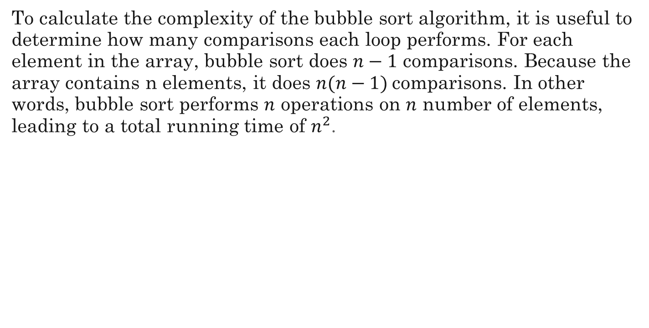
Complexity
To calculate the complexity of the bubble sort algorithm, it is useful to determine how many comparisons each loop performs. For each element in the array, bubble sort does $n−1$ comparisons. Because the array contains n elements, it does $n(n−1)$comparisons. In other words, bubble sort performs $n$ operations on $n$ number of elements, leading to a total running time of $n^{2}$.

Slide 37
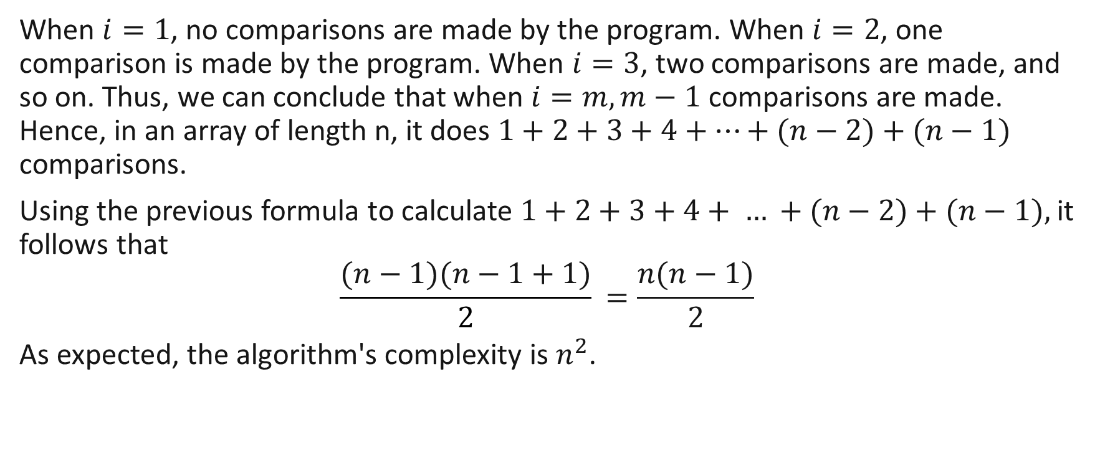
Complexity (cont.)
When $i=1$, no comparisons are made by the program. When $i=2$, one comparison is made by the program. When $i=3$, two comparisons are made, and so on. Thus, we can conclude that when $i=m, m−1$comparisons are made. Hence, in an array of length n, it does $1+2+3+4+…+(n−2)+(n−1)$ comparisons.
Using the previous formula to calculate $1+2+3+4+ … +(n−2)+(n−1),$it follows that
$$\frac{(n−1)(n−1+1)}{2}​=\frac{n(n−1)​}{2}$$
As expected, the algorithm's complexity is $n^{2}$.

Slide 38

Complexity (cont.)
$n$ is the best-case running time for bubble sort. It is possible to modify bubble sort to keep track of the number of swaps it performs. If an array is already in sorted order, and bubble sort makes no swaps, the algorithm can terminate after one pass. With this modification, if bubble sort encounters a list that is already sorted, it will finish in $n$ time.

