Slide 1
Data Structure & Algorithms
Growth of functions

Slide 2
Overview
Order of growth of functions provides a simple characterization of efficiency
Allows for comparison of relative performance between alternative algorithms
Concerned with asymptotic efficiency of algorithms
Best asymptotic efficiency usually is best choice except for smaller inputs
Several standard methods to simplify asymptotic analysis of algorithms

Slide 3
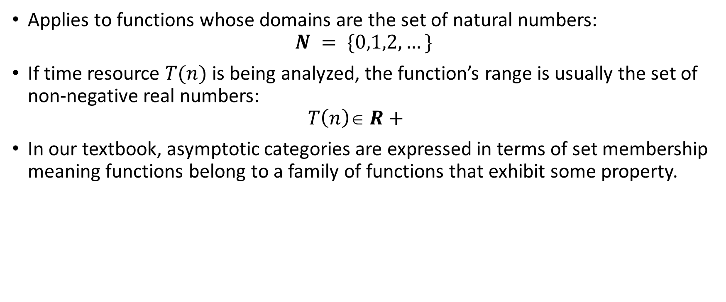
Asymptotic Notation
Applies to functions whose domains are the set of natural numbers: $N = \{0,1,2,…\}$
If time resource $T(n)$is being analyzed, the function’s range is usually the set of non-negative real numbers: $T\left(n\right)\text{∈} R+$
In our textbook, asymptotic categories are expressed in terms of set membership meaning functions belong to a family of functions that exhibit some property.

Slide 4
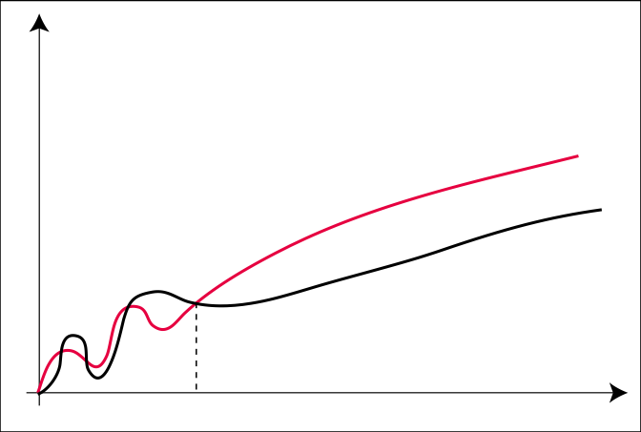


The $O$-Notation
$$f(n)∈O(g(n))$$
$$O\left(g\left(n\right)\right)= \left\{ f\left(n\right): ∃c > 0, \text{n}\text{0}> 0 \right|∀n ≥\text{n}\text{0} : f(n) ≤ c ⋅ g(n) \}$$
c ⋅ g
f
n₀

Slide 5

The $O$-Notation
Example: $f\left(n\right)∈5n+10$
$f\left(n\right)∈O(n)$
$f\left(n\right)∈O(n^{2})$
$f\left(n\right)∉O(\sqrt{n})$
$If$ $\lim_{n→∞}{\frac{f(n)}{g(n)}}$ = $0 then, f\left(n\right)∈O\left(g\left(n\right)\right).$

Slide 6
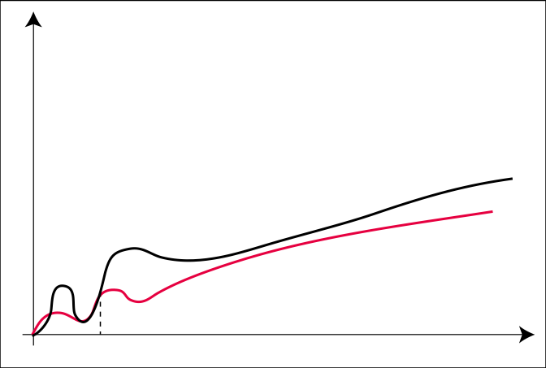


The $Ω$-Notation
$$f\left(n\right)∈\text{Ω}\left(g\left(n\right)\right)$$
$$Ω\left(g\left(n\right)\right)= \left\{ f\left(n\right): ∃c > 0, \text{n}\text{0}> 0 \right|∀n ≥\text{n}\text{0}: f(n) ≥ c ⋅ g(n) \}$$
n₀

Slide 7

The $Ω$-Notation
Example: $f\left(n\right)∈5n+10$
$f\left(n\right)∈\text{Ω}(n)$
$f\left(n\right)∈\text{Ω}(\sqrt{n})$
$f\left(n\right)∉\text{Ω}(n^{2})$
$If$ $\lim_{n→∞}{\frac{f(n)}{g(n)}}$ = $∞ then, f\left(n\right)∈Ω\left(g\left(n\right)\right).$

Slide 8
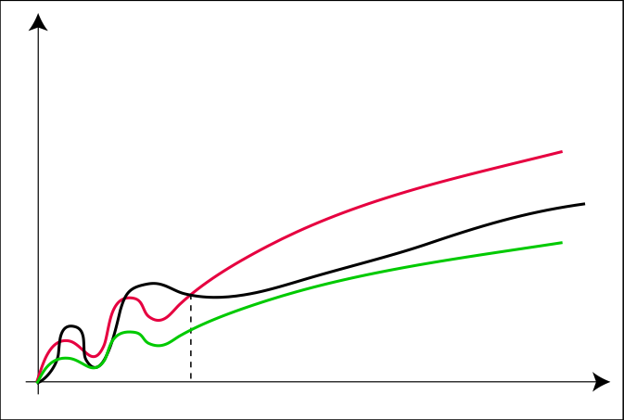


The $Θ$-Notation
$$f(n)∈Θ(g(n))$$
$$Θ\left(g\left(n\right)\right)= \left\{ f\left(n\right): ∃c1, c2 > 0,\text{n}\text{0}> 0 \right| ∀n ≥\text{n}\text{0}: c1 · g(n) ≤ f(n) ≤ c2 ⋅ g(n)\}$$
c₂ ⋅ g
f
c₁ ⋅ g
n₀

Slide 9

The $Θ$-Notation
Example: $f\left(n\right)∈5n+10$
$f\left(n\right)∈Θ(n)$
$f\left(n\right)∉Θ(\sqrt{n})$
$f\left(n\right)∉Θ(n^{2})$
$If$ $\lim_{n→∞}{\frac{f(n)}{g(n)}}$ = $c, for some constant c>0, then f\left(n\right)∈Θ\left(g\left(n\right)\right).$

Slide 10
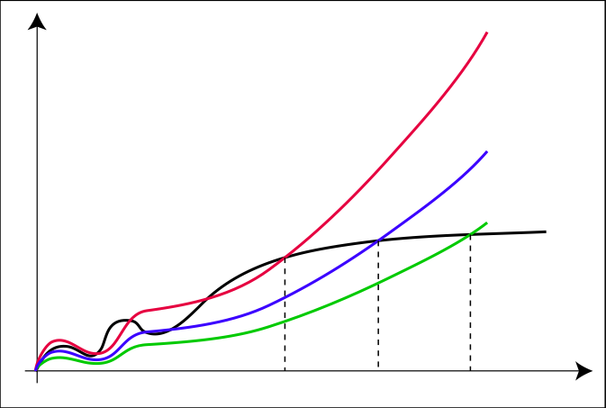


The $o$-Notation
$$f(n)∈o(g(n))$$
$$o(g(n)) = \{ f(n) : ∀c > 0 ∃n0 > 0 | ∀n ≥ n0: f(n) ≤ c ⋅ g(n) \}$$
c₃ ⋅ g
c₂ ⋅ g
c₁ ⋅ g
f
n₀
n₁
n₂
n₃

Slide 11

The $o$-Notation
Example: $f\left(n\right)∈5n+10$
$f\left(n\right)∉o(n)$
$f\left(n\right)∉o(\sqrt{n})$
$f\left(n\right)∈o(n^{2})$

Slide 12
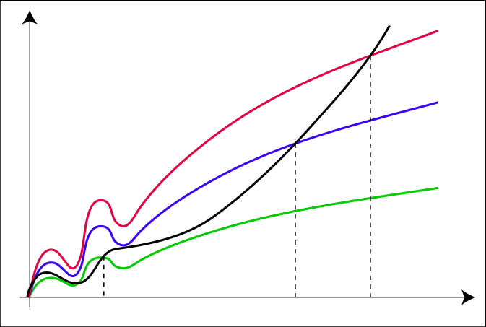


The $ω$-Notation
$$f(n)∈ω(g(n))$$
$$ω(g(n)) = \{ f(n) : ∀c > 0 ∃n0 > 0 | ∀n ≥ n0: f(n) ≥ c ⋅ g(n) \}$$
f
c₃ ⋅ g
c₂ ⋅ g
c₁ ⋅ g
n₀
n₁
n₂
n₃

Slide 13

The $ω$-Notation
Example : $f\left(n\right)=5n+10$
$f\left(n\right)∉ω(n)$
$f\left(n\right)∈ω(\sqrt{n})$
$f\left(n\right)∉ω\left(n^{3}\right)$
$f\left(n\right)∈ω(logn)$

Slide 14
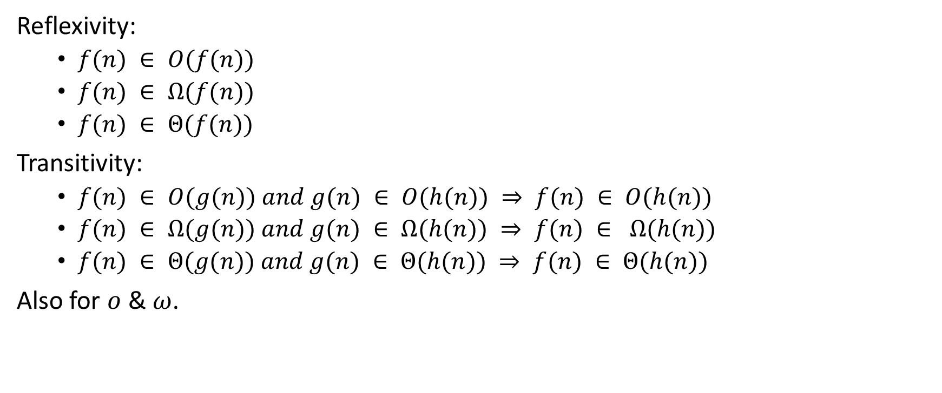
Comparison of Functions
Reflexivity:
$f(n) ∈ O(f(n))$
$f(n) ∈ Ω(f(n))$
$f(n) ∈ Θ(f(n))$
Transitivity:
$f(n) ∈ O(g(n)) and g(n) ∈ O(h(n)) ⇒ f(n) ∈ O(h(n))$
$f(n) ∈ Ω(g(n)) and g(n) ∈ Ω(h(n)) ⇒ f(n) ∈ Ω(h(n))$
$f(n) ∈ Θ(g(n)) and g(n) ∈ Θ(h(n)) ⇒ f(n) ∈ Θ(h(n))$
Also for $o$ & $ω$.

Slide 15
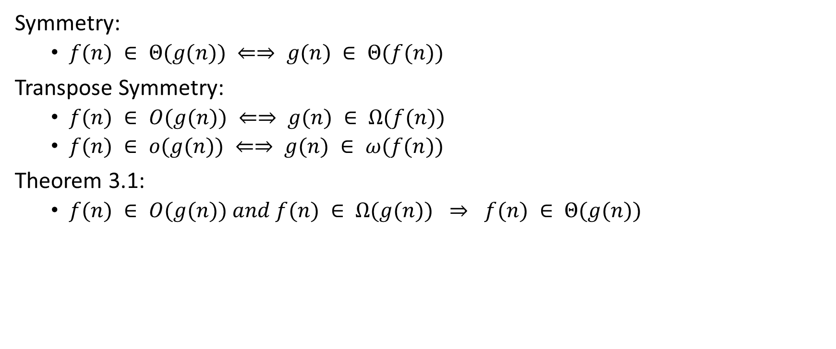
Comparison of Functions
Symmetry:
$f(n) ∈ Θ(g(n)) ⇐⇒ g(n) ∈ Θ(f(n))$
Transpose Symmetry:
$f(n) ∈ O(g(n)) ⇐⇒ g(n) ∈ Ω(f(n))$
$f(n) ∈ o(g(n)) ⇐⇒ g(n) ∈ ω(f(n))$
Theorem 3.1:
$f(n) ∈ O(g(n)) and f(n) ∈ Ω(g(n)) ⇒ f(n) ∈ Θ(g(n))$

Slide 16

Comparison of Functions
Also:
$f(n) ∈ O(g(n)) and g(n) ∈ O(f(n)) ⇒ f(n) ∈ Θ(g(n))$
$f(n) ∈ Ω(g(n)) and g(n) ∈ Ω(f(n)) ⇒ f(n) ∈ Θ(g(n))$

Slide 17

Comparison of Functions
Also:
$f1(n) ∈ O(g1(n)) and f2(n) ∈ O(g2(n)) ⇒ f1(n) + f2(n) ∈ O(g1(n) + g2(n))$
$f(n) ∈ O(g(n)) ⇒ f(n) + g(n) ∈ O(g(n))$

Slide 18

Correspondence between notations and “<“ , “>”
$f\left(n\right)∈O\left(g\left(n\right)\right)$
$f\left(n\right)∈\text{Ω}(g\left(n\right))$
$f\left(n\right)∈Θ\left(g\left(n\right)\right)$
$f\left(n\right)∈o(g\left(n\right))$
$f\left(n\right)∈ω(g(n))$
a $≤$ b
a $≥$ b
a = b
a < b
a > b

Slide 19
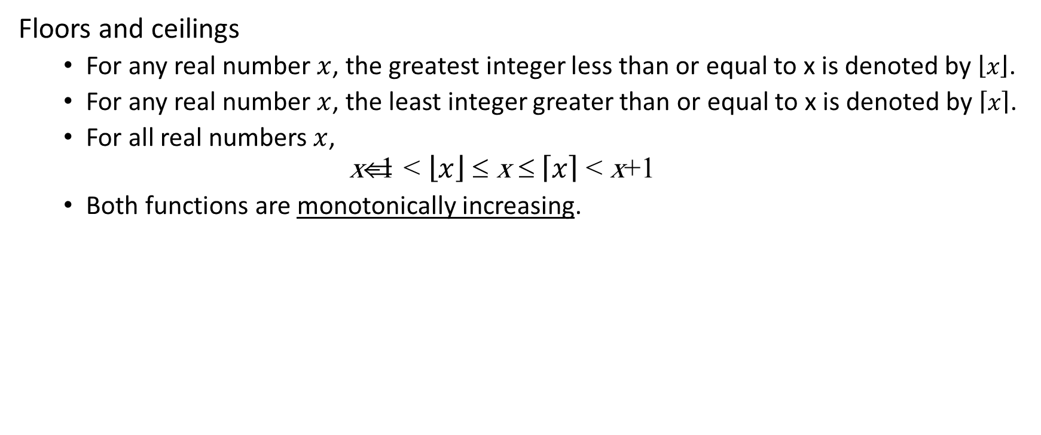
Standard Notation and Common Functions
Floors and ceilings
For any real number $x$, the greatest integer less than or equal to x is denoted by $\left\lfloor x\right\rfloor$.
For any real number $x$, the least integer greater than or equal to x is denoted by $\left\lceil x\right\rceil$.
For all real numbers $x$, $\text{x}\text{−}\text{1 }\text{< }\left\lfloor x\right\rfloor \text{≤ }\text{x} \text{≤} \left\lceil x\right\rceil \text{< }\text{x}\text{+}\text{1}$
Both functions are monotonically increasing.

Slide 20

Standard Notation and Common Functions
$n ∈ℕ, \left\lceil \frac{n}{2}\right\rceil$+$\left\lfloor \frac{n}{2}\right\rfloor =n$
$n ∈ℝ , n≥0, a,b>0, \left\lceil \frac{\left\lceil \frac{n}{a}\right\rceil }{b}\right\rceil$=$\left\lceil \frac{n}{ab}\right\rceil$ $\& \left\lfloor \frac{\left\lceil \frac{n}{a}\right\rceil }{b}\right\rfloor$=$\left\lfloor \frac{n}{ab}\right\rfloor$
a,b $∈ℝ$, $a>1, \lim_{n→∞}{\frac{n^{b}}{a^{n}}}$ = 0 $→ n^{b}$ $∈$ o($a^{n}$)

Slide 21

Standard Notation and Common Functions
$x ∈ℝ, e^{x}$= $1+x+ \frac{x^{2}}{2!}$ + $\frac{x^{3}}{3!}$ + …. $→$ $e^{x}$ $≥1+x$
$If \left|x\right|≤1 then 1+x≤e^{x}≤1+x+x^{2}$
$\lim_{n→∞}{{(1+\frac{x}{n})}^{n}=e^{x}}$

Slide 22

Standard Notation and Common Functions
$\left|x\right|<1→ \ln\left(1+x\right)=x−\frac{x^{2}}{2}+\frac{x^{3}}{3}−\frac{x^{4}}{4}+\frac{x^{5}}{5}−…$
$x>−1$ $→\frac{x}{x+1}≤\ln{(1+x)≤}x$

Slide 23

Standard Notation and Common Functions
Stirling’s Approximation:
$n!= \sqrt{2πn}(1+θ\left(\frac{1}{n}\right)$)${(\frac{n}{e}\text{)}}^{n}$

Slide 24

Exercise
Prove this relations:
$\lg\left(n!\right)∈θ(nlogn)$
$n! ∈ ω\left(2^{n}\right)$
$n! ∈ o\left(2^{n}\right)$

Slide 25
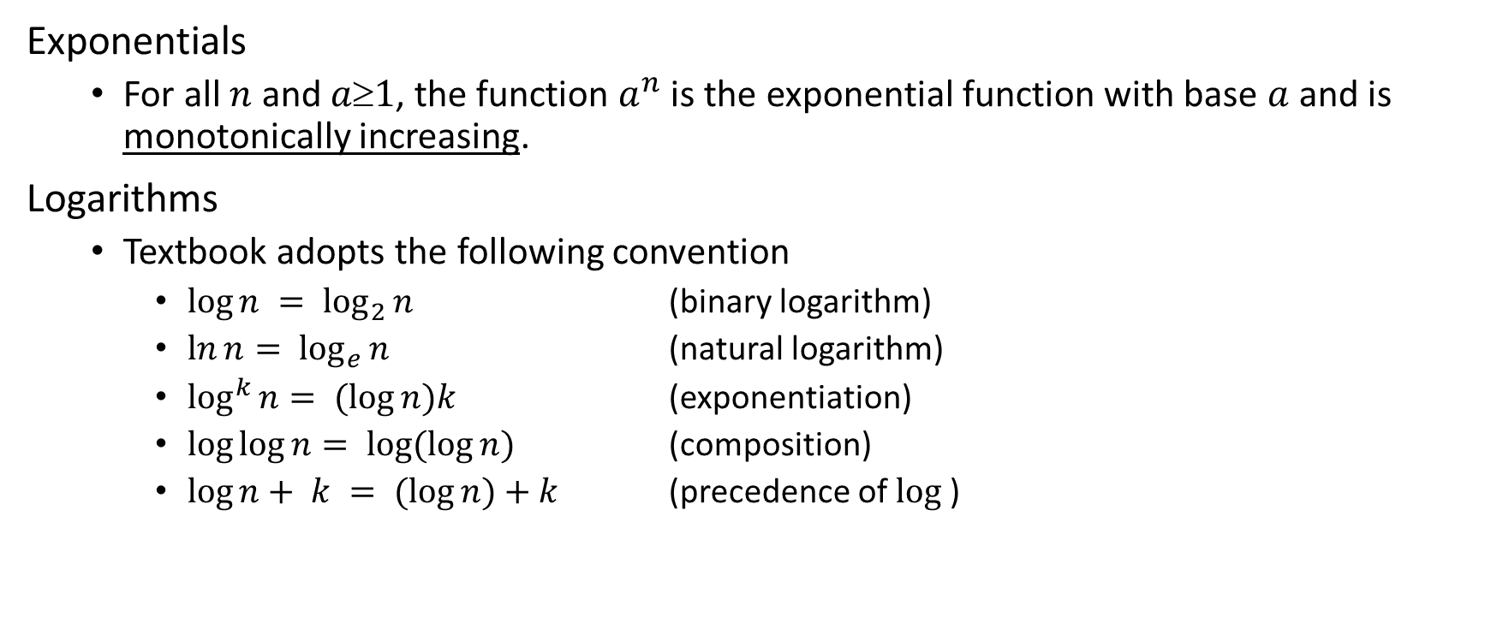
Standard Notation and Common Functions
Exponentials
For all $n$ and $a1$, the function $a^{n}$ is the exponential function with base $a$ and is monotonically increasing.
Logarithms
Textbook adopts the following convention
$\log{n} = \log_{2}{n}$ (binary logarithm)
$\ln{n}= \log_{e}{n}$ (natural logarithm)
$\log^{k}{n}= (\log{n})k$ (exponentiation)
$\log{\log{n}}= \log{(\log{n})}$ (composition)
$\log{n}+ k = (\log{n})+k$ (precedence of $log⁡$)

Slide 26
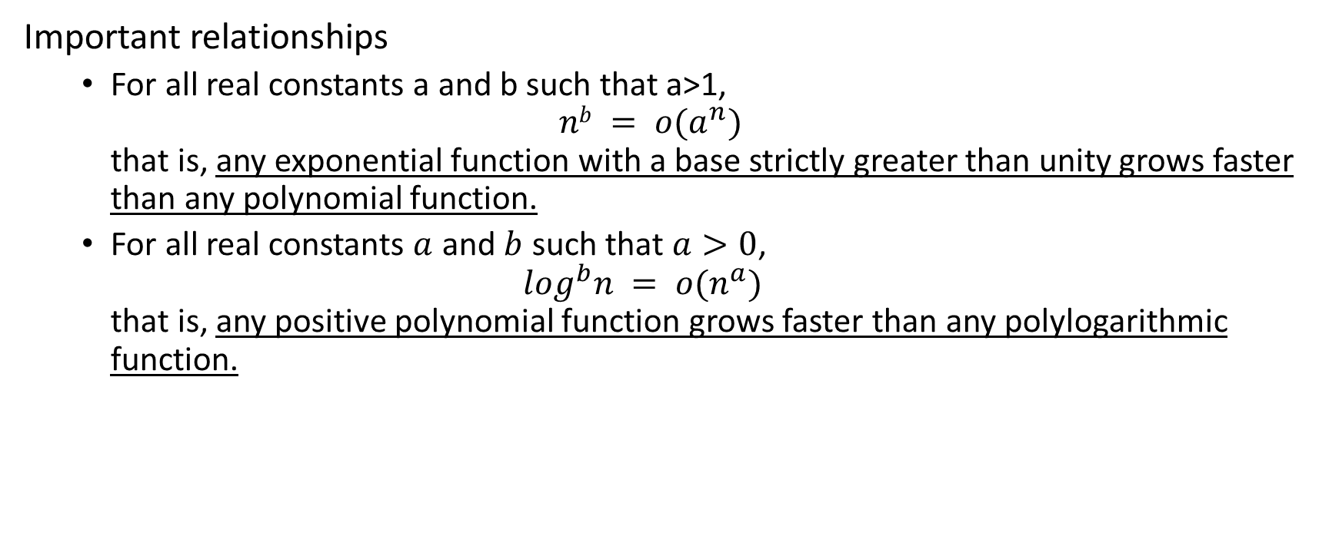
Standard Notation and Common Functions
Important relationships
For all real constants a and b such that a>1, $nb = o(a^{n})$ that is, any exponential function with a base strictly greater than unity grows faster than any polynomial function.
For all real constants $a$ and $b$ such that $a>0$, $\log^{b}n = o(n^{a})$ that is, any positive polynomial function grows faster than any polylogarithmic function.

Slide 27

Standard Notation and Common Functions
Factorials
For all $n$ the function $n!$or $“n factorial”$is given by $n! = n\text{}(n−1)\text{}(n−2)\text{}(n−3)\text{}…\text{}2\text{}1$
It can be established that $n! = o(n^{n})$ $n! =\text{ω}(2^{n})$ $log⁡(n!) =\text{Θ}(nlogn)$

Slide 28
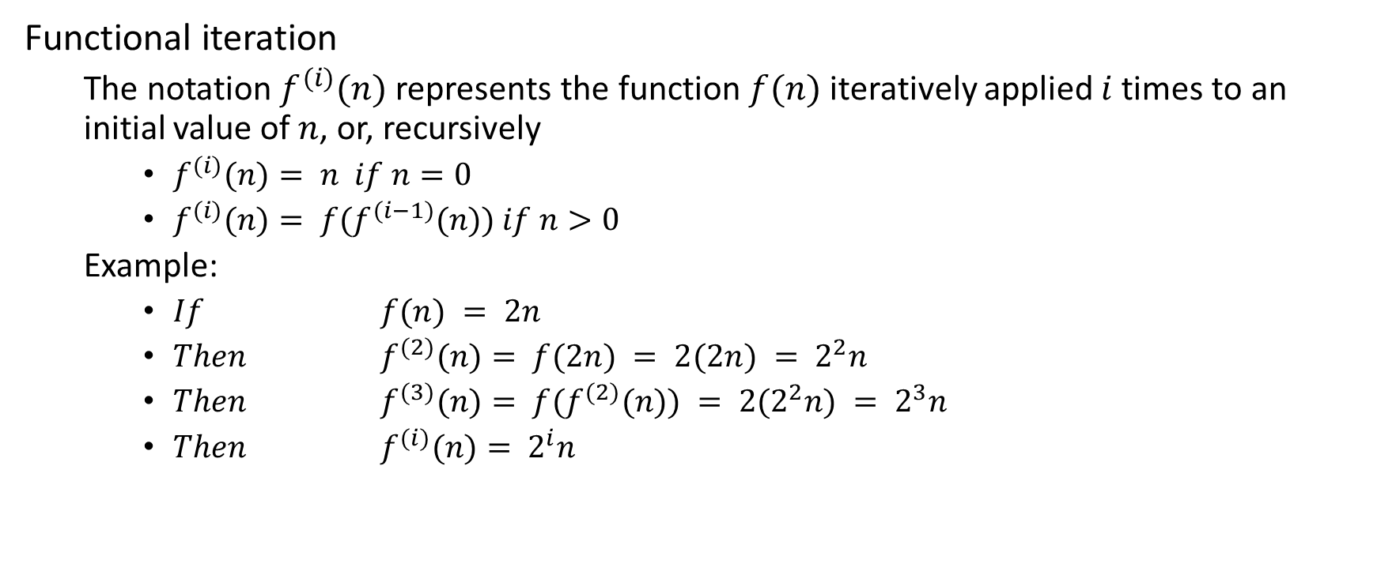
Standard Notation and Common Functions
Functional iteration
The notation $f^{(i)}(n)$represents the function $f(n)$iteratively applied $i$times to an initial value of $n$, or, recursively
$f^{(i)}(n)= n if$ $n=0$
$f^{(i)}(n)= f(f^{(i−1)}(n)) if$ $n>0$
Example:
$If$ $f(n) = 2n$
$Then$ $f^{(2)}(n)= f(2n) = 2(2n) = 2^{2}n$
$Then$ $f^{(3)}(n)= f(f^{(2)}(n)) = 2(2^{2}n) = 2^{3}n$
$Then$ $f^{(i)}(n)= 2^{i}n$

Slide 29
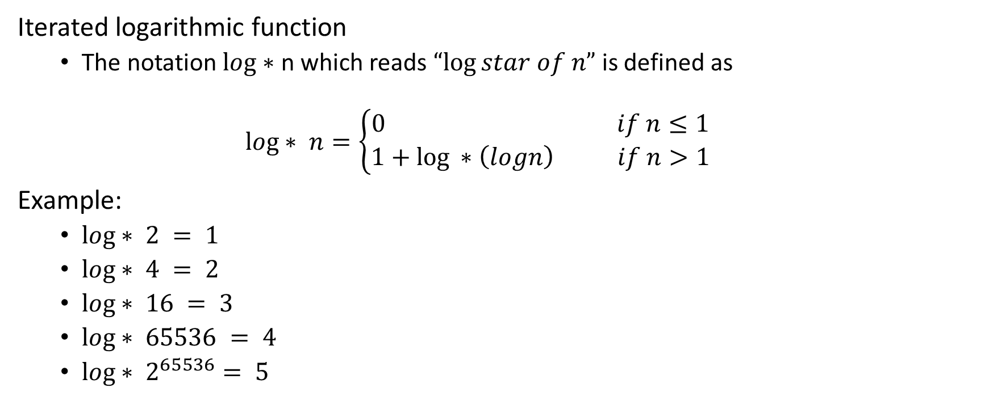
Standard Notation and Common Functions
Iterated logarithmic function
The notation $log∗$ n which reads $“log⁡star of n”$is defined as
$$log∗ n=\left\{\begin{aligned}0 if n≤1 \\ 1+\log{ ∗\left(logn\right) if n>1}\end{aligned}\right.$$
Example:
$log∗ 2 = 1$
$log∗ 4 = 2$
$log∗ 16 = 3$
$log∗ 65536 = 4$
$log∗ 2^{65536}= 5$

Slide 30

Standard Notation and Common Functions
Fibonnaci relations:
$F_{0}=0, F_{1}=1→F_{i}=F_{i−1}+F_{i−2 }i≥2$
$φ=\frac{1+\sqrt{5}}{2} \hat{φ}$ $=\frac{1−\sqrt{5}}{2}$
$F_{i}=\frac{φ^{i}−{\hat{φ}}^{i}}{\sqrt{5}}$

