Slide 1



برنامه نویسی پیشرفته
رفع اشکال: جلسه ۴
Memory management
Primitive vs. reference types, autoboxing/unboxing
.equals vs. ==
wrapper classes
Basics of testing (JUnit) and debugging (IDE tools)

Slide 2
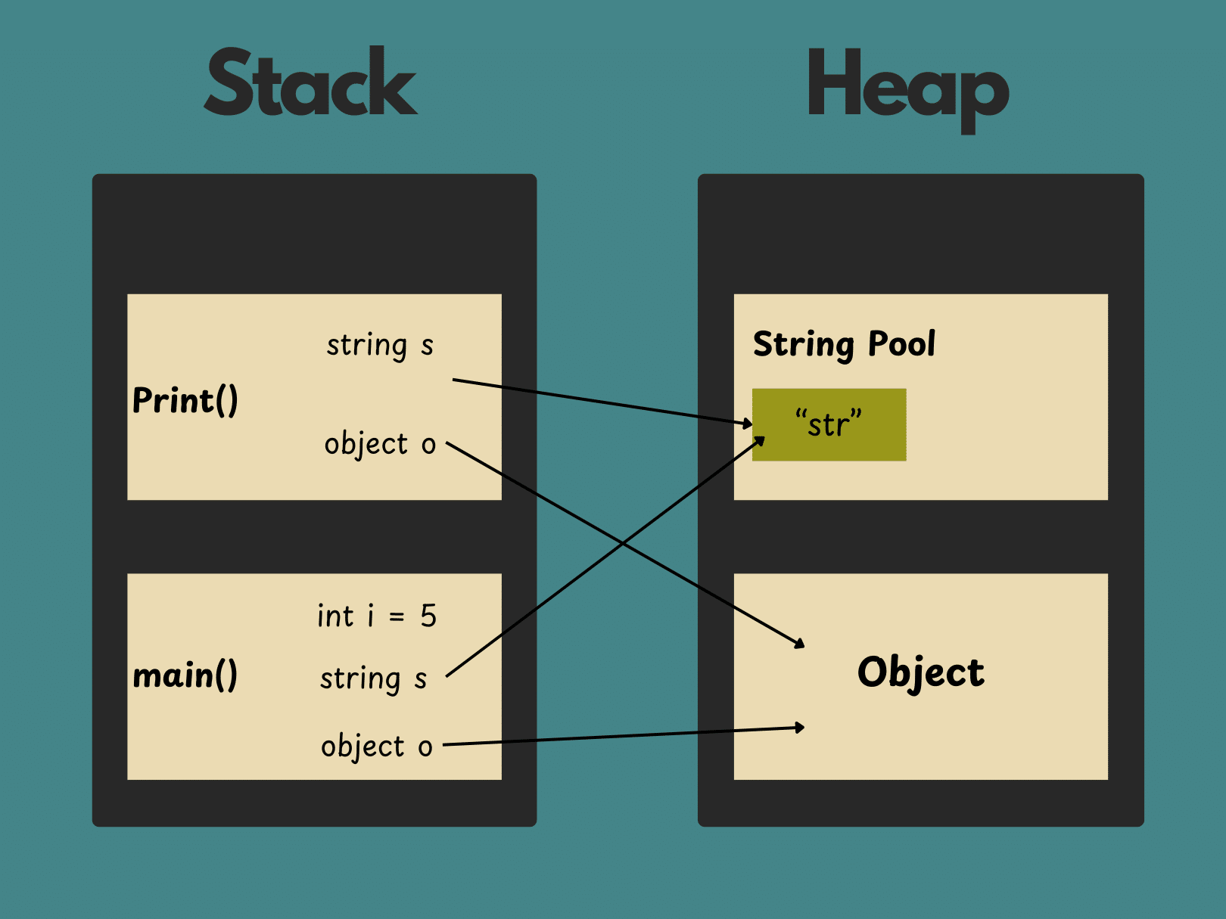
Stack vs. Heap memory
1. Stack Memory
Used for local variables and method calls.
Follows LIFO (Last In, First Out) order.
Memory is automatically allocated and deallocated.
Faster access but has limited size.
Stores primitive variables and references to objects (not the objects themselves).
2. Heap Memory
Used for storing objects (instances of classes).
Managed by Garbage Collector.
Slower access compared to Stack but has more space.
All objects are stored in Heap, while their references are in Stack.

Slide 3
5 key points
1. Instance Variables Are Not Stored in Stack
In Java, instance variables (fields of a class) are stored in the Heap, while local variables are stored in the Stack.
Example:
class Example {
int instanceVariable = 42; // Stored in Heap
void method() {
int localVariable = 10; // Stored in Stack
}
}

Slide 4
5 key points
2. Stack Variables Do NOT Get Default Values, But Heap Variables Do
Local (Stack) variables must be initialized before use.
Heap variables (instance fields) get default values automatically.
Example:
class Example {
int num; // Default: 0 (Stored in Heap)
void method() {
int localNum; // Not initialized (Stored in Stack)
System.out.println(localNum); // ERROR!
}
}

Slide 5
5 key points
3. Static variables are stored in heap
Example:
class Example {
static int staticVar = 100; // Stored in
}
4. Difference between == and .equals()
Example:
String s1 = new String("Java"); String s2 = new String("Java");
System.out.println(s1 == s2); // false (Different references)
System.out.println(s1.equals(s2)); // true (Same value in Heap)

Slide 6
5 key points
5. Changing Objects in Heap Through Stack References
Since Stack only stores references, modifying an object through one reference affects all references pointing to the same object.
Example:
public class Test {
public static void main(String[] args) {
Data d1 = new Data(); // Object is in Heap, d1 is in Stack
d1.value = 10;
Data d2 = d1; // Copies the reference, NOT the object
d2.value = 20;
System.out.println(d1.value); // 20 (same object in Heap)
}
}

Slide 7
Questions
What will happen if a reference to an object in the Heap is lost in Stack, but the object is still referenced somewhere else in the Heap?

Slide 8
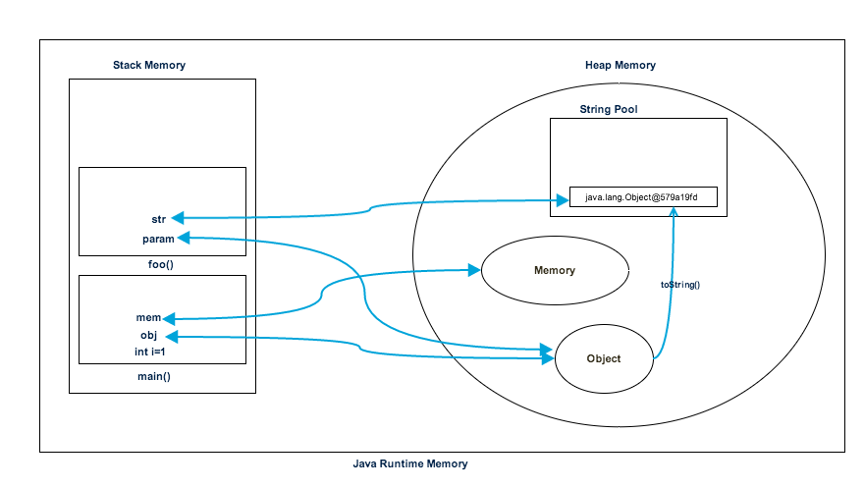
Answers
The object will not be garbage collected immediately, as it still has an active reference elsewhere. It will remain in the Heap until all references to it are lost, and the Garbage Collector identifies it as unreachable.

Slide 9
Memory allocation examples
Arrays
int[] arr = new int[2];
Stack:
A reference to the memory address in the heap is stored. This reference points to an array in the heap that contains 5 int values.
Heap:
5 memory cells of type int are allocated consecutively.
The value of each cell is initialized to 0 by default.
int[][] matrix = new int[2][1];
Heap:
First, an array of 3 references (for the 3 rows) is allocated in the heap. This array only stores references to arrays of 4 integers (representing the rows).
Then, for each of these rows, a 4-element array is allocated in the heap.
1000
0
1004
0
1008
100C
1018
1010
1020
1014
matrix
100C
FFF4
1018
arr
1000
FFF8
0
101C
FFFC
1020
0
1024

Slide 10
Memory allocation examples
class Employee {
String name;
private int id;
static String companyName = "TechCorp"; // Static variable
public Employee(String name, int id) {
this.name = name;
this.id = id;
}
public void sayWelcome() {
String wel = new String(" Welcome " );
System.out.println(wel + name);
}
}

Slide 11
Memory allocation examples
public class MemoryAllocationDemo {
public static void main(String[] args) {
// Creating Employee object (Heap)
Employee emp1 = new Employee("Alice", 101);
// Copying the object (Shallow copy)
Employee emp2 = emp1;
// Changing emp1's details
emp1.name = "Bob"; // emp2's name will also be "Bob" because it's a shallow copy
emp1.sayWelcome();
}
}
“Alice”
X
String pool
"TechCorp"
Y
“Bob”
Z
companyName
(Static Memory)
Y
heap
stack
1000
name
X
1004
Z
id
101
1008
FFE4
100C
wel
100C
FFE8
“Welcome”
1010
FFEC
FFEC
FFF0
FFEC
emp2
1000
FFF4
1000
emp1
1000
FFF8
1000
FFFC
What if we had an array of employees?

Slide 12
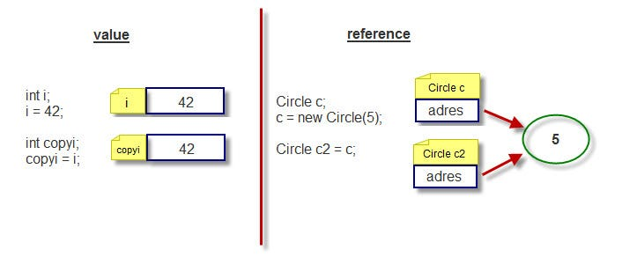
Primitive vs. Reference Types
Primitive types
Primitive types in Java store the actual value of the data.
These types includes: int, float, double, Boolean, char, byte, short, long.
They have a fixed value and are not dependent on any object or structure.
They are stored in the Stack and consume less memory.
Reference types
Reference types in Java store the address of an object in memory,
not the object itself.
These types can include classes (objects), arrays, and interfaces.
The object is stored in the Heap, and its address is stored in the Stack.

Slide 13
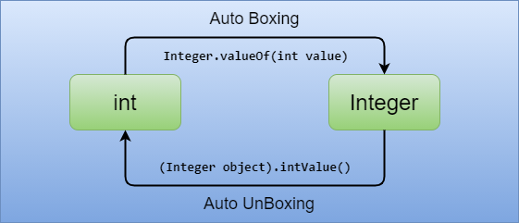
Autoboxing and Unboxing
Autoboxing
Autoboxing happens when a primitive type is automatically converted to its corresponding reference type.
This automatic conversion is handled by the Java compiler, so you don’t need to do it manually.
int num = 10;
Integer obj = num; // Autoboxing: automatic conversion from int to Integer
Unboxing
Unboxing happens when a reference type is automatically converted to its corresponding primitive type.
This conversion is also done automatically by the compiler.
Integer obj = 10;
int num = obj; // Unboxing: automatic conversion from Integer to int

Slide 14
Questions
What will be the output of the following code, and why?
Integer num1 = 200;
Integer num2 = 200;
System.out.println(num1 == num2);
Break down the code below and explain the process it follows
Integer a = 5;
Integer b = 10;
Integer sum = a + b; // Autoboxing and unboxing occur here.

Slide 15
Answers
A) The output will be false.
Explanation: In Java, Integer objects are cached for values between -128 and 127. For values outside this range, new Integer objects are created, and therefore, they will not refer to the same memory address.
num1 == num2 compares the memory addresses (references) of the two Integer objects, and since they are different objects (for the value 200), the result is false.
To compare the actual values of the two Integer objects, you should use the equals() method instead.
B)
Unboxing: a and b are unboxed from Integer objects to primitive int values (5 and 10).
Addition: The operation a + b is performed as a regular int operation (5 + 10), resulting in 15.
Re-boxing: The result 15 is boxed back into a new Integer object (Integer sum = 15).

Slide 16
Equals() vs ==
== operator
The == operator is used to compare primitive types by their values and reference types by their memory addresses (i.e., whether they refer to the same object in memory).
For primitive types, == compares the actual values.
For reference types (objects), == checks if two references point to the exact same object in memory (reference comparison).
🔹 Example with primitives:
int a = 5;
int b = 5;
System.out.println(a == b); // true, compares values
🔹 Example with reference types:
String str1 = new String("Hello");
String str2 = new String("Hello");
System.out.println(str1 == str2); // false, compares memory addresses (different objects)

Slide 17
Equals() Method
Equals() Method
The Equals() method is defined in the Object class, and it is used to compare the contents or values of objects, not their memory addresses.
By default, equals() behaves like == (i.e., comparing references), but it can be overridden in a class to compare the actual data inside the objects.
🔹 Example with reference types:
String str1 = new String("Hello");
String str2 = new String("Hello");
System.out.println(str1.equals(str2)); // true, compares values (contents of the strings)

Slide 18
Wrapper Classes
Wrapper classes are used to wrap primitive types into objects. Java provides a wrapper class for each primitive type.
Why use wrapper classes?
Object storage: Wrapper classes are useful when you need to store primitive values in collections like ArrayList, which can only store objects.
Utility methods: Wrapper classes come with useful methods, such as:
parseInt(), parseDouble() for parsing strings into primitive types.
toString(), equals(), and compareTo() for object manipulation.
Nullability: A wrapper class can be null, while a primitive type cannot. This is useful in some situations like database operations where a field might not have a value.
primitive | reference
int | Integer
char | Character
double | Double
Boolean | Boolean
byte | Byte

Slide 19
Junit and debugging
JUNIT
What it is: JUnit is a popular testing framework for Java applications.
Purpose: It helps developers write and run unit tests to ensure that individual parts of the application (like methods or functions) work correctly.
Annotations: Key annotations in JUnit include @Test (marks a method as a test case), @Before (setup before tests), and @After (cleanup after tests).
Assertions: Methods like assertEquals() and assertTrue() are used to check the correctness of test results.
JUnit Versions: JUnit 4 and 5 are the most commonly used versions. JUnit 5 is the latest, offering more features and improvements over JUnit 4.

Slide 20
Junit and debugging
Debugging
What it is: Debugging is the process of identifying and fixing issues (bugs) in a program.
Tools: IDEs like IntelliJ IDEA or Eclipse offer built-in debuggers for step-by-step execution and variable inspection.
Common techniques:
Breakpoints: Pause the execution of code at certain points to inspect the state.
Watch variables: Track changes to specific variables during runtime.
Step Over/Into/Out: Control the execution flow to analyze how the code is working or where it fails.
Logging: Adding log statements can also help trace the flow and identify errors.

Slide 21
build automation with Maven
Maven is a build automation and project management tool primarily used for Java projects. It uses a Project Object Model (POM) file (pom.xml) to manage dependencies, build configurations, and project metadata. Maven simplifies tasks like compiling code, packaging applications, and managing libraries.
Using Maven in IntelliJ IDEA:
Add dependencies inside the <dependencies> tag in pom.xml (You can find packages in Maven website).
<dependency>
<groupId>org.apache.commons</groupId>
<artifactId>commons-lang3</artifactId>
<version>3.12.0</version>
</dependency>
Use the Maven tool window (usually on the right side of IntelliJ) or CLI commands.
Run lifecycle commands like clean, compile, package.

Slide 22
Exercise (memory allocation)
public class MemoryAllocationExample {
static class Person {
String name;
int age;
public Person(String name, int age) {
this.name = name;
this.age = age;
}
public void displayInfo() {
System.out.println("Name: " + name + ", Age: " + age);
}
}
public static void main(String[] args) {
int[] numbers = new int[5];
Person person1 = new Person("Alice", 25);
Person person2 = new Person("Bob", 30);
Person[] people = new Person[2];
people[0] = person1;
people[1] = person2;
System.out.println("Using object references:");
for (Person person : people) {
person.displayInfo();
}
System.out.println("\nUsing integer array:");
for (int i = 0; i < numbers.length; i++) {
numbers[i] = i * 10;
System.out.println("numbers[" + i + "] = " + numbers[i]);
}
}
}

Slide 23
Time to code 1
Modify Banking System from previous session to work with Junit and use Maven as package manager.

Slide 24
Time to code 2
Student Management System with classes for Student, Course, Professor, Enrollment
Student: Represents a student with attributes like studentID, name, major, grades.
Course: Represents a course with attributes like courseID, courseName, credits.
Professor: Represents a professor with professorID, name, and a list of courses they teach.
Enrollment: Tracks which students are enrolled in which courses.

Slide 25



پایان

