Slide 1



برنامه نویسی پیشرفته
رفع اشکال: جلسه 7
Exceptions
Streams
Try-with-Resources
Generics

Slide 2
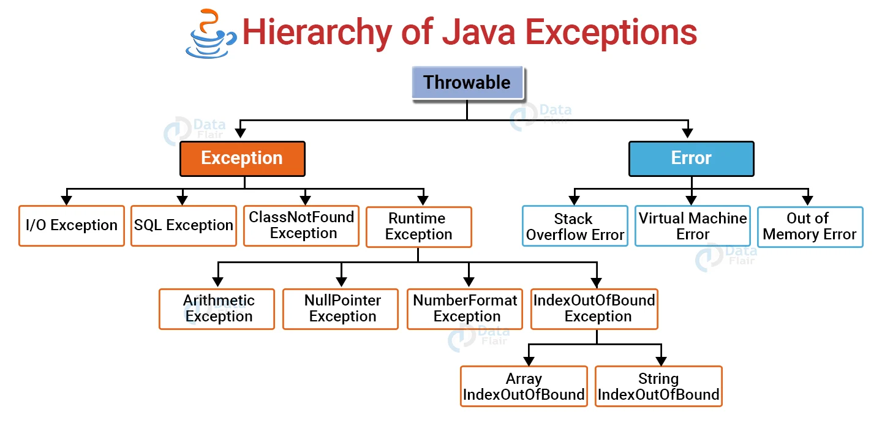
Exception Handling – Basics
Definition: Mechanism to handle runtime errors
Types:
Checked Exceptions (e.g., IOException)
Unchecked Exceptions (e.g., NullPointerException)

Slide 3
try/catch/finally
try {
// risky code
} catch (ExceptionType e) {
// handle error
} finally {
// always executes
}
try: Wraps code that might throw exceptions
catch: Handles exceptions
finally: Executes regardless of exception

Slide 4
Custom Exceptions
class MyException extends Exception {
public MyException(String message) {
super(message);
}
}
Why? For meaningful, domain-specific error handling

Slide 5
Exception Handling – Questions
Q1. What is the difference between checked and unchecked exceptions?
Q2. Will the finally block execute if there’s a return in the try block?

Slide 6
Answers – Exception Handling
A1.
Checked exceptions are checked at compile-time (e.g., IOException) and must be declared or handled.
Unchecked exceptions are subclasses of RuntimeException (e.g., NullPointerException) and are not checked at compile time.
A2.
Yes, the finally block will always execute, even if there is a return in the try or catch block, unless the JVM exits or the thread is killed.

Slide 7
Try-with-Resources
Introduced in Java 7
Automatically closes resources
try (FileReader fr = new FileReader("file.txt")) {
// use resource (calls fr.close() automatically at the end)
} // (calls fr.close() automatically at the end)
Resource must implement AutoCloseable

Slide 8
Try-with-Resources – Questions
Q1. What are the advantages of using try-with-resources?
Q2. What happens if both the try block and the close() method throw exceptions?

Slide 9
Answers – Try-with-Resources
A1.
Automatic resource management
Cleaner and less error-prone code
Ensures resources are closed properly even if an exception is thrown
A2.
The exception from the try block is thrown.
The exception from close() is suppressed and can be retrieved using getSuppressed() on the thrown exception.

Slide 10
File Streams in Java
Java I/O File Streams:
Handle reading and writing of files
Work with bytes (binary) or characters (text)
try (BufferedReader reader = new BufferedReader(new FileReader("data.txt"))) {
String line;
while ((line = reader.readLine()) != null) {
System.out.println(line);
}
} catch (IOException e) {
e.printStackTrace();
}

Slide 11
Byte Streams vs Character Streams
Feature | Byte Streams | Character Streams
Used For | Binary data (images, PDFs, etc.) | Text data (characters, strings)
Base Classes | InputStream / OutputStream | Reader / Writer
Encoding Awareness | Not aware of character encoding | Handles encoding (e.g., UTF-8, UTF-16)
Examples | FileInputStream, BufferedOutputStream | FileReader, BufferedWriter
Use Case Example | Reading a .jpg file | Reading a .txt file
Use Buffered variants (BufferedReader, BufferedInputStream, etc.) for better performance!

Slide 12
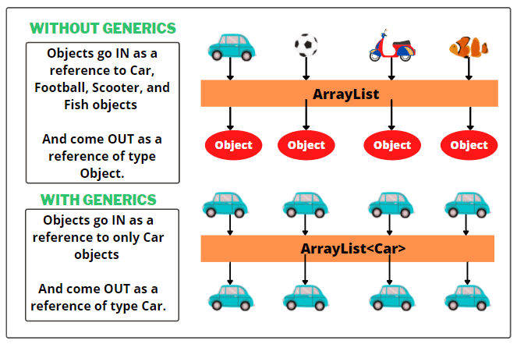
Stream API Basics
Introduced in Java 8 for functional-style operations on collections
Stream pipeline: Source → Intermediate Ops → Terminal Op
List<String> names = List.of("Alice", "Bob");
names.stream()
.filter(n -> n.startsWith("A"))
.forEach(System.out::println);

Slide 13
Generics – What and Why?
Allow type parameters for classes & methods
Prevents runtime ClassCastException
List<String> list = new ArrayList<>();

Slide 14
Generic Methods & Classes
class Box<T> {
T value;
void set(T value) { this.value = value; }
T get() { return value; }
}
<T> void printArray(T[] array) {
for (T item : array) System.out.println(item);
}

Slide 15
Generics – Questions
Q1. What are the benefits of using generics in Java?
Q2. How do generic methods differ from regular methods?

Slide 16
Answers – Generics
A1.
Type safety (compile-time checks)
Eliminates need for casting
Reusability of code for different data types
A2.
Generic methods define their own type parameters (<T>)
These can be used independently of the class's generic type (if any)
They're more flexible for utility-type operations

Slide 17
Time to Code
We'll look at a short program that demonstrates:
Custom exception for invalid age
Reading from a file using try-with-resources
Generic method to print a list of valid ages

