Slide 1



برنامه نویسی پیشرفته
رفع اشکال: جلسه ۱۰
JavaFX Application Structure
UI Controls and Events
FXML and CSS
Properties and Bindings
Multimedia and animations
Concurrency

Slide 2
JavaFX Application
JavaFX is Oracle’s official Java library for building rich-client desktop applications with modern UI controls, 2D/3D graphics, and multimedia support. A JavaFX application typically consists of the following components:
Application Class: The entry point of any JavaFX application, extending the Application class.
Stage: Represents the primary window of the application.
Scene: Holds the UI elements (nodes) and is set on the stage.
Nodes: The UI components like buttons, labels, etc.

Slide 3
Hello, JavaFX!
import javafx.application.Application;
import javafx.scene.Scene;
import javafx.scene.control.Label;
import javafx.stage.Stage;
public class HelloFX extends Application {
@Override
public void start(Stage primaryStage) {
Label label = new Label("Hello, JavaFX!");
Scene scene = new Scene(label, 300, 200);
primaryStage.setScene(scene);
primaryStage.setTitle("HelloFX");
primaryStage.show();
}
public static void main(String[] args) {
launch(args);
}
}

Slide 4
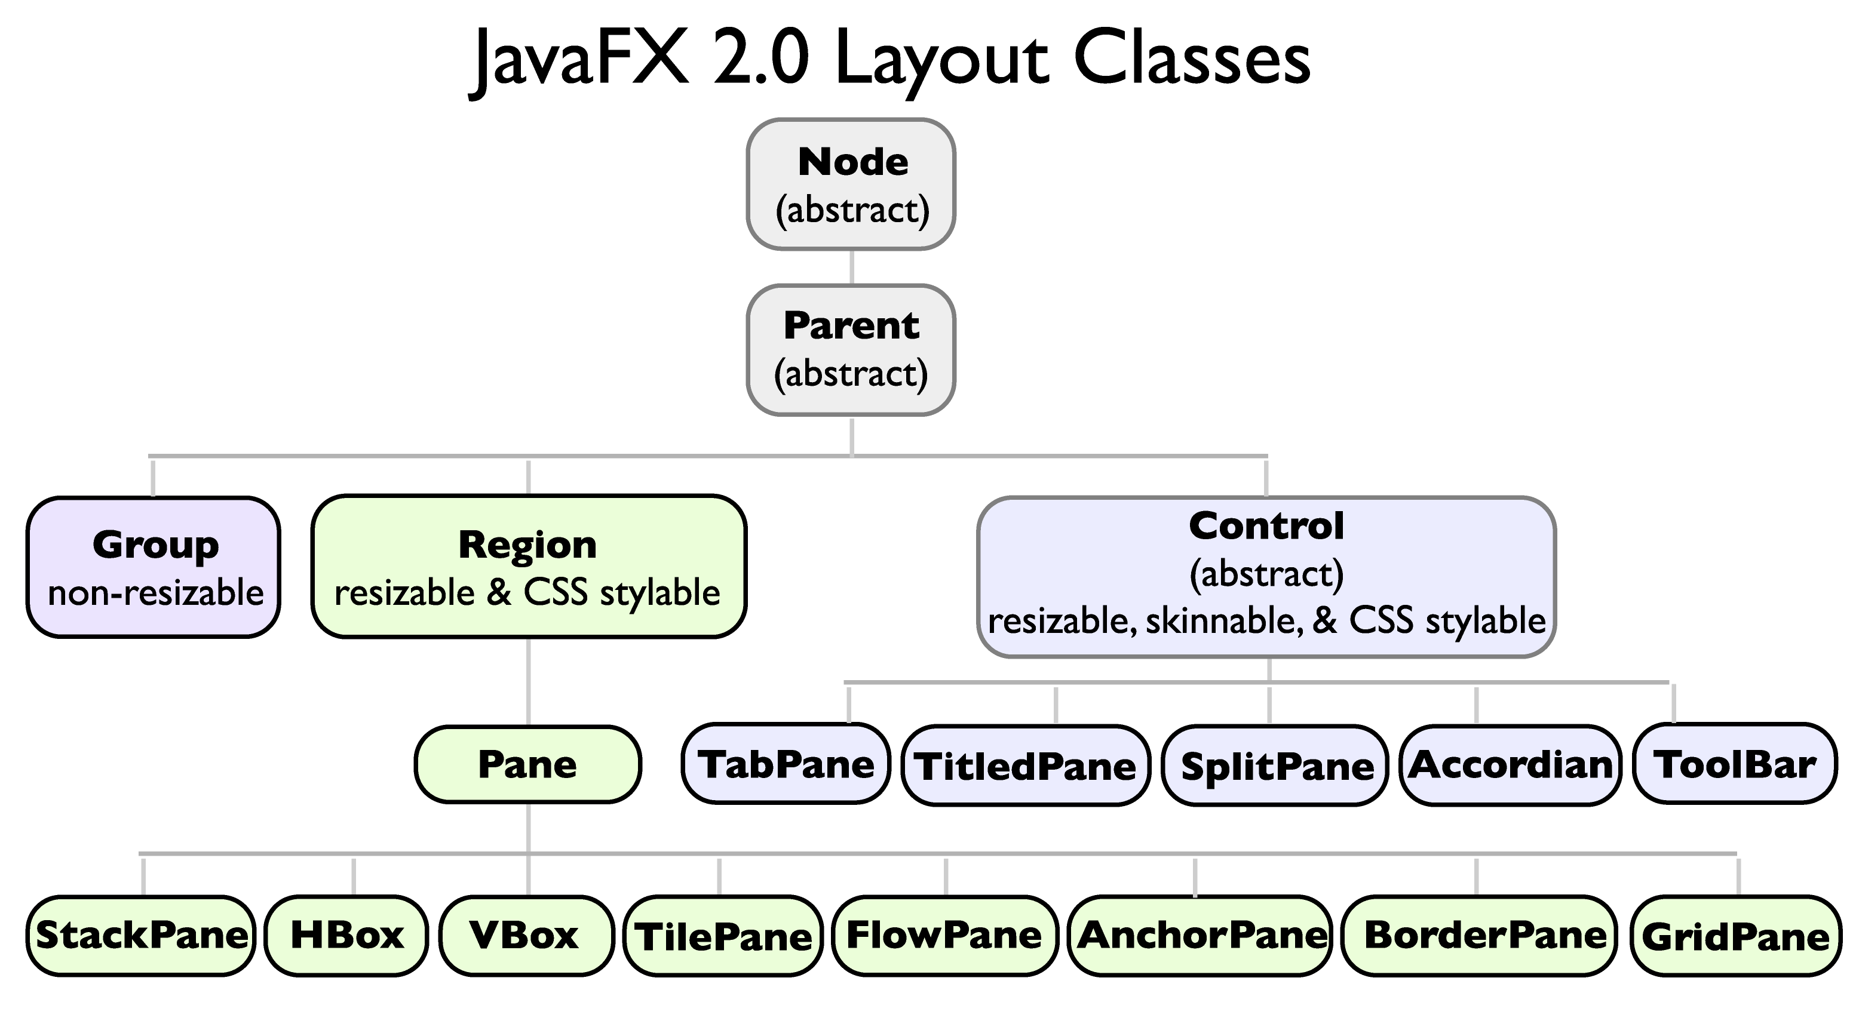
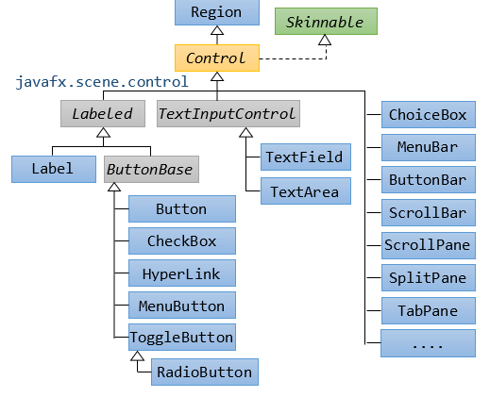
UI Nodes
JavaFX provides a rich set of UI controls, including buttons, labels, text fields, checkboxes, and more. These controls can handle user interactions through event handling mechanisms.

Slide 5
UI Controls and Layouts
Component | Description | Component | Description
Button | A clickable control used to perform an action. | Label | Displays non-editable text, often used to describe other controls.
TextField | Allows single-line text input from the user. | CheckBox | Represents a boolean option that can be toggled on or off.
ComboBox | Provides a dropdown list for selecting one item from multiple choices. | ListView | Displays a scrollable list of items, allowing single or multiple selections.
HBox | Arranges its children in a single horizontal row. | VBox | Arranges its children in a single vertical column.
GridPane | Lays out its children within a flexible grid of rows and columns. | BorderPane | Divides the layout into five regions: top, bottom, left, right, and center.

Slide 6
FXML and scene builder
FXML is an XML-based language that allows you to define the UI structure separately from the application logic in a controller class.
<?xml version="1.0" encoding="UTF-8"?>
<?import javafx.scene.control.Button?>
<?import javafx.scene.layout.StackPane?>
<StackPane xmlns:fx="http://javafx.com/fxml" stylesheets="@style.css">
<Button text="Click Me!" fx:id="myButton" styleClass="custom-button"/>
</StackPane>
public class MyController {
@FXML
private Button myButton;
@FXML
private void initialize() {
myButton.setOnAction(e -> System.out.println("Button Clicked from FXML!"));
}}
// To load the fxml:
FXMLLoader loader = new FXMLLoader(getClass().getResource("layout.fxml"));
Parent root = loader.load();
Scene scene = new Scene(root);

Slide 7
CSS
JavaFX allows you to style your UI components using CSS, similar to web development.
/* style.css for previous page example */
.custom-button {
-fx-font-size: 16px;
-fx-background-color: linear-gradient(to bottom, #00c6ff, #0072ff);
-fx-text-fill: white;
-fx-padding: 10 20 10 20;
-fx-background-radius: 8;
}

Slide 8
Media
JavaFX supports playing audio and video files using the Media and MediaPlayer classes.
String path = "path_to_video.mp4";
Media media = new Media(new File(path).toURI().toString());
MediaPlayer mediaPlayer = new MediaPlayer(media);
MediaView mediaView = new MediaView(mediaPlayer);
StackPane root = new StackPane(mediaView);
Scene scene = new Scene(root, 640, 480);
primaryStage.setScene(scene);
primaryStage.setTitle("Media Example");
primaryStage.show();
mediaPlayer.play();

Slide 9
animations
JavaFX provides several classes for creating animations, such as FadeTransition, TranslateTransition, RotateTransition, and more.
Label label = new Label("Fading Text");
FadeTransition fade = new FadeTransition(Duration.seconds(2), label);
fade.setFromValue(1.0);
fade.setToValue(0.0);
fade.setCycleCount(FadeTransition.INDEFINITE);
fade.setAutoReverse(true);
fade.play();
StackPane root = new StackPane(label);
Scene scene = new Scene(root, 300, 200);
primaryStage.setScene(scene);
primaryStage.setTitle("Animation Example");
primaryStage.show();

Slide 10
Javafx threads
JavaFX uses a multi-threaded architecture to keep UIs responsive by separating rendering, event handling, and background work across distinct threads. The JavaFX Application Thread handles all UI updates and event dispatching.
Thread | Role | UI Access? | Primary Use
Application | Live scene‑graph & events | Yes | Scene graph updates
Launcher | Startup & init() | No | Bootstrap FX runtime
Prism Render | Frame rendering | No | Graphics pipeline
Media | Audio/video decode | No | Media playback
Pulse | 60 Hz heartbeat | No | Layout/CSS/animation tick
Background | Worker threads | No | I/O, tasks, computation

Slide 11
Concurrency
In JavaFX, long-running tasks should not be executed on the JavaFX Application Thread, as this can make the UI unresponsive. Instead use:
Task<V> – For Background Work
Task is a JavaFX class for running long or blocking operations off the UI thread.
Platform.runLater(Runnable) – For UI Updates from Any Thread
Note that JavaFX UI can only be safely updated from its main thread.
Platform.runLater(() -> button.setText("Updated!"));

Slide 12
Time to code
Do a full JavaFX Snake game example, complete with:
Initialization of game state
Animation loop
directional movement
Collision detection
game-over logic
Score display
automatic restart

Slide 13



پایان

