Slide 1



برنامه نویسی پیشرفته
رفع اشکال: جلسه ۹
Socket Programming Basics of TCP/UDP sockets.
Building a simple client-server application.
Introduction to Http

Slide 2
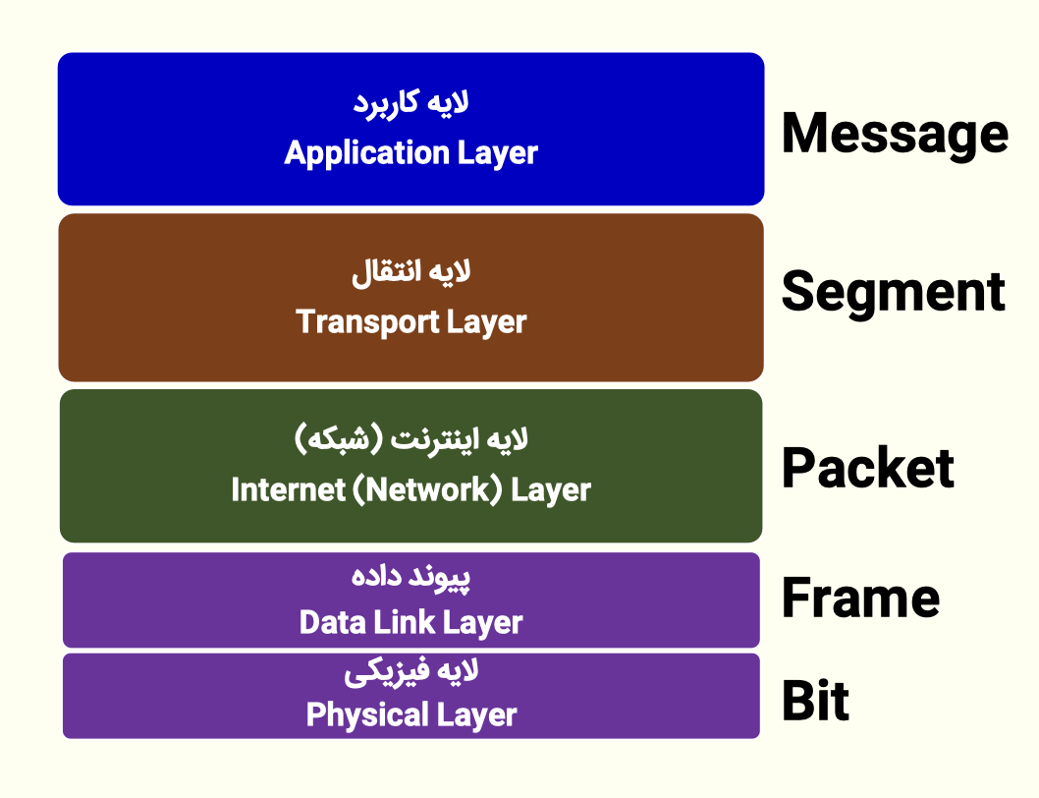
Network architecture
A network architecture is a set of layers and protocols used to reduce network design complexity.
Each layer is connected only to the two layers above and below it.
The service of each layer to the higher layer is data transfer.
Each layer has a specific task routing, error control, or ...
Each layer in the source node has a protocol with its corresponding layer in the destination node to perform its tasks.

Slide 3
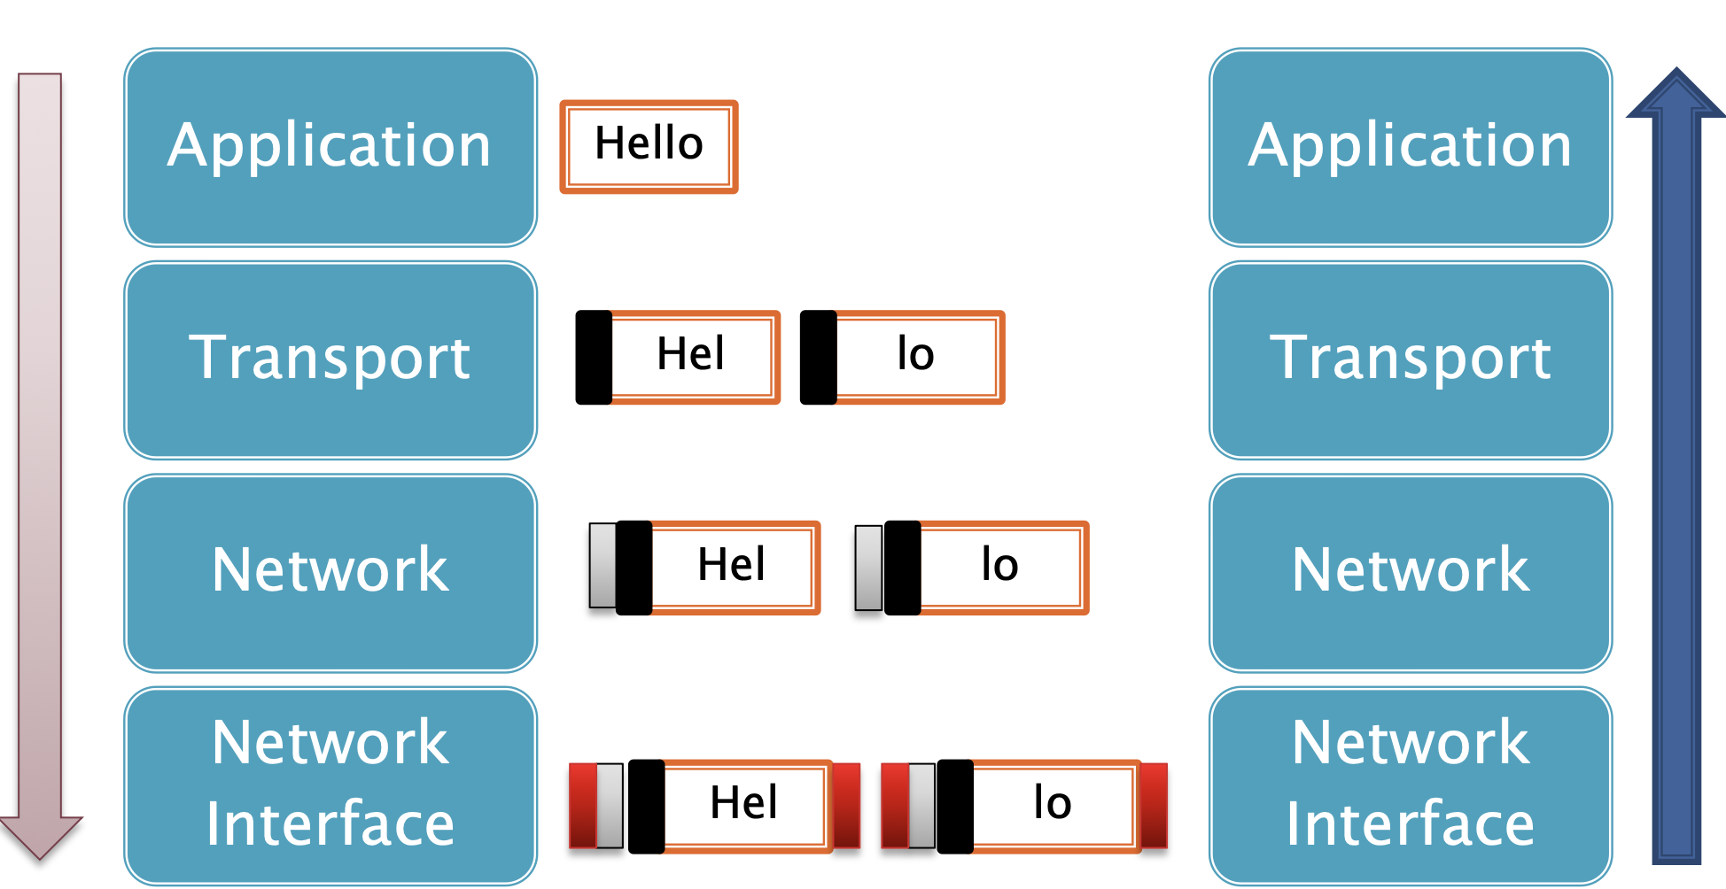
TCP/IP model
Application Layer : Where user applications such as browsers, chat clients, or Java applications work with data. Transport Layer : This layer breaks data into smaller pieces called segments and is responsible for ensuring that they are sent correctly and in the correct order. Internet/Network Layer : Adding the destination and source IP addresses so the packet knows where to go. Data Link Layer : Responsible for packet delivery between two direct nodes on the network (e.g. two devices on a LAN) via MAC address. Physical Layer : At this layer, data is converted into bits (0 and 1) and transmitted as electrical, optical, or wave signals over a cable or Wi-Fi.

Slide 4
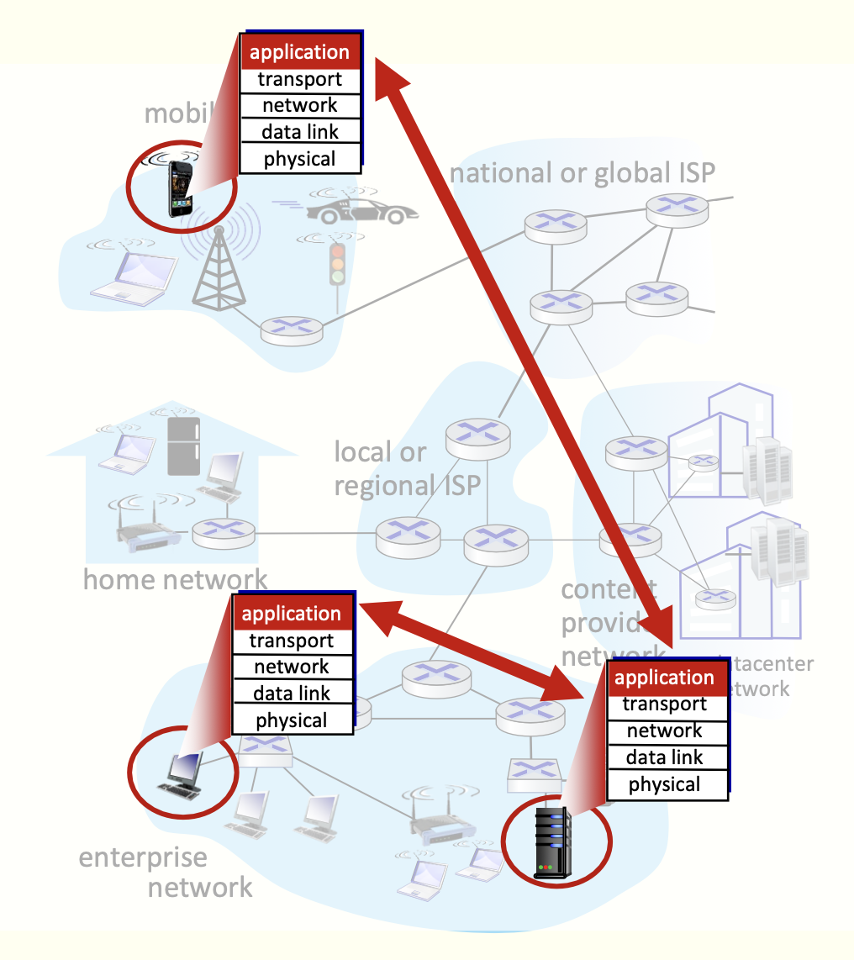
Client-Server model
Applications have only one of two roles: server or client.
Servers :
Are always running and ready to serve.
Static IP address
Has a permanent connection to the Internet.
Often in data centers for scalability and to reduce running costs
Clients
Must already have the IP address and port number of the server
By sending a message to the server, they announce their request to receive the service.
May not have a static IP address.
May not have a permanent connection to the Internet.

Slide 5
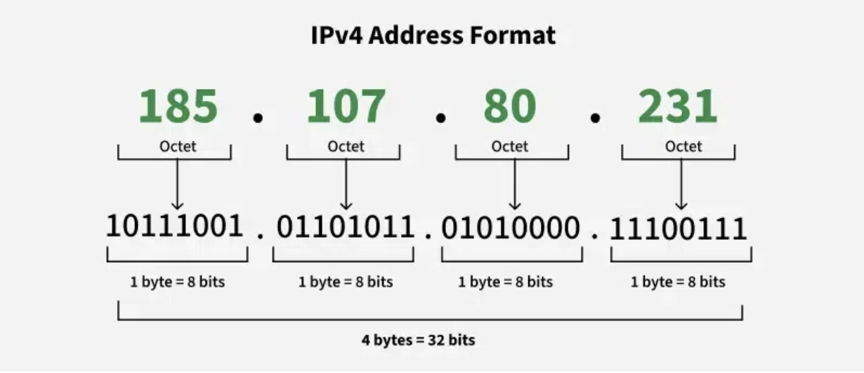
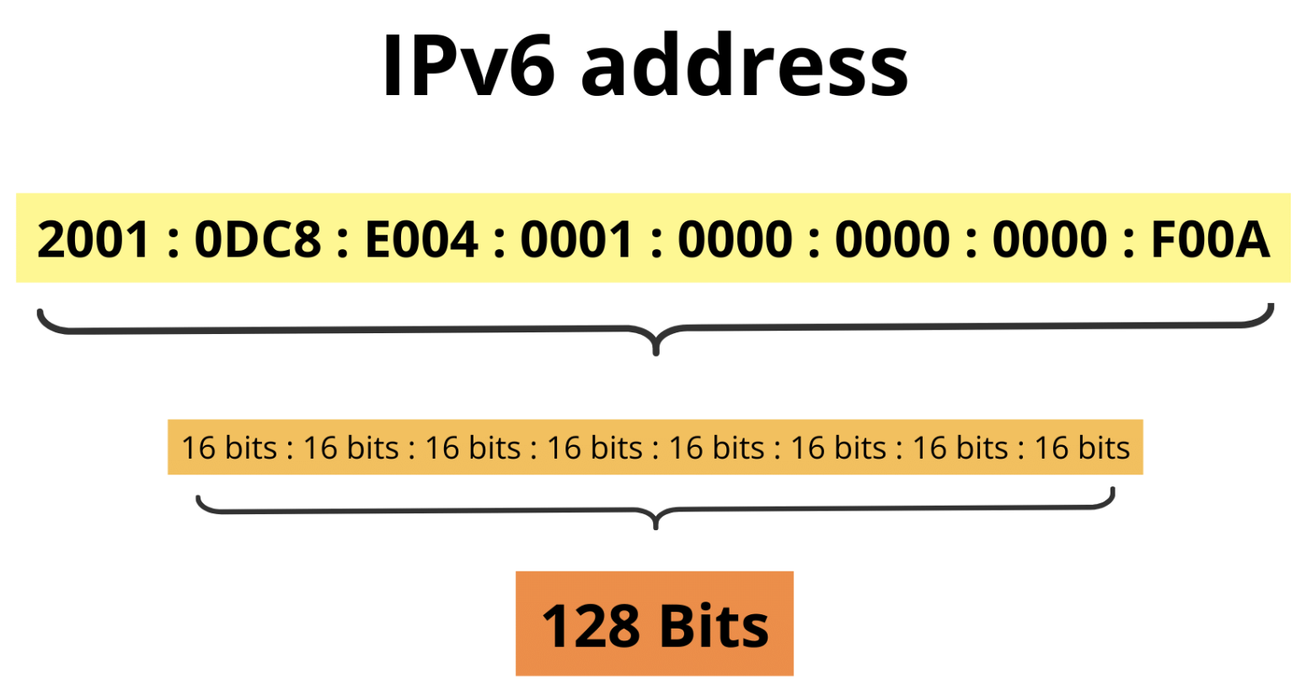
IP Address
An IP address is a unique numerical identifier assigned to each device on a network to allow communication between nodes.
Like a postal address, an IP address helps systems send data to the correct destination.

Slide 6
POrt
A port is a 16-bit number (between 0 and 65535) used as an identifier for a service or process on a device
When data arrives at a device, the IP specifies which device, and the port specifies which program receives it.
Well-Known Ports : Range 0 to 1023 Reserved by IANA for basic and universal services . Protocols and services that must be available on all systems and networks operate on this range of ports. Dynamic / Private Ports (Ephemeral) : Range: 49152 to 65535 Allocator: Automatically by the operating system When a client wants to establish a temporary connection, the OS itself selects a free port.
These ports are used only for the duration of the connection.

Slide 7
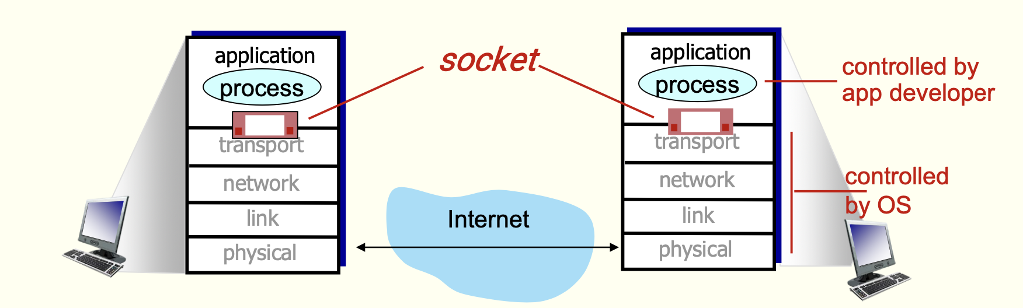
SOCKET
A socket is a software endpoint between two processes that communicate over a network using a transport protocol (such as TCP or UDP) on two different machines or on the same machine.
In fact, a socket is a point in the Application Layer through which data is input/output, and the operating system is responsible for transferring it through the lower layers (Transport, Network, Link, Physical).

Slide 8
note
In Java, when you use Socket, you are essentially saying to the OS:
"Please open a communication port for me to talk to another program on another system."
The OS:
Manages buffers
Does the packaging and addressing
Provides a stable and secure TCP connection or a fast and simple UDP connection
A socket is a logical gateway between your application and the network; not a physical connection

Slide 9
Protocol
A protocol is a set of rules for transferring data. In socket writing, it is usually chosen between TCP and UDP.
Feature | TCP (Transmission Control Protocol) | UDP (User Datagram Protocol)
Connection-oriented | Yes (connect(), handshake required) | No (connectionless)
Delivery guarantee | Guaranteed | Not guaranteed
Order of data | Ordered delivery | May arrive out of order
Speed | Slower (due to reliability checks) | Faster (no delivery assurance)
Overhead | Higher | Lower
Java Usage | Socket, ServerSocket | DatagramSocket, DatagramPacket

Slide 10
TCP
Server
public static void main(String[] args) {
try {
ServerSocket serverSocket = new ServerSocket(6000);
System.out.println("Server is listening...");
Socket client = serverSocket.accept();
System.out.println("connected to a client");
System.out.println(client.getPort());
} catch (IOException exception) {
exception.printStackTrace();
}
}
Client public static void main(String[] args) {
try {
Socket socket = new Socket("127.0.0.1", 6000);
System.out.println(socket.getInetAddress());
} catch (IOException exception) {
exception.printStackTrace();
}
}
* The accept method is a blocking method and the following lines will not be executed until the client connects to the server

Slide 11
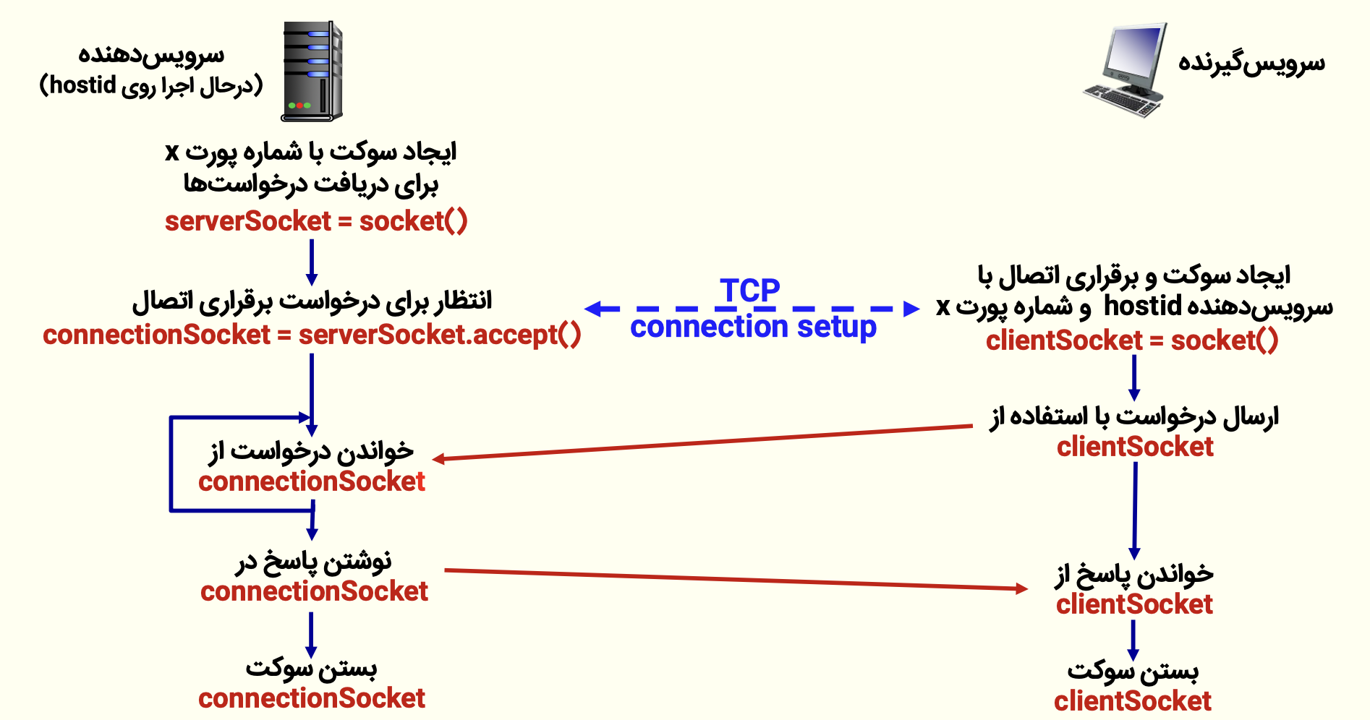
TCP Diagram

Slide 12
UDP
USAGE : Very high speed and tolerance for some packet loss For VoIP & online gaming
Client DatagramSocket socket = new DatagramSocket();
String msg = "Hello UDP";
DatagramPacket packet = new DatagramPacket(msg.getBytes(),msg.length(),InetAddress.getByName("localhost"), 6000);
socket.send(packet);
Server DatagramSocket serverSocket = new DatagramSocket(6000);
byte[] buffer = new byte[1024];
DatagramPacket packet = new DatagramPacket(buffer, buffer.length);
serverSocket.receive(packet);
System.out.println("Received: " + new String(packet.getData()));

Slide 13
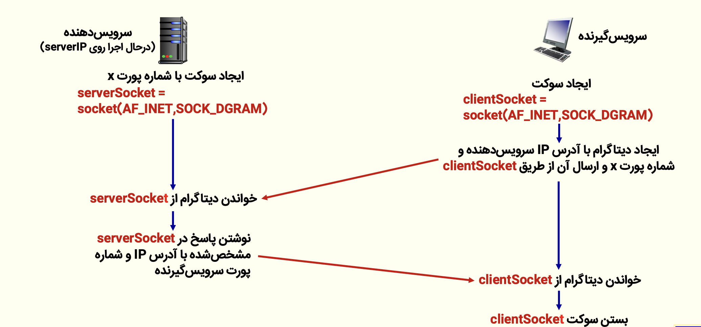
UDP Diagram

Slide 14
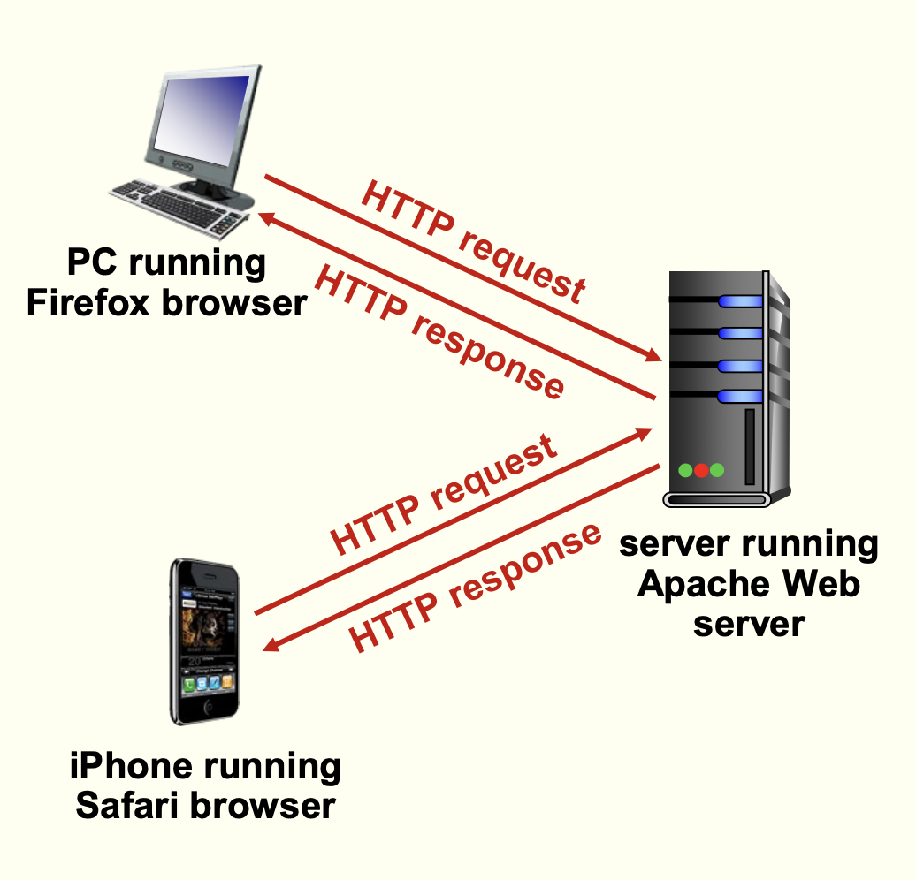
Introduction to http
(HyperText Transfer Protocol) is an application-layer protocol used to transfer hypertext (like HTML) over the web between clients and servers
Client
The web browser uses the HTTP protocol to request web objects.
The web browser displays the received web pages in response to its requests.
Server
The web server uses the HTTP protocol to send web pages in response to the client's requests.
HTTP is just data sent in a specific format over TCP. And just the appearance of the exchange, but its transport is the responsibility of TCP and sockets.

Slide 15
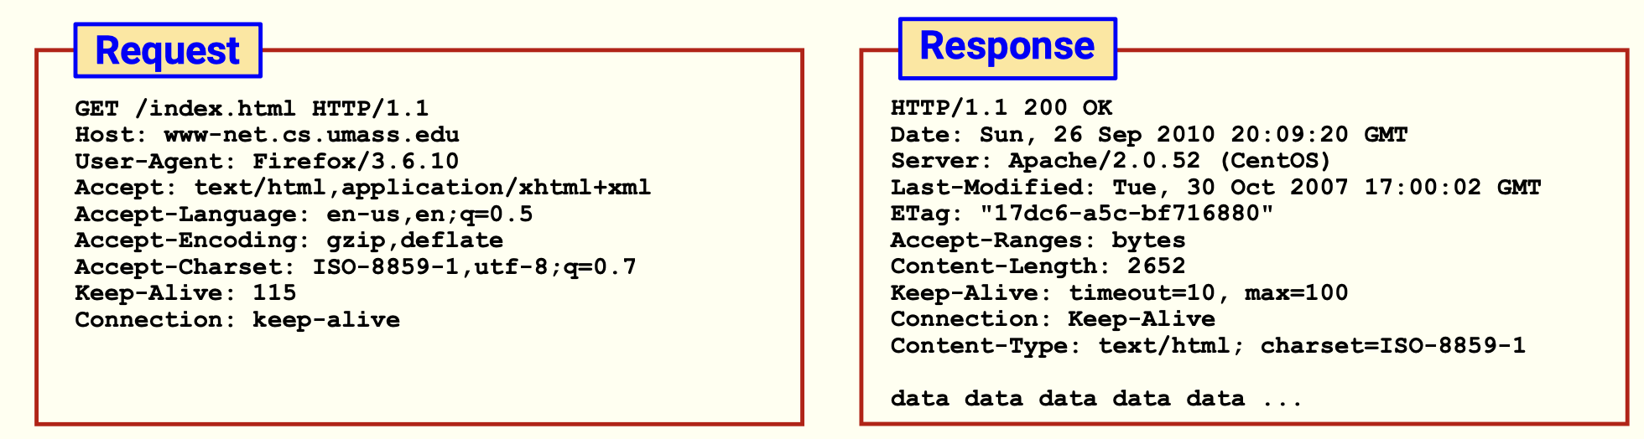
http methods
Method | Purpose
GET | Retrieve data from server (read-only)
POST | Submit data (e.g., form submission)
PUT | Update or replace a resource
DELETE | Remove a resource
HTTP is stateless ! Because each request is independent and the server does not remember previous requests unless you use mechanisms like cookies or sessions.

Slide 16
Question
Choose the correct statements
1) By executing the accept method in the Socket class, the server's desired conditions are agreed upon and the connection is established.
2) The length of the IP address (version (IPv4)) is exactly 32 bits.
3) In a single-threaded Java program, it is not possible to easily send or receive messages to multiple users simultaneously.
4) To create a socket and connect to the server, it is enough to have the port of that server.

Slide 17
answer
1) False The Socket class is for the client. The accept() method is for the ServerSocket class. So this option is technically wrong. 2) True IPv4 addresses are made up of 4 8-bit numbers (such as 192.168.1.1), totaling 32 bits. 3)True In single-threaded applications, it is difficult to accept and respond to simultaneous requests from multiple users because there is only one execution path. 4) False To connect to a server, we need both the IP address and the port number. The port alone is not enough.

Slide 18



پایان

