Slide 1



برنامه نویسی پیشرفته
رفع اشکال: جلسه ۱
Introduction to Java and JDK
Basic syntax, control flow, classes and objects
Constructors, getters, setters, and encapsulation
Class Diagram
Examples

Slide 2
Java
Java is a high-level, class-based, object-oriented programming. It is intended to let application developers write once, run anywhere (WORA), meaning that compiled Java code can run on all platforms that support Java without the need for recompilation.
Java Development Kit (JDK):
Compiler (javac): Converts Java source code into bytecode.
Java Runtime Environment (JRE): Provides libraries, JVM, and other components.
Java Virtual Machine (JVM): An abstract machine that enables your computer to run a Java program
Java Archive Tool (jar): Packages multiple files into a single JAR archive.

Slide 3
Java execution
Write the Source Code:
public class HelloWorld {
public static void main(String[] args) {
System.out.println("Hello, World!");
}
}
Compile the Code:
javac HelloWorld.java
Run the Program:
java HelloWorld
4. Output:
Hello, World!

Slide 4
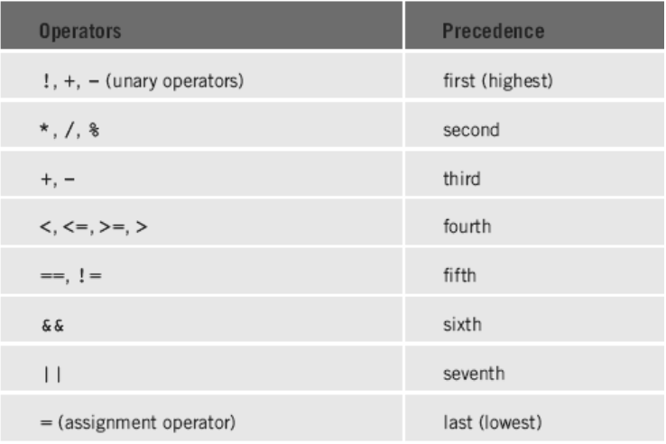
Basic Syntax
Case Sensitivity: Java is case-sensitive; Variable and variable are different identifiers.
Class Names: By convention, class names start with an uppercase letter.
Method Names: Method names start with a lowercase letter.
File Name: The filename must match the class name and have a .java extension.

Slide 5
Conditional Statements
if Statement:
int x = 10;
if (x > 5) {
System.out.println("x is greater than 5");
}
if-else Statement:
int x = 10;
if (x > 5) {
System.out.println("x is greater than 5");
} else {
System.out.println("x is less than or equal to 5");
}

Slide 6
Switch Statements
switch Statement:
int day = 3;
switch (day) {
case 1:
System.out.println("Monday");
break;
case 2:
System.out.println("Tuesday");
break;
case 3:
System.out.println("Wednesday");
break;
default:
System.out.println("Invalid day");
break;
}
Enhanced switch is also supported in java with (->) notation.

Slide 7
Loops
for Loop:
for (int i = 0; i < 5; i++) {
System.out.println("i is: " + i);
}
while Loop:
int i = 0;
while (i < 5) {
System.out.println("i is: " + i);
i++;
}
do-while Loop:
int i = 0;
do {
System.out.println("i is: " + i);
i++;
} while (i < 5);

Slide 8
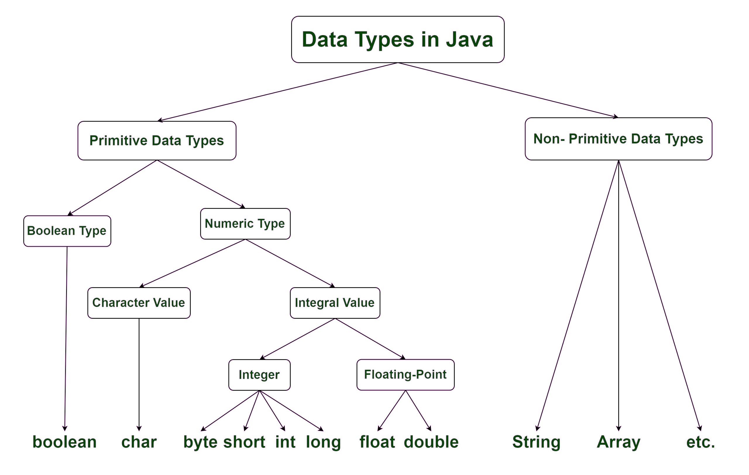
Data Types

Slide 9
Strings
You can create a String using string literals or the `new` keyword.
public class StringExample {
public static void main(String[] args) {
// Creating Strings
String greeting = "Hello, Java!";
String anotherGreeting = new String("Welcome to OOP!");
// Using String methods
System.out.println("Greeting: " + greeting);
System.out.println("Length of greeting: " + greeting.length());
System.out.println("Character at position 1: " + greeting.charAt(1));
System.out.println("Substring (7, 11): " + greeting.substring(7, 11)); // prints "Java“
System.out.println("Concatenated string: " + greeting.concat(" Let's code."));
}
}

Slide 10
Arrays and For-each
An array in Java is a collection of elements of the same data type, stored in a contiguous block of memory.
int[] numbers; // Preferred style
numbers_2 = new int[5]; // Creates an array with default values
int[] numbers_3 = {1, 2, 3, 4, 5};
System.out.println(numbers[0]);
System.out.println(numbers.length);
for (int num : numbers) {
System.out.println(num); // Outputs: 1, 2, 3, 4, 5
}

Slide 11
Scanner
The Scanner class in Java (found in the `java.util` package) is used to capture input from various sources.
import java.util.Scanner;
public class ScannerExample {
public static void main(String[] args) {
Scanner scanner = new Scanner(System.in);
System.out.print("Enter your name: ");
String name = scanner.nextLine();
System.out.print("Enter your age: ");
int age = scanner.nextInt();
System.out.print("Enter your height in meters: ");
double height = scanner.nextDouble();
System.out.println("Hello, " + name + ". You are " + age + " years old and " + height + " meters tall.");
// Close the scanner to free resources
scanner.close();
}
}

Slide 12
Classes and Objects
A class is a blueprint that defines the properties (attributes) and behaviors (methods) common to all
objects of that type.
// Main method to test our class
public static void main(String[] args) {
// Creating objects
Person p1 = new Person("Alice", 30);
Person p2 = new Person("Bob", 25);
// Calling methods
p1.displayInfo();
p2.displayInfo();
}
}
public class Person {
// attributes
private String name;
private int age;
// Constructor
public Person(String name, int age) {
this.name = name;
this.age = age;
}
// Method
public void displayInfo() {
System.out.println("Name: " + name + ", Age: " + age);
}

Slide 13
Constructor
A constructor is a special method used to initialize new objects. It has the following key properties:
Same name as the class.
No return type.
Can be overloaded: You can have multiple constructors with different parameter lists.
public class Car {
private String brand;
private int speed;
public Car() {
this.brand = "Unknown";
this.speed = 0;
}
public Car(String brand, int speed) {
this.brand = brand;
this.speed = speed;
}
}

Slide 14
Encapsulation
Encapsulation is the concept of bundling data (instance variables) and methods that operate on that data into one unit—a class. It also involves hiding the internal state of the object from the outside world. This is usually achieved by:
- Declaring instance variables as private.
- Providing public getter and setter methods to read and modify these variables.
Why Encapsulate?
Control Access: Prevent direct access to the fields so that you can enforce constraints (e.g., a person’s age cannot be negative).
Maintainability: You can change the internal implementation later without affecting classes that use your object.
Data Hiding: Protects the object’s state from unintended interference.

Slide 15
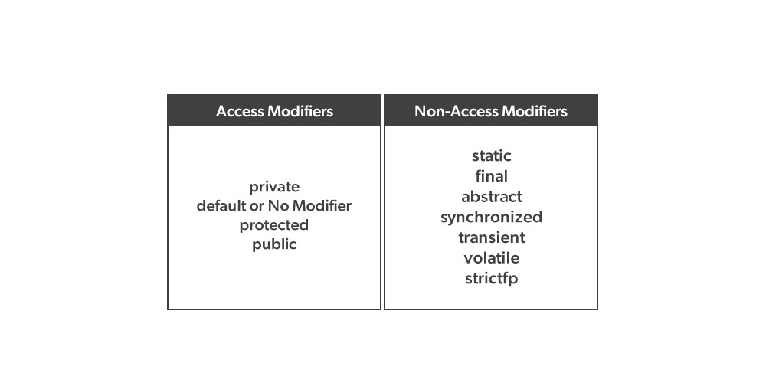
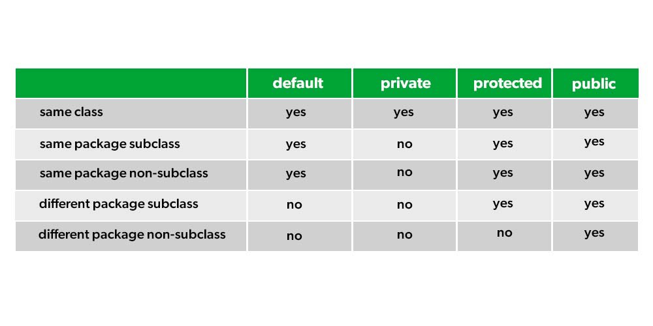
access modifiers and non-access modifiers
Java provides different access modifiers to control the visibility of classes, variables, and methods:
Note that we will learn about non-access modifiers in later chapters.

Slide 16
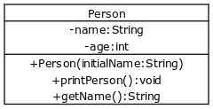
Class Diagrams
A class diagram is a diagram used in designing and modeling software to describe classes and their relationships. Class diagrams enable us to model software in a high level of abstraction and without having to look at the source code.
Note that we will learn about UML in later chapters.
Classes: Represented as rectangles.
Attributes (fields): Listed in the top section (often with a “–” sign if they’re private).
Methods (operations): Listed in the bottom section (with a “+” for public methods).
Object Composition: User-defined types can be used in a class.

Slide 17
Time to Code
Bank:
Develop a Java application that simulates a simple banking system. The system should manage customers and their bank accounts, allowing for basic operations such as account creation, deposits, withdrawals, and fund transfers between accounts.
2. Library
Develop a Library Management System in Java that manages books and members, and allows users to search and borrow books.

Slide 18



پایان

