Slide 1



برنامه نویسی پیشرفته
رفع اشکال: جلسه ۱
Introduction to Java and JDK
Basic syntax, control flow, classes and objects
Constructors, getters, setters, and encapsulation
Class Diagram
Examples

Slide 2
Java
Java is a high-level, class-based, object-oriented programming. It is intended to let application developers write once, run anywhere (WORA), meaning that compiled Java code can run on all platforms that support Java without the need for recompilation.
Java Development Kit (JDK):
Compiler (javac): Converts Java source code into bytecode.
Java Runtime Environment (JRE): Provides libraries, JVM, and other components.
Java Virtual Machine (JVM): An abstract machine that enables your computer to run a Java program
Java Archive Tool (jar): Packages multiple files into a single JAR archive.

Slide 3
Some questions
A) Whats is the difference between JVM , JRE , JDK ?
B) What process does a Java program go through to be executed?

Slide 4
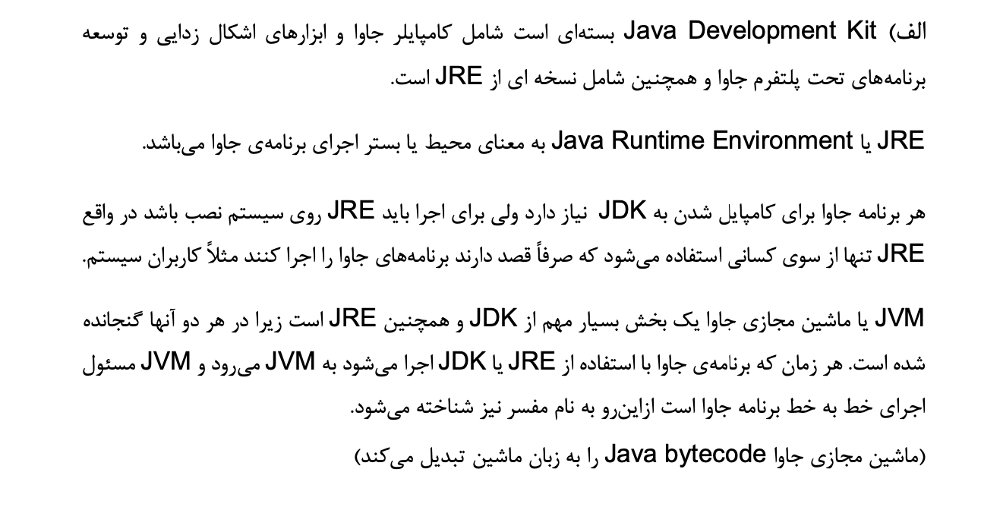
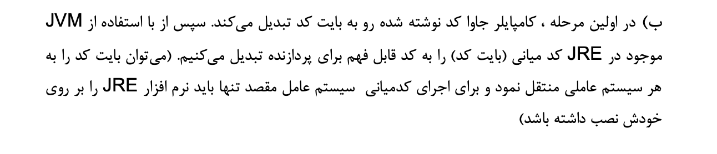
Answers

Slide 5
Java execution
Write the Source Code:
public class HelloWorld {
public static void main(String[] args) {
System.out.println("Hello, World!");
}
}
Compile the Code:
javac HelloWorld.java
Run the Program:
java HelloWorld
4. Output:
Hello, World!

Slide 6
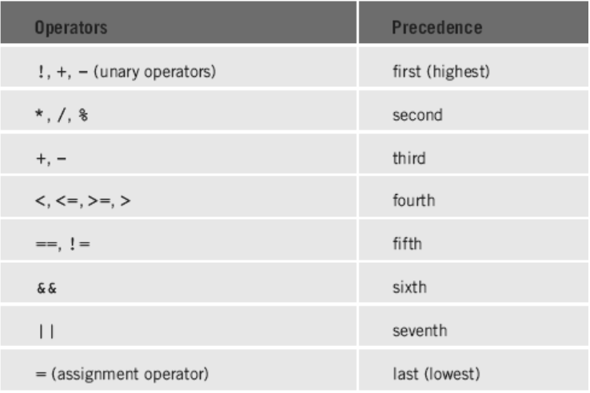
Basic Syntax
Case Sensitivity: Java is case-sensitive; Variable and variable are different identifiers.
Class Names: By convention, class names start with an uppercase letter.
Method Names: Method names start with a lowercase letter.
File Name: The filename must match the class name and have a .java extension.

Slide 7
Some questions
A) What error occurs if the file name is not the same as the class name?
‌ B) Can we have multiple public classes in the same file? Why?

Slide 8
Answers
A- Compile Error occurs : Java checks each .java file at compile time and expects the public class name to be the same as the file name. Otherwise, the class cannot be found and processed correctly.
B- No : The compiler needs to know which class to consider as the main file. As a result, the compiler gives a file naming error. But Java allows more than one non-public class in a file. public class MainClass { public static void main(String[] args) { HelperClass.sayHello(); } } class HelperClass { static void sayHello() { System.out.println("Hello from HelperClass!"); } } Non-public classes are actually "helper" classes and can only be used from within the same file or package. Non-public classes do not need to match the file name.

Slide 9
Conditional Statements
if Statement:
int x = 10;
if (x > 5) {
System.out.println("x is greater than 5");
}
if-else Statement:
int x = 10;
if (x > 5) {
System.out.println("x is greater than 5");
} else {
System.out.println("x is less than or equal to 5");
}

Slide 10
Switch Statements
switch Statement:
int day = 3;
switch (day) {
case 1:
System.out.println("Monday");
break;
case 2:
System.out.println("Tuesday");
break;
case 3:
System.out.println("Wednesday");
break;
default:
System.out.println("Invalid day");
break;
}
Enhanced switch is also supported in java with (->) notation.

Slide 11
Loops
for Loop:
for (int i = 0; i < 5; i++) {
System.out.println("i is: " + i);
}
while Loop:
int i = 0;
while (i < 5) {
System.out.println("i is: " + i);
i++;
}
do-while Loop:
int i = 0;
do {
System.out.println("i is: " + i);
i++;
} while (i < 5);

Slide 12
Some questions
A) What error occurs if the wrong index (for example, a negative index or one greater than the length) is used when traversing an array?
B) Can an array be resized in Java after it has been defined?

Slide 13
answers
A) An ArrayIndexOutOfBoundsException error occurs also for negative index ( not like C )
B) No, the size of an array cannot be changed after it is created . But you can use ArrayList (from java.util) to have a dynamic array (not like realloc in C ) int[] arr = new int[5]; // آرایه‌ای با اندازه‌ی ثابت 5
arr = new int[10]; // این کار آرایه جدیدی می‌سازد ولی مقدارهای قبلی از بین می‌روند ArrayList<Integer> list = new ArrayList<>(); // آرایه‌ی قابل تغییر

Slide 14
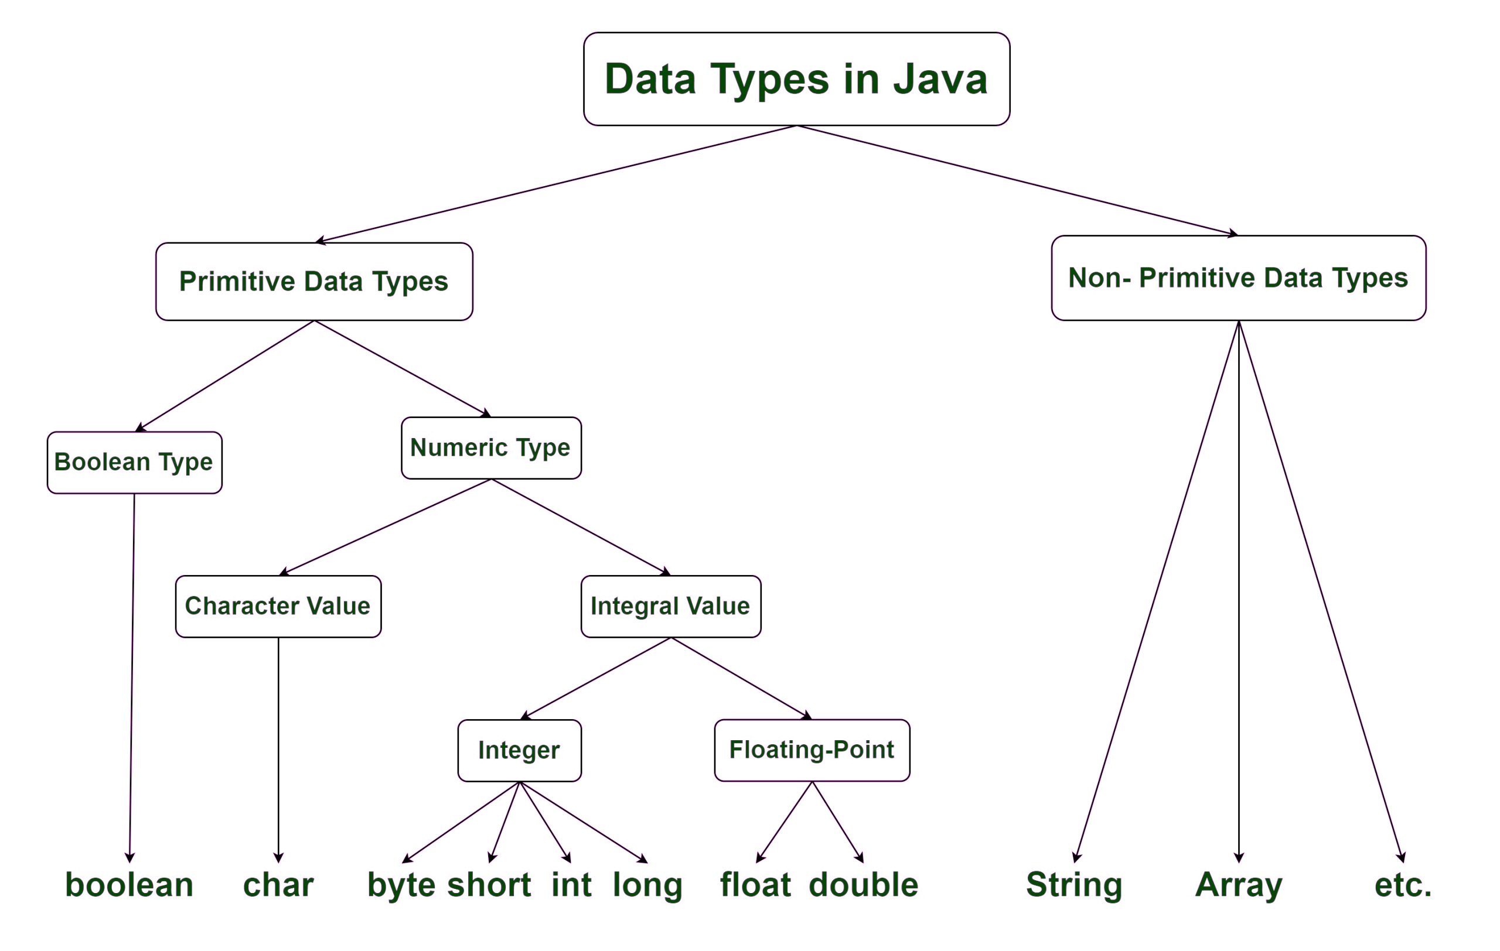
Data Types

Slide 15
Strings
You can create a String using string literals or the `new` keyword.
public class StringExample {
public static void main(String[] args) {
// Creating Strings
String greeting = "Hello, Java!";
String anotherGreeting = new String("Welcome to OOP!");
// Using String methods
System.out.println("Greeting: " + greeting);
System.out.println("Length of greeting: " + greeting.length());
System.out.println("Character at position 1: " + greeting.charAt(1));
System.out.println("Substring (7, 11): " + greeting.substring(7, 11)); // prints "Java“
System.out.println("Concatenated string: " + greeting.concat(" Let's code."));
}
}

Slide 16
Questions
A)Why is it not possible to change a string in Java? What is the meaning of String being immutable?

Slide 17
Answers
A) Every time the value of a String is changed, a new object is created in memory. The original value remains unchanged and the changes are applied to a new object. String str = "Hello";
str.concat(" World");
System.out.println(str); In Java, strings are stored in the String Pool.
If strings were immutable, changing one string would change all other references to that string! With String being immutable, each object is created and shared only once in the String Pool, which reduces memory usage. New applies. Solution : StringBuilder or StringBuffer

Slide 18
Arrays and For-each
An array in Java is a collection of elements of the same data type, stored in a contiguous block of memory.
int[] numbers; // Preferred style
numbers_2 = new int[5]; // Creates an array with default values
int[] numbers_3 = {1, 2, 3, 4, 5};
System.out.println(numbers[0]);
System.out.println(numbers.length);
for (int num : numbers) {
System.out.println(num); // Outputs: 1, 2, 3, 4, 5
}

Slide 19
Scanner
The Scanner class in Java (found in the `java.util` package) is used to capture input from various sources.
import java.util.Scanner;
public class ScannerExample {
public static void main(String[] args) {
Scanner scanner = new Scanner(System.in);
System.out.print("Enter your name: ");
String name = scanner.nextLine();
System.out.print("Enter your age: ");
int age = scanner.nextInt();
System.out.print("Enter your height in meters: ");
double height = scanner.nextDouble();
System.out.println("Hello, " + name + ". You are " + age + " years old and " + height + " meters tall.");
// Close the scanner to free resources
scanner.close();
}
}

Slide 20
Questions
A)Why might unexpected behavior be seen if we immediately call nextLine() after using nextInt()?

Slide 21
answers
A) In Java, the Scanner class processes input line by line and token by token. When reading data from the user, the Scanner uses an Input Buffer.
When you use nextInt() to read a number, it only reads the numeric value but leaves the Enter (newline \n) in the buffer.
Then if nextLine() is used immediately, instead of taking new input from the user, it will just read the remaining \n in the buffer. nextLine() does not take any new input from the user and is unexpectedly rejected. SOLUTION : 1- put an extra nextLine()
2- nextLine() for all inputs & convert the numeric value with Integer.parseInt()

Slide 22
Classes and Objects
A class is a blueprint that defines the properties (attributes) and behaviors (methods) common to all
objects of that type.
// Main method to test our class
public static void main(String[] args) {
// Creating objects
Person p1 = new Person("Alice", 30);
Person p2 = new Person("Bob", 25);
// Calling methods
p1.displayInfo();
p2.displayInfo();
}
}
public class Person {
// attributes
private String name;
private int age;
// Constructor
public Person(String name, int age) {
this.name = name;
this.age = age;
}
// Method
public void displayInfo() {
System.out.println("Name: " + name + ", Age: " + age);
}

Slide 23
Constructor
A constructor is a special method used to initialize new objects. It has the following key properties:
Same name as the class.
No return type.
Can be overloaded: You can have multiple constructors with different parameter lists.
public class Car {
private String brand;
private int speed;
public Car() {
this.brand = "Unknown";
this.speed = 0;
}
public Car(String brand, int speed) {
this.brand = brand;
this.speed = speed;
}
}

Slide 24
Default constructor
Java's Default Behavior for Constructors In Java, if you don't write any constructors : the compiler automatically creates a default (no parameters) constructor. public Person() { super(); // فراخوانی سازنده کلاس والد }
class Person {}
public class Main {
public static void main(String[] args) {
Person p = new Person(); } } // مشکلی ندارد، زیرا سازندهٔ پیش‌فرض وجود دارد.

Slide 25
QUESTIONS
A) Under what circumstances should we define class fields as static?

Slide 26
Answers
The static keyword in Java is used to define fields (variables), methods, and special blocks that belong to a class, rather than to each object (instance). Static variables are created only once for the entire class and are shared by all objects of that class. 1- When the value of a variable must be common to all objects 2- When the value of a variable is independent of any object 3- When we need a global variable 4- When we want the initial value to be set only once

Slide 27
examples
class Student {
String name;
static int studentCount = 0; // بین همه اشیا مشترک است
public Student(String name) {
this.name = name;
studentCount++; // افزایش تعداد دانش‌آموزان }}
public class Main {
public static void main(String[] args) {
Student s1 = new Student("Alice");
Student s2 = new Student("Bob");
System.out.println(Student.studentCount); }} // خروجی: 2
class Config {
static String appName = "My Application";
static int maxUsers = 100;
} class Database {
static String connectionString;
static {
// مقداردهی اولیه فقط یک‌بار انجام می‌شود
connectionString = "jdbc:mysql://localhost:3306/mydb";
}
}

Slide 28
Final variable
final makes the value of a variable permanent (constant) after it has been initialized. final can be used for instance variables or static variables. If we want a value to be both static and final : is shared across all objects (static) does not change after it is initialized (final) class MathUtil {
static final double PI = 3.14159;
}

Slide 29
Encapsulation
Encapsulation is the concept of bundling data (instance variables) and methods that operate on that data into one unit—a class. It also involves hiding the internal state of the object from the outside world. This is usually achieved by:
- Declaring instance variables as private.
- Providing public getter and setter methods to read and modify these variables.
Why Encapsulate?
Control Access: Prevent direct access to the fields so that you can enforce constraints (e.g., a person’s age cannot be negative).
Maintainability: You can change the internal implementation later without affecting classes that use your object.
Data Hiding: Protects the object’s state from unintended interference.

Slide 30
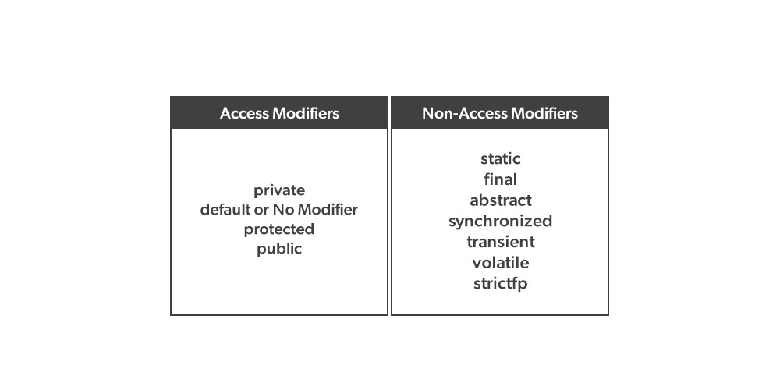
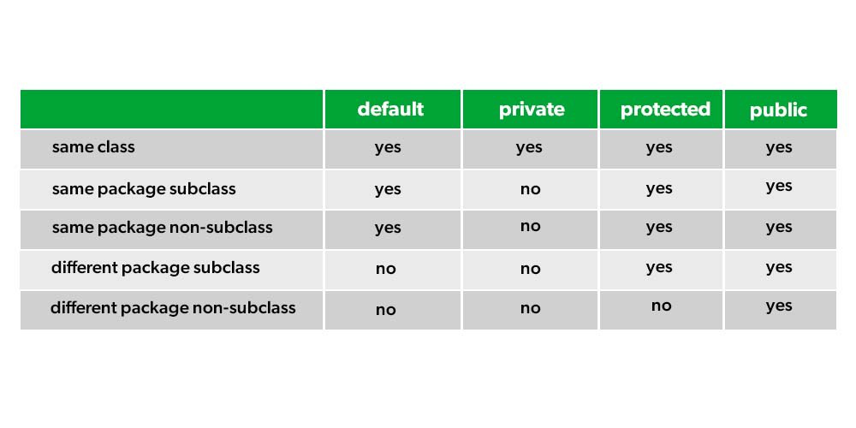
access modifiers and non-access modifiers
Java provides different access modifiers to control the visibility of classes, variables, and methods:
Note that we will learn about non-access modifiers in later chapters.

Slide 31
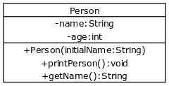
Class Diagrams
A class diagram is a diagram used in designing and modeling software to describe classes and their relationships. Class diagrams enable us to model software in a high level of abstraction and without having to look at the source code.
Note that we will learn about UML in later chapters.
Classes: Represented as rectangles.
Attributes (fields): Listed in the top section (often with a “–” sign if they’re private).
Methods (operations): Listed in the bottom section (with a “+” for public methods).
Object Composition: User-defined types can be used in a class.

Slide 32
examples
A) When do we use protected access modifier?
B) What is the difference between Composition and Aggregation relation ?

Slide 33
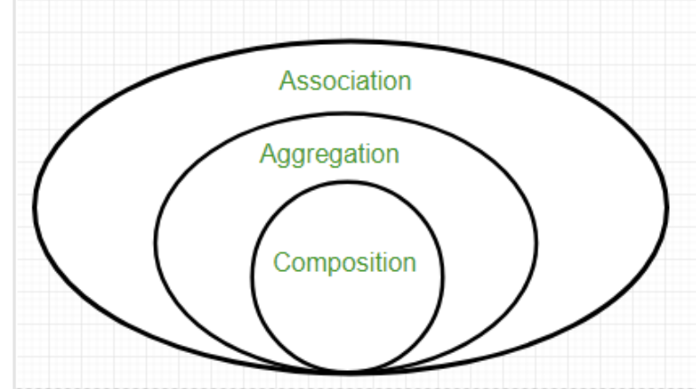
Answers
A) The protected keyword is an access level between private and public. Accessible in the same class and child classes (in inheritance). Accessible within the same package. Not directly accessible in other classes (outside the package), except through inheritance.
B) In Composition, the part is dependent on the whole and cannot exist without it. The life cycle of the part is completely dependent on the whole ( Car & Engine) In Aggregation, a part can exist independently of the whole. The lifecycle of a part is not dependent on the whole ( School & Student )

Slide 34
Time to Code
Bank:
Develop a Java application that simulates a simple banking system. The system should manage customers and their bank accounts, allowing for basic operations such as account creation, deposits, withdrawals, and fund transfers between accounts.
2. Library
Develop a Library Management System in Java that manages books and members, and allows users to search and borrow books.

Slide 35
Class diagram Practice
3. Medical Clinic Management System Develop a Java application that simulates a simple medical clinic management system. The system should manage patients, doctors, and appointments, allowing for the following
Register Patients with details such as name, age, medical record number, and medical history.
Register Doctors with details like name, specialization, and doctor ID.
Schedule Appointments between patients and doctors with a specific date and time.
Manage Prescriptions including medicine names, dosage, and doctor's recommendations.
Search and view a patient’s medical history based on their medical record number.

Slide 36



پایان

