Slide 1



برنامه نویسی پیشرفته
رفع اشکال: جلسه 3
Lists, Sets and Maps
Iterators
Generics

Slide 2
Why Use Collections in Java?
Collections provide flexible and efficient ways to manage groups of objects.
Unlike arrays, they can dynamically resize and offer more functionality.
Main types: Lists, Sets, Maps, and Queues.
import java.util.ArrayList;
import java.util.List;public
class CollectionsIntro {
public static void main(String[] args) {
List<String> names = new ArrayList<>(); names.add("Alice");
names.add("Bob");
names.add("Alice"); // Lists allow duplicates System.out.println(names);
}
}

Slide 3
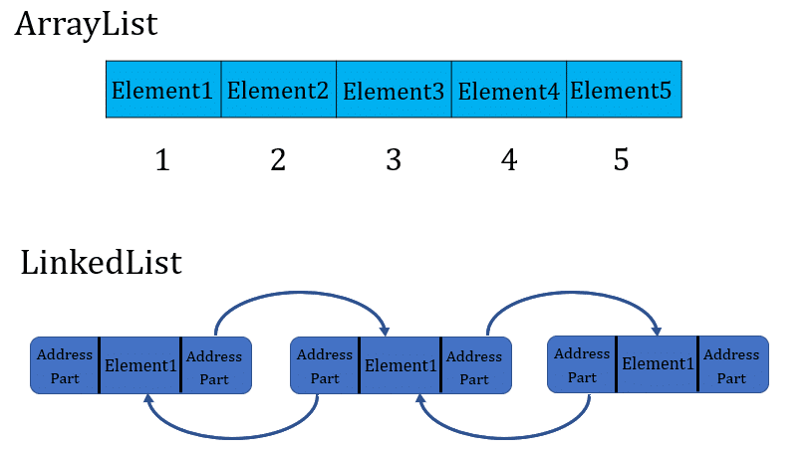
Questions – Lists
How do ArrayList and LinkedList differ in adding and removing elements?
What happens if you modify a List while iterating over it using a for-each loop?

Slide 4
Answers - Lists
Answer 1: ArrayList vs LinkedList
Adding & Removing:
ArrayList: Fast at the end (O(1)), slow elsewhere (O(n)) due to shifting.
LinkedList: Fast at start and end (O(1)), slow in the middle (O(n)) due to traversal.
Iterator Benefits (LinkedList):
ListIterator allows efficient bidirectional traversal and modification (O(1) for insert/remove).
Answer 2: Modifying List During Iteration
For-each loop: Causes ConcurrentModificationException if elements are added/removed.
Solution: Use Iterator.remove() instead of list.remove().

Slide 5
Iterators
What is an Iterator?
An object that allows sequential access to elements in a collection.
Supports safe removal during iteration.
import java.util.*;
public class IteratorExample {
public static void main(String[] args) {
List<String> list = new ArrayList<>(List.of("A", "B", "C"));
Iterator<String> it = list.iterator();
while (it.hasNext()) {
String s = it.next();
if (s.equals("B"))
it.remove(); // Safe removal
}
System.out.println(list); // Output: [A, C]
}
}

Slide 6
HashSet
Key Features:
Stores unique elements (no duplicates).
Unordered (no guaranteed insertion order).
Uses a hash table for fast operations (O(1) for add, remove, and contains in average cases).
import java.util.*;
public class HashSetExample {
public static void main(String[] args) {
Set<String> set = new HashSet<>();
set.add("Apple");
set.add("Banana");
set.add("Apple"); // Duplicate, won't be added System.out.println(set); // Output: [Apple, Banana] (order may vary)
}
}

Slide 7
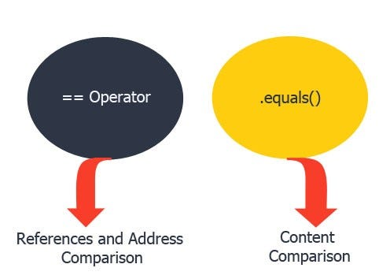
Equality & Comparison in Java
== (Reference Equality):
Checks if two references point to the same object in memory.
.equals() (Logical Equality):
Used to compare the actual content of objects.
Default implementation (from Object) behaves like ==, but can be overridden.
compareTo() (Comparable Interface):
Used for sorting (Collections.sort()).
Returns:
0 → Objects are equal
< 0 → First object is smaller
> 0 → First object is larger

Slide 8
Using HashSets (Wrong)
class Person {
String name;
Person(String name) {
this.name = name;
}
}
Public class Main {
public static void main(String[] args) {
Set<Person> set = new HashSet<>();
set.add(new Person("Alice"));
set.add(new Person("Alice"));
System.out.println(set.size()); // ❌ Output: 2 (should be 1)
}

Slide 9
Using HashSets (Correct)
class Person {
String name;
public boolean equals(Object o) {
return o instanceof Person && name.equals(((Person) o).name);
}
public int hashCode() {
return name.hashCode();
}
}
Public class Main {
public static void main(String[] args) {
Set<Person> set = new HashSet<>();
set.add(new Person("Alice"));
set.add(new Person("Alice"));
System.out.println(set.size()); //✅ Output: 1
}

Slide 10
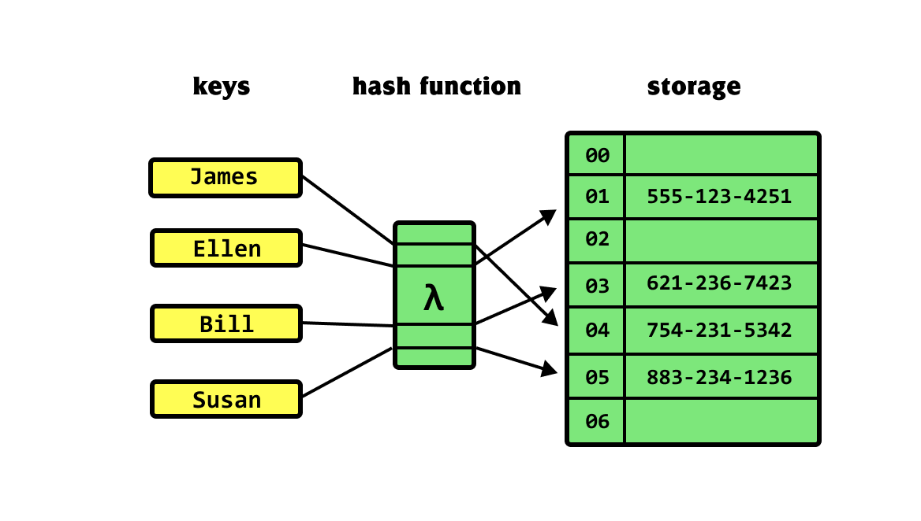
HashMap
Key Features:
Stores data as key-value pairs.
Keys are unique; values can be duplicated.
Uses a hash table for fast lookups (O(1) in average cases).
import java.util.*;
public class HashMapExample {
public static void main(String[] args) {
Map<Integer, String> map = new HashMap<>();
map.put(1, "Alice");
map.put(2, "Bob");
map.put(1, "Charlie"); // Overwrites value for key 1
System.out.println(map); // Output: {1=Charlie, 2=Bob}
System.out.println(map.get(1)); // Output: Charlie
}
}

Slide 11
Generics in Collections
Why Generics?
Allow type safety → Prevents ClassCastException.
Eliminates the need for manual type casting.
Generic Type in ArrayList<>
ArrayList<String> → Only stores String values.
ArrayList<Object> → Can store any type, but loses type safety.

Slide 12
Generics in Collections
import java.util.*;
public class GenericsExample {
public static void main(String[] args) {
// Type-safe ArrayList
ArrayList<String> names = new ArrayList<>();
names.add("Alice");
names.add("Bob");
// names.add(10); // Compile-time error!
// Without Generics (before Java 5)
ArrayList list = new ArrayList();
list.add("Alice");
list.add(10); // No type safety
System.out.println(names);
System.out.println(list);
}
}

Slide 13
Questions - Generics
Can you store primitive types (e.g., int, float) directly in an ArrayList<>?
What happens if you remove an element from an ArrayList<Integer> using remove(int index)?

Slide 14
Answers - Generics
Answer 1:
No, Java Generics do not support primitive types.
Solution: Use their wrapper classes:
List<Integer> list = new ArrayList<>(); // ✅ Correct
List<int> list = new ArrayList<>(); // ❌ Compilation Error
Java autoboxes primitives (int → Integer) automatically when added to a collection.

Slide 15
Answers - Generics
Answer 2:
Removes the element at the given index, not the value itself.
List<Integer> list = new ArrayList<>(List.of(1, 2, 3, 4));
list.remove(2); // ❌ Removes index 2 (value 3), NOT the number 2!
To remove a value instead of an index:
list.remove(Integer.valueOf(2)); // ✅ Removes the number 2

Slide 16
Where & Why Do We Use Collections?
ArrayList – Fast Random Access, Dynamic Resizing
✅ Use when: You need fast lookups and dynamic resizing.
LinkedList – Fast Insertions/Deletions
✅ Use when: Frequent add/remove operations, especially at the start/middle.
HashSet – Unique Elements, Fast Lookups
✅ Use when: Avoiding duplicates, ensuring fast searches.
HashMap – Key-Value Pair Storage, Fast Retrieval
✅ Use when: Need quick lookups based on keys.

Slide 17
Time to Code
Bank with Collections:
Modify the bank system from the last lecture to use Lists or HashMap for storing accounts. Implement separated CLI for admin and customer.

Slide 18



پایان

