Slide 1
amirkabir_linux_festival
introduction_to_linux

Slide 2
history_of_linux

Slide 3
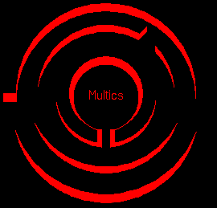
multics:
Multics (Multiplexed Information and Computing Service) was a mainframe time-sharing operating system that was developed in the 1963-1969 period through the collaboration of the Massachusetts Institute of Technology (MIT), General Electric (GE), and Bell Labs (AT&T).

Slide 4
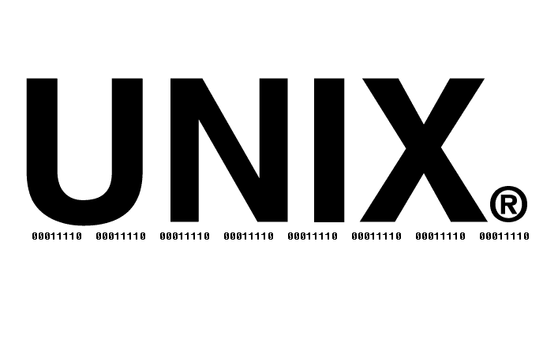
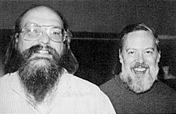
unix:
By 1970, Bell Labs had withdrawn from the Multics project.
Ken Thompson:
“I did the first of two or three versions of UNIX all alone. And Dennis became an evangelist. Then there was a rewrite in a higher-level language that would come to be called C. He worked mostly on the language and on the I/O system, and I worked on all the rest of the operating system. That was for the PDP-11, which was serendipitous, because that was the computer that took over the academic community.”
UNIX is the first free Operating System

Slide 5

BSD:
BSD (Berkeley Software Distribution) was the first major variant of unix created at University of California at Berkeley.
the BSD and Bell Labs versions of UNIX headed off in separate directions. BSD continued forward in the free-ﬂowing, share-the-code manner that was the hallmark of the early Bell Labs UNIX, whereas AT&T started steering UNIX toward commercialization
FreeBSD
NetBSD
OpneBSD

