Slide 1

Text Processing Tools
All the best people in life seem to like LINUX. Steve Wozniak
Making Linux GPL'd was definitely the best thing I ever did.
Linus Torvalds
Amirkabir Linux Festival 2021

Slide 2
Cat command in Linux
Cat(concatenate) command is very frequently used in Linux. It reads data from the file and gives their content as output. It helps us to create, view, concatenate files. So let us see some frequently used cat commands.

Slide 3




To view a single file Command:
To view multiple files Command:
To view contents of a file preceding with line numbers Command:
Cat command can suppress repeated empty lines in output Command:

Slide 4
Source
https://www.geeksforgeeks.org/cat-command-in-linux-with-examples/
https://www.tecmint.com/13-basic-cat-command-examples-in-linux/

Slide 5

Gedit
Gedit is a full-featured text editor for the GNOME desktop environment. You can use it to prepare simple notes and documents, or you can use some of its advanced features, making it your own software development environment.
Created for the GNOME desktop environment, gedit is a text editor designed with ease of use in mind. The gedit editor is often used to edit source code and markup languages (e.g., HTML and XML), and uses a virtual file system for dragging and dropping files between gedit and GNOME files.w

Slide 6
Install gedit
Gedit is located in Ubuntu's Main repository and is installed by default. gedit can be installed in Kubuntu, Xubuntu and other distributions although additional libraries are necessary and will be installed on non-GNOME systems.
To install gedit:
1. Select gedit in Synaptic (System → Adminstration → Synaptic Package Manager)
2. From a terminal or ALT-F2:

Slide 7



Launching gedit
Opening gedit via the command line allows the user to take advantage of several options unavailable from the GUI menu. If a path is not included in the startup command, gedit will look for the file in the current directory. If the file is not found, gedit will open a blank file with the file name entered on the command line:
1. To open a specific file:
2. To open multiple files:
3. To edit system files:
4. To open at a specific line number:

Slide 8
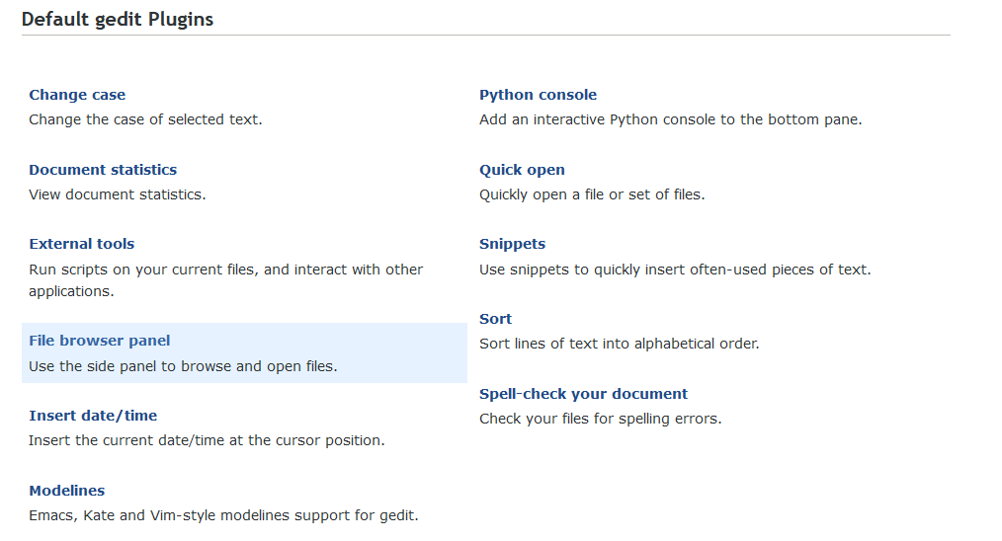
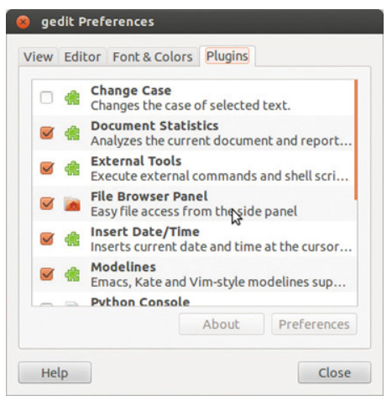
Gedit plugins
Plugins greatly enhance the power of gedit and are are accessed via Edit → Preferences → Plugins. More than a dozen plugins are pre-installed and can be enabled/disabled in this section. Some of the most popular are enabled by default while others must be enabled by the user.

Slide 9
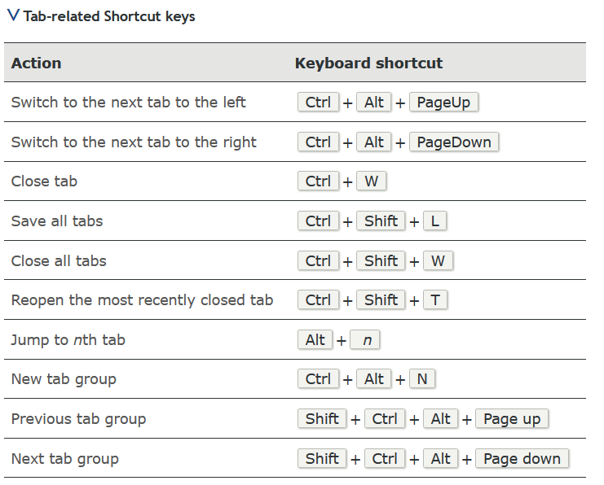
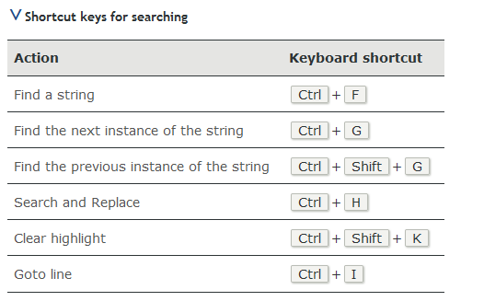
Shortcut keys
Use shortcut keys to perform common tasks more quickly than with the mouse and menus. The following tables list all of gedit's shortcut keys.

Slide 10
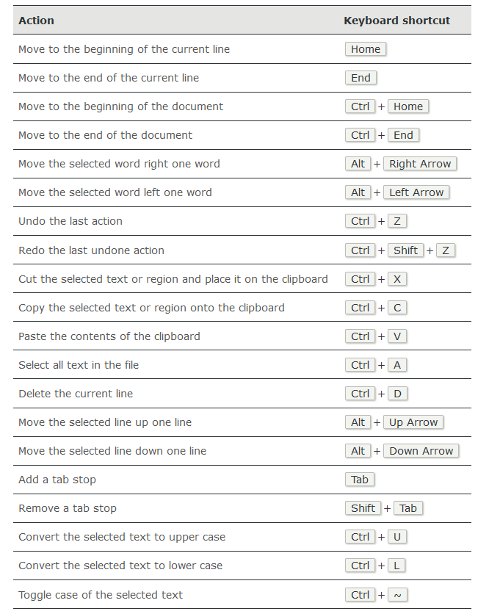
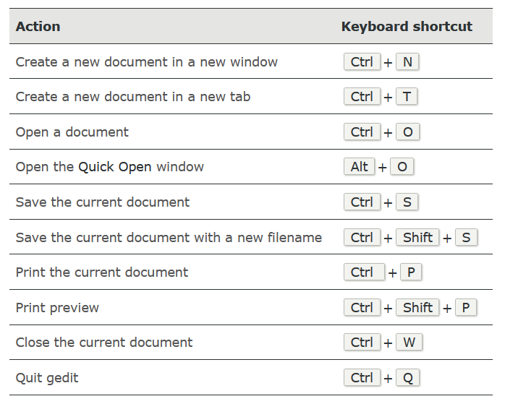

Slide 11
Source
https://www.computerhope.com/jargon/g/gedit.htm
https://help.gnome.org/users/gedit/stable/
http://www.fifi.org/doc/gedit/html/usage.html
https://www.howtogeek.com/413514/how-to-edit-text-files-graphically-on-linux-with-gedit/

Slide 12
Linux sed command
On Unix-like operating systems, sed is a stream editor: it filters and transforms text.
The sed stream editor performs basic text transformations on an input stream (a file, or input from a pipeline). While in some ways similar to an editor which permits scripted edits (such as ed), sed works by making only one pass over the input(s), and is consequently more efficient. But it is sed's ability to filter text in a pipeline which particularly distinguishes it from other types of editors.

Slide 13
If you do not specify INPUTFILE, or if INPUTFILE is "-", sed filters the contents of the standard input. The script is actually the first non-option parameter, which sed specially considers a script and not an input file if and only if none of the other options specifies a script to be executed (that is, if neither of the -e and -f options is specified).

Slide 14
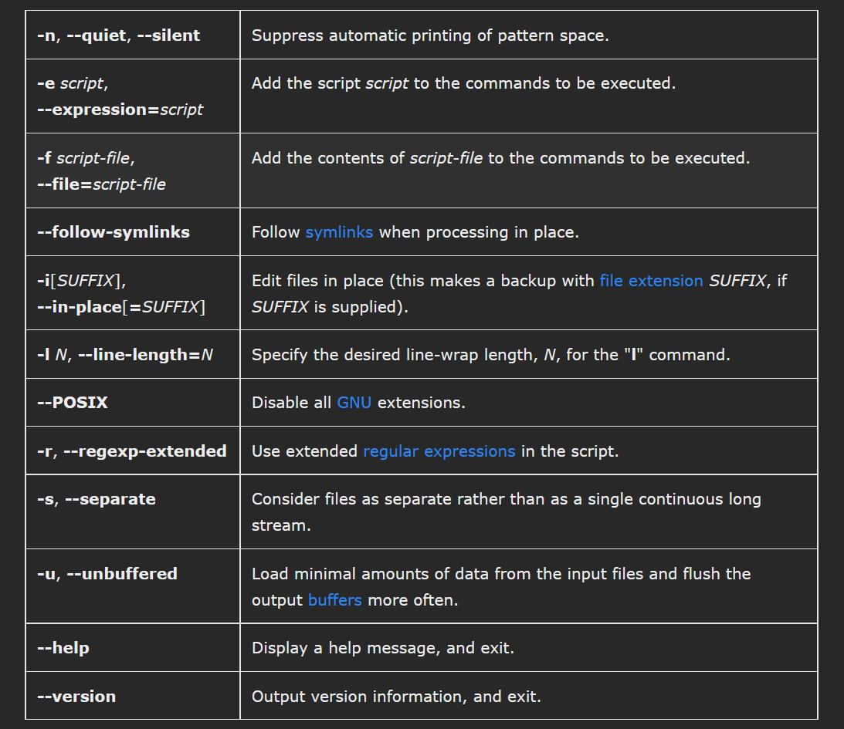
Sed options:

Slide 15
Sed programs
A sed program consists of one or more sed commands, passed in by one or more of the -e, -f, --expression, and --file options, or the first non-option argument if none of these options are used. This documentation frequently refers to "the" sed script; this should be understood to mean the in-order catenation of all of the scripts and script-files passed in.
Commands within a script or script-file can be separated by semicolons (";") or newlines (ASCII code 10). Some commands, due to their syntax, cannot be followed by semicolons working as command separators and thus should be terminated with newlines or be placed at the end of a script or script-file. Commands can also be preceded with optional non-significant whitespace characters.
Each sed command consists of an optional address or address range (for instance, line numbers specifying what part of the file to operate on; see Selecting Lines for details), followed by a one-character command name and any additional command-specific code.

Slide 16
How sed works
sed maintains two data buffers: the active pattern space, and the auxiliary hold space. Both are initially empty.
sed operates by performing the following cycle on each line of input: first, sed reads one line from the input stream, removes any trailing newline, and places it in the pattern space. Then commands are executed; each command can have an address associated to it: addresses are a kind of condition code, and a command is only executed if the condition is verified before the command is to be executed.
When the end of the script is reached, unless the -n option is in use, the contents of pattern space are printed out to the output stream, adding back the trailing newline if it was removed. Then the next cycle starts for the next input line.

Slide 17
Sed examples
1. Viewing a range of lines of a document
Tools such as head and tail allow us to view the bottom or the top of a file. What if we need to view a section in the middle? The following sed one-liner will return lines 5 through 10 from myfile.txt:

Slide 18
2. Viewing the entire file except a given range
On the other hand, it’s possible that you want to print the entire file except a certain range. To exclude lines 20 through 35 from myfile.txt, do:

Slide 19
3. Viewing non-consecutive lines and ranges
It’s possible that you’re interested in set of non-consecutive lines, or in more than one range. Let’s display lines 5-7 and 10-13 from myfile.txt:

Slide 20
4. Replacing words or characters (basic substitution)
To replace every instance of the word version with story in myfile.txt, do:

Slide 21
5. Replacing words or characters inside a range
If you’re interested in replacing words only within a line range (30 through 40, for example), you can do:

Slide 22
6. Inserting spaces in files
With sed, we can also insert spaces (blank lines) for each non-empty line in a file. To insert one blank line every other line in LICENSE, a plain text file, do:

Slide 23
7. Replacing or substituting string
Sed command is mostly used to replace the text in a file. The below simple sed command replaces the word “unix” with “linux” in the file.

Slide 24
8. Replacing the nth occurrence of a pattern in a line
Use the /1, /2 etc flags to replace the first, second occurrence of a pattern in a line. The below command replaces the second occurrence of the word “unix” with “linux” in a line.

Slide 25
9. Replacing all the occurrence of the pattern in a line
The substitute flag /g (global replacement) specifies the sed command to replace all the occurrences of the string in the line.

Slide 26
10. Replacing from nth occurrence to all occurrences in a line
Use the combination of /1, /2 etc and /g to replace all the patterns from the nth occurrence of a pattern in a line. The following sed command replaces the third, fourth, fifth… “unix” word with “linux” word in a line.

Slide 27
Source
https://www.geeksforgeeks.org/sed-command-in-linux-unix-with-examples/
https://www.gnu.org/software/sed/manual/sed.html
https://www.tecmint.com/linux-sed-command-tips-tricks/
https://www.howtogeek.com/666395/how-to-use-the-sed-command-on-linux/
https://linuxhint.com/50_sed_command_examples/
https://www.computerhope.com/unix/used.htm

Slide 28
AWK command in Linux
Awk is a scripting language used for manipulating data and generating reports. The awk command programming language requires no compiling, and allows the user to use variables, numeric functions, string functions, and logical operators.
Awk is a utility that enables a programmer to write tiny but effective programs in the form of statements that define text patterns that are to be searched for in each line of a document and the action that is to be taken when a match is found within a line. Awk is mostly used for pattern scanning and processing. It searches one or more files to see if they contain lines that matches with the specified patterns and then performs the associated actions.
Awk is abbreviated from the names of the developers – Aho, Weinberger, and Kernighan.

Slide 29
WHAT CAN WE DO WITH AWK ?
1. AWK Operations: (a) Scans a file line by line (b) Splits each input line into fields (c) Compares input line/fields to pattern (d) Performs action(s) on matched lines
2. Useful For: (a) Transform data files (b) Produce formatted reports
3. Programming Constructs: (a) Format output lines (b) Arithmetic and string operations (c) Conditionals and loops

Slide 30
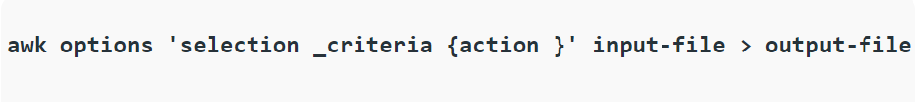
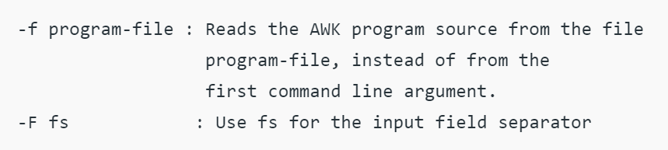
Syntax:
Options:

Slide 31
Sources
AWK command in Unix/Linux with examples – GeeksforGeeks
How To Use the AWK language to Manipulate Text in Linux | DigitalOcean
30 Examples for Awk Command in Text Processing - Like Geeks

Slide 32
Nano - Linux command line Text editor
You can run nano in two ways. To open nano with an empty buffer, just type in “nano” at the command prompt.
You can also use the following syntax:
Nano will follow the path and open that file if it exists. If it does not exist, it’ll start a new buffer with that filename in that directory.
Notice that in Debian/ubuntu distributions you can type:
“sudo apt install nano” for installation.

Slide 33
At the top, you’ll see the name of the program and version number, the name of the file you’re editing, and whether the file has been modified since it was last saved. If you have a new file that isn’t saved yet, you’ll see “New Buffer.” Next, you’ll see the contents of your document, a body of text. The third-line from the bottom is a “system message” line that displays information relevant to the program executing a function. Here, you can see that it says “New File.” Lastly, the final two rows at the bottom are what make this program very user-friendly: the shortcut lines.

Slide 34
Nano Shortcuts
Program functions are referred to as “shortcuts” in nano, such as saving, quitting, justifying, etc. The most common ones are listed at the bottom of the screen, but there are many more that aren’t. Note that nano does not use the Shift key in shortcuts. All shortcuts use lowercase letters and unmodified number keys, so Ctrl+G is NOT Ctrl+Shift+G.
Hit Ctrl+G to bring up the Help documentation and scroll down to see a list of valid shortcuts.
When you’re done looking at the list, hit Ctrl+X to exit help.

Slide 35
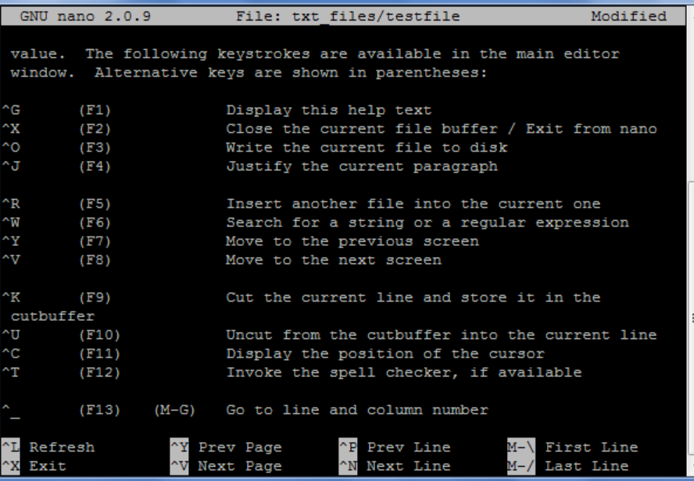

Slide 36
To move the cursor forward or backward, you can type Ctrl+F and Ctrl+B. To move up and down one line at a time, you can type Ctrl+P and Ctrl+N. In other words, you can use those keys instead of the Right, Left, Up, and Down arrows, respectively.

Slide 37
Sources
How to Install Nano & Use Text Editor Commands in Linux (phoenixnap.com)
The Beginner’s Guide to Nano, the Linux Command-Line Text Editor (howtogeek.com)
GNU nano – Wikipedia
How to Use the GNU Nano Editor – Linux Hint

Slide 38
Useful text manipulation tools (head & tail)
It is used to show head (top) or tail (bottom) of a file.
Syntax: head [OPTION]... [FILE]...
tail [OPTION]... [FILE]...
You can specify the amount of text by -c option followed by number of bytes.
Or you can use -n option specifying the amount of lines to be displayed.
If you use a leading - with -c or -n options, it will display all of the file except the amount you specified after - character.
Example: How can we generate a 16 byte random value ? Ans: head -c16 /dev/random

