Slide 1
amirkabir_linux_festival
File & directory permissions

Slide 2
What we will learn:
users and groups
Understanding permissions and ownership
File vs directory permissions
Changing permissions and ownership
Masks

Slide 3
Users and groups:Overall view
All the information about a system’s users are stored inside a database file located at /etc/paswwd
passwd and chpasswd commands are used to change or set a user’s password.
useradd and usermod commands are used to create and modify a user in linux
userdel is used to delete users
groups command is used to see the groups that the user is a part of.

Slide 4
/etc/passwd
System use this file to store user’s information. Users are stored with the following format:
[username]:[pass]:[UID]:[GID]:[Comment]:[Home Dir]:[Default bash]
smf8: x :1000 : 1000 :Mohammad: /home/smf8 : /bin/bash
if there is a x in place of password field, User password is located in /etc/shadow file
UID and GID for root user is set to 0

Slide 5
useradd
create a new user or update default new user information.
In debian systems, it is recommended to use adduser instead.
commonly used options:
-c uesd to provide comments for user
-d path to the home directory
-g,-G provide a single group or a list of groups for user
adduser [options] username adduser will prompt you for a password but useradd will not.

Slide 6
passwd
passwd [Options] user
User will be prompt to enter old password. For root user this step is bypassed.
After entering password, it’ll be checked for complexity, complexity limitations vary in distribution. as a general guideline, passwords should consist of 6 to 8 characters of :
lowercase alphabets
digits from 0 to 9
punctuation marks
Options:
-e set account’s password expiry
-d delete password

Slide 7
usermod
usermod is used to modify a user’s information.
usermod [options] username
commonly used options:
-aG used to append groups to user
-d used to set user’s home directory
-s change user’s default shell
How to give an existing user sudo privilege ? ans: usermod -aG sudo username

Slide 8
userdel or deluser ?
userdel or deluser both are used to delete users from a system but deluser provides friendlier front end to userdel.
check deluser’s man page for it’s usage syntax and options.
How to remove sudo privilege from a user ? ans: deluser username sudo

Slide 9
Ownership

Slide 10
In linux, permissions are divided into 3 groups.
Owner Group Others
User (Owner) : By default, the user who created the file is it’s owner Group: These types of permissions are applied to the group that is assigned to the file.
It is possible for a group to have multiple users.
Others: Pretty self-explanatory.

Slide 11
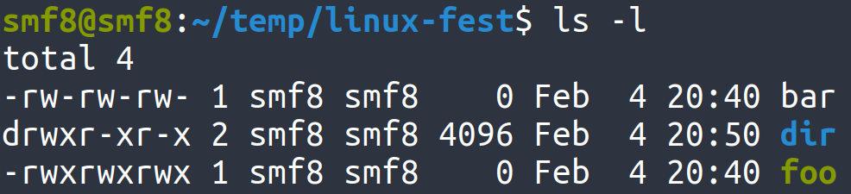
Permissions:
Group
Symbol
Permission
User Owner
Others
r
Read
w
Write
x
Execute

Slide 12
File vs Directory permission:
^{Permission}
^{Directory}
^{File}
^{r}
^{Allows reading of dir’s files}
^{Allows file to be read}
^{w}
Allows modification of folder’s content
^{Allows file modification}
^{x}
Allows user’s entrance into dir
^{Allows file to be executed}
⁻
^{No permission}
^{No permission}
What permission(s) do we need to delete a file ?
Notes:
https://unix.stackexchange.com/questions/21251/execute-vs-read-bit-how-do-directory-permissions-in-linux-work video

Slide 13
Modifying permissions:
Absolute (Numeric) mode
Symbolic mode
for each owner type there are 3 permissions represented with: --- (read)(write)(execute).
each permission have either 0 or 1 value.
the total value of 3 bit number --- represented in octal base is that owner type’s permission.
Example : 755 : 111 101 101 , rwx r-x r-x
use permissions and ownership symbols to modify permissions
ownerships: u(user), g(group), o(other), a(all)
permissions: r(read), w(write), x(execute)
operations: +(add), -(subtract), =(set)
Examples:
o+w (will add write permission for others)
g-w (will revoke write permission for groups)
u=rw (will set user’s permission to rw-)

Slide 14
chmod:
Permission modification is with ‘chmod’ command in linux.
usage syntax: chmod permission file example commands:
chmod 644 bar.txt chmod g+x,o+x bar.txt
chmod a=rw bar.txt
// 644 in binary format is 110 100 100 so file’s permissions will become -rw-r--r--
// -rw-r-xr-x
// -rw-rw-rw-

Slide 15
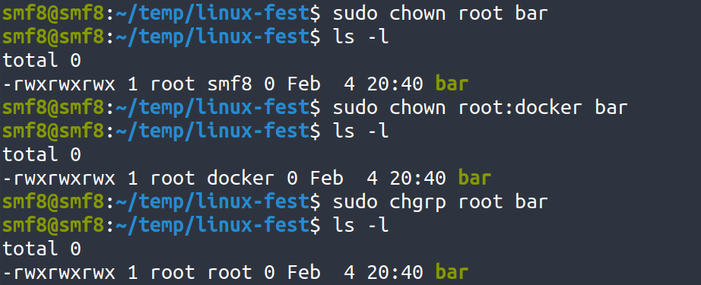
Changing ownership
‘chown’ is used for changing ownership (user, group) of a file. chown requires root privileges
syntax: chown user:group filename
examples:
‘chgrp’ is used to only change group owner of a file

Slide 16
How to set default permissions ?
When a file is created, it’s default permissions are 666.
These permissions for folders are 777.
Creation masks change the final permissions. it is subtracted from initial permissions.
We can change these creation masks with ‘umask’ command
umask -S [symbolic permissions] will set default permissions
umask [numeric permissions] will subtract given octal number from initial permissions.
Notes:
sources : thelinuxacademy course https://www.computerhope.com/unix/uumask.htm https://www.guru99.com/file-permissions.html

