Slide 1
Writing shell scripts

Slide 2
Why we need them?
Have you ever had a task that you needed to do over and over that took lots of typing on the command line? Do you ever think to yourself, “Wow, I wish I could just type one command to do all this”? Maybe a shell script is what you’re after.

Slide 3
A shell script is a group of commands, functions, variables, or just about anything else you can use from a shell.
These items are typed into a plain text file.
That file can then be run as a command.

Slide 4
Lets check it!

Slide 5
How we can run them?
We can execute a shell script in two basic ways:
The filename is used as an argument to the shell (as in bash myscript). This is most common for quick, simple tasks.
The shell script may also have the name of the interpreter placed in the first line of the script preceded by #! (as in #!/bin/bash) and have the execute bit of the file containing the script set (using chmod +x filename). You can then run your script just like any other program in your path simply by typing the name of the script on the command line.

Slide 6
Some notes before we start…
In some cases, you can place an echo statement at the beginning of lines within the body of a loop and surround the command with quotes. That way, rather than executing the code, you can see what will be executed without making any permanent changes.
To achieve the same goal, you can place dummy echo statements throughout the code. If these lines get printed, you know the correct logic branch is being taken.
You can use set -x near the beginning of the script to display each command that is executed or launch your scripts using $ bash -x myscript
Because useful scripts have a tendency to grow over time, keeping your code readable as you go along is extremely important. Do what you can to keep the logic of your code clean and easy to follow.

Slide 7
Anything following the name of the script is referred to as a command-line argument.
The pound sign (#) prefaces comments and can take up an entire line or exist on the same line after script code.
Variable names within shell scripts are case-sensitive and can be defined in the following manner: NAME=value
Be sure that the NAME and value touch the equal sign, without any spaces!!!!

Slide 8
Variables can contain the output of a command or command sequence. You can accomplish this by preceding the command with a dollar sign and open parenthesis, and following it with a closing parenthesis.
MYDATE=$(date) assigns the output from the date command to the MYDATE variable.
Enclosing the command in backticks (`) can have the same effect.

Slide 9
Escaping Special Shell Characters
Typing echo '$HOME' or echo \$HOME would literally show $HOME on the screen. So, if you want to have the shell interpret a single character literally, precede it with a backslash (\). To have a whole set of characters interpreted literally, surround those characters with single quotes (').

Slide 10
When assigning variables, use only the variable name (for example, BALANCE). When you reference a variable, meaning you want the value of the variable, precede it with a dollar sign (as in $CurBalance). The result of the latter is that you get the value of the variable, not the variable name itself.

Slide 11
Special shell positional parameters
There are special variables that the shell assigns for you. One set of commonly used variables is called positional parameters or command line arguments and is referenced as $0, $1, $2, $3...$n. $0 is special and is assigned the name used to invoke your script.
Example: #!/bin/bash # Script to echo out command-line arguments echo "The first argument is $1, the second is $2." echo “The command itself is called $0.” $ chmod 755 /home/sarb/bin/myscript $ myscript foo bar

Slide 12
Special shell positional parameters
Another variable, $#, tells you how many parameters your script was given.
The $@ variable holds all the arguments entered at the command line.
Another particularly useful special shell variable is $?, which receives the exit status of the last command executed.

Slide 13
As mentioned earlier, if you want the value of a variable, you precede it with a $ (for example, $CITY). This is really just shorthand for the notation ${CITY}; curly braces are used when the value of the parameter needs to be placed next to other text without a space.
Going into all the rules is probably overkill for a quick introduction to shell scripts, but the following list presents some common constructs you’re likely to see in bash scripts you find on your Linux system!

Slide 14
Some shortcuts with {}!
${var:-value}—If variable is unset or empty, expand this to value.
${var#pattern}—Chop the shortest match for pattern from the front of var’s value.
${var##pattern}—Chop the longest match for pattern from the front of var’s value.
${var%pattern}—Chop the shortest match for pattern from the end of var’s value.
${var%%pattern}—Chop the longest match for pattern from the end of var’s value.

Slide 15
Arithmetic in bash
Bash uses untyped variables, meaning it normally treats variables as strings or text, but can change them on the fly if you want it to. Unless you tell it otherwise with declare, your variables are just a bunch of letters to bash. But when you start trying to do arithmetic with them, bash converts them to integers if it can. This makes it possible to do some fairly complex arithmetic in bash.
Integer arithmetic can be performed using the built-in let command or through the external expr or bc commands.
BIGNUM=1024 let RESULT=$BIGNUM/16 RESULT=`expr $BIGNUM / 16` RESULT=`echo "$BIGNUM / 16" | bc` let foo=$RANDOM; echo $foo
To see a complete list of the kinds of arithmetic you can perform using the let command, type help let at the bash prompt.

Slide 16
Programming constructs in shell scripts

Slide 17
The “if...then” statements
VARIABLE=1 if [ $VARIABLE -eq 1 ] ; then echo "The variable is 1" fi
Instead of using -eq, you can use the equal sign (=). The = works best for comparing string values, while -eq is often better for comparing numbers.
STRING="Friday" if [ $STRING = "Friday" ] ; then echo "WhooHoo. Friday." else echo "Will Friday ever get here?" fi

Slide 18
The “if...then” statements
filename="$HOME" if [ -f "$filename" ] ; then echo "$filename is a regular file" elif [ -d "$filename" ] ; then echo "$filename is a directory" else echo "I have no idea what $filename is" fi
you can type help test on the command line to get the information about if switchs.

Slide 19
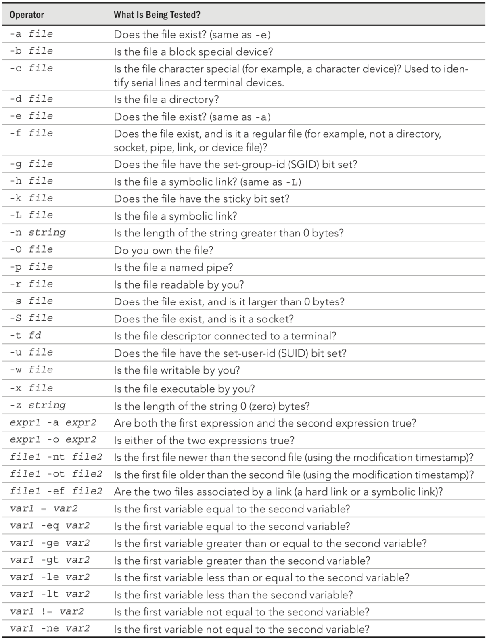

Slide 20
If shortcuts
# [ test ] || action # Perform simple single command if test is false dirname="/tmp/testdir" [ -d "$dirname" ] || mkdir "$dirname"
# [ test ] && {action} # Perform simple single action if test is true [ $# -ge 3 ] && echo "There are at least 3 command line arguments."

Slide 21
Case statement
case "VAR" in Result1) { body };; Result2) { body };; *) { body };; esac

Slide 22
The “for...do” loop
Loops are used to perform actions over and over again until a condition is met or until all data has been processed.
for VAR in LIST do { body } done
for NUMBER in 0 1 2 3 4 5 6 7 8 9 do echo The number is $NUMBER done
for FILE in `/bin/ls` do echo $FILE done

Slide 23
C-style “for...do” loop
LIMIT=10 # Double parentheses, and no $ on LIMIT even though it's a variable! for ((a=1; a <= LIMIT ; a++)) ; do echo "$a" done

Slide 24
The “while...do”
while condition do { body } done
N=0 while [ $N -lt 10 ] ; do echo -n $N let N=$N+1 done

