Slide 1
amirkabir_linux_festival
File & directory permissions

Slide 2
What we will learn:
Understanding permissions and ownership
File vs directory permissions
Changing permissions and ownership
Masks

Slide 3
Ownership

Slide 4
In linux, permissions are divided into 3 groups.
Owner Group Others
User (Owner) : By default, the user who created the file is it’s owner Group: These types of permissions are applied to the group that is assigned to the file.
It is possible for a group to have multiple users.
Others: Pretty self-explanatory.

Slide 5
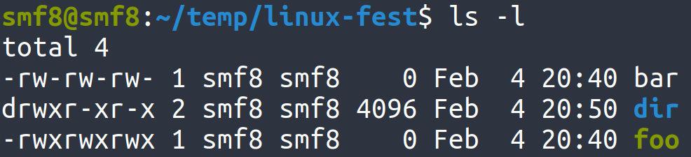
Permissions:
Group
Symbol
Permission
User Owner
Others
r
Read
w
Write
x
Execute

Slide 6
File vs Directory permission:
^{Permission}
^{Directory}
^{File}
^{r}
^{Allows reading of dir’s files}
^{Allows file to be read}
^{w}
Allows modification of folder’s content
^{Allows file modification}
^{x}
Allows user’s entrance into dir
^{Allows file to be executed}
⁻
^{No permission}
^{No permission}
What permission(s) do we need to delete a file ?
Notes:
https://unix.stackexchange.com/questions/21251/execute-vs-read-bit-how-do-directory-permissions-in-linux-work video

Slide 7
Modifying permissions:
Absolute (Numeric) mode
Symbolic mode
for each owner type there are 3 permissions represented with: --- (read)(write)(execute).
each permission have either 0 or 1 value.
the total value of 3 bit number --- represented in octal base is that owner type’s permission.
Example : 755 : 111 101 101 , rwx r-x r-x
use permissions and ownership symbols to modify permissions
ownerships: u(user), g(group), o(other), a(all)
permissions: r(read), w(write), x(execute)
operations: +(add), -(subtract), =(set)
Examples:
o+w (will add write permission for others)
g-w (will revoke write permission for groups)
u=rw (will set user’s permission to rw-)

Slide 8
chmod:
Permission modification is with ‘chmod’ command in linux.
usage syntax: chmod permission file example commands:
chmod 644 bar.txt chmod g+x,o+x bar.txt
chmod a=rw bar.txt
// 644 in binary format is 110 100 100 so file’s permissions will become -rw-r--r--
// -rw-r-xr-x
// -rw-rw-rw-

Slide 9
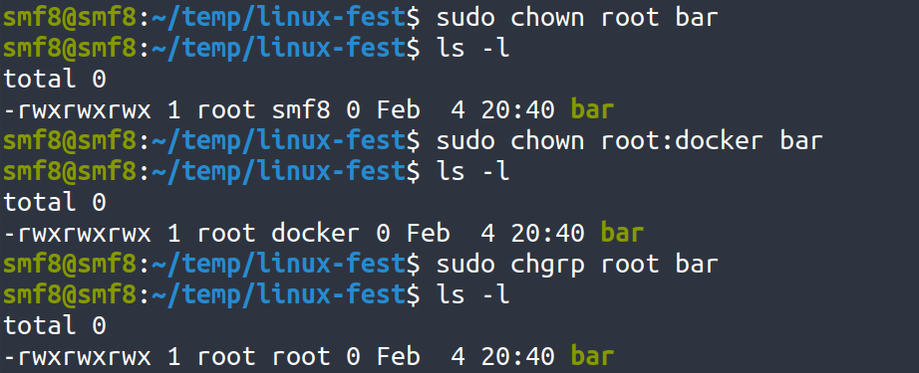
Changing ownership
‘chown’ is used for changing ownership (user, group) of a file. chown requires root privileges
syntax: chown user:group filename
examples:
‘chgrp’ is used to only change group owner of a file

Slide 10
How to set default permissions ?
When a file is created, it’s default permissions are 666.
These permissions for folders are 777.
Creation masks change the final permissions. it is subtracted from initial permissions.
We can change these creation masks with ‘umask’ command
umask -S [symbolic permissions] will set default permissions
umask [numeric permissions] will subtract given octal number from initial permissions.
Notes:
sources : thelinuxacademy course https://www.computerhope.com/unix/uumask.htm https://www.guru99.com/file-permissions.html

