Slide 1
amirkabir_linux_festival
introduction_to_linux

Slide 2
history_of_linux

Slide 3
the_old_days:
Imagine computers as big as houses, even stadiums. While the sizes of those computers posed substantial problems, there was one thing that made this even worse: every computer had a different operating system.
Software was always customized to serve a specific purpose, and software for one given system didn't run on another system. Being able to work with one system didn't automatically mean that you could work with another. It was difficult, both for the users and the system administrators.

Slide 4
early_operating_systems

Slide 5
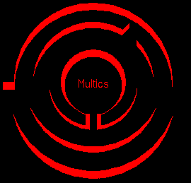
multics:
Multics (Multiplexed Information and Computing Service) was a mainframe time-sharing operating system that was developed in the 1963-1969 period through the collaboration of the Massachusetts Institute of Technology (MIT), General Electric (GE), and Bell Labs (AT&T).
The operating system was written in PL/I and ran on GE hardware.

Slide 6
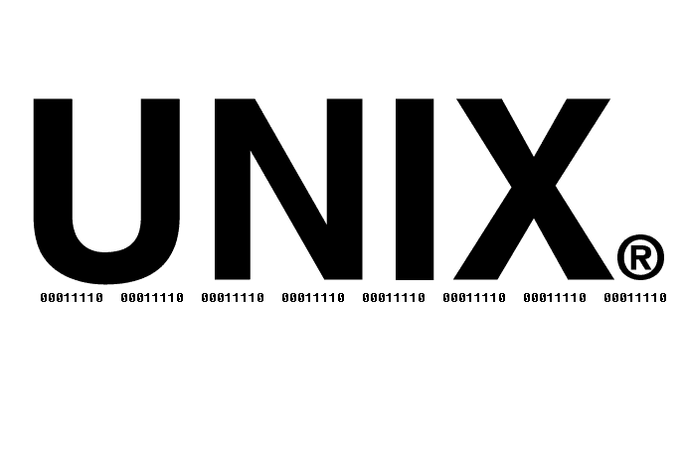
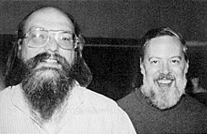
unix:
By 1970, Bell Labs had withdrawn from the Multics project.
Ken Thompson:
“I did the first of two or three versions of UNIX all alone. And Dennis became an evangelist. Then there was a rewrite in a higher-level language that would come to be called C. He worked mostly on the language and on the I/O system, and I worked on all the rest of the operating system. That was for the PDP-11, which was serendipitous, because that was the computer that took over the academic community.”
UNIX is the first free Operating System

Slide 7
Written in the C programming language instead of in assembly code.
Simple and elegant.
Able to recycle code.
UNIX on the other hand needed only a small piece of that special code, which is now commonly named the kernel
software vendors were quick to adapt, since they could sell ten times more software almost effortlessly
users working on different systems without the need for extra education to use another computer

Slide 8

bsd:
BSD (Berkeley Software Distribution) was the first major variant of unix created at University of California at Berkeley.
the BSD and Bell Labs versions of UNIX headed off in separate directions. BSD continued forward in the free-ﬂowing, share-the-code manner that was the hallmark of the early Bell Labs UNIX, whereas AT&T started steering UNIX toward commercialization
FreeBSD
NetBSD
OpenBSD

Slide 9

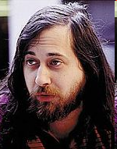
gnu:
GNU (GNU is Not UNIX) was started in 1983 by Richard Stallman.
GNU was intended to become a recoding of the entire UNIX operating system that could be freely distributed
By 1990, the GNU system was almost complete; the only major missing component was the kernel. Initially the components required for kernel development were written: editors, shell, compiler
the GNU Hurd is a collection of servers (i.e., a herd of GNUs) that run on top of Mach, and do the various jobs of the Unix kernel.
GNU/Hurd was not successful
https://www.gnu.org/gnu/thegnuproject.html

Slide 10
free_or_opensource

Slide 11
A program is free software, for a particular user, if:
You have the freedom to run the program as you wish, for any purpose.
You have the freedom to modify the program to suit your needs.
You have the freedom to redistribute copies, either gratis or for a fee.
You have the freedom to distribute modified versions of the program, so that the community can benefit from your improvements.

Slide 12
Copyleft And GPL (GNU General Public License):
GPL was written by Stallman in 1989
instead of a means for restricting a program, it becomes a means for keeping the program free. The central idea of copyleft is that we give everyone permission to run the program, copy the program, modify the program, and distribute modified versions but not permission to add restrictions of their own.
Basic features of the GNU Public License include the following:
Author Rights — The original author retains the rights to his or her software.
Free Distribution — Source code must be included with the distribution.
Copyright Maintained — The Original GNU agreement maintained .
Open Source:
Stallman explains: "The two terms describe almost the same category of software, but they stand for views based on fundamentally different values. Open source is a development methodology; free software is a social movement."

Slide 13


minix (minimal unix):
MINIX is a unix base OS originally developed in 1987 by Andrew S. Tanenbaum as a teaching tool for his textbook.
During the early 1990s, MINIX was popular among hobbyists and developers because of its inexpensive proprietary license. However
MINIX uses a micro-kernel .

Slide 14

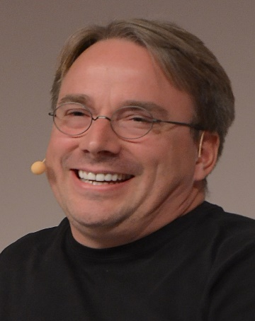
linux:
By the beginning of the 90s home PCs were finally powerful enough to run a full blown UNIX.
In 1991, while attending the University of Helsinki, Torvalds became curious about operating systems. Frustrated by the licensing of MINIX, which at the time limited it to educational use only. He thought it would be a good idea to have some sort of freely available academic version of UNIX so he began to work on his own operating system kernel, which eventually became the Linux kernel.
Torvalds began the development of the Linux kernel on MINIX and applications written for MINIX were also used on Linux.

Slide 15
From: torvalds@klaava.Helsinki.FI (Linus Benedict Torvalds)
Newsgroups: comp.os.minix
Subject: Gcc-1.40 and a posix-question
Message-ID:
Date: 3 Jul 91 10:00:50 GMT
Hello netlanders,
Due to a project I'm working on (in minix), I'm interested in the posix
standard definition. Could somebody please point me to a (preferably)
machine-readable format of the latest posix rules? Ftp-sites would be
nice.

Slide 16
Hello everybody out there using minix -
I'm doing a (free) operating system (just a hobby, won't be big and
professional like gnu) for 386(486) AT clones. This has been brewing
since april, and is starting to get ready. I'd like any feedback on
things people like/dislike in minix, as my OS resembles it somewhat
(same physical layout of the file-system (due to practical reasons)
among other things).
I've currently ported bash(1.08) and gcc(1.40), and things seem to work.
This implies that I'll get something practical within a few months, and
I'd like to know what features most people would want. Any suggestions
are welcome, but I won't promise I'll implement them :-)
Linus (torvalds@kruuna.helsinki.fi)
PS. Yes - it's free of any minix code, and it has a multi-threaded fs.
It is NOT protable (uses 386 task switching etc), and it probably never
will support anything other than AT-harddisks, as that's all I have :-(.

Slide 17
gnu/linux:
Many computer users run a modified version of the GNU system every day, without realizing it. the version of GNU which is widely used today is often called “Linux”
There really is a Linux, but it is just a part of the system they use. Linux is the kernel.
Kernel is the program in the system that allocates the machine's resources to the other programs that you run.
Kernel is an essential part of an operating system.
Kernel is useless by itself.
Kernel can only function in the context of a complete operating system.
Linux is normally used in combination with the GNU operating system: the whole system is basically GNU with Linux added, or GNU/Linux. All the so-called “Linux” distributions are really distributions of GNU/Linux.

Slide 18
linux_distribution

Slide 19
what_are_linux_distributions:
A linux distribution consists of the components needed to create a working linux system and the procedure needed to get those components installed and running.
Diffrent distributions are diffrent combination of linux kernel version, GNU tools, management tools and other tools
For the display manager example: a distribution could continue to use X.Org’s X-Server because it has been the standard for the past few decades, or the distribution could use Wayland instead because it provides new features and other needed updates
differ based on which desktop environment: This case is seen with Ubuntu, where Ubuntu uses Gnome/Unity, Kubuntu uses KDE, Xubuntu uses Xfce, Lubuntu uses LXDE, and so on.

Slide 20

debian:
Debian is a Linux distribution composed of free and open-source software.
Developed by the community-supported Debian Project, which was established by Ian Murdock on August 16, 1993.
Debian aims to provide an extremely stable distribution (and therefore contains older software) .
The Debian Stable branch is the most popular edition for personal computers and servers, and is the basis for many other distributions.
Debian is great for servers.

Slide 21

ubuntu:
Ubuntu is a free and open-source Linux distribution based on Debian.
Ubuntu is an ancient African word meaning ‘humanity to others’.
Mark Shuttleworth gathered a small team of Debian developers who together founded Canonical and set out to create an easy-to-use Linux desktop called Ubuntu.
Ubuntu was the first operating system to commit to scheduled releases on a predictable cadence, every six months.
every fourth release, made every two years, would receive long-term support for large-scale deployments (5 year) . This is the origin of the term LTS for stable, maintained releases.
GNOME is default Desktop environment for ubuntu.

Slide 22

mint:
Linux Mint is a community-driven Linux distribution based on Ubuntu or Debian.
Linux Mint provides full out-of-the-box multimedia support by including some proprietary software.
It's both free of cost and open source.
Linux Mint aims to provide an extremely easy distribution for users of other operating systems like Windows and Mac OS X to use and get used to Linux.
Mostly used with Cinamon, Mate or XFCE (DEs) .

Slide 23

fedora:
Fedora Linux is a Linux distribution developed by the community-supported Fedora Project which is sponsored primarily by Red Hat Inc.
Free and open source software platform.
Fedora exists to be the first to use the latest software, meaning that it uses both the latest versions of software and is the first to include or switch to a new technology
Fedora, on the other hand, has a very strong open-source policy that prevents it from including any proprietary software in its repositories.
Fedora uses GNOME 3 as default desktop environment.

Slide 24
ubuntu_installation

Slide 25
ubuntu_gui

Slide 26
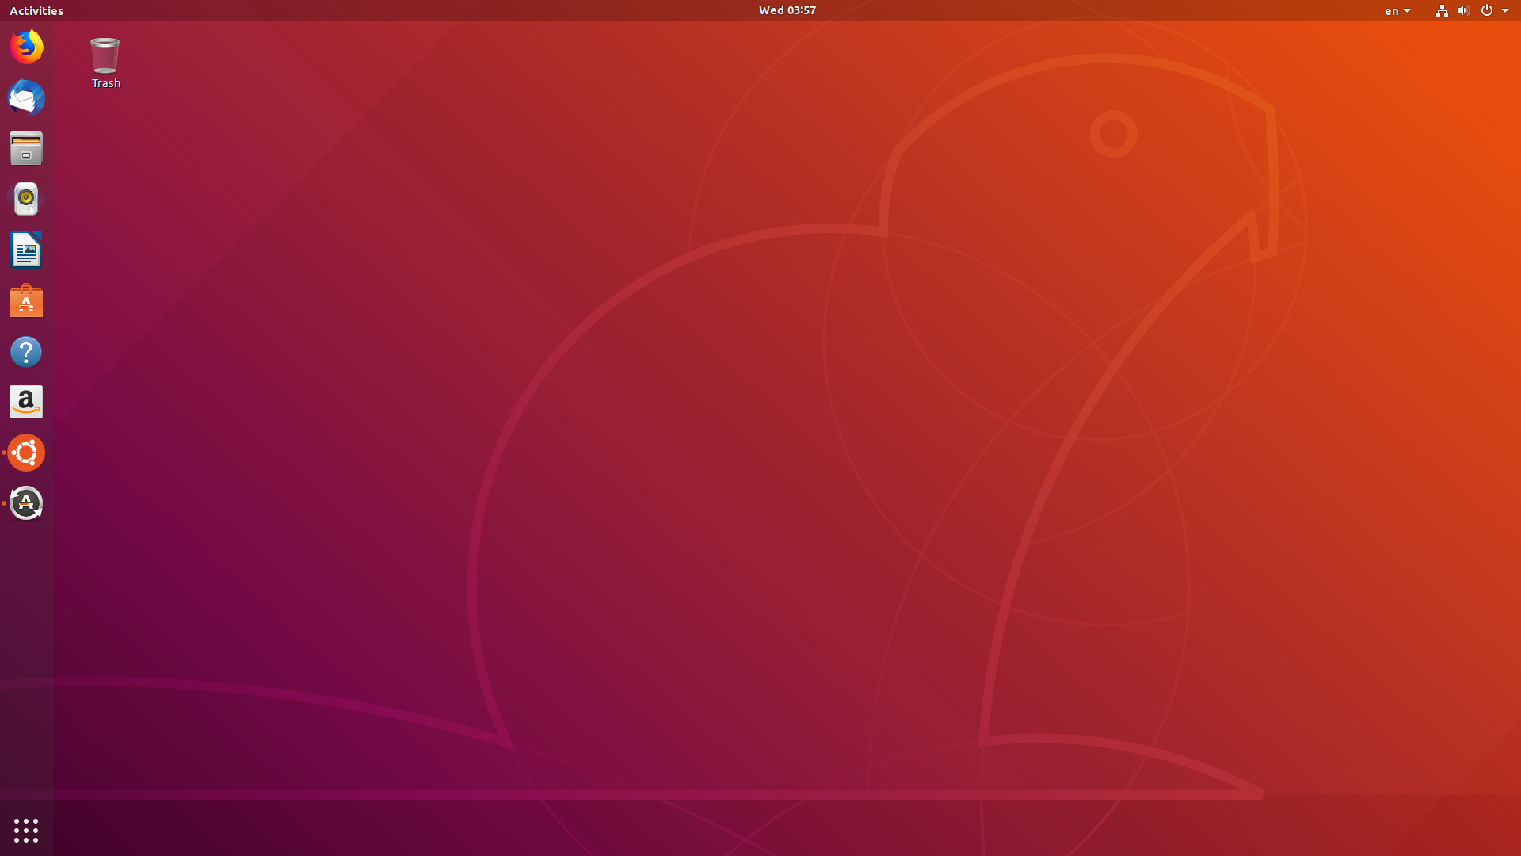
Window switcher
Calendar an notification
System menu
Dock
Apps button

Slide 27
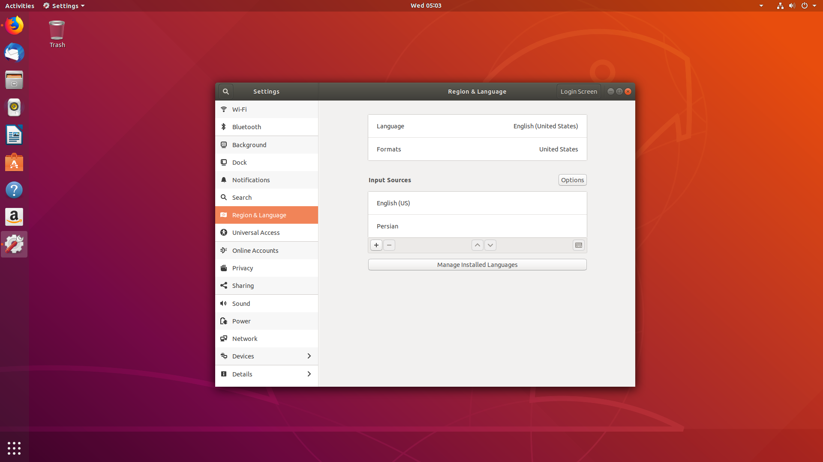

Slide 28
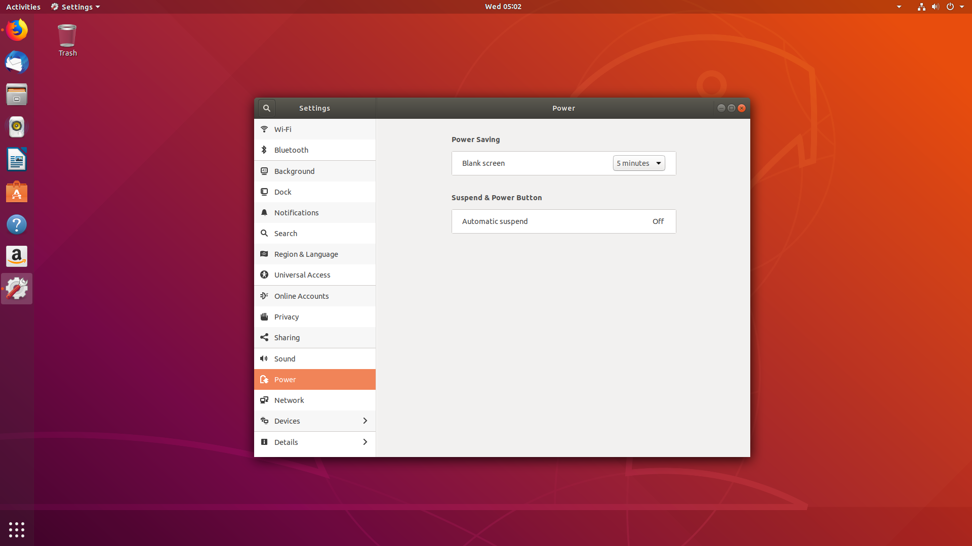

Slide 29
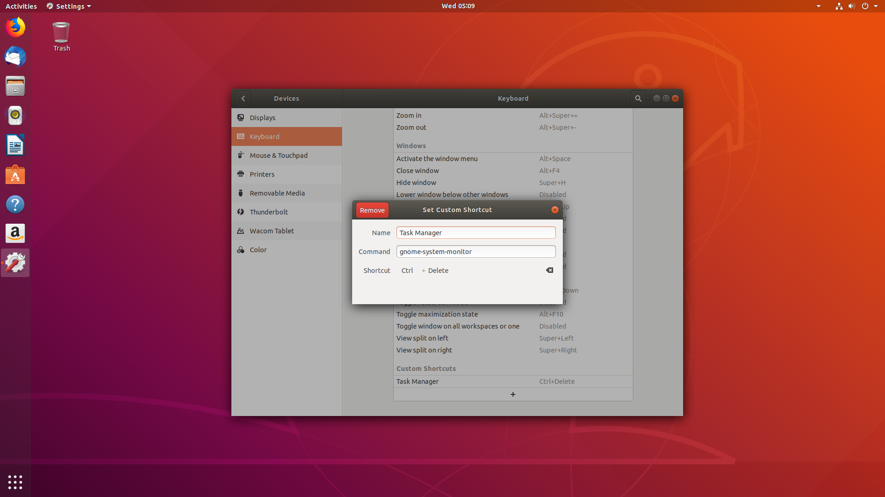

Slide 30
Use <Super> <number> to run application from dock.
Use <Alt> <Tab> or <Super> <Tab> to switch between open apps.
Use <Super> <`> to switch between instances of open app.
Use <Super> to see all current Activities.
Use <Ctrl> <Alt> <Up> or <Ctrl> <Alt> <Down> to change workspace.
Use <Ctrl> <Alt> <Shift> <Up> or <Ctrl> <Alt> <Shift> <Down> to put open app in another workspace.
Use <Super> <a> to open applications.

Slide 31
Use <Ctrl> <Alt> <Tab> to switch to diffrent part of gui.
Use <Ctrl> <Alt> <t> to open terminal.
Use <Super> <L> to lock the screen.
Use <Super> <Space> to change keyboard language.
Use <Super> <d> to hide all apps.
Use <Super> <h> to hide current app.
Use <Super> <Up> or <Super> <Down> to minimize or maximize window.
Use <Alt> <F8> then <Arrow> to resize window manualy.

Slide 32
linux_filesystem

Slide 33
Main Idea: Every thing in linux is file if it’s not it’s a process.
If we map out the ﬁles and directories in Linux, it would look like an upside-down tree . At the top is the root directory represented / .
/
├── bin
├── boot
├── cdrom
├── dev
├── etc
├── lib
├── lib64
├── media
├── mnt
├── opt
├── proc
├── root
├── run
├── sbin
├── snap
├── srv
├── sys
├── tmp
├── usr
└── var
/
|
├── bin
├── boot
├── cdrom
├── dev
├── etc
├── lib
├── lib64
├── media
├── mnt
├── opt
├── proc
├── root
├── run
├── sbin
├── snap
├── srv
├── sys
├── tmp
├── usr
└── var

Slide 34
/bin
├── bash
├── Cat
├── ip
├── ls
├── mv
├── cp
├── less
├── mknod
├── echo
├── lsblk
├── ping
├── ln
├── ...
Bin contains the system binary files that are essential for general operation of your computer. These exectuable files are the next line after the system kernel. Withtout these you can’t do a whole lot of anything on your computer .
Programs are shared by the system, the system administrator and the users.
A lot of these binaries will be discussed during the course.

Slide 35
/boot
├── grub
├── vmlinuz-4.15.0-46-generic
├── initrd.img-4.15.0-46-generic
├── config-4.15.0-20-generic
├── config-4.15.0-46-generic
├── memtest86+.bin
├── memtest86+.elf
├── memtest86+_multiboot.bin
├── System.map-4.15.0-46-generic
grub ─ is the grand unified boot loader and is an attempt to get rid of the many different boot-loaders we know today.
vmlinuz ─ stands for virtual memory linux kernel zipped. vmlinuz is a compressed Linux Kernel image which is used at the time of booting Linux operating system.
initrd ─ called as Initializing RAM Disk which loads temporary file system in to RAM at the time of booting process before actual file system mounting. This file is loaded by your kernel image.
System.map ─ This is a map file used by kernel. This file contains memory location mapped to the kernel variables or functions. Again this file is used by vmlinuz kernel image at the time of booting to set symbol names.

Slide 36
/cdrom
CD-Roms can be mounted to this folder but it is not in the official Linux Filesystem Hierarchy. CD-Roms should be mounted under /media.

Slide 37
/dev
├── loop0
├── null
├── pts
├── random
├── sda
├── sda1
├── tty
├── zero
└── ...
Contains ﬁles representing access points to devices on your systems. These include terminal devices (tty*), ﬂ oppy disks (fd*), hard disks (sd*), RAM (ram*), and CD-ROM (cd*). Users can access these devices directly through these device ﬁ les.
Every hard drive is shown as sd[x] and every partition is shown ad sd[x][n]

Slide 38
/etc
├── docker
├── fstab
├── dpkg
├── java-8-openjdk
├── mysql
├── python3.6
├── hostname
├── ssh
├── ufw
├── vim
├── X11
├── xdg
└── apt
Contains administrative conﬁguration ﬁles. Most of these ﬁles are plaintext ﬁles that can be edited with any text editor if the user has proper permission.
Almost Every program makes a file in etc folder.
For example, the files that contain the name of your system, the users and their passwords, the names of machines on your network and when and where the partitions on your hard disks should be mounted are all in here
/etc/fstab – Contains file system mounting information and we can edit this file to mount file system permanently and delete mount points.
/etc/mtab – Contains all mounted device status like what devices are mounted, where they mounted and properties of mount points.

Slide 39
/lib
├── apparmor
├── brltty
├── crda
├── hdparm
├── init
├── klibc
├── linux-sound-base
├── lsb
├── modprobe.d
├── modules
├── netplan
├── systemd
├── terminfo
├── udev
└── ufw
a library is an assortment of pre-compiled pieces of code that can be reused in a program
Static libraries – are bound to a program statically at compile time.
Dynamic or shared libraries – are loaded when a program is launched and loaded into memory and binding occurs at run
There are more lib directories scattered around the file system, but this one, the one hanging directly off of / is special in that, among other things, it contains the all-important kernel modules.
lib holds 32 bit libraries

Slide 40
/lib64
lib64 contains 64 bit libraries.

Slide 41
/media
The /media directory is where external storage will be automatically mounted when you plug it in and try to access

Slide 42
/mnt
This is where you would manually mount storage devices or partitions. It is not used very often nowadays.

Slide 43
/opt
concontains extra and third party software .

Slide 44
/proc
├── [pid]
├── cpuinfo
├── interrupts
├── dma
├── kmsg
├── …
└── self
A virtual file system containing information about system resources.
[pid] – Numerical subdirectory for each running process; the subdirectory is name by
the Process ID. Contains both root’s process and user’s processes.
[interrupts] - This is used to record the number of interrupts per CPU per IO device. such
as NMI (nonmaskable interrupt), LOC (local timer interrupt), TLB (TLB flush interrupt),
RES (rescheduling interrupt), CAL (remote function call interrupt).
[cpuinfo] - This is a collection of CPU and system architecture dependent items, for each
supported architecture a different list. Two common entries are processor which gives CPU
number and bogomips.
[dma] - This is a list of the registered ISA DMA (direct memory access) channels in use.
[kmsg] - This file can be used instead of the syslog system call to read kernel messages.
[self] - When a process accesses this magic symbolic link, it resolves to the process's
own /proc/[pid] directory.
For more details you can check “man proc”

Slide 45
links
hard links - A hard link is merely an additional name for an existing file on Linux. In Linux when you perform a listing in a directory the listing is actually is a list of references that map to an inode.
Inode - is a data structure which describes a filesystem object such as a file or a directory. Each inode stores the attributes and disk block location(s) of the object’s data. Filesystem object attributes may include metadata (times of last change,access, modification), as well as owner and permission data.
ln <target> <destination>
hard links can not be make for directories.
Create a hard link of a file and copy of a file.

Slide 46
soft link - is a special kind of file that points to another file, much like a shortcut. Unlike a hard link, a symbolic link does not contain the data in the target file.
soft links can be linkesd to directories, or to files on remote computers, networked through NFS.
when you delete a target file, symbolic links to that file become unusable.
ln -s <target> <destination>
Create a soft link of a directory and copy a file in it.

Slide 47
/home
├── [username]
├── Downloads
├── Documents
├── Desktop
├── Pictures
├── Public
├── videos
Home directories of the common users.
Usually shown as ~ .
Custom configuration are mostly here like: .vimrc, .bashrc .

Slide 48
/root
The administrative user's home directory. Mind the difference between /, the root directory and /root, the home directory of the root user.

Slide 49
/run
is a tmpfs (temporary file system) available early in the boot process where ephemeral run-time (currently logged-in users and running daemons) data is stored. Files under this directory are removed or truncated at the beginning of the boot process.

Slide 50
/sbin
├── fdisk
├── chroot
├── ifconfig
├── cpuinfo
├── ip
├── …
└── mkfs
/sbin is similar to /bin, but it contains applications that only the superuser will need. You can use these applications with the sudo command.
Files in /sbin are usually used to configure the system.

Slide 51
/snap
The /snap directory contains all the files and the software installed from snaps.

Slide 52
/srv
The /srv directory contains data for servers. If you are running a web server from your Linux box, your HTML files for your sites would go into /srv/http (or /srv/www). If you were running an FTP server, your files would go into /srv/ftp.

Slide 53
/sys
├── block
├── bus
├── class
├── dev
├── devices
├── firmware
├── fs
├── hypervisor
├── kernel
├── module
└── power
In addition to /proc, the kernel also exports information to another virtual file system called sysfs. sysfs is used by programs such as udev to access device and device driver information.
Block – directory contains entries for each block device in the system. Symbolic links point to the physical device that the device maps to in the physical device tree
Module – this directory contains subdirectories for each module that is loaded into the kernel.

Slide 54
/tmp
/tmp contains temporary files, usually placed there by applications that you are running.

Slide 55
/usr
├── bin
├── games
├── include
├── lib
├── libexec
├── local
├── sbin
├── share
└── src
The /usr directory was where users’ home directories were originally kept back in the early days of UNIX. These days, /usr contains a mish-mash of directories which in turn contain applications, libraries, documentation, wallpapers, icons and a long list of other stuff that need to be shared by applications and services.
You will also find bin, sbin and lib directories in /usr. Originally, the /bin directory (hanging off of root) would contain very basic commands, like ls, mv and rm. /usr/bin on the other hand would contain stuff the users would install and run to use the system as a workstation, things like word processors, web browsers, and other apps.

Slide 56
/var
/var
├── backups
├── cache
├── crash
├── lib
├── local
├── lock -> /run/lock
├── log
├── mail
├── metrics
├── opt
├── run -> /run
├── snap
├── spool
└── tmp
Storage for all variable files and temporary files created by users, such as log files, the mail queue, the print spooler area, space for temporary storage of files downloaded from the Internet, or to keep an image of a CD before burning it.
lib – data that are modified as programs run.
lock – lock files to track resources in use.
opt – like lib but for vendors.

