Slide 1

Badminton Booking
Booking Service

Slide 2
Outline
Project Description
Technologies and Resources
Architecture
Frontend Design
Backend Design
Demo
Future Work

Slide 3
Project Description
Requirements
User Features:
Book a court for a specific date
View court usage and availability
Backend:
REST API for modular communication
Database for persistent bookings
Frontend:
Simple and user-friendly interface
Service Requirements:
High availability and scalability
Cost-effective operation

Slide 4

Project Description
Requirements
User Features:
Book a court for a specific date
View court usage and availability
Backend:
REST API for modular communication
Database for persistent bookings
Frontend:
Simple and user-friendly interface
Service Requirements:
High availability and scalability
Cost-effective operation
Utilize Cloud Services

Slide 5
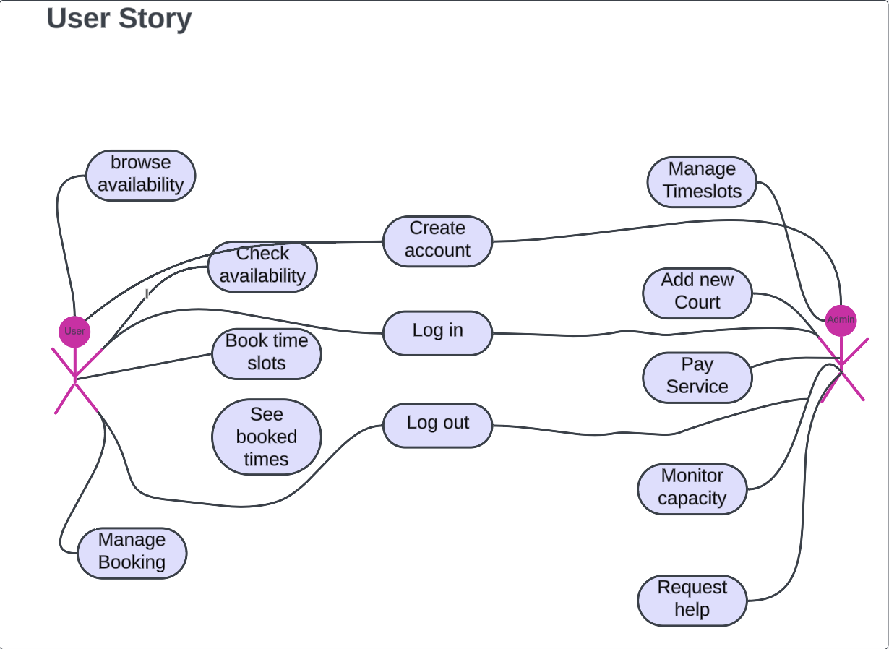
User Actions
Utilized User Story diagrams to define and document the initial application requirements
Facilitated a clear understanding of user needs and system functionality
Provided a foundation for further detailed specifications and development planning
Notes:
Breifly discuss the user actions in the diagram between the user and admin.

Slide 6
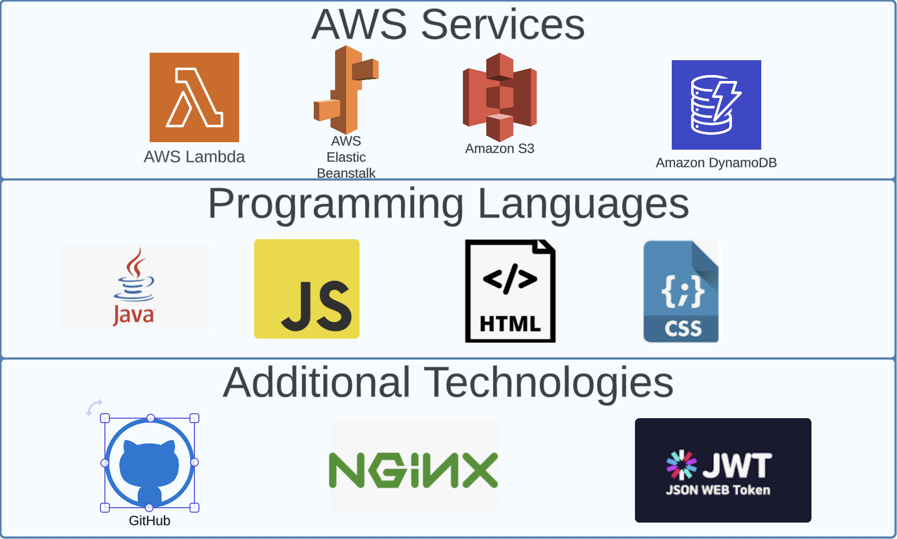
Technologies and Resources
AWS Service to deploy the Application
Utilized Elastic Beanstalk for seamless deployment
Leveraged DynamoDB for efficient semi-structured JSON data handling
S3 to store files and images
Backend Development: Java
Frontend Development: ReactJS, HTML, CSS
Authentication: JWT (JSON Web Tokens)
Load Balancing: NGINX
CI/CD: GitHub

Slide 7
Technologies and Resources
AWS Service to deploy the Application
Backend Development: Java
Frontend Development: ReactJS, HTML, CSS
Authentication: JWT (JSON Web Tokens)
Load Balancing: NGINX
CI/CD: GitHub
Notes:
Utilized Elastic Beanstalk for seamless deployment
Leveraged DynamoDB for efficient semi-structured JSON data handling
S3 to store files and images

Slide 8
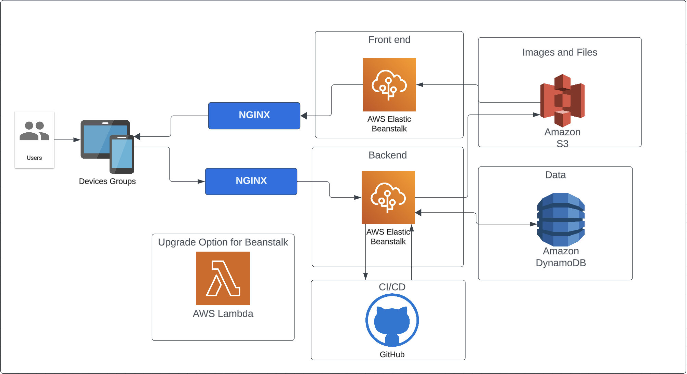
Application Architecture

Slide 9
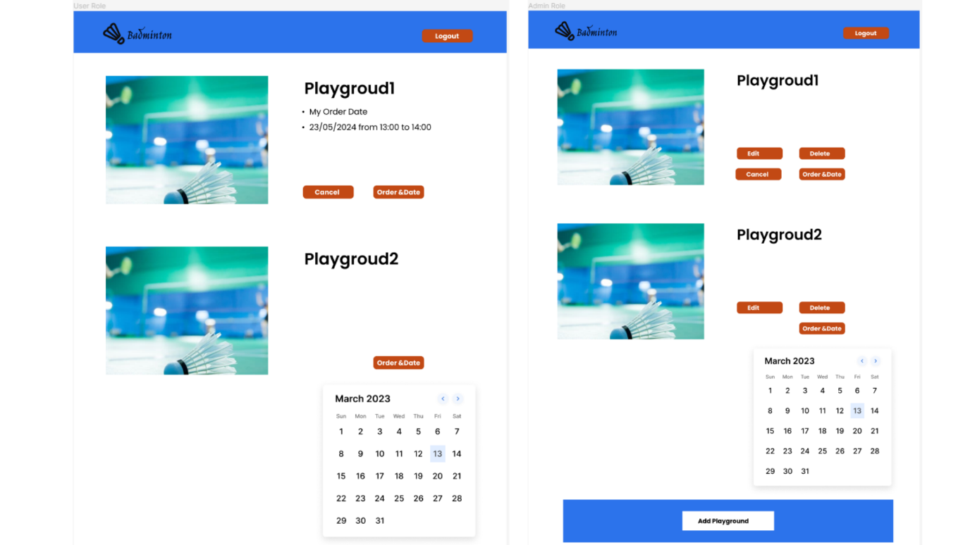
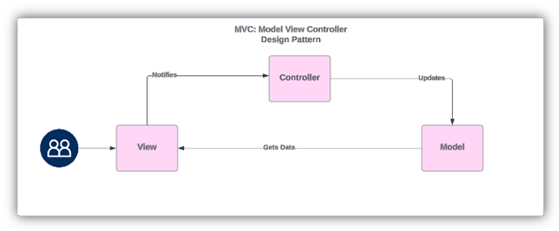
Front and Backend Application Design
Frontend developed using Figma for creating detailed and interactive UI/UX designs
Backend implements a Model-View-Controller (MVC) design pattern to separate concerns and enhance maintainability

Slide 10

Front and Backend Application Design
The frontend developed using Figma for creating detailed and interactive UI/UX designs
The backend implements a Model-View-Controller (MVC) design pattern to separate concerns and enhance maintainability

Slide 11
DEMO

Slide 12







Future Works
Add Data Warehouse and ETL from DynamoDB to Snowflake/ Redshift
Add a payment system (eg. Windcave)
Multifactor Authentication (MFA)
Adding functionality for different types of courts and event locations
AWS Lambda for backend application
CloudFront implementation for CDN and frontend application

Slide 13
Future Works
Add Data Warehouse and ETL from DynamoDB to Snowflake/ Redshift
Add a payment system (eg. Windcave)
Multifactor Authentication (MFA)
Adding functionality for different types of courts and event locations
AWS Lambda for backend application
CloudFront implementation for CDN and frontend application

