Slide 1
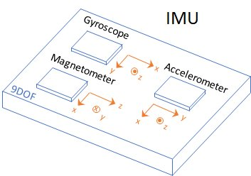
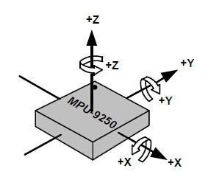
OBSERVER - EKF
The sensor available onboard is the IMU (Inertia Measurements Unit) with 9 DOFs, that are:
3 axes linear accelerations
3 axes angular velocity
3 axes magnetic field
Maggioni Anna, Mastromauro Matteo, Pina Camilla, Zagati Alex

Slide 2






OBSERVER - EKF
High level working scheme of the EKF:
IMU
EKF
$$\hat{φ}$$
Accelerometer
$$a^{b}$$
$$\hat{θ}$$
$$ω^{b}$$
Gyroscope
$$B^{b}$$
$$\hat{ψ}$$
Magnetometer
Maggioni Anna, Mastromauro Matteo, Pina Camilla, Zagati Alex

Slide 3














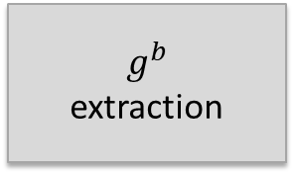



OBSERVER - EKF
EKF
$$g^{b}$$
extraction
$\tilde{φ} \& \tilde{θ}$
computation
$$ω^{b}$$
$$EKF_{φ,θ}$$
$$\hat{φ }, \hat{θ}$$
$$a^{b}$$
$$g^{b}$$
$$\tilde{φ} , \tilde{θ}$$
$${\hat{b}}_{x},{\hat{b}}_{y},{\hat{b}}_{z}$$
$$ω^{b}$$
$$\hat{φ }, \hat{θ}$$
$$\tilde{ψ}$$
$$EKF_{ψ}$$
$$\tilde{ψ}$$
computation
$$B^{b}$$
$$\hat{φ }, \hat{θ}$$
$$\hat{ψ }$$
$${\hat{b}}_{x},{\hat{b}}_{y},{\hat{b}}_{z}$$
Maggioni Anna, Mastromauro Matteo, Pina Camilla, Zagati Alex

Slide 4
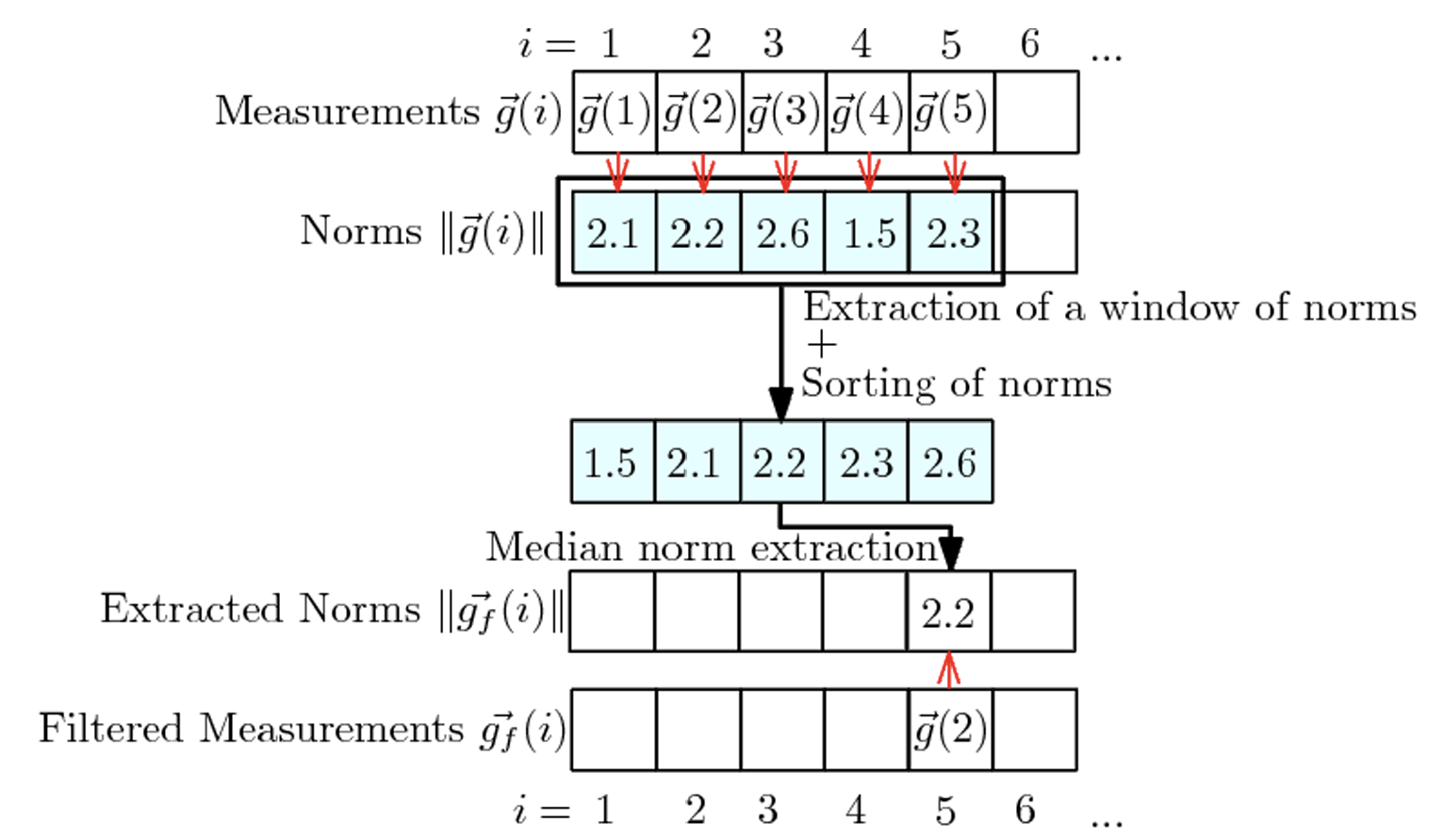

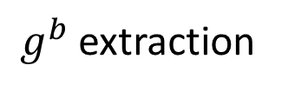


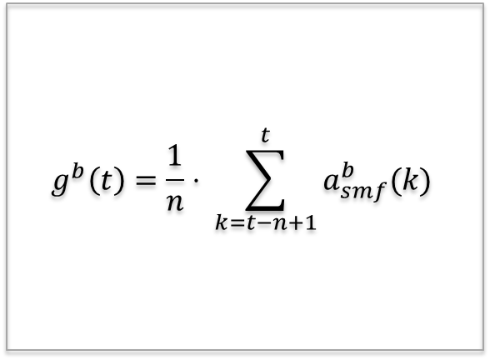

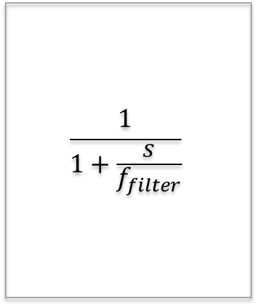
OBSERVER - EKF
$g^{b}$extraction
$$a^{b}$$
Low-Pass
Filter
$$a_{filtered}^{b}$$
Sliding Median Filter
$$a_{smf}^{b}$$
Sliding Average Filter
$$g^{b}$$
$$\frac{1}{1+\frac{s}{f_{filter}}}$$
$$g^{b}\left(t\right)=\frac{1}{n}⋅ \sum_{k=t−n+1}^{t}{a_{smf}^{b}(k)}$$
Maggioni Anna, Mastromauro Matteo, Pina Camilla, Zagati Alex

Slide 5
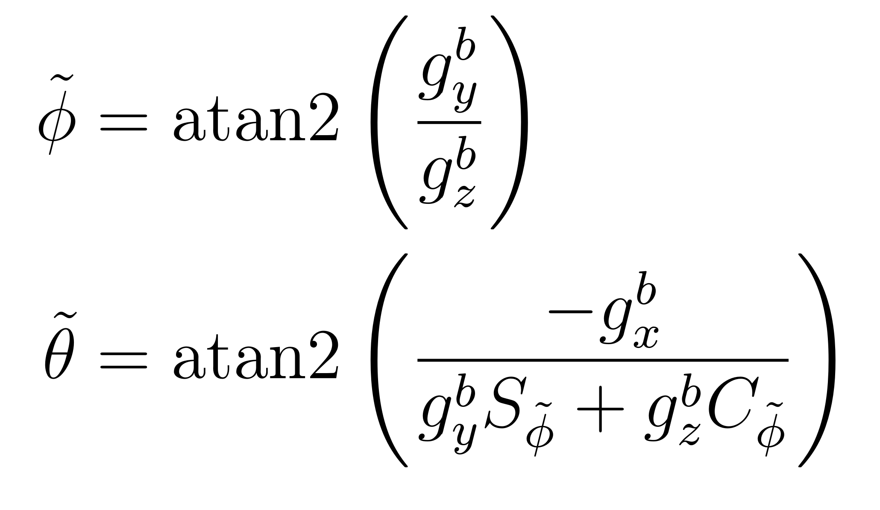
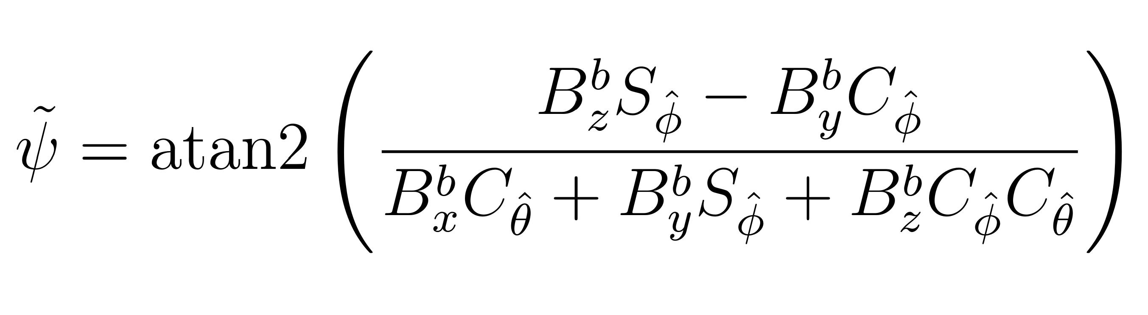
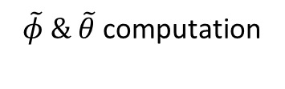





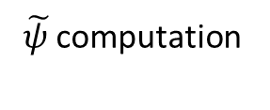
OBSERVER - EKF
$\tilde{φ} \& \tilde{θ}$ computation
$\tilde{ψ }$computation
$$\hat{φ }, \hat{θ}$$
$$a^{b}$$
$$\tilde{φ} , \tilde{θ}$$
$$\tilde{ψ}$$
$$B^{b}$$
Maggioni Anna, Mastromauro Matteo, Pina Camilla, Zagati Alex

Slide 6
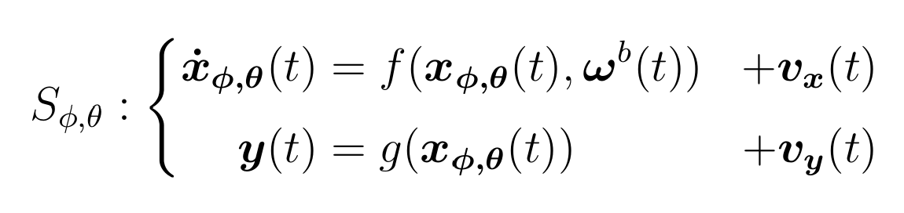
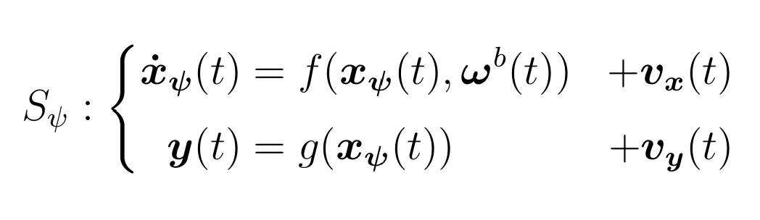
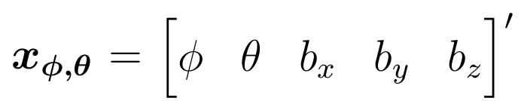
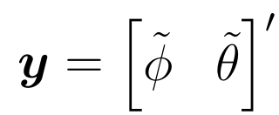
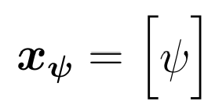
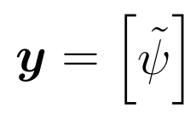
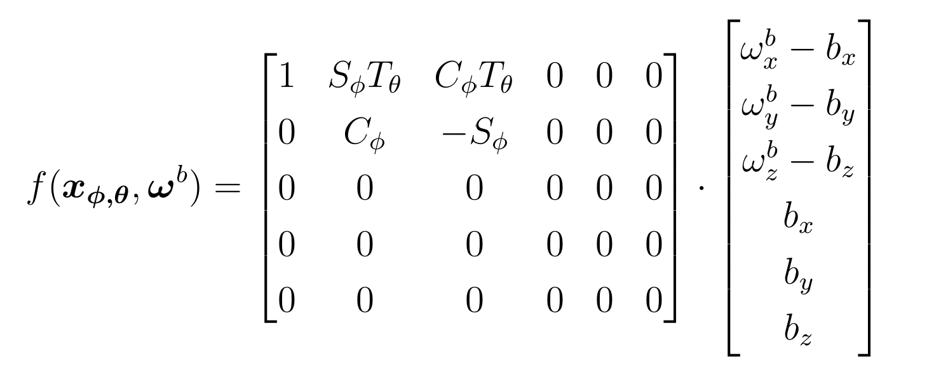
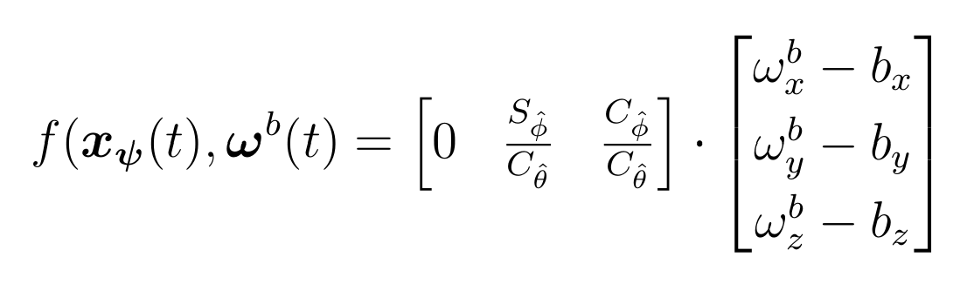
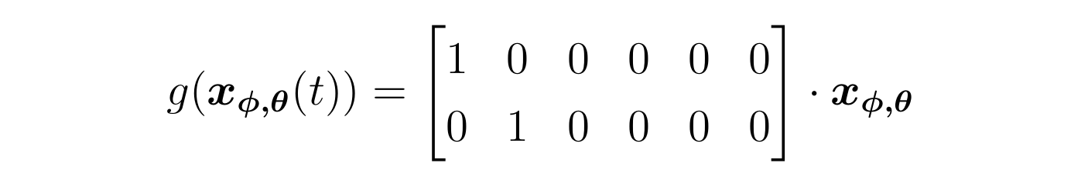









OBSERVER - EKF
$$EKF_{φ,θ}$$
$$EKF_{ψ}$$
$$ω^{b}$$
$$ω^{b}$$
$$\hat{φ }, \hat{θ}$$
$$\tilde{ψ}$$
$$\tilde{φ} , \tilde{θ}$$
$$\hat{φ }, \hat{θ}$$
Maggioni Anna, Mastromauro Matteo, Pina Camilla, Zagati Alex

Slide 7
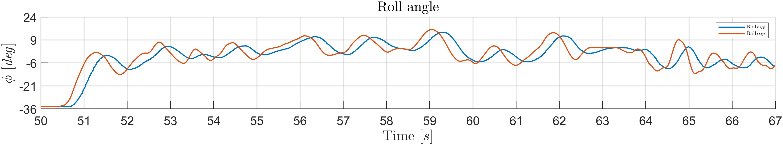
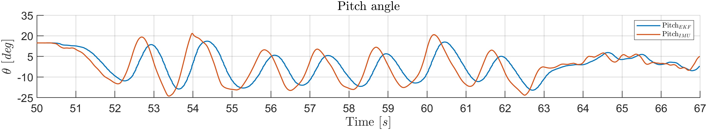
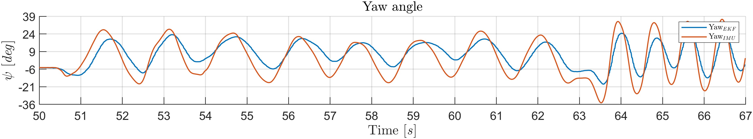
OBSERVER - EKF
Results:
Maggioni Anna, Mastromauro Matteo, Pina Camilla, Zagati Alex

Slide 8
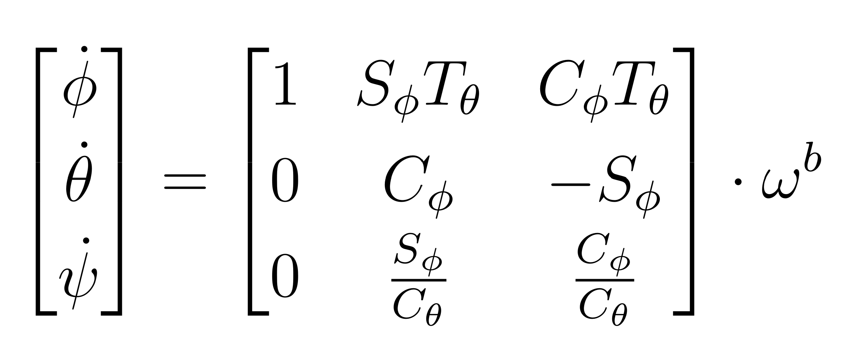




OBSERVER - EKF
$\hat{\dot{φ}},\hat{\dot{θ}},\hat{\dot{ψ}}$ computation
$$ω^{b}$$
$$\hat{\dot{φ}},\hat{\dot{θ}},\hat{\dot{ψ}}$$
$$\hat{φ }, \hat{θ}, \hat{ψ}$$
Maggioni Anna, Mastromauro Matteo, Pina Camilla, Zagati Alex

Slide 9
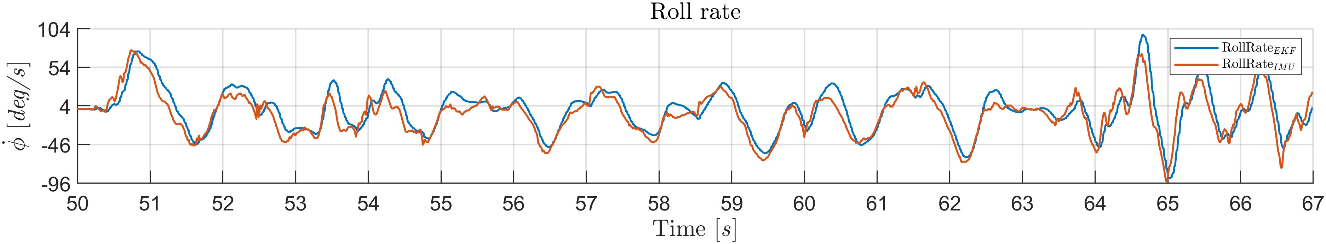
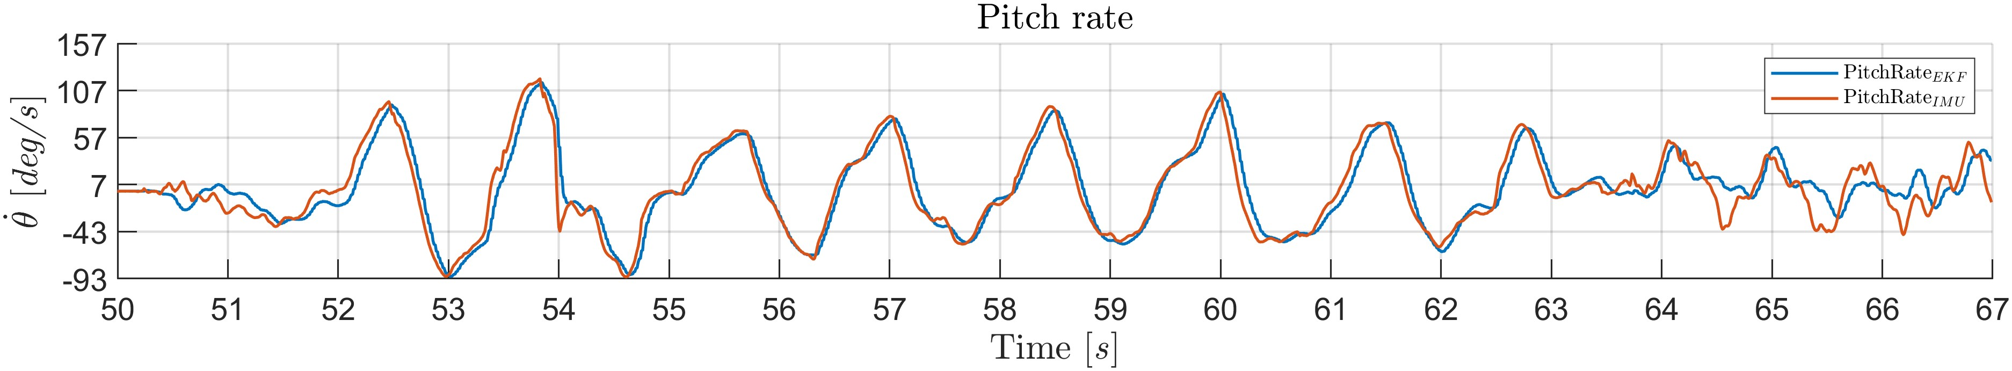
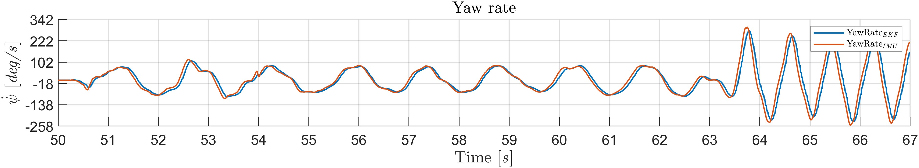
OBSERVER - EKF
Results:
Maggioni Anna, Mastromauro Matteo, Pina Camilla, Zagati Alex

