Slide 1

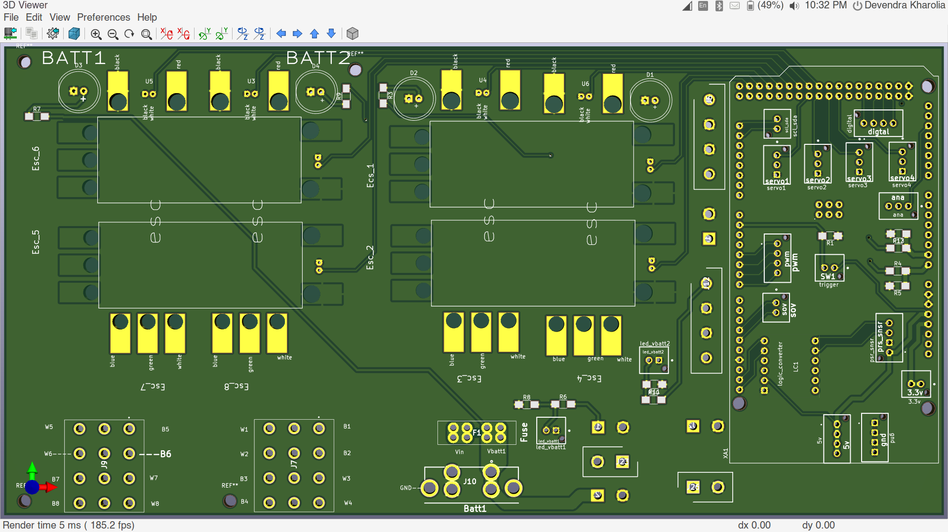
Pcb_v2.0_FRONT
Pcb_v2.0_FRONT

Slide 2
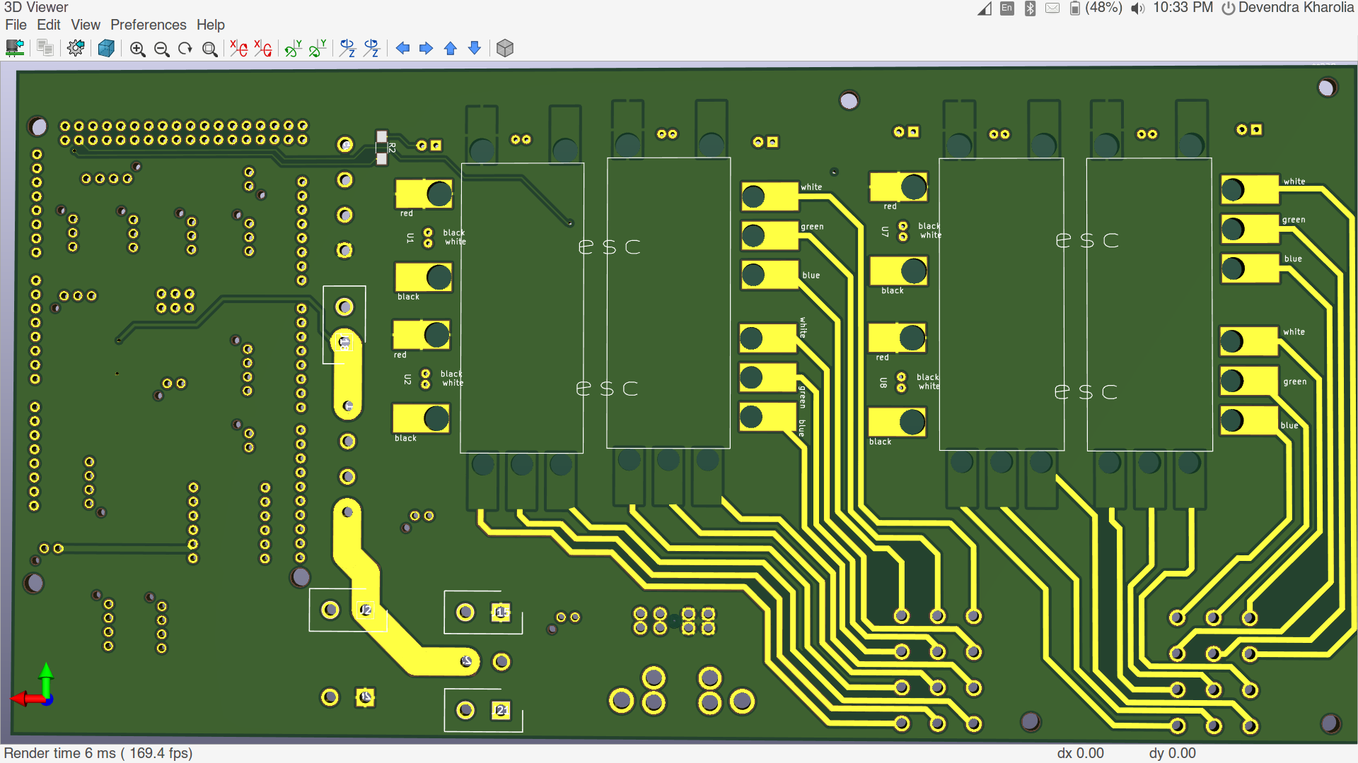
Pcb_v2.0_BACK

Slide 3
Specification
1. 8 Esc aligned according to HEAT-SINK compatibility.
2. Can be used to drive 4 servos.
3. Supports External SOV (pcb only has electrical connections).
4. Has 2 bucks compatibility two get multiple voltage lines.
5. Battery voltage measuring.

