Slide 1

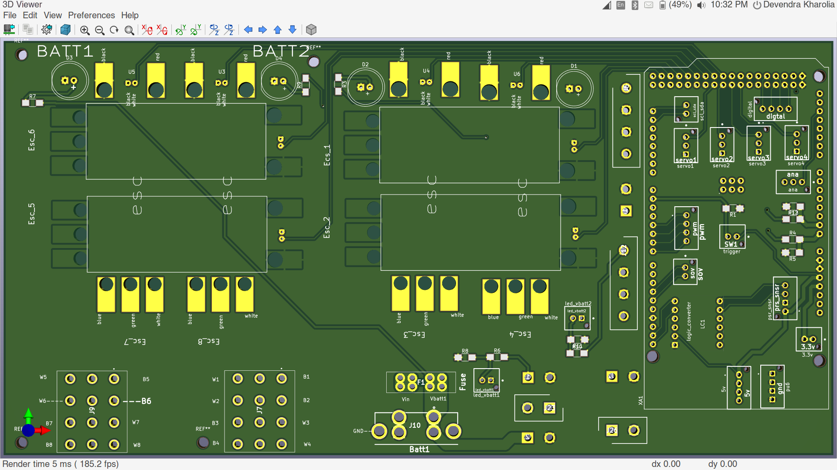
Pcb_v2.0_FRONT
Pcb_v2.0_FRONT

Slide 2
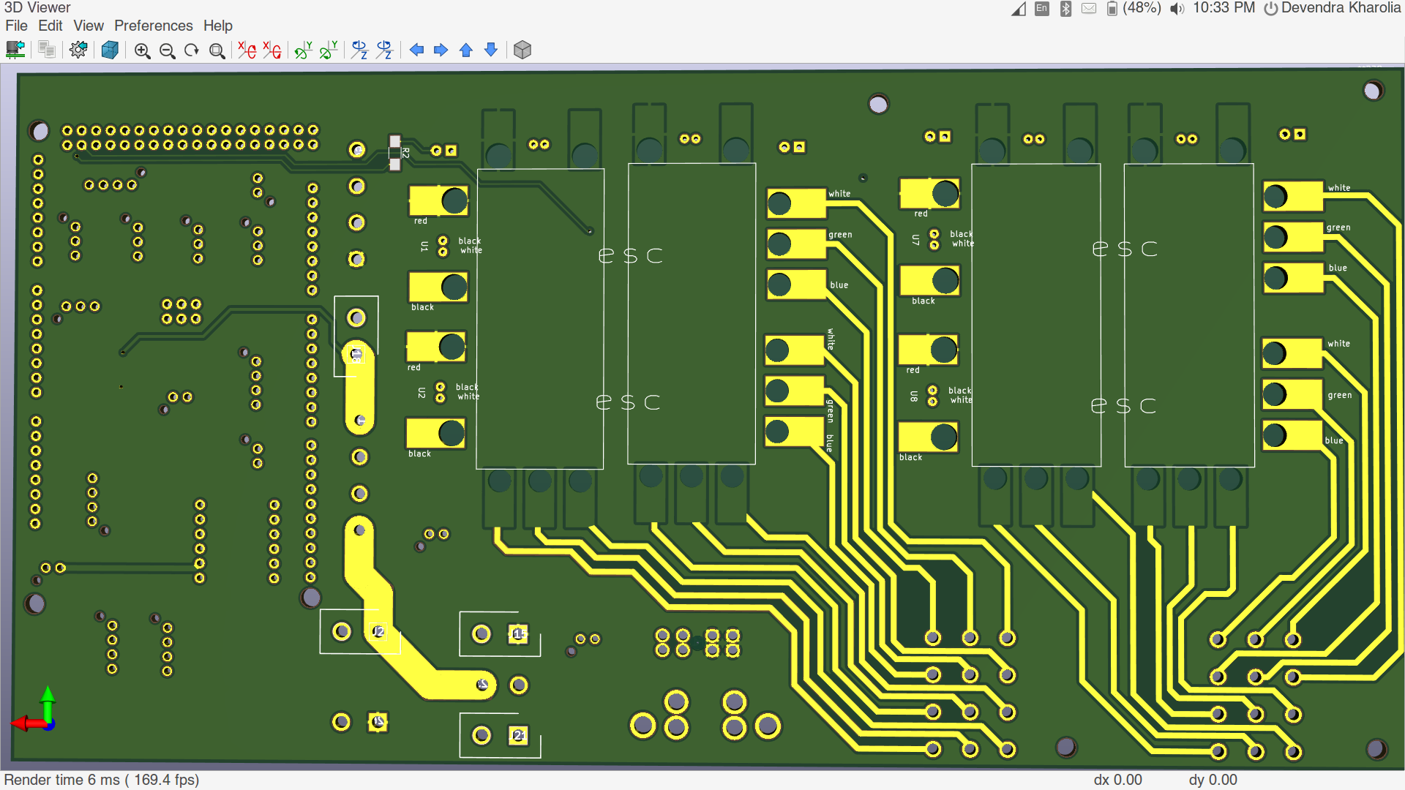
Pcb_v2.0_BACK

Slide 3
Specification
1. 8 Esc alinged according to HEAT-SINK compatibility.
2. 4 servo.
3. Supports External SOV (pcb only has connections).
4. 2 buck (for servo and nuc).
5. Connections for External buck.
6. Battery voltage measuring.

