Slide 1
De-Anonymizing DDoS Attackers
Fingerprinting with a Custom DNS Server
Ryan Raymond 12/1/24

Slide 2
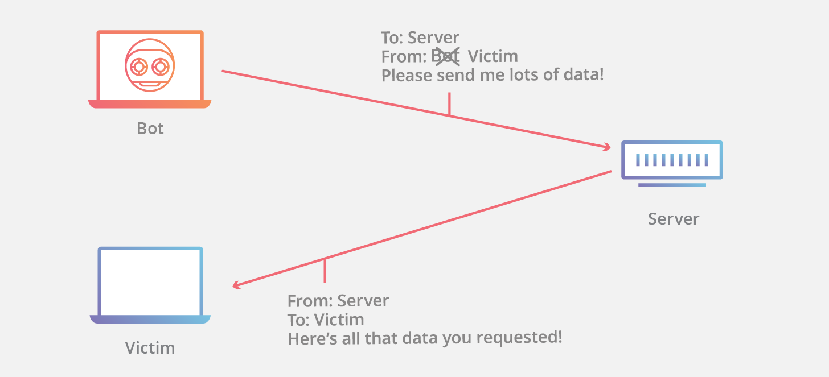
Anonymous DDoS Attackers
DDoS attacker machines do not need to disclose their IP addresses. They can easily pretend that traffic is originating elsewhere.
The “attacker” cannot simply be blocked by the firewall. Not only would this be ineffective, but it would also risk harming innocent bystander clients.
Our technique can perform two important functions.
We can prevent attackers from impersonating other clients.
We can de-anonymize attackers and determine their true IP addresses.

Slide 3
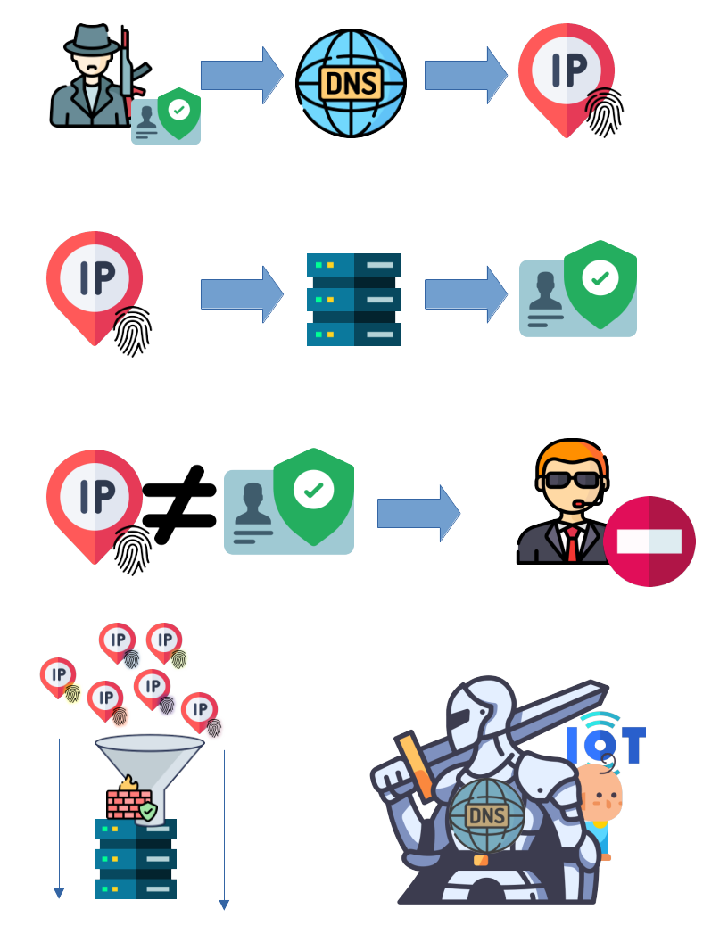
Forced Disclosure of Identity
Each source address (/64 subnet) has only one acceptable destination address, as determined by reversible encryption.
E.g., a client at fc00:df25:793:97c4:: must connect to fc00::b45:df96:26d7:bb34 or the request packets will be dropped.
It is computationally intractable to guess either address
The most efficient way to find a route the server is to query a cooperative DNS over HTTPS server which knows the pre-shared key and initial vector used in encryption and decryption.
HTTP GET /dns-query?name=i75.iot.us&type=AAA
"fc00::5677:bbd0:e22e:5503"
All IP addresses on some range are routed through the firewall and into the server ->

Slide 4
Countering Malicious Activity
The attacker cannot try to guess another address on the server’s range, because its source address will not match.
Neither can the attacker easily forge a DNS request on behalf of an innocent bystander, because the attacker would need to receive response data from the DNS server.
If malicious activity is detected, that particular destination address can be closed.
If the attacker queries the DNS server to find a new address to attack, it will only reply with the same IP address as last time.

Slide 5
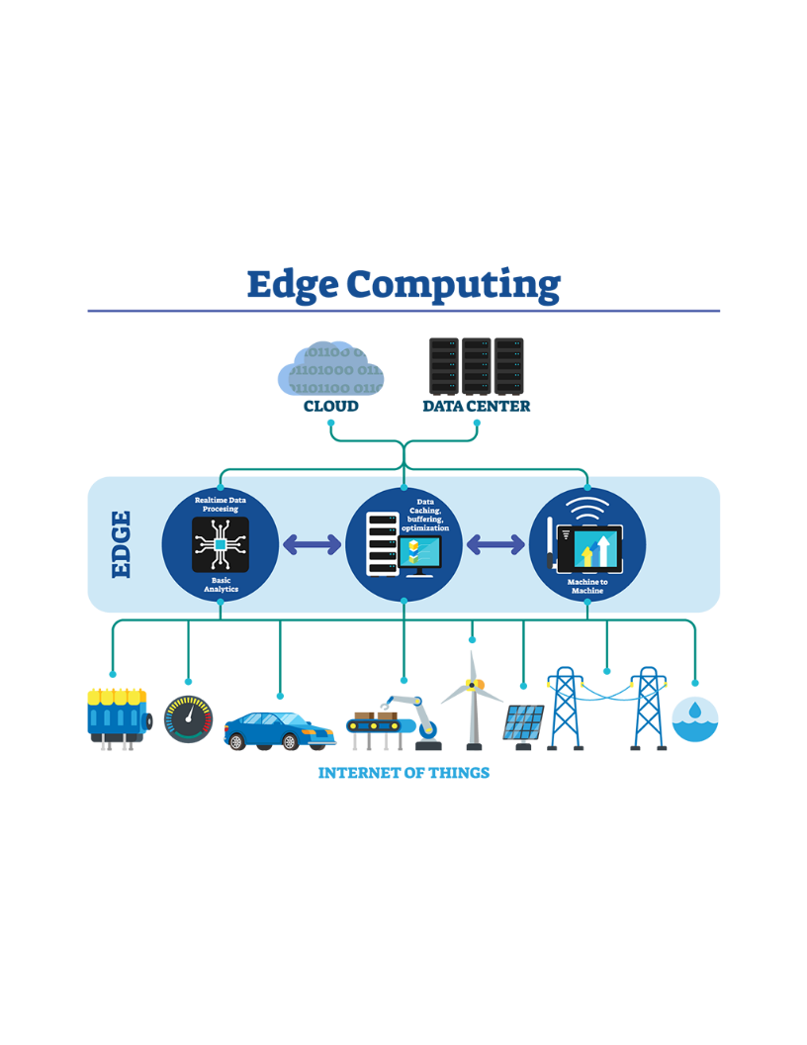
Use-Case: IoT Edge Servers
Small-scale compute is used when low-latency is needed, or when network transfer is expensive.
Small compute lacks effective DDoS protection
By depending on a large, central cloud DNS provider, DNS compute can off-load some of the DDoS burden onto the much beefier cloud DNS server

