Slide 1
Computer networking
Uses and features of networks
Alex Chan

Slide 2
Introduction
Networking in general is substantial to our daily lives and it is engrained so much that most our daily functions would cease in the advent of its disappearance. From providing commercial services for businesses to facilitating communication needs for mission-critical military operations, networking is responsible for many tasks undertaken and a necessity to the highly digitalised lives of today. Perforce, it is paramount that an individual understands networking; the types, nomenclature as well as applications of such given networks. Knowledge of these different networks, their features and uses, will reinforce depth of understanding and clearer definitions of the use cases and benefits of computer networks will be realised.

Slide 3
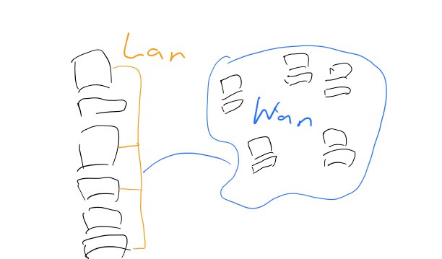
Network type
WAN
WAN ( short for wide area network ) is a network commonly used throughout by government and educational bodies. Wide areas are most useful when connecting nodes spanning vast amounts of land is needed, for example the networks used within large businesses. It can be distinguished by LAN in that LAN refers to locally proximal networks, whereas WAN can span entire regions, countries, or even globally. WAN
is not limited by its location, unlike LAN, and therefore can provide for organisations such as schools or businesses communication of data at greater lengths.

Slide 4
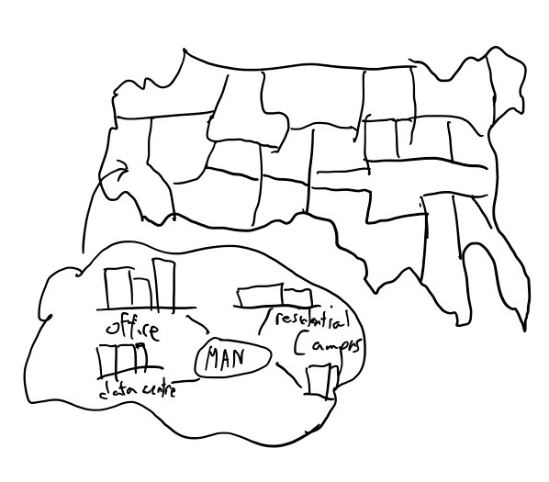
Network type
MAN
Metropolitan area networks concern chiefly the networks regarding metropolitan sized areas, cites and the like. A particularly useful concept as certain large companies require the need to link up their offices and relay information within cities. Implementation of MAN
originated when companies opted to use dark fibre ( unused optical fibre cables ) to link together their offices. These dark fibre cables were a byproduct of civil engineering design,
as cost of labour was often much more expensive than the fibre itself, redundancy had been built in large amounts of said data links such that repair and maintenance cost would be reduced.
Telephone companies having realised the commercial value and market LANs of their customers need to be linked together and started to offer their dark fibre for use on a subscription
basis. This solution solved the problem for companies and that they could link together their office networks, but crucially these were leased by telephone companies as private networks and therefore did not have necessary gateways connecting them to the internet and are therein limited to metropolitan areas.

Slide 5
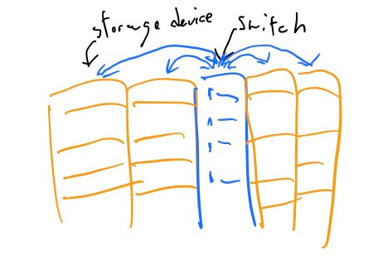
Network type
SAN
A most definite useful network type, storage area networks are commonly found within data centres and are used as a means of offering access to the vast amounts of data within said system with servers separate from the storage devices. Storage area networks are developed such that access, storing, and copies of data can be made with ease and a dedicated network can be established between storage devices. Specific protocols are developed and data linking methods are used such that the a SAN can be configured for the specific needs of the user of that network.

Slide 6
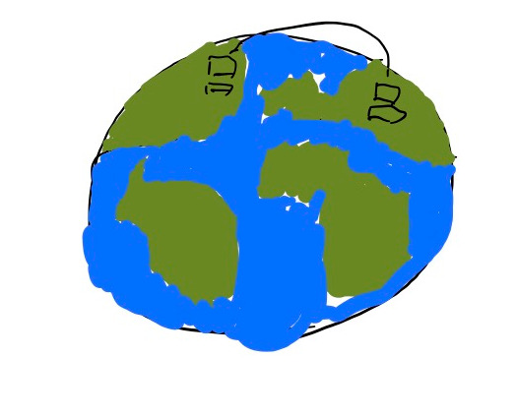
Uses of computer networks
The uses of computer networks is so ineffably large that description of its minute detail can be scarcely done. But it is often useful to generalise and subdivide it into certain categories. Description of three main uses of computer networks will be done here. First, communication is a crucial service provided by the use of computer networks. Essential services such as instant messaging or email
allow users from messages to be forwarded and received from different regions of the world. Another use case is that of commerce, that is with use of computer networks purchase of products could be done online and monetary transactions need not be done physically and convenience is the result. A different use is that of education, being teaching and conversely learning can be done in spite of having being physically present. This is most useful for it allows students to ask questions or review learnt content through computers and done within networks.

Slide 7
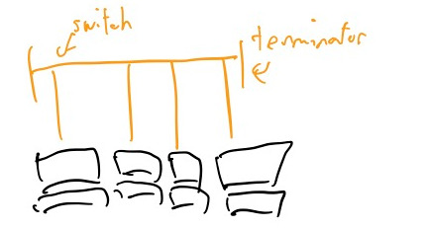
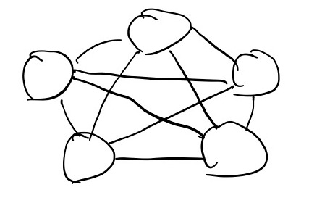
User experience and network features
Greater understanding can be realised when analysing the different topologies and connection methods used within networks. Differing types can affect end users in their own ways and when knowledge of their unique characteristics can one make a best choice of network method be determined with precise clarity.
Bus
Mesh
The bus networking topology is a arrangement of nodes within a network by which all nodes communicate their data to a central station and no nodes has any special priority to access the network. As such algorithms must be in place such that when a computer on that network wish to forward data, it can detect if other computers are sending any data and avoid collisions from occurring, wait until the computer has finished sending their message before proceeding to send their own.
Generally useful in applications where high speed reliable networks are need, mesh topologies are highly advanced and use sophisticated algorithms and require immense amounts of planning to ensure maintainability as well as reliability. When nodes within the system are established, it will be linked with each and every other node within the system. As a result, in the event of that specific node going out of service, the whole functionality of the system will remain and its performance decrease will be negligible. A drastic disadvantage is that due to the precise nature of its design, locating which node had malfunctioned at which link it was becomes immeasurably difficult. As well as maintenance downtime there is consideration of the cost of the cables alone, as the network grows the amount of cables linked are increasing exponentially, and may be result of large amounts of maintenance cost.

Slide 8
Strengths of different network types
Strengths
WAN
MAN
The strengths of wide area networks are plentiful, being that they span regions and countries, their reach is enormous and companies can thus send data to their constituent parts at efficient rates. Reliability is also afforded when using a wide area network as when more networks join together to from a larger monolithic network, when certain areas of the network go out of operation ( power outage, disaster, etc. ), data can be circumnavigated and directed using paths defined with the other networks
Metropolitan networks are generally useful for certain organizations centralized within a city and does not require the wide spanning coverage that wide area networks are associated with. Hospitals and government institutes benefit from this type of network the most, their fibre optic links pre-installed( MANs use dark fibre ) and as result is MANs can be established very fast.

Slide 9
Strengths of different network types
Weaknesses
WAN
MAN
Whilst reviewing the strengths of WAN, it is also instrumental to consider its downside, being how it can easily be hard to manage, connect, and ensured for security from all possible threats. Scalability is the main concern, linking together the growing amount of nodes to the network and managing and creating efficient connections requires immense amount of manpower and planning. It is this that WAN is most disadvantaged, the fact that they are expensive and complex is why larger organizations manage WANs.
There are also downsides to the use of MAN networks, a key reason why MANs aren't used as widely is that at times they can limited to span only cities. Connect to larger networks are impossible as to how they are set up, being forced to use pre-existing optical fibre links only has set limitations as to the region of MANs. This can be disadvantageous to some but a few organizations may only limit their network to city sizes.

Slide 10
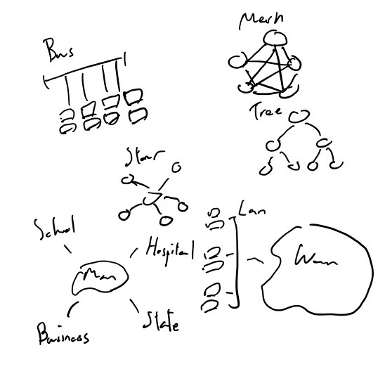
Summary
Concluding, computer networks permeate throughout our lives and it use cases is immensely varied. From providing communication services as well as education ones, computer networks are critical to the functions of everyday living. It is also after analysis that insight into how different network types can vary and what uses they fit into. A crucial understanding is further instantiated as knowledge of the strengths and weaknesses of different network types is studied. It is not realised that one most consider the network type that they are creating during the planning process. A WAN may have its specific upsides, such as speed and wide area coverage, but its downsides in being hard to maintain and connect may cause use of a smaller scale LAN be more applicable. These key concepts of when and what computer networks should be used provide knowledge into what comprises the necessary fundamental bases in which more advanced network concepts can be consolidated and their ideas developed. Considering the full scope of networks provide us the motivations and desire to see sufficient and reliable networks realised such that their implementation will be extensible and well defined.

