Slide 1
AVX-Framework
Roadmap to developing user-facing applications
11-19-2023

Slide 2
AVX-Framework dependencies – 3B27
AVX Framework
http://github.com/AV-Text
<< C++ / x64 / DLL >>
AVX-Search
[Rapid YAML]
http://github.com/AV-Text
<< C++ / x64 / static lib >>
AVX-Text
[includes XVMem]
blueprint_blue.h
<< generated header >>
P/Invoke
avx_search.h
<< generated header >>
yaml
http://github.com/AV-Text
<< C# / x64 / DLL >>
AV-Engine
[YamlDotNet]
http://github.com/kwonus
<< C# Assembly >>
AVX-Lib
AVX-Omega-3911
Digital-AV SDK
Module | Input | Output
AV-Engine | Quelle Command (text) | IAVResult interface
AVX-Lib | C# Classes/Methods | C# Classes/Methods
AVX-Search | blueprint (yaml) | avx_search (yaml)
AVX-Text | C++ Classes/Methods | C++ Classes/Methods
Pinshot-Blue | null-terminated text | null-terminated json
Blueprint-Blue | null-terminated string | blueprint (yaml)
NUPhone | C# Classes/Methods | C# Classes/Methods
avx_search.fbs
<< flattbuffers schema >>
poco
poco
string
yaml
http://github.com/kwonus
<< C# Assembly >>
NUPhone
http://github.com/kwonus
<< C# Assembly >>
Blueprint-Blue
[FlatSharp]
http://github.com/kwonus
<< Rust x64 DLL >>
Pinshot-Blue
[Pest crate]
string
P/Invoke
json
en_US.txt
<<IPA lexicon>>
blueprint_blue.fbs
<< flattbuffers schema >>
Quelle.pest
<<PEG Grammar>>

Slide 3
AVX Roadmap – 3B27 – CY2023
AVX Framework
http://github.com/AV-Text
<< C++ / x64 / DLL >>
AVX-Search
[Rapid YAML]
Q4/2023
http://github.com/AV-Text
<< C++ / x64 / static lib >>
AVX-Text
[includes XVMem]
Q2/2023
http://github.com/kwonus
<< C# / x64 >>
AV-Bible
[WPF Windows only BETA]
Q4/2023
✓
yaml
✓
http://github.com/AV-Text
<< C# / x64 / DLL >>
AV-Engine
[YamlDotNet]
Q4/2023
http://github.com/kwonus
<< C# Assembly >>
AVX-Lib
Q4/2023
AVX-Omega-3911
Digital-AV SDK
poco
Windows User
http://github.com/AV-Text
<< C# / x64 >>
AV-Console
[Windows-Only BETA]
Q4/2023
✓
poco
poco
string
yaml
http://github.com/kwonus
<< C# Assembly >>
NUPhone
Q3/2023
http://github.com/kwonus
<< C# Assembly >>
Blueprint-Blue
[FlatSharp]
Q3/2023
http://github.com/kwonus
<< Rust x64 DLL >>
Pinshot-Blue
[Pest crate]
Q3/2023
string
✓
✓
json
✓

Slide 4
AVX Roadmap – 3B27 – CY2024
AVX Framework
http://github.com/kwonus
<< C# / x64 / App >>
AV-Bible
[WPF Windows Desktop App]
Q1/2024
http://github.com/AV-Text
<< C++ / x64 / DLL >>
AVX-Search
[Rapid YAML]
Q4/2023
http://github.com/AV-Text
<< C++ / x64 / static lib >>
AVX-Text
[includes XVMem]
Q2/2023
Windows User
✓
yaml
✓
Microsoft Word
<< TBD / x64 / Service >>
AV-Bible-Web
Q4/2024
http://github.com/AV-Text
<< C# / x64 / DLL >>
AV-Engine
[YamlDotNet]
Q4/2023
http://github.com/kwonus
<< C# Assembly >>
AVX-Lib
Q4/2023
AVX-Omega-3911
Digital-AV SDK
poco
Any User
json
REST
poco
poco
string
yaml
<< javaScript >>
AV-Word
[Microsoft Word Web Addin]
Q3/2024
http://github.com/AV-Text
<< C# / x64 / Service >>
AV-API
[ASP.Net / REST]
Q2/2024
http://github.com/kwonus
<< C# Assembly >>
NUPhone
Q3/2023
http://github.com/kwonus
<< C# Assembly >>
Blueprint-Blue
[FlatSharp]
Q3/2023
http://github.com/kwonus
<< Rust x64 DLL >>
Pinshot-Blue
[Pest crate]
Q3/2023
REST
string
json
json
✓
✓
✓

Slide 5
AVX Roadmap – 3B27 – CY2025
AVX Fully-Native Framework
http://github.com/AV-Text
<< Native x64 >>
AV-Command
[C++ or Rust]
<< C++ / x64 / DLL >>
AVX-Search
<< C++ / x64 / static lib >>
AVX-Text
Any User
http://github.com/kwonus
<< Rust x64 DLL >>
Pinshot-Blue
[Pest crate]
http://github.com/kwonus
<< C# Native x64 >>
Blueprint-Blue
[dotnet 8 / AOT]
http://github.com/kwonus
<< C# Native x64 >>
NUPhone
[dotnet 8 AOT]

Slide 6
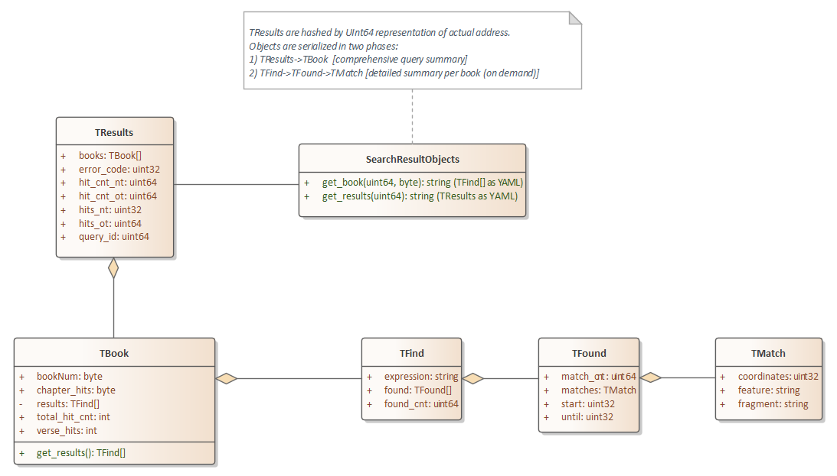
Results: C++ to C# via staged YAML
TBook maps to TFound and TChapter
Total_hits
Book_hits
Chapter_hits
Verse_hits
Book_cnt
Byte Chapter_cnt[66]
Byte Chapter_hit_cnt[66]
Map<book_num, TChapter>
TFound includes TFind (bidirectional) // Tfind includes Tfragment // TFound includes matched features from matchany
TResults maps to Tfind list
Tchapter has list of Chapter_hits (one per chapter); and a map<uint32, Tfound>[] by chapter

Slide 7
AVX Roadmap – 3A21 – CY2024
AVX Framework
http://github.com/AV-Text
<< C# / x64 / App >>
AV-Bible
[WPF Windows Desktop App]
Q1/2024
http://github.com/AV-Text
<< C++ / x64 / DLL >>
AVX-Lib
[includes a hijacked XVMem]
Q2/2023
http://github.com/AV-Text
<< C++ / x64 / DLL >>
AVX-Search
[library / flatbuffers]
Q4/2023
Windows User
Microsoft Word
<< C# / x64 / Service >>
AV-Bible-Web
[ASP.Net / Blazor]
Q4/2024
http://github.com/AV-Text
<< C# / x64 / DLL >>
AV-Engine
[FlatSharp]
Q4/2023
Any User
<< javaScript >>
AV-Word
[Microsoft Word Web Addin] Q3/2024
http://github.com/AV-Text
<< C# / x64 / Service >>
AVX-API
[ASP.Net / REST]
Q2/2024
http://github.com/kwonus
<< Rust x64 DLL >>
Pinshot-Blue
Q3/2023
http://github.com/kwonus
<< C# Assembly>>
Blueprint-Blue
Q3/2023
http://github.com/kwonus
<< C# Assembly>>
NUPhone
Q3/2023
✓
✓
✓

Slide 8
AVX Roadmap – 3911
http://github.com/kwonus
<< Rust x64 DLL >>
Pinshot-Blue
Q3/2023
http://github.com/AV-Text
<< C++ / x64 >>
AVX-Lib
[includes a hijacked XVMem]
Q2/2023
<< C# >>
AV-Bible-Web
[Azure Web App / Blazor]
Q3/2024
AVX-Omega-3911
Digital-AV SDK
Quelle
<<PEG Grammar>>
✓
✓
generate
generate
Rust: FFI
AVX-Lexicon
<<flatbuffers>>
http://github.com/kwonus
<< C# x64 >>
Blueprint-Blue
[dotnet 7.0 / FlatSharp]
Q3/2023
Quelle command
http://github.com/AV-Text
<< C++ / x64 >>
AVX-Search
[library / flatbuffers]
Q4/2023
http://github.com/AV-Text
<< C++ / x64 >>
AVX-API
[Oat++]
Q2/2024
Pinshot
<<json>>
generate
✓
Blueprint
<<flatbuffers>>
http://github.com/kwonus
<< C# Assembly>>
NUPhone
[dotnet 7.0]
Q3/2023
http://github.com/AV-Text
<< C++ / x64 >>
AVX-Command
[console app]
Q4/2023
http://github.com/AV-Text
<< C# / x64 >>
AV-Bible
[initially Windows only]
Q1/2024
<< javaScript >>
AV-Word
[Microsoft Word Web Addin]
Q4/2024
en_US.txt
<<IPA lexicon>>
✓
Microsoft Word
Windows User
Any User

Slide 9
Functional view of a Quelle parsing sequence
Quelle
command
Pinshot Blue
Blueprint
Blue
Model for Quelle command
pinshot
blueprint

