Slide 1



Hangman Game
RNS INSTITUTE OF TECHNOLOGY
BENGALURU - 98
DEPARTMENT OF INFORMATION SCIENCE & ENGINEERING
Presentation on
Internship
Aman verma
USN: 1RN18IS014
ENMAZ Engineering Services Pvt. Ltd.
Internal Guide
Mr. Pramoda R
Asst. Prof, Dept of ISE, RNSIT
External Guide
Mr Akshay D R
Co-founder and CEO, Enmaz engineering services

Slide 2
AGENDA
Abstract
About the Company
Introduction
Literature Survey
Requirements
System Design
Detailed Design
Implementation
Conclusion and Future Enhancements
References
Department of ISE, RNSIT

Slide 3
ABSTRACT
In learning foreign language such as English, a learner should have motivation
in order to have willingness to learn. This project is an attempt to investigate the
user motivation in learning English by using Hangman Game. And this project
Was to find out if the use of Hangman game motivates the students in learning
English.
Hangman is an old school favorite, a word game where the goal is simply to find the missing word or words. You will be presented with a number of blank spaces representing the missing letters you need to find.
This project is implemented using flutter.
Department of ISE, RNSIT

Slide 4
About the Company
Enmaz has a simple yet robust solution that helps any Industry / Factory digitise their workfloor in no time.
The products offered will help in remote monitoring, controlling and also analysing any machinene parameter or process.
Reliable Hardware, Time tested, high quality, designed, developed and manufactured in India. 18 months of replacement warranty.
Department of ISE, RNSIT

Slide 5
INTRODUCTION
As the name of the game suggests, the diagram is designed to look like a hanging man. A common alternative for teachers is to draw an apple tree with ten apples, erasing or crossing out the apples as the guesses are used up.
The exact nature of the diagram differs, some players draw the gallows before play and draw parts of the man's body (traditionally the head, then the torso, then the arms and legs one by one). Some players begin with no diagram at all, and drawing the individual elements of the gallows as part of the game, effectively giving the guessing players more chances. If your chosen letter exists in the answer, then all places in the answer where that letter appear will be revealed. After you've revealed several letters, you may be able to guess what the answer is and fill in the remaining letters. Be warned, every time you guess a letter wrong you loose a life and the hangman begins to appear, piece by piece. Solve the puzzle before the hangman dies.
Department of ISE, RNSIT

Slide 6
LITERATURE SURVEY
Language games is a general term used to cover a variety of language activities, and the function of language games is to practice specific language items such as grammar, sentence structures, vocabulary, and spelling, and it is important to develop language skill.
Users can get a lot of knowledge and new experience by playing language games, because the users can learn language with different and fun ways. Language games will give them much benefit which is very important for their language skills.
Department of ISE, RNSIT

Slide 7
Requirements
Software Requirements
  Operating System : Windows 7 and above
  Coding Language : Dart , flutter
  IDE : Visual Studio Code , Android Studio
Hardware Requirements
  8 GB ROM
  64-bit processor
  2 GB Memory
Department of ISE, RNSIT

Slide 8
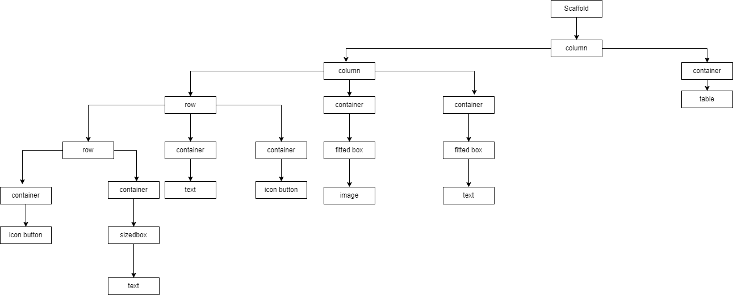
System Design
Department of ISE, RNSIT

Slide 9
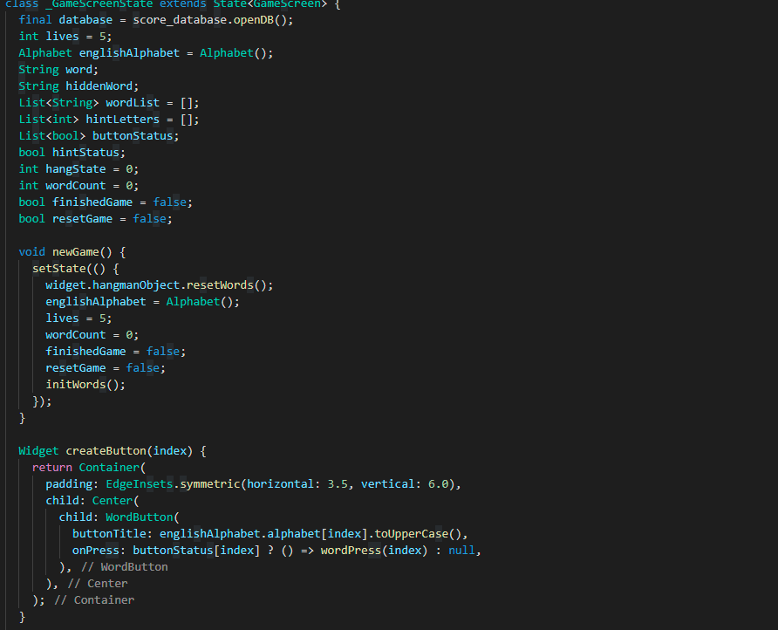
Implementation
Department of ISE, RNSIT

Slide 10
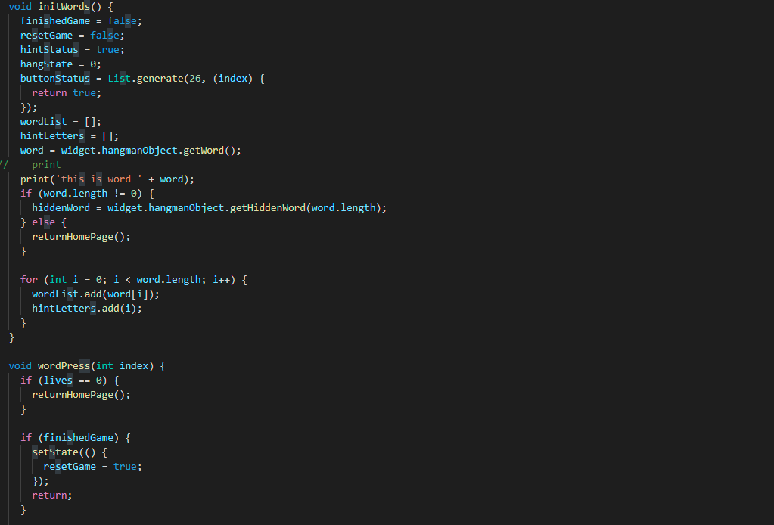
Department of ISE, RNSIT

Slide 11
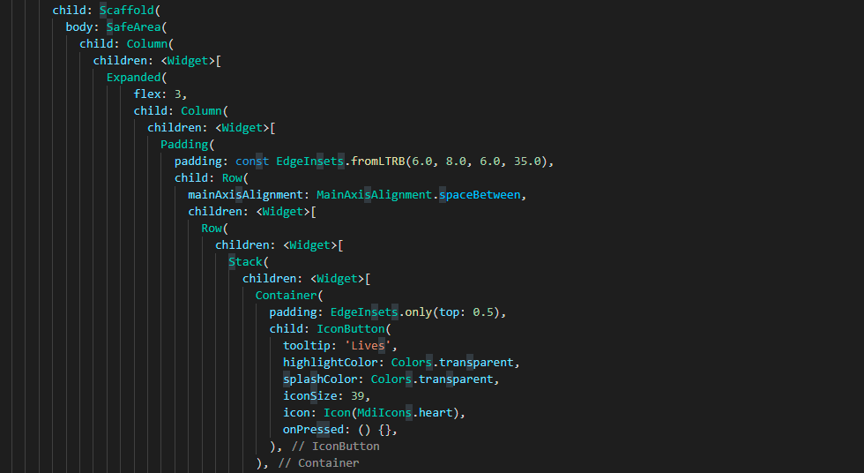
Department of ISE, RNSIT

Slide 12
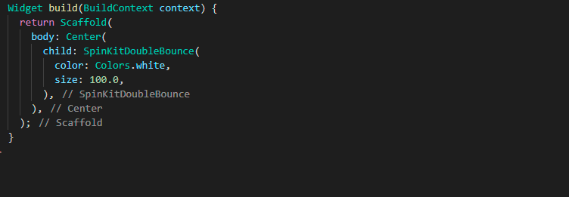
9/14/19
Department of ISE, RNSIT

Slide 13
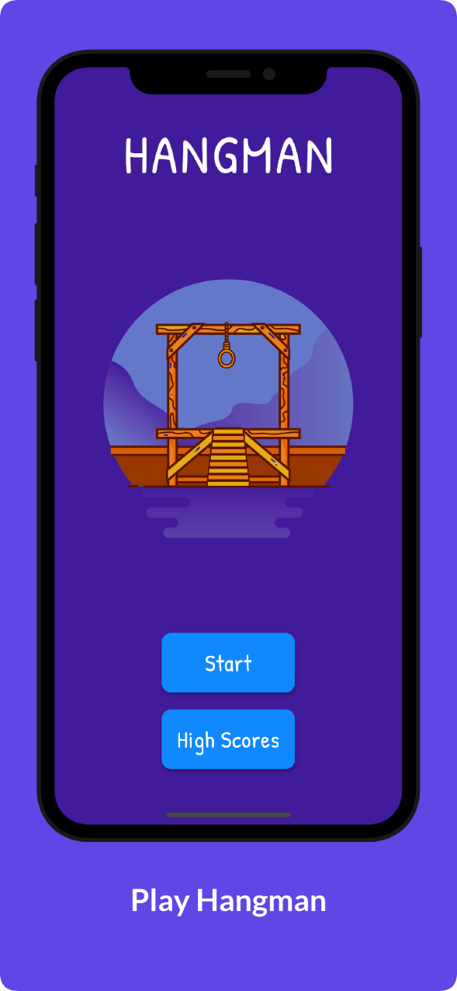
SNAPSHOTS
Department of ISE, RNSIT

Slide 14
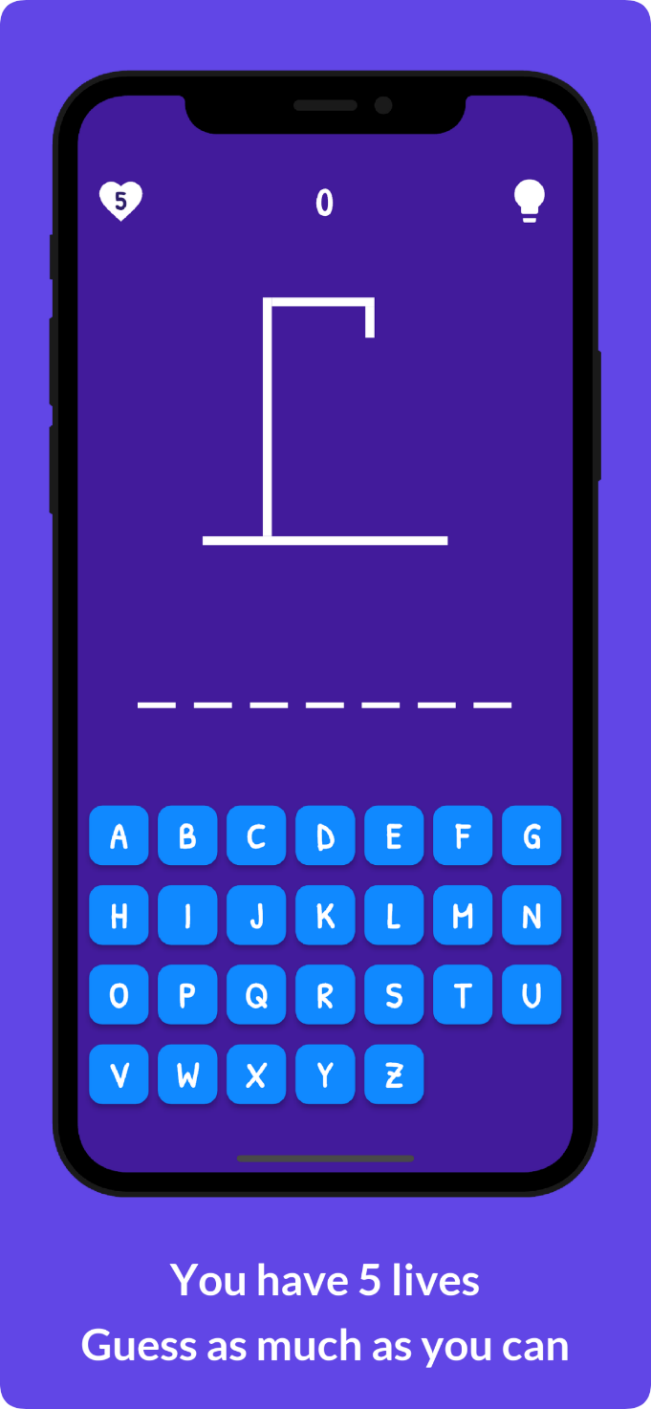
Department of ISE, RNSIT

Slide 15
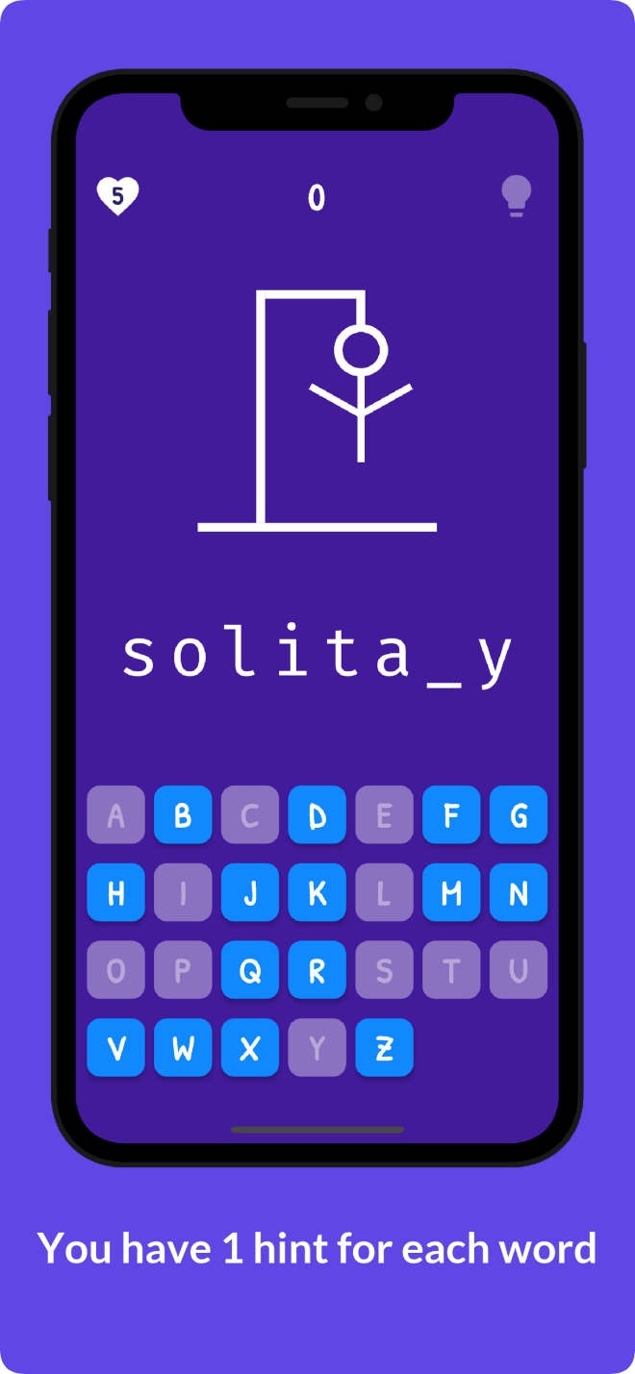
Department of ISE, RNSIT

Slide 16
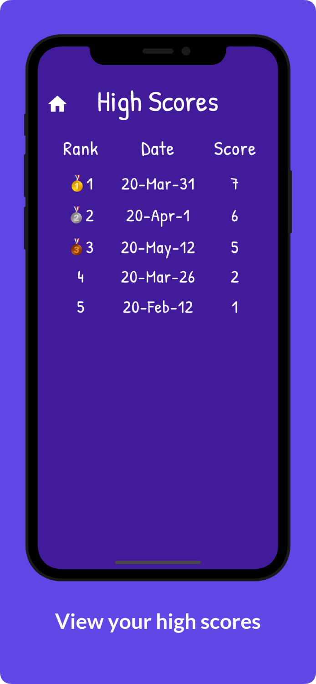
Department of ISE, RNSIT

Slide 17
CONCLUSIONS
In the conclusion of this project, Hangman is a traditional game, typically played with words.
The application is user friendly and attractive thus easily playable by user of all age groups.
The applications has a specialized leaderboard thus making the game more competative.
The game was successfully implemented and designed so that the users playing the game successfully improve their hold on the language.
Department of ISE, RNSIT

Slide 18
Future Enhancements
This game can have varied applications in the context of word formations and puzzles. Its knowledge can be valuable to many other games like CROSSWORD PUZZLES, WHEEL OF FORTUNE, SCRABBLE. We can also have an investigation of very popular and commonly used letters in most of the words. Make a frequency distribution in graph out of it. The underlying mathematical concepts are Data Collection and Analysis, Presentation and Interpretation which can have lot of implications in language processing and study of graphs and testing conjectures. Also, we can find out that the most popular letter in the English language is "e". The letter frequency of all letters in the English language is: e t a o i n s r h l d c u m f p g w y b v k x j q z.
Department of ISE, RNSIT

Slide 19
REFERENCES
Flutter : https://docs.flutter.dev/
https://stackoverflow.com/questions/tagged/flutter
The Dart Programming Language book by Gilad Bracha
https://flutter.dev/community
“Hangman Game “ : https://en.wikipedia.org/wiki/Hangman_(game)
Department of ISE, RNSIT

Slide 20
THANK YOU
Department of ISE, RNSIT

