Slide 1
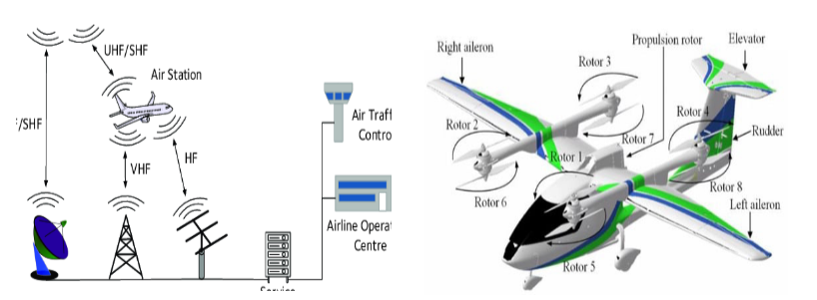

Aircraft Communications Availability based Flight Dynamics Restriction

Slide 2
Antennas
Antenna Type | Description | Function | Wavelength Range
VHF Antenna | Whip-like, often located on top or bottom of fuselage | Communicates with ground stations for voice and data | 30 MHz-300 MHz 118–137 MHz
GPS Antenna | Small, dome-shaped or blade-like | Receives GPS signals for navigation and precise positioning | L5 1176.45 MHz
ATC/UHF/DME Antenna | Blade or cone-shaped, on the bottom of the aircraft | radar-based aircraft identification and tracking | 960 MHz - 1,215 MHz
TCAS Antenna | Blade or circular disk | Transmits and receives signals for Traffic Collision Avoidance System (TCAS) | 2.0 GHz - 3.0 GHz
ELT Antenna | Whip or blade-like | Transmits Emergency Locator Transmitter signals in distress | 121.5 MHz, 243 MHz and 406 MHz
Weather Radar Antenna | Large, dish-shaped | Sends and receives radar signals for weather detection | 3.0 GHz - 30.0 GHz
5G |  | Communicates with ground stations for everything | 410-7125 MHz or 24.25-52.6 GHz
Notes:
VHF : shadowing, The cat whisker, dual blade, and towel bar, also the marker beacon on the bottom because highly directional and used with ILS
GPS: as an amplifier, antenna on the very top to avoid shadowing
DME : only use 1025 to 1150 MHz to receive
5G: Use of the C-band frequencies like the altimeter. Spatial multiplexing

Slide 3
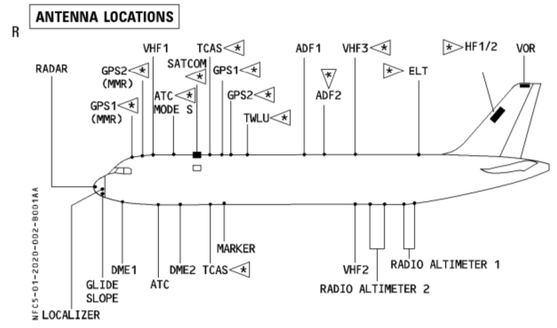
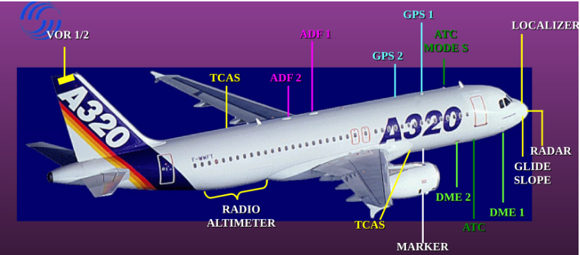
A320 – antennas

Slide 4

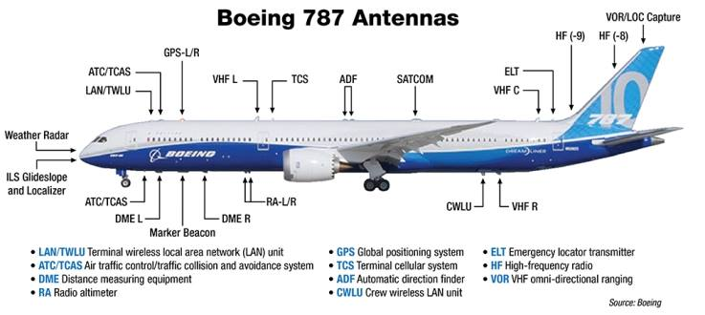
Boeing 787 – antennas

Slide 5
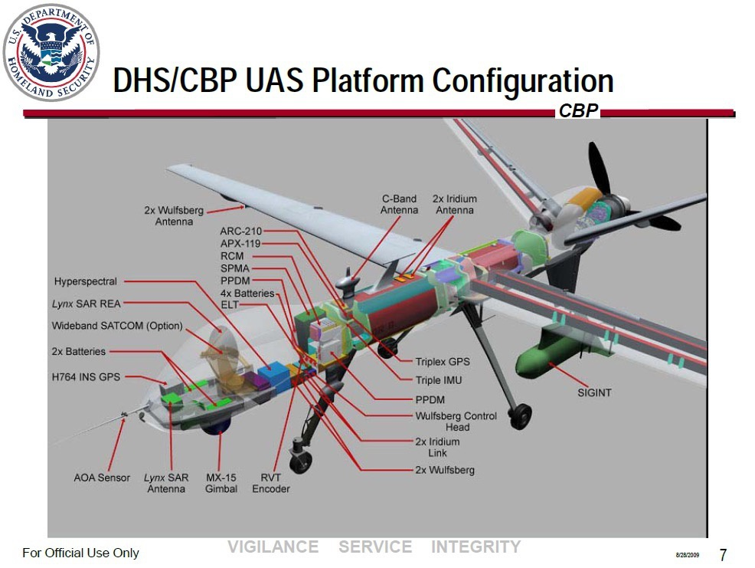
Reaper – antennas

Slide 6
Control system
Straight and Level Flight: The aircraft maintains a constant altitude and heading, flying in a straight line.
Turns: Changing the aircraft's heading by banking (rolling) to one side. Turns can be coordinated or uncoordinated depending on the use of rudder.
Climbs and Descents : Controlled ascents and descents to change altitude. Climbs involve increasing pitch or adding power, while descents involve decreasing pitch or reducing power.
Climbing and Descending Turns : Combining the elements of a turn and a climb or descent. For example, a climbing turn involves both a change in altitude and heading simultaneously.
Stalls and Stall Recovery : A stall occurs when the critical angle of attack is exceeded, leading to a loss of lift. Pilots practice recognizing stalls and recovering by reducing the angle of attack.
Spins and Spin Recovery : A spin is an aggravated stall resulting in a rotating descent. Spin recovery involves applying specific control inputs to stop the rotation and recover from the stall.
S-turns Across a Road : A manoeuvre where the aircraft alternates its heading in a series of S-shaped turns while maintaining a constant altitude.
Lazy Eights : A climbing and descending manoeuvre in the shape of a figure-eight. It combines turns and changes in pitch to create a symmetrical pattern.
Chandelle : A climbing turn executed at a constant rate, resulting in a 180-degree change in heading and a climb to a higher altitude.
Steep Turns : Turns performed with a steep bank angle, often used for pilot training to enhance coordination and control skills.
Immelmans : A half-loop followed by a half-roll, resulting in a change of direction with a 180-degree roll.
Split-S : The opposite of an Immelman, involving a half-roll followed by a half-loop. It's a descending maneuver used for changing direction.
Rolls : Aircraft rotation around its longitudinal axis. Rolls can be aileron rolls, barrel rolls, or slow rolls, each with different techniques.
Knife Edge Flight : Flying the aircraft on its side, perpendicular to the horizon, using a combination of aileron and rudder inputs.
Touch and Go : Landing on a runway and taking off again without coming to a full stop, often practiced during flight training.

Slide 7
References
VHF: https://en.wikipedia.org/wiki/Very_high_frequency#:~:text=Very%20high%20frequency%20(VHF)%20is,ten%20meters%20to%20one%20meter.
GPS: https://en.wikipedia.org/wiki/GPS_signals
DME: https://en.wikipedia.org/wiki/Distance_measuring_equipment#:~:text=An%20airplane's%20DME%20interrogator%20uses,and%20126%20channels%20for%20reply.
TCAS: https://www.ll.mit.edu/sites/default/files/publication/doc/tcas-maneuvering-aircraft-horizontal-plane-burgess-ja-7195.pdf
A320: https://www.aviationhunt.com/wp-content/uploads/2022/08/a320-antennas-probes-sensors-exterior-lights-location.pdf
Boeing 787: https://dev.flyfa.com/lms_news/2781/
Reaper: https://www.quora.com/Why-do-military-drones-have-that-hump-on-the-front
5G:
https://www.alpa.org/resources/aircraft-operations-radar-altimeter-interference-5G#:~:text=Radar%20altimeter%20interference%20from%205G%20signals%20can%20take%20the%20form,altitude%20information%20unknowingly%20being%20generated
https://saankhyalabs.com/5g-based-avionics-communication-system/
4G/5G: https://www.icao.int/Meetings/anconf13/Documents/WP/wp_244_en.pdf
Control system: https://canvas.cranfield.ac.uk/courses/27249/modules
Antennas: https://canvas.cranfield.ac.uk/courses/27248/modules

