Slide 1

2023-2024 AVDC MSc Individual Research Project:
Aircraft Communications Availability based Flight Dynamics Restriction
1st Interim Project Review
10 June 2024
Supervisors: Prof Saba Alrubaye,Dr Dmitry Ignatyev and Dr Christantus Obinna Nnamani

Slide 2
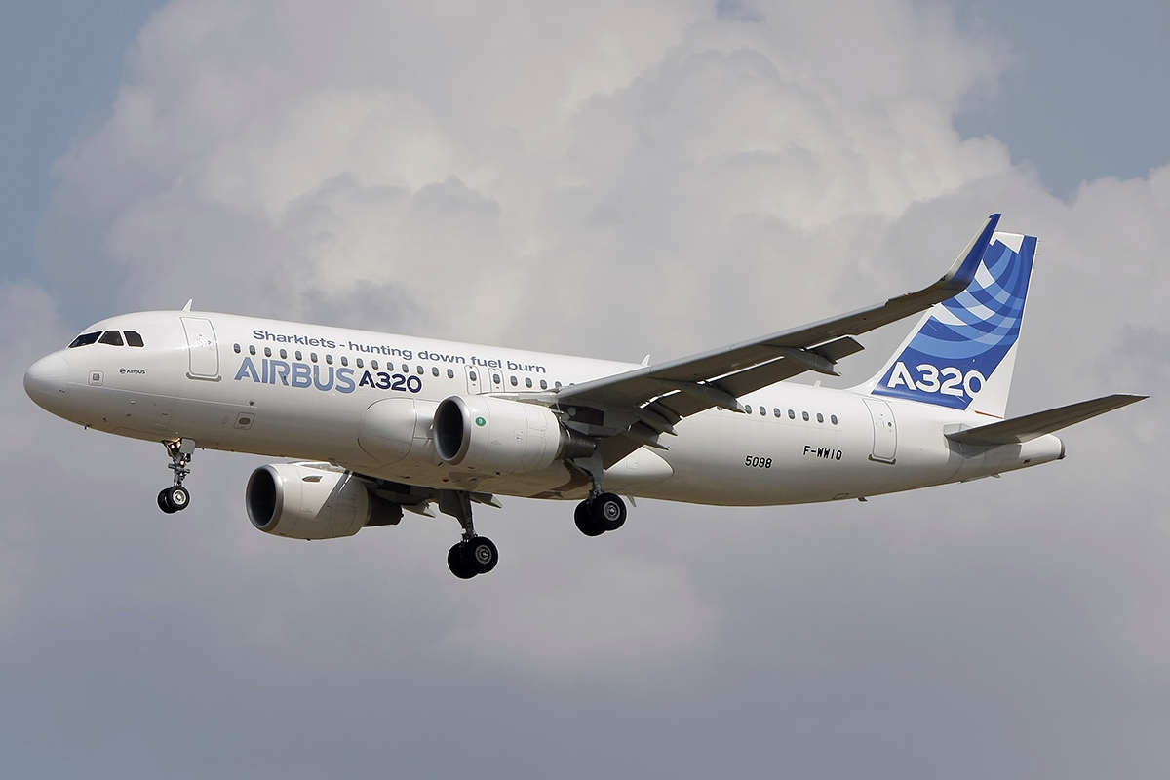
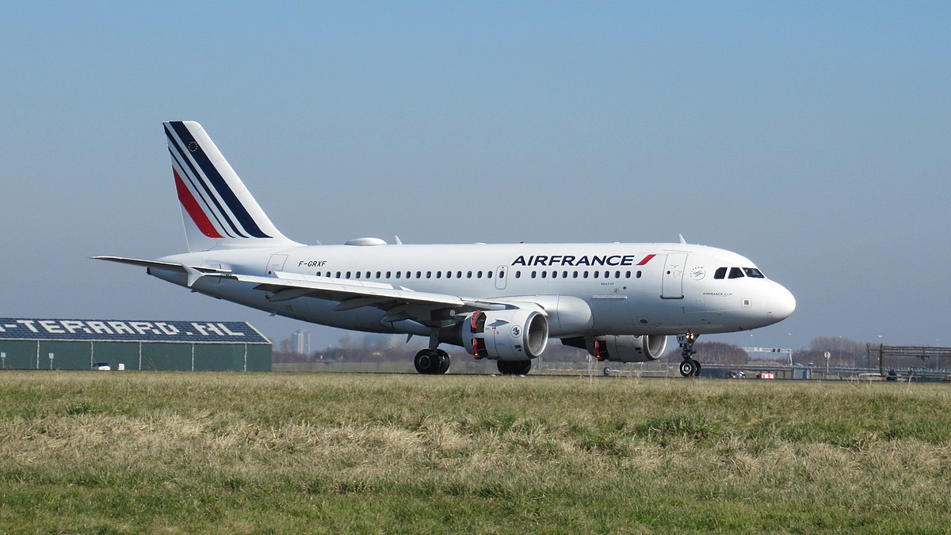
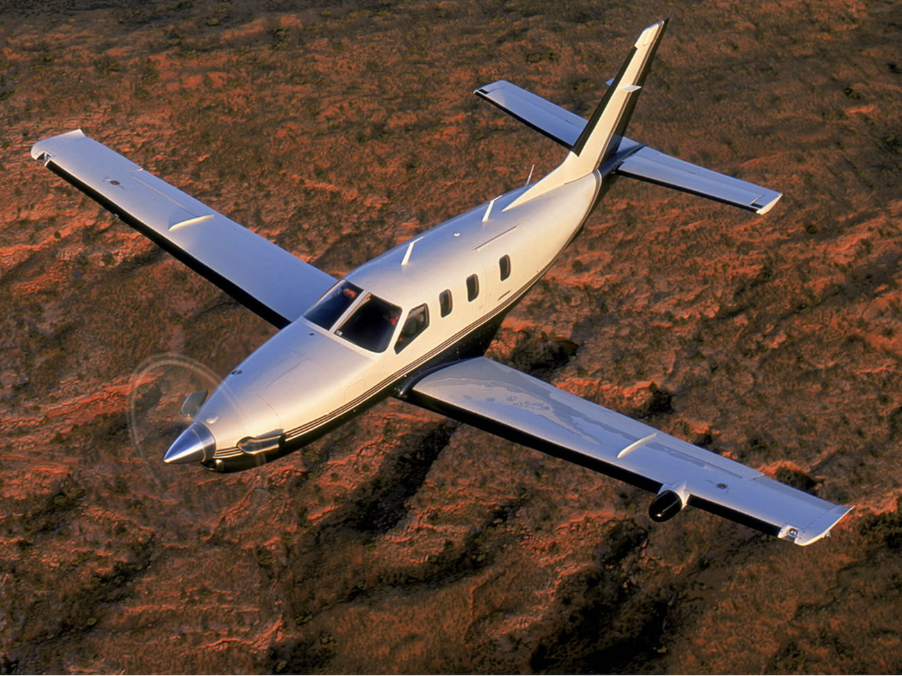
Introduction
A320 Denver CO USA 2009
A319, Nantes, 2006
TBM8, Birmingham UK, 2011
https://skybrary.aero/articles/loss-communication

Slide 3


Aim and objectives
Aim: Develop a system integrating real-time flight data and dynamic parameters able to intelligently manage and optimize communication resources, ensuring efficient and secure aircraft communication during different phases of flight.
Objectives:
Develop a model in Unity able to simulate air to ground communications
Integrate an algorithm to compute the quality of the signals
Develop an algorithm to swap between antennas to always get the best signal
Predict no communication zones and avoid them

Slide 4
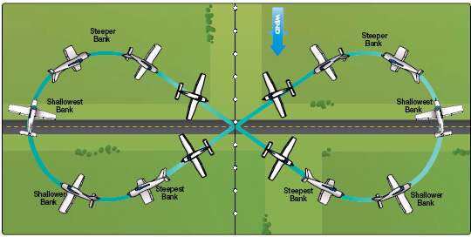
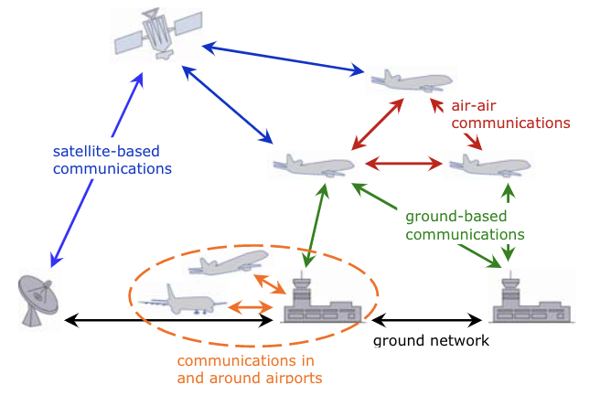
Literature Review
Control system
Communication system
Impact of the control system on the communication system
https://www.aviationsafetymagazine.com/features/commercial-maneuvers/
https://www.researchgate.net/figure/Integration-of-different-aeronautical-communication-systems-into-a-global-airborne_fig2_224989091

Slide 5
Literature Review – Manoeuvres
Manoeuvre | Rudder Position | Ailerons Position | Elevators/Horizontal Stabilizer Position | Flaps/Slats Position
Level Flight | Neutral | Neutral | Neutral | Neutral
Climb | Neutral or Slight Deflection towards turn direction | Neutral | Upward | Neutral
Descent | Neutral or Slight Deflection opposite turn direction | Neutral | Downward | Neutral
Turn (Banking) | Deflected towards turn direction | Up in the direction of the bank | Neutral | Neutral
Roll (Aileron Roll) | Neutral | Full deflection in the direction of roll | Neutral | Neutral
Pitch Up | Neutral | Neutral | Upward | Neutral
Pitch Down | Neutral | Neutral | Downward | Neutral
Takeoff | Neutral | Neutral | Upward | Extended
Landing | Neutral | Neutral | Downward | Fully extended
Stall Recovery | Neutral or opposite to stall direction | Neutral | Neutral | Neutral
D. Ignatyev , “Basic aerodynamics,” [Online]. Available: https://canvas.cranfield.ac.uk/courses/27249/files/1921602?wrap=1.

Slide 6
Literature Review – Antennas
Antenna Type | Antenna Description | Main function of the antenna | Wavelength
VHF Antenna | Whip-like, often located on top or bottom of fuselage | Communicates with ground stations for voice and data | 118–137 MHz (30 MHz-300 MHz)
GPS Antenna | Small, dome-shaped or blade-like | Receives GPS signals for navigation and precise positioning | L5 1176.45 MHz
ATC/UHF/DME Antenna | Blade or cone-shaped, on the bottom of the aircraft | radar-based aircraft identification and tracking | 960 MHz - 1,215 MHz
TCAS Antenna | Blade or circular disk | Transmits and receives signals for Traffic Collision Avoidance System (TCAS) | 2.0 GHz - 3.0 GHz
ELT Antenna | Whip or blade-like | Transmits Emergency Locator Transmitter signals in distress | 121.5 MHz, 243 MHz and 406 MHz
Weather Radar Antenna | Large, dish-shaped | Sends and receives radar signals for weather detection | 3.0 GHz - 30.0 GHz
5G | Blade or cone-shaped, on the bottom of the aircraft | Communicates with ground stations for everything | 410-7125 MHz or 24.25-52.6 GHz
S. I. A. M. L. W. Douglas W.Burgess, «TCAS: Maneuvering Aircraft in the Horizontal PLane,» THE LINCOLN LABORATORY JOURNAL, vol. 7, n° %12, pp. 295-312, 1994.
W. contributors, «Very high frequency,» Wikipedia, The Free Encyclopedia., 4 May 2024. [En ligne]. Available: https://en.wikipedia.org/w/index.php?title=Very_high_frequency&oldid=1227114617.
W. contributors, «GPS signals,» Wikipedia, The Free Encyclopedia, 3 May 2024. [En ligne]. Available: https://en.wikipedia.org/w/index.php?title=GPS_signals&oldid=1224166622.
W. contributors, «Distance measuring equipment,» Wikipedia, The Free Encyclopedia, 22 February 2024. [En ligne]. Available: https://en.wikipedia.org/w/index.php?title=Distance_measuring_equipment&oldid=1209645947.

Slide 7
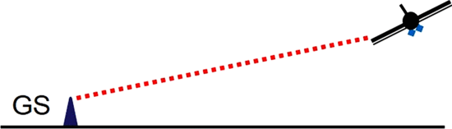
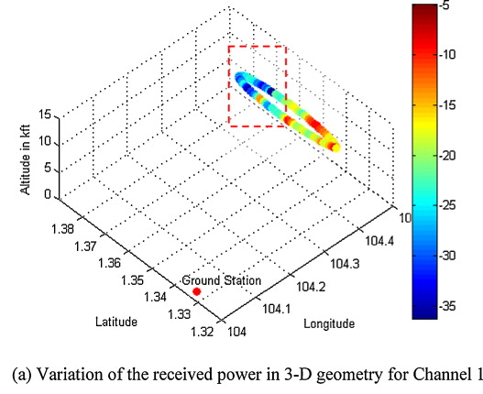
Literature Review – Cross Impact
In What respect the control system affects the communication:
Shadowing effect
Antenna beam deflection
Link Budget (position)
Airframe shadowing illustration
Other impacts on the communication:
Antenna position
Weather
Yu Song Meng, Yee Hui Lee,Study of shadowing effect by aircraft maneuvering for air-to-ground communication,AEU - International Journal of Electronics and Communications,Volume 66, Issue 1,2012,Pages 7-11,ISSN 1434-8411.
R. Sun, D. W. Matolak and W. Rayess, "Air-Ground Channel Characterization for Unmanned Aircraft Systems—Part IV: Airframe Shadowing," in IEEE Transactions on Vehicular Technology, vol. 66, no. 9, pp. 7643-7652, Sept. 2017, doi: 10.1109/TVT.2017.2677884.
Notes:
Shadowing : Aircraft trajectory, bank angles roll etc,

Slide 8
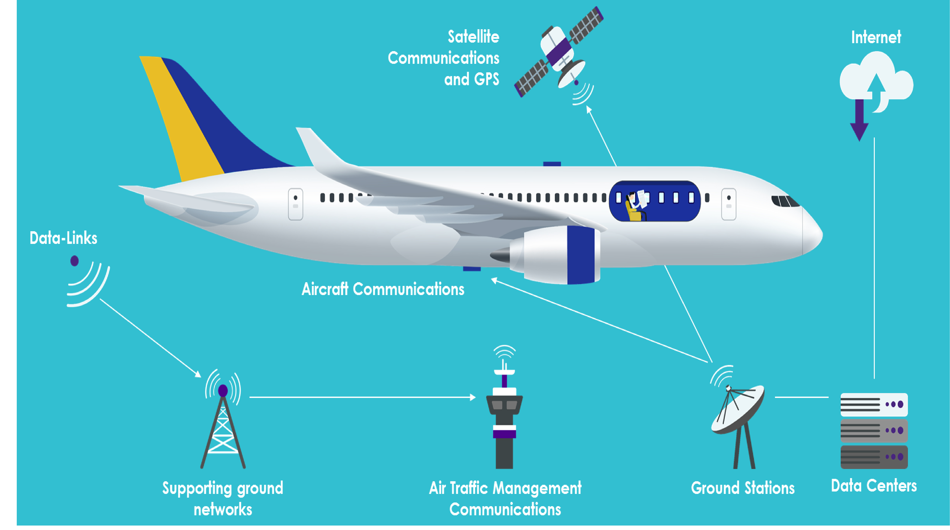
Problem statement
Model:
Unity
Ansys
Boeing 727
VHF
Antennas:
Antennas of the Boeing 727
VHF
Multiple ground antennas
Possibility to move the Aircraft antenna
Link Budget:
Free space loss
Antenna loss
Temperature loss
https://www.thalesgroup.com/en/markets/aerospace/thales-connected-aircraft

Slide 9


Simulation Software
3D simulation easy to get and modify
Faster implementation
Flexibility
Allow 3D simulation with CAD designs

Slide 10
Methodology
Trajectory Planner
Control system
Data
Analyse antennas Quality of signal
Link budget of each antenna
Zones to avoid flying in
Choose the best antenna for the communication
Determine possible dead zones

Slide 11
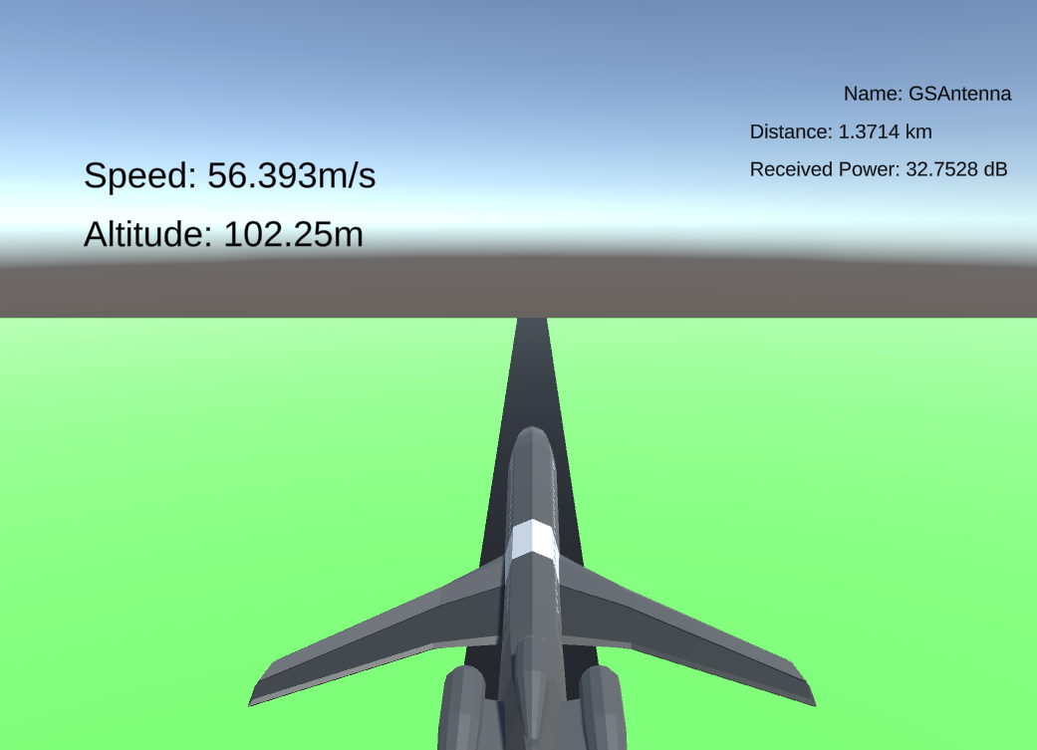
Result to date
Implemented Systems
Ray Tracing
Real time Link Budget
Trajectory Simulation
Model used
Boeing 727
VHF antenna C50-17

Slide 12
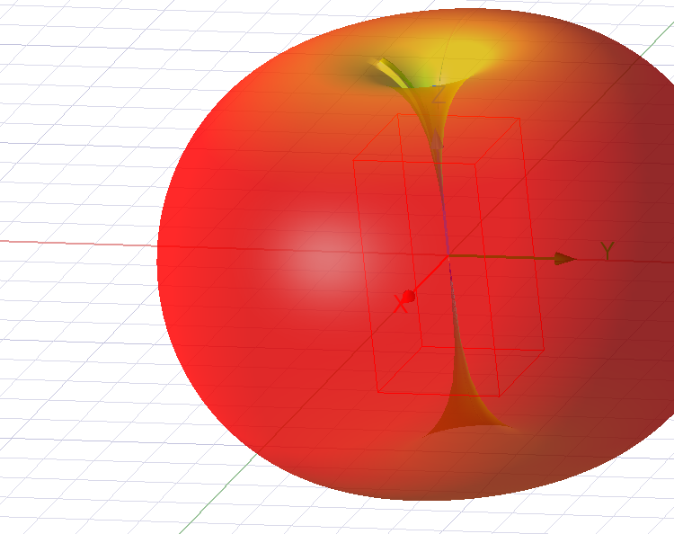
Result to date
Model of the antenna radiation pattern:
Dipole
Horn

Slide 13
Risk register
Category | Risk event | Probability | Impact | Priority | Risk Response
Project management | Delay | Medium | High | High | Use of GitHub as a productivity and management tool
Design | Ineffective research and literature review | Medium | High | High | Seek for some experts by asking to the supervisors
Design | Unable to properly design the antenna radiation pattern | Low | Medium | Medium | Slight change of the antenna or change software
Design | Unable to perform the best antenna switch | Medium | High | Low | Change algorithm and performances analysis

Slide 14
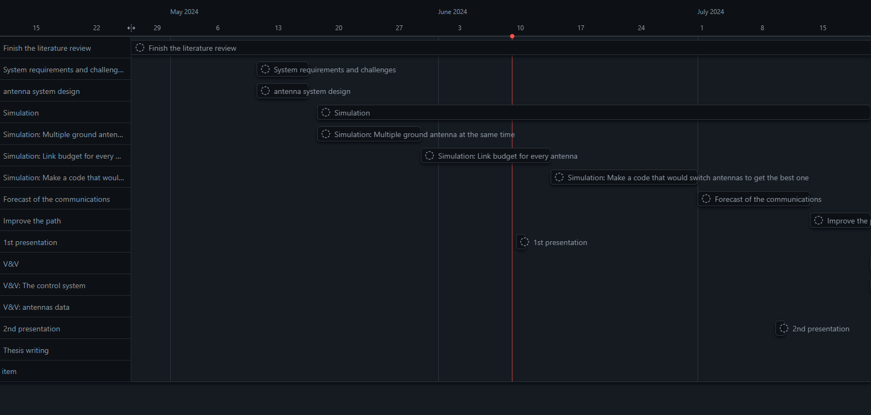
Gantt chart

Slide 15
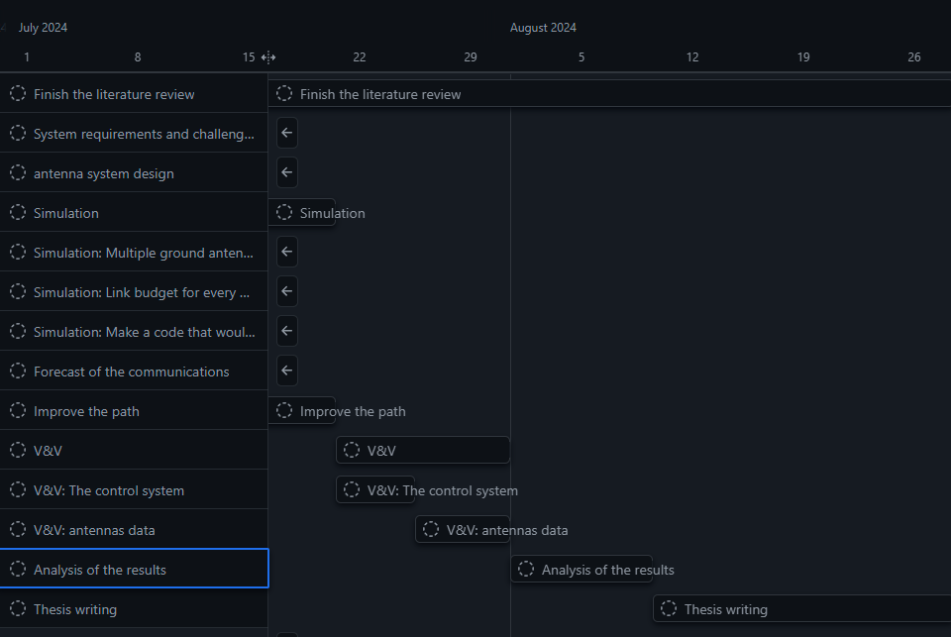
Gantt chart

Slide 16

Conclusion
Model in Unity
Shadowing effect different from literature
Not a lot of literature on air to ground communication
Link budget could be improved

Slide 17
Thank you!

