Slide 1
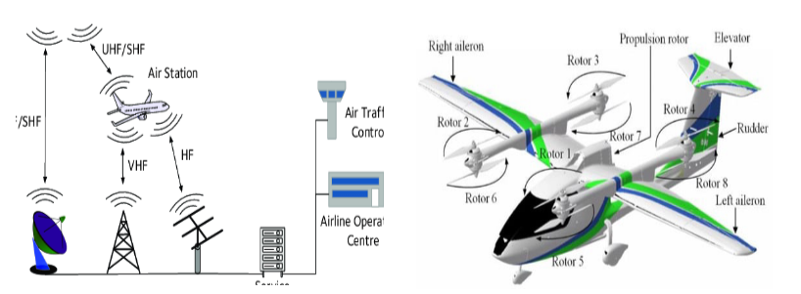

Aircraft Communications Availability based Flight Dynamics Restriction
Notes:
Beam tracking

Slide 2
Antenna power

Slide 3
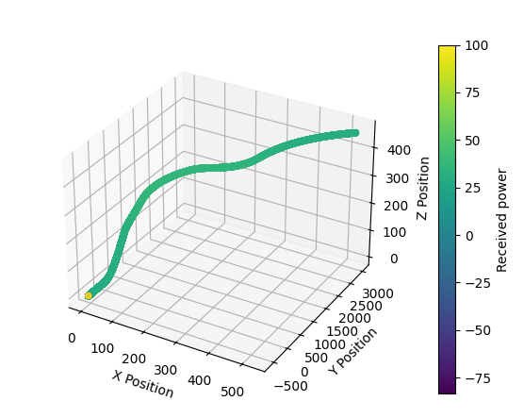
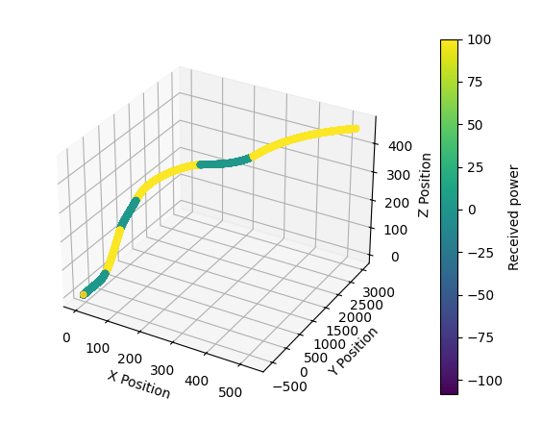
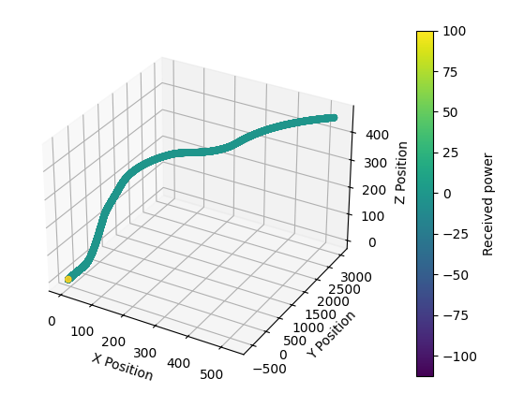
Graph
Received power of each antenna (100 = shadowed)

Slide 4
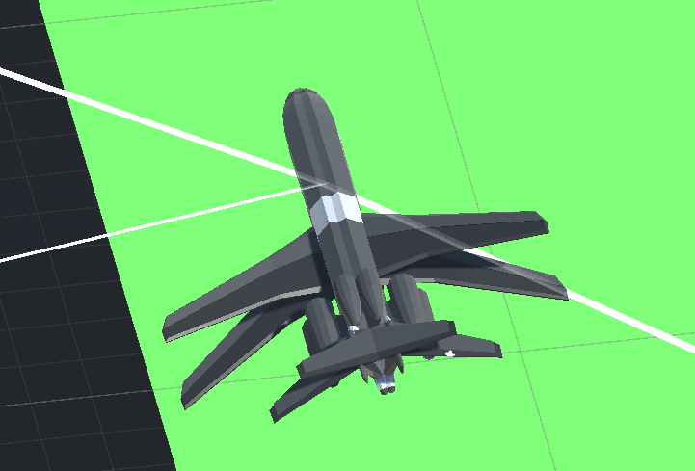
Maximum Bank angle
Creation of a digital twin
Notes:
Add to use digital twin without any dynamics to avoid impacting the speed of the simulation
Going to check every possible position

