Slide 1
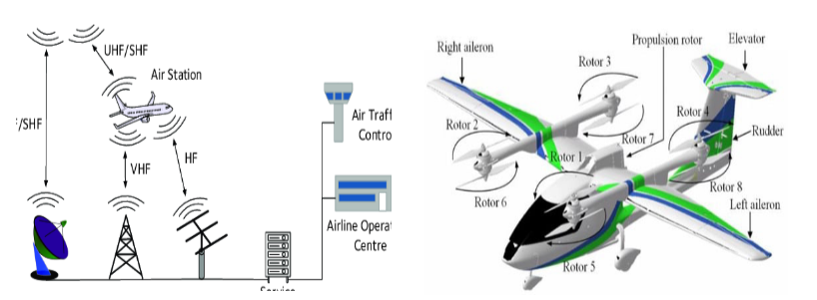

Aircraft Communications Availability based Flight Dynamics Restriction
Notes:
Beam tracking

Slide 2
Antennas
Antenna Type | Description | Function | Wavelength Range
VHF Antenna | Whip-like, often located on top or bottom of fuselage | Communicates with ground stations for voice and data | 30 MHz-300 MHz 118–137 MHz
GPS Antenna | Small, dome-shaped or blade-like | Receives GPS signals for navigation and precise positioning | L5 1176.45 MHz
ATC/UHF/DME Antenna | Blade or cone-shaped, on the bottom of the aircraft | radar-based aircraft identification and tracking | 960 MHz - 1,215 MHz
TCAS Antenna | Blade or circular disk | Transmits and receives signals for Traffic Collision Avoidance System (TCAS) | 2.0 GHz - 3.0 GHz
ELT Antenna | Whip or blade-like | Transmits Emergency Locator Transmitter signals in distress | 121.5 MHz, 243 MHz and 406 MHz
Weather Radar Antenna | Large, dish-shaped | Sends and receives radar signals for weather detection | 3.0 GHz - 30.0 GHz
5G |  | Communicates with ground stations for everything | 410-7125 MHz or 24.25-52.6 GHz
Notes:
VHF : shadowing, The cat whisker, dual blade, and towel bar, also the marker beacon on the bottom because highly directional and used with ILS
GPS: as an amplifier, antenna on the very top to avoid shadowing
DME : only use 1025 to 1150 MHz to receive
5G: Use of the C-band frequencies like the altimeter. Spatial multiplexing

Slide 3
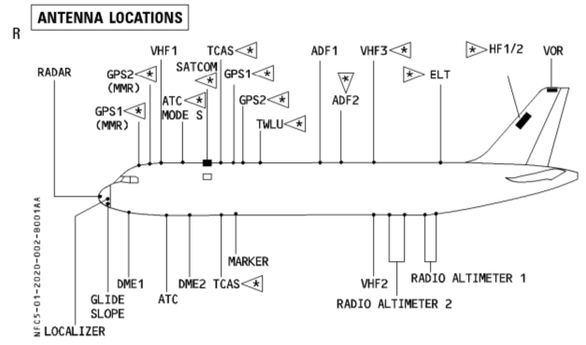
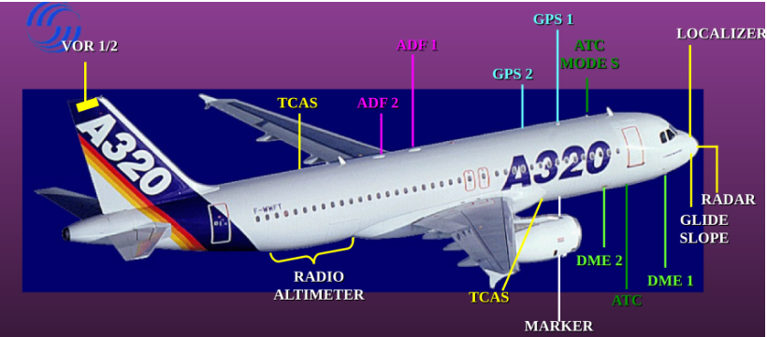
A320 – antennas

Slide 4

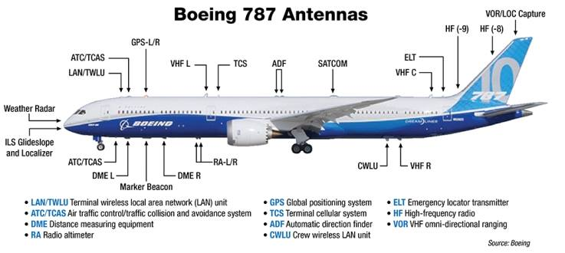
Boeing 787 – antennas

Slide 5
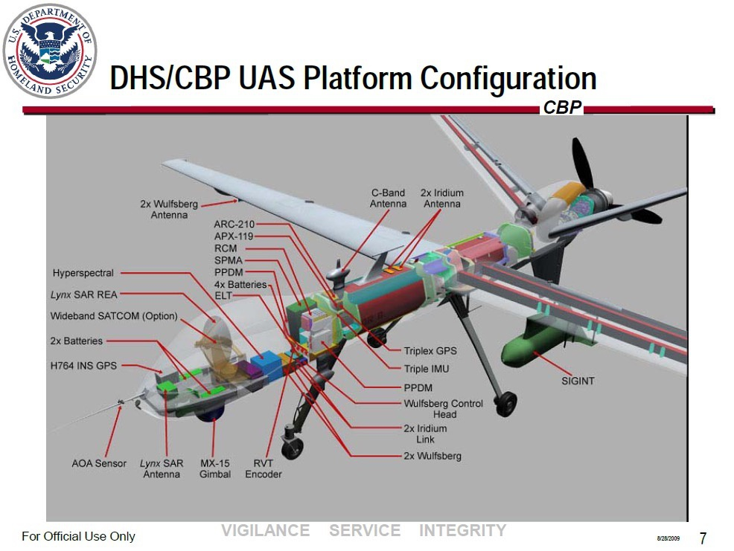
Reaper – antennas

Slide 6
Control system
Straight and Level Flight: The aircraft maintains a constant altitude and heading, flying in a straight line.
Turns: Changing the aircraft's heading by banking (rolling) to one side. Turns can be coordinated or uncoordinated depending on the use of rudder.
Climbs and Descents : Controlled ascents and descents to change altitude. Climbs involve increasing pitch or adding power, while descents involve decreasing pitch or reducing power.
Climbing and Descending Turns : Combining the elements of a turn and a climb or descent. For example, a climbing turn involves both a change in altitude and heading simultaneously.
Stalls and Stall Recovery : A stall occurs when the critical angle of attack is exceeded, leading to a loss of lift. Pilots practice recognizing stalls and recovering by reducing the angle of attack.
Spins and Spin Recovery : A spin is an aggravated stall resulting in a rotating descent. Spin recovery involves applying specific control inputs to stop the rotation and recover from the stall.
S-turns Across a Road : A manoeuvre where the aircraft alternates its heading in a series of S-shaped turns while maintaining a constant altitude.
Lazy Eights : A climbing and descending manoeuvre in the shape of a figure-eight. It combines turns and changes in pitch to create a symmetrical pattern.
Chandelle : A climbing turn executed at a constant rate, resulting in a 180-degree change in heading and a climb to a higher altitude.
Steep Turns : Turns performed with a steep bank angle, often used for pilot training to enhance coordination and control skills.
Immelmans : A half-loop followed by a half-roll, resulting in a change of direction with a 180-degree roll.
Split-S : The opposite of an Immelman, involving a half-roll followed by a half-loop. It's a descending maneuver used for changing direction.
Rolls : Aircraft rotation around its longitudinal axis. Rolls can be aileron rolls, barrel rolls, or slow rolls, each with different techniques.
Knife Edge Flight : Flying the aircraft on its side, perpendicular to the horizon, using a combination of aileron and rudder inputs.
Touch and Go : Landing on a runway and taking off again without coming to a full stop, often practiced during flight training.

Slide 7
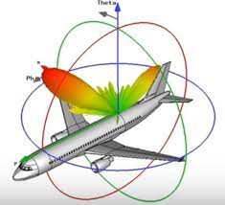
Radiation pattern of one antenna
Ansys

Slide 8
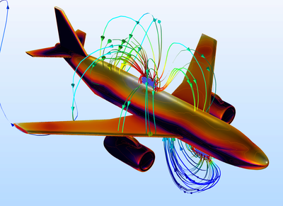
Radiation pattern of multiple antennas
Matlab

Slide 9
Maneuver | Rudder Position | Ailerons Position | Elevators/Horizontal Stabilizer Position | Flaps/Slats Position
Level Flight | Neutral | Neutral | Neutral | Neutral
Climb | Neutral or Slight Deflection towards turn direction | Neutral | Upward | Neutral
Descent | Neutral or Slight Deflection opposite turn direction | Neutral | Downward | Neutral
Turn (Banking) | Deflected towards turn direction | Up in the direction of the bank | Neutral | Neutral
Roll (Aileron Roll) | Neutral | Full deflection in the direction of roll | Neutral | Neutral
Pitch Up | Neutral | Neutral | Upward | Neutral
Pitch Down | Neutral | Neutral | Downward | Neutral
Takeoff | Neutral | Neutral | Upward | Extended
Landing | Neutral | Neutral | Downward | Fully extended
Stall Recovery | Neutral or opposite to stall direction | Neutral | Neutral | Neutral

Slide 10
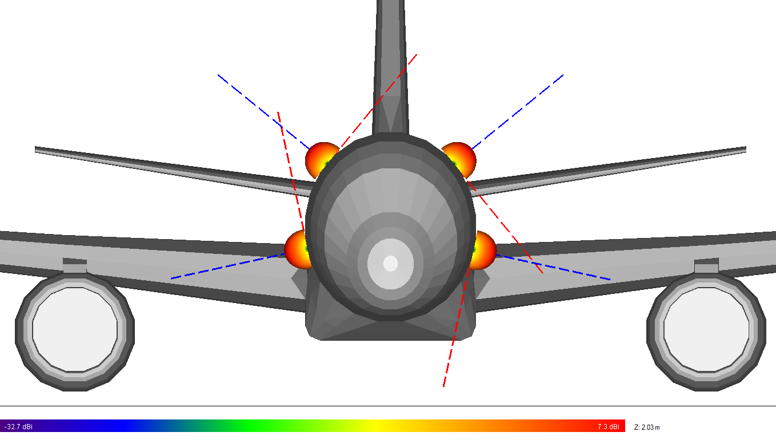
Switch antennas
Matlab

Slide 11
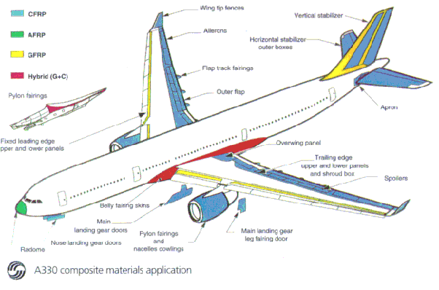
Change the position of the antenna
Regarding the materials used for the fuselage of the aircraft
Regarding the different antennas

Slide 12

Antenna requirements
VHF : 118.0MHz to 136.975MHz
Impedence : 50
Return Loss VSWR < 2.0 : 1
No speed limit
No temperature limit

Slide 13
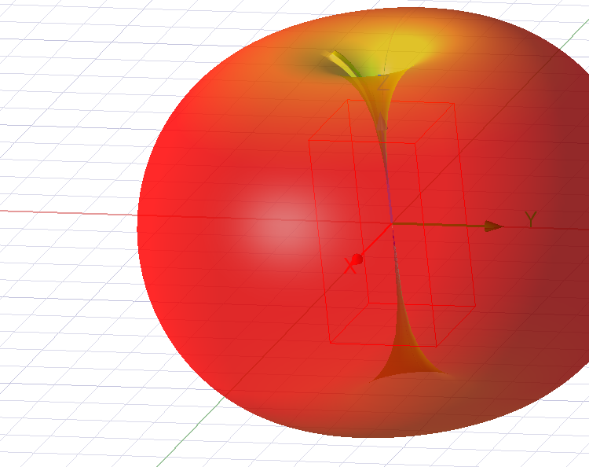
Antenna simulation - Dipole

Slide 14
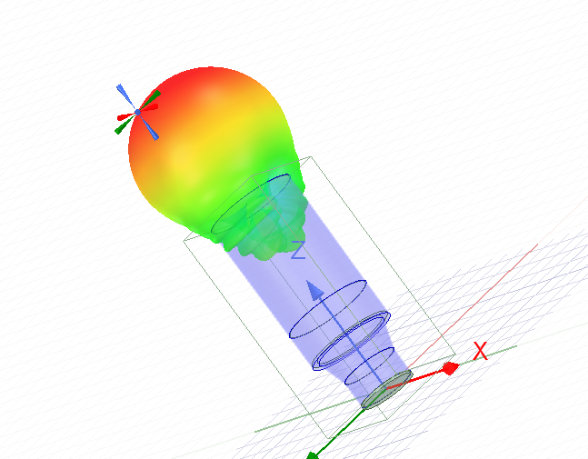
Antenna simulation - Horn

Slide 15
References
VHF: https://en.wikipedia.org/wiki/Very_high_frequency#:~:text=Very%20high%20frequency%20(VHF)%20is,ten%20meters%20to%20one%20meter.
GPS: https://en.wikipedia.org/wiki/GPS_signals
DME: https://en.wikipedia.org/wiki/Distance_measuring_equipment#:~:text=An%20airplane's%20DME%20interrogator%20uses,and%20126%20channels%20for%20reply.
TCAS: https://www.ll.mit.edu/sites/default/files/publication/doc/tcas-maneuvering-aircraft-horizontal-plane-burgess-ja-7195.pdf
A320: https://www.aviationhunt.com/wp-content/uploads/2022/08/a320-antennas-probes-sensors-exterior-lights-location.pdf
Boeing 787: https://dev.flyfa.com/lms_news/2781/
Reaper: https://www.quora.com/Why-do-military-drones-have-that-hump-on-the-front
5G:
https://www.alpa.org/resources/aircraft-operations-radar-altimeter-interference-5G#:~:text=Radar%20altimeter%20interference%20from%205G%20signals%20can%20take%20the%20form,altitude%20information%20unknowingly%20being%20generated
https://saankhyalabs.com/5g-based-avionics-communication-system/
4G/5G: https://www.icao.int/Meetings/anconf13/Documents/WP/wp_244_en.pdf
Control system: https://canvas.cranfield.ac.uk/courses/27249/modules
Antennas: https://canvas.cranfield.ac.uk/courses/27248/modules
https://archive.ll.mit.edu/mission/aviation/publications/publication-files/atc-reports/Schlieckert_1975_ATC-37_WW-15318.pdf
https://ntrs.nasa.gov/api/citations/19780007381/downloads/19780007381.pdf
https://www.peter-ftp.co.uk/aviation/misc-euroga/2017-98Dec_Calusdian.pdf
https://ieeexplore.ieee.org/document/7910800
https://ieeexplore.ieee.org/document/8402597

