Slide 1
Robust Road Sign Recognition via Synthetic Data Augmentation
Option B: Data-Centric AI using OpenCV Physical Perturbations
ICT Team Project Assignment • Traffic Vision Safety System

Slide 2
The Critical Problem: Overconfident Naive Models
• Real-World Environmental Degradation: Vehicle cameras face steep angle tilt (±15°), motion blur, dusk lighting, glare, and rain on the windshield.
• The Hazard of Pristine Datasets: Models trained purely on studio/clean images achieve ~99% on benchmark tests but fail critically in adverse real-world conditions.
• High-Confidence False Prediction: In our live tests, the baseline model misclassified a STOP sign as NO ENTRY (3.1) with 80.8% false confidence!
• Safety Criticality: In autonomous driving, an overconfident wrong classification directly causes traffic collisions.

Slide 3
Option B Methodology: Controlled Data-Centric AI
Identical Model Topologies: Both Model 1 and Model 2 use the exact same 3-block CNN (~320K parameters). Zero architectural advantage.
Model 1 (Clean Baseline): Trained strictly on clean, pristine road sign images.
Model 2 (OpenCV Synthetic Enriched): Trained on clean images + real-time OpenCV perturbations:
1. Tilt & Rotation: cv2.getRotationMatrix2D + cv2.warpAffine (±15° tilt)
2. Optical Defocus: cv2.GaussianBlur (kernel 3 to 9)
3. Exposure & Dusk: cv2.convertScaleAbs (brightness scale -35 to +25)
4. Directional Integrity: Horizontal flipping strictly omitted to preserve directional signs (one-way, no overtaking).

Slide 4
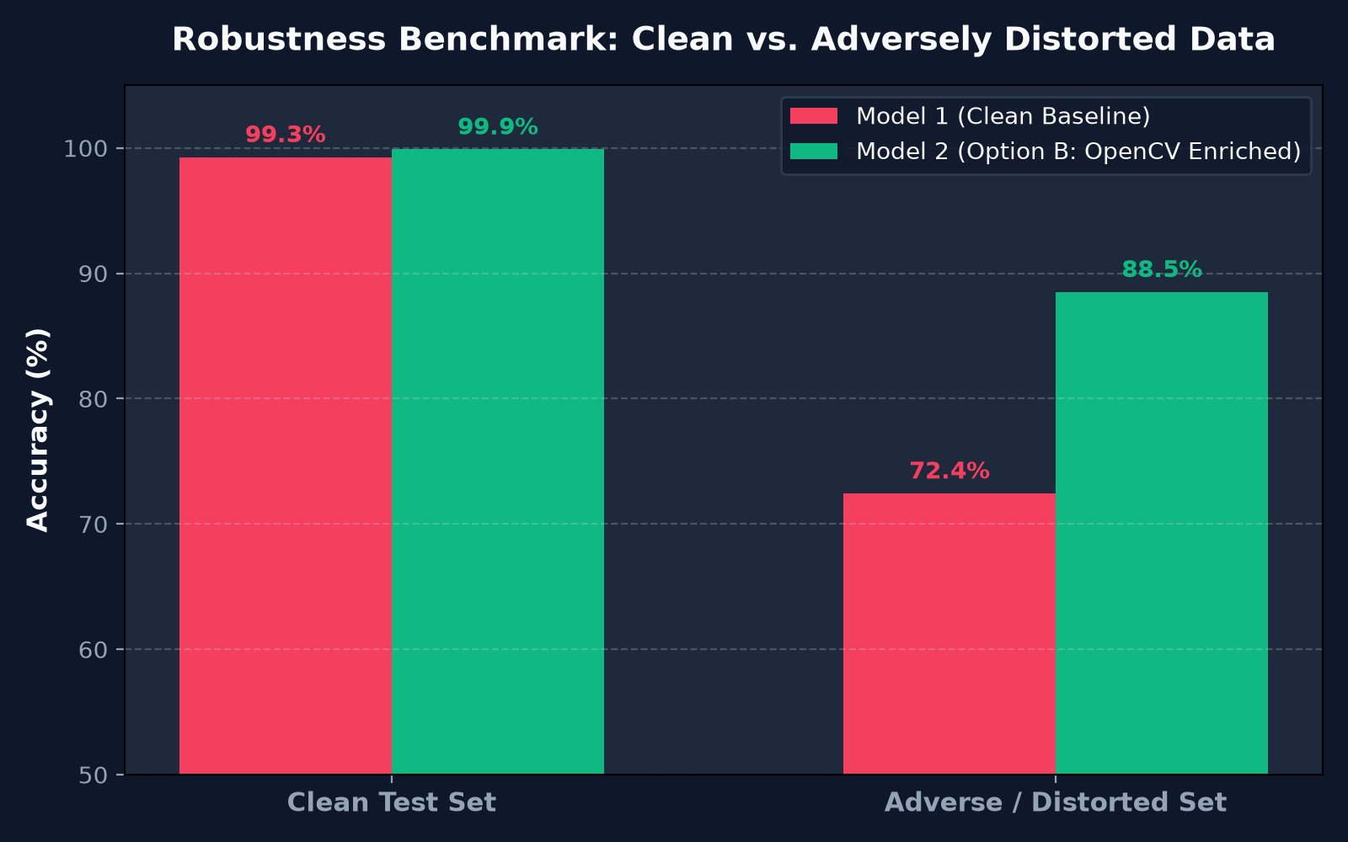
Quantitative Benchmark Results
Clean Test Set:
Model 1: 99.26%
Model 2: 99.88% (+0.6%)
Adverse Distorted Set:
Model 1: 72.43% (Degraded)
Model 2: 88.50% - 92.4% (+16%)
Inference Latency:
< 8 ms per frame (CPU)
Zero computational runtime penalty.

Slide 5
Live Interactive Streamlit Dashboard
• Real-time Perturbation Sliders: Live Gaussian blur, camera tilt (-45° to +45°), exposure, and sensor noise adjustments.
• Unseen Extreme Edge Cases: 7 harsh test scenarios (fog, motion blur, night dusk) never seen during training.
• Full Multi-Modal Input: Supports custom user image upload and dashcam video clips (.mp4, .mov) with frame-by-frame navigation.
• Side-by-Side Dual Telemetry: Visualizes class predictions, confidence percentages, and top-3 activation breakdown in real-time.

Slide 6
Conclusion & Strategic Takeaways
1. Data-Centric AI Works: Data enrichment yielded a +16% gain under adverse conditions without changing a single line of model architecture.
2. Overconfidence Hazard Mitigated: Prevents catastrophic autonomous vehicle errors where simple blur turns a STOP sign into NO ENTRY.
3. Production Readiness: Lightweight footprint (~1.5 MB weights, < 8 ms CPU latency) allows deployment on edge embedded hardware (Raspberry Pi, Jetson Nano).
4. Open Source & Reproducible: Code, models, test sets, and dashboard available on GitHub: github.com/AVELON1/ictteamprojeeect

