Slide 1



bodyperformance
View in Power BI
Last data refresh:
7/28/2023 3:12:02 AM UTC
Downloaded at:
7/28/2023 3:14:43 AM UTC

Slide 2
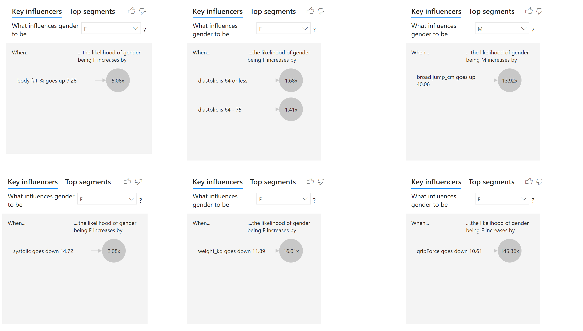

Slide 3
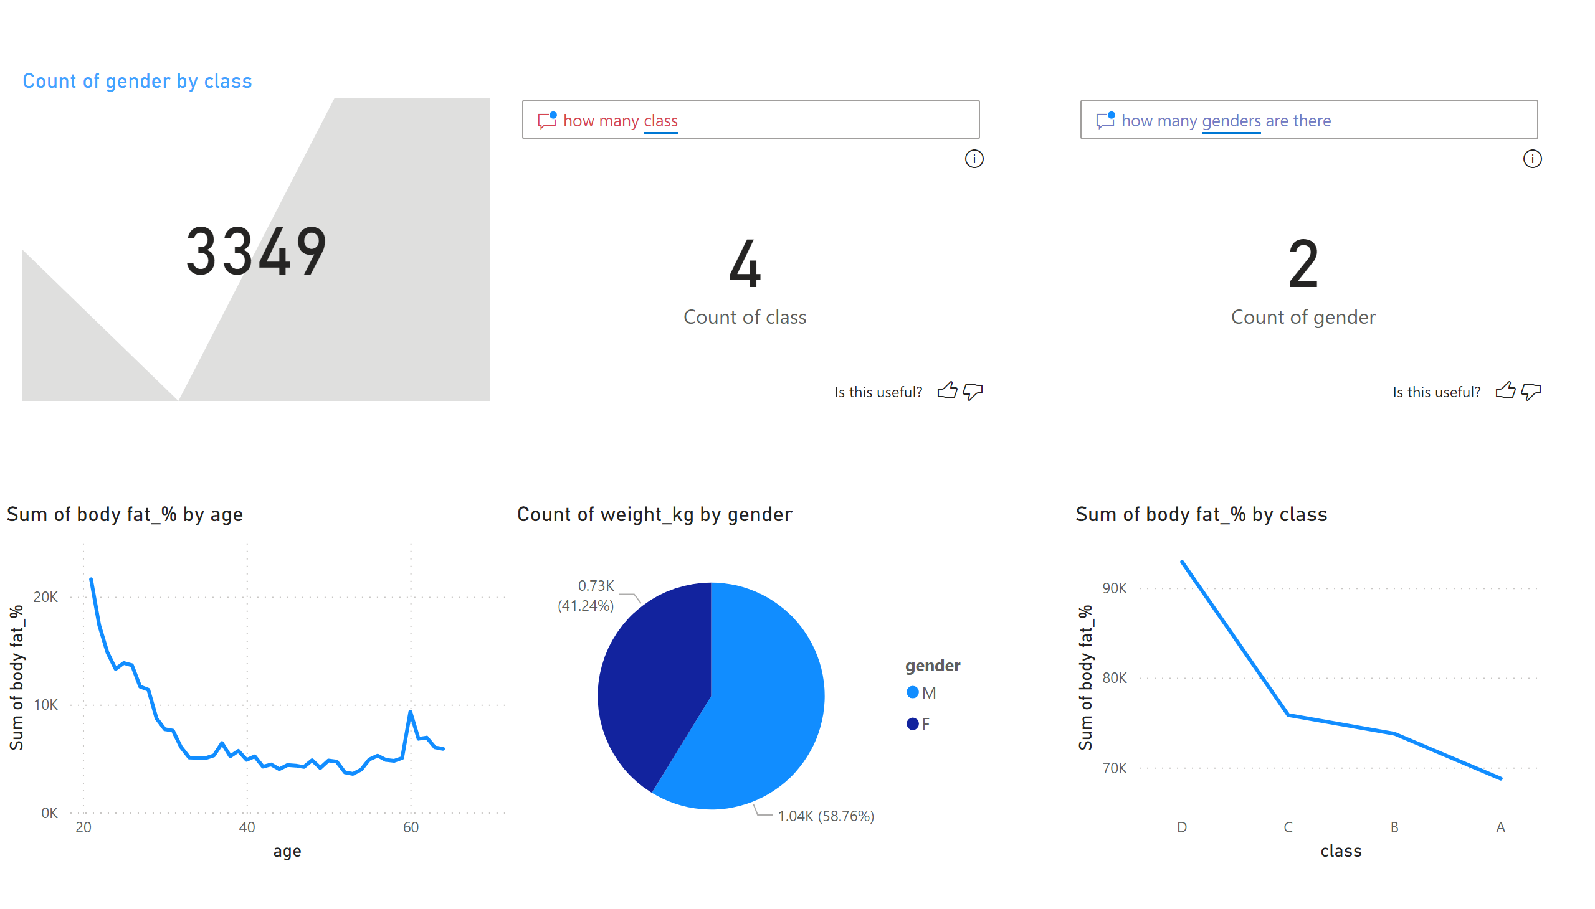
Page 1
Notes:
kpi
No alt text provided
qnaVisual
No alt text provided
qnaVisual
No alt text provided
lineChart
No alt text provided
pieChart
No alt text provided
lineChart
No alt text provided

Slide 4
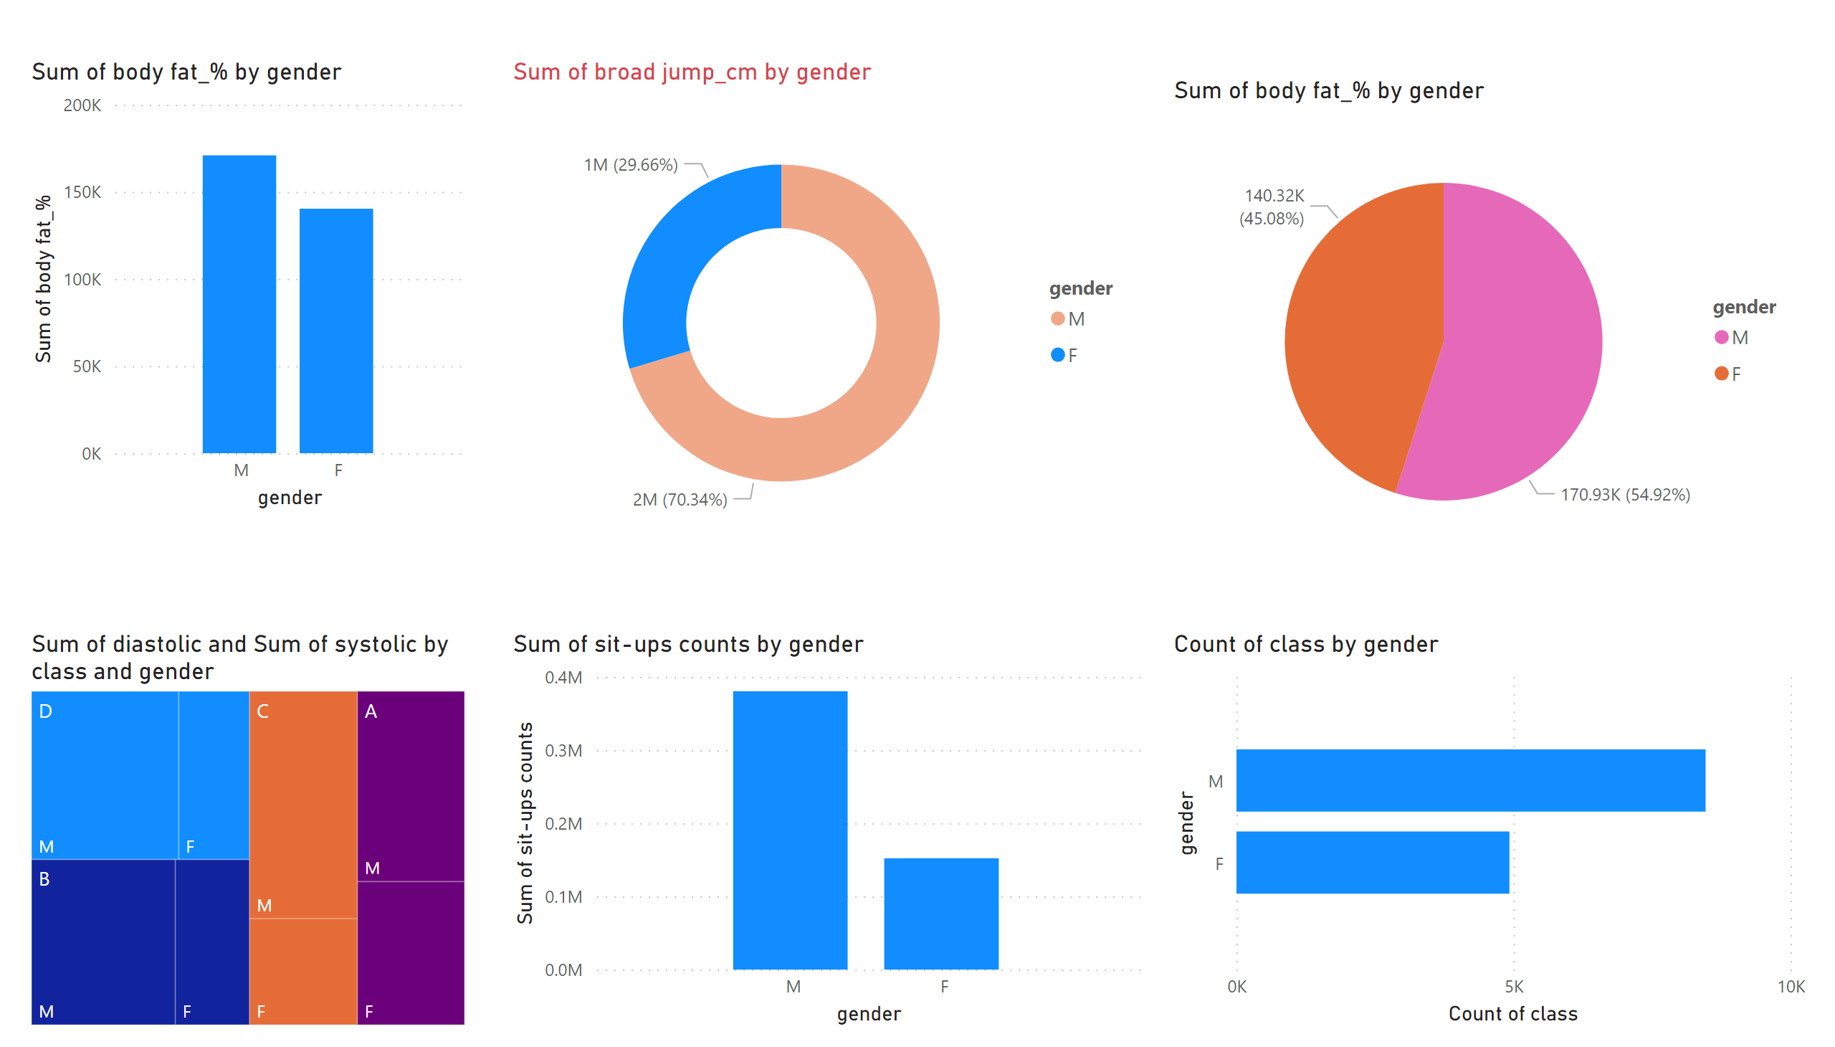

Slide 5
