Slide 1

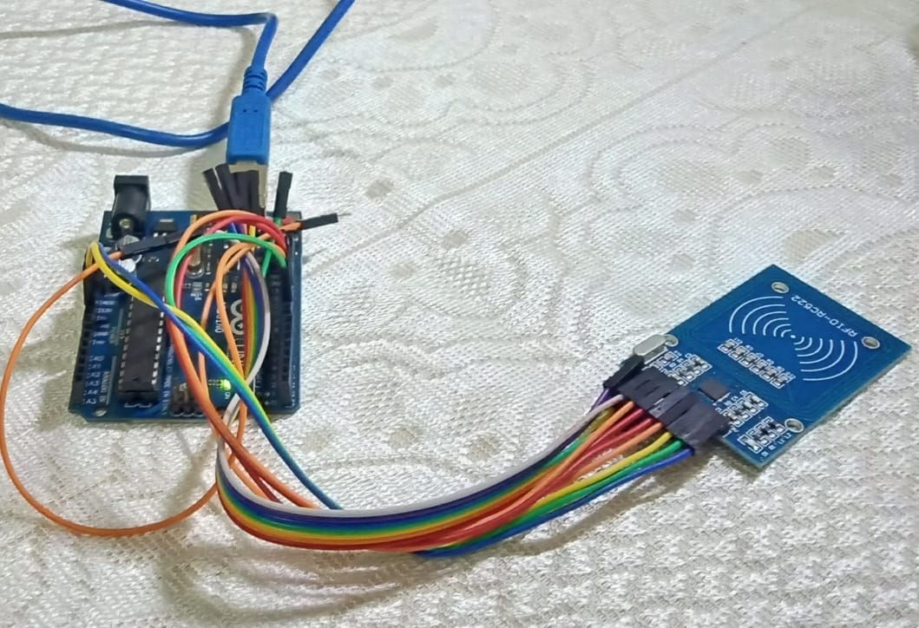
ANTI PROXY FRAMEWORK
BY-Team (243)
CIPHER_RANGERS
SAMYAK SANJIV GUPTA {E22CSEU1090;B-37}
KHYATI SATIJA {E22CSEU1197;B-40}
RAJUL GUPTA{E22CSEU1549;B-37}
ARPIT PANWAR{E22CSEU1105;B-37}
MEHAK GOYAL{E22CSEU1682;B-01}
VANSHIKA SINGH {E22CSEU0460}
HACKATHON
PROJECT

Slide 2


Agenda
We intend to solve the problem of attendance through Arduino UNO using python. Arduino board is connected to the RFID board. Each ID card has a built in RFID in it. The idea is based on the concept of Mutual Induction. In this project we have designed RFID based attendance system using Arduino.

Slide 3
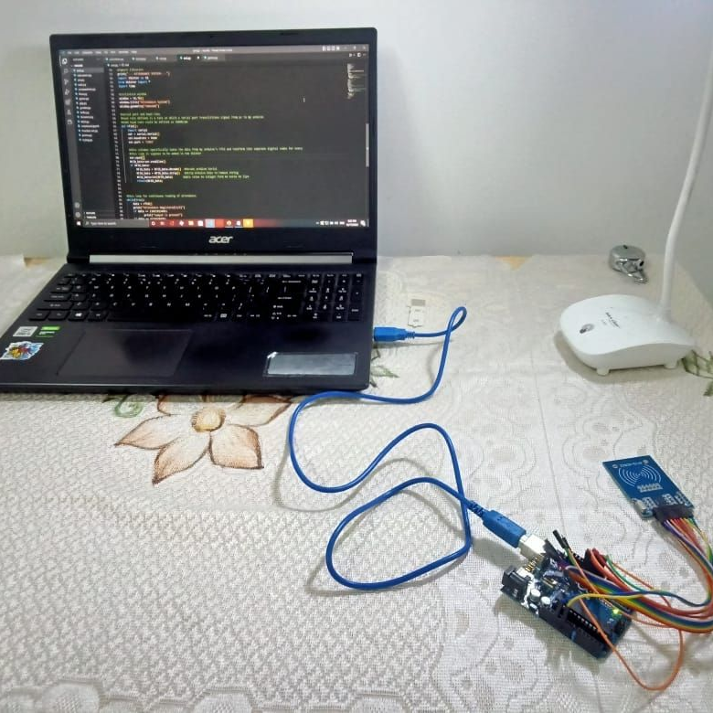
We have used an Arduino board that is connected to the PC using the COM3 port. A Python code has been written using the Serial and Time module. A scanner scans the ID card and registers the attendance in the system.
METHODS

Slide 4

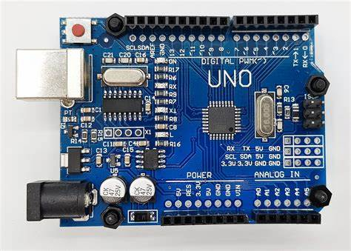
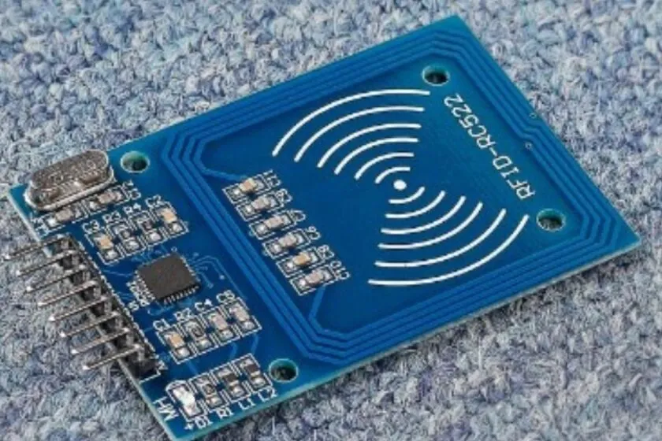
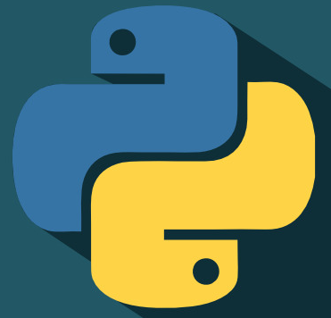
Introduction
This report aims to discuss a python project based on Arduino system and RFID for attendance. The project is designed to help organizations and companies to track the attendance of their employees. The project implements a python program to read the RFID tags of the employees and record their attendance. The project begins by connecting the Arduino Uno board to the computer and uploading the python program to the board. The program is used to read the RFID tags of the employees and store the tag IDs in a database. Once the employee’s tag is read, it is sent to the database and the employee’s attendance is recorded. The program then reads the data from the database and generates a report of the employee’s attendance. The report is then sent to the concerned authority or displayed on the computer screen. The Arduino system and RFID are used in this project to provide a secure and accurate attendance system. The RFID tags are difficult to replicate and hence provides a secure system. The Arduino board is used to read the RFID tags and send the data to the computer. The python program is used to process the data and generate the report. The project is relatively easy to implement and cost effective. It can help organizations and companies

Slide 5

In the present scenario , many students put proxy. So the final attendance calculated is not genuine and can’t rely on that for authenticity. So to prevent that and to ensure that only the students attending the class gain the attendance, we thought of coming up with an anti proxy framework. The idea ensures that students attend classes and not bunk them. We have used an Arduino Board and a scanner ,connected to the PC using COM3 port. The Hardware could be further used for the following ideas : 1. Create an automated entrance system using RFID and Python. This could be used to unlock a door, turn on a light, or even start a car. 2. Build an RFID-based attendance tracking system that uses Python to log when people arrive and leave. 3. Develop an RFID-based library system that uses Python to keep track of which books have been checked out and who has checked them out. 4. Create a security system that uses Python and RFID to detect intruders, and send an alert to a designated person or location. 5. Design a RFID-based inventory management system that uses Python to keep track of product stock levels. 6. Program an RFID-based pet tracking system that uses Python to determine where a lost pet is located. 7. Create an RFID-based payment system that uses Python to process payments and complete transactions.

Slide 6
Problem Statement
Many students miss classes in college for several reasons. Sometimes they are overwhelmed with the workload or they just want to hangout with their friends. In the long run, they struggle with the minimum 75% attendance needed to pass the semester. Hence we thought of coming up with an anti proxy framework. Objectives are to prevent students from putting proxy , ensuring that students attend their class and to ensure that the attendance calculated is genuine and not false

Slide 7
Solution Approach
The aim of an RFID-based attendance system using an Arduino board is to make attendance tracking faster,
easier, and more accurate by using Radio Frequency Identification (RFID) tags to scan and register student
attendance. This system can be used to track attendance in classrooms, libraries, or other events. It can also beused to track employee attendance in offices or factories.
If the student has to register his attendance thrice, during the beginning of the class, in the middle of the class and at the end of the end, then he/she would be obliged to sit through the entire duration of the class. This will prevent the student from faking his/her attendance or putting a proxy.

Slide 8







Solution Overview
Arduino
Serial Module
PYTHON
ENTERING THE CLASS
RFID
ID CARD
PYTHON
ARDUINO
RFID
Python code is running
Through serial module we are able to connect python with Arduino
Takes input from ID in an integral value
Taking attendance in time intervals of 3
Attendance has been recorded

Slide 9
INDIVIDUAL CONTRIBUTION
1)Samyak Sanjiv Gupta (LEADER) E22CSEU1090 B.Tech CSE -gave the idea and connected the Arduino Board to the PC using COM3 port. -worked on the Serial module
2)Khyati Satija E22CSEU1197 B.Tech CSE -worked on the GUI using Tkinter -debugging the code
3)Rajul Gupta E22CSEU1549 B.Tech CSE -worked on the Time module -general functioning of the code
4)Arpit Panwar E22CSEU1105 B.Tech CSE -worked on the GUI using Tkinter -did the database handling
5)Mehak Goyal E22CSEU1682 B.Tech CSE -worked on the Time module 2 Academic Proposal Template - draft 1.1 -introduced loops into the code

Slide 10
Applications
1. Create an automated entrance system using RFID and Python. This could be used to unlock a door, turn on a light, or even start a car.
2. Build an RFID-based attendance tracking system that uses Python to log when people arrive and leave.
3. Develop an RFID-based library system that uses Python to keep track of which books have been checked out and who has checked them out.
4. Create a security system that uses Python and RFID to detect intruders, and send an alert to a designated person or location.
5. Design a RFID-based inventory management system that uses Python to keep track of product stock levels.
6. Program an RFID-based pet tracking system that uses Python to determine where a lost pet is located.
7. Create an RFID-based payment system that uses Python to process payments and complete transactions.

Slide 11
References
RFID Based Attendance System Using Arduino Uno- wikipedia read
Arduino UNO -wikipedia read
TechnotixClub
Youtube
PYserial
4

Slide 12


Thank You

