Slide 1

Crypto and Crypto

Slide 2




CRYPTO CONTAINER
2

Slide 3
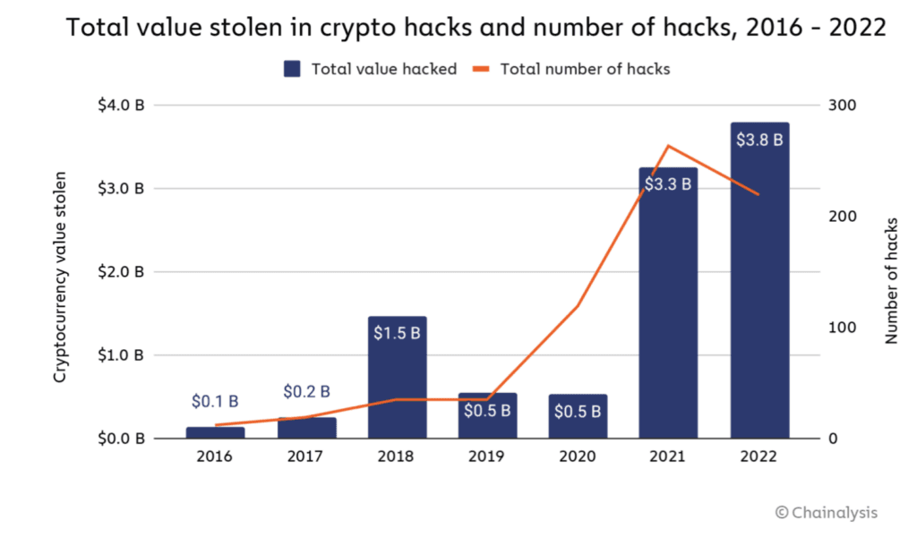
Problems in the crypto industry 2021-2023
Theft and loss of cryptocurrency from centralized resources - exchanges, funds, exchangers
Cryptocurrency losses due to fraud or deception
Theft and loss in decentralized systems (DeFi)
High cost of cryptocurrency transactions and storage associated with security costs
Total losses are estimated at about 8 billion USD per year.
From 2020 to March 2023, 239 cryptocurrency exchanges were closed in the world.*
*Chainalysis data

Slide 4
Problems in the crypto industry 2021-2023 Decentralized finance (DeFi) in 2021-2023
Most attacks in 2022 focused on decentralized finance (DeFi) platforms, which accounted for more than four out of every five victims в 2022 году.

Slide 5
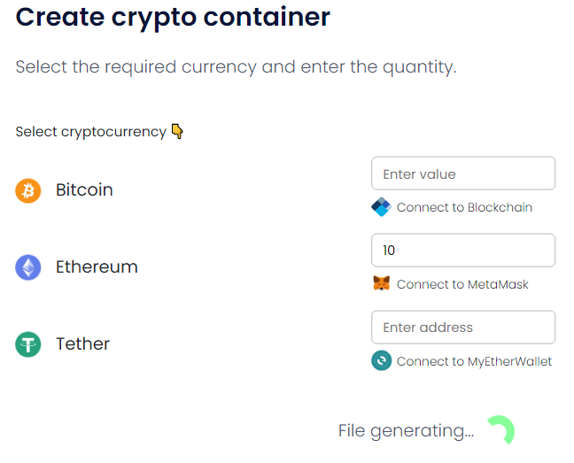
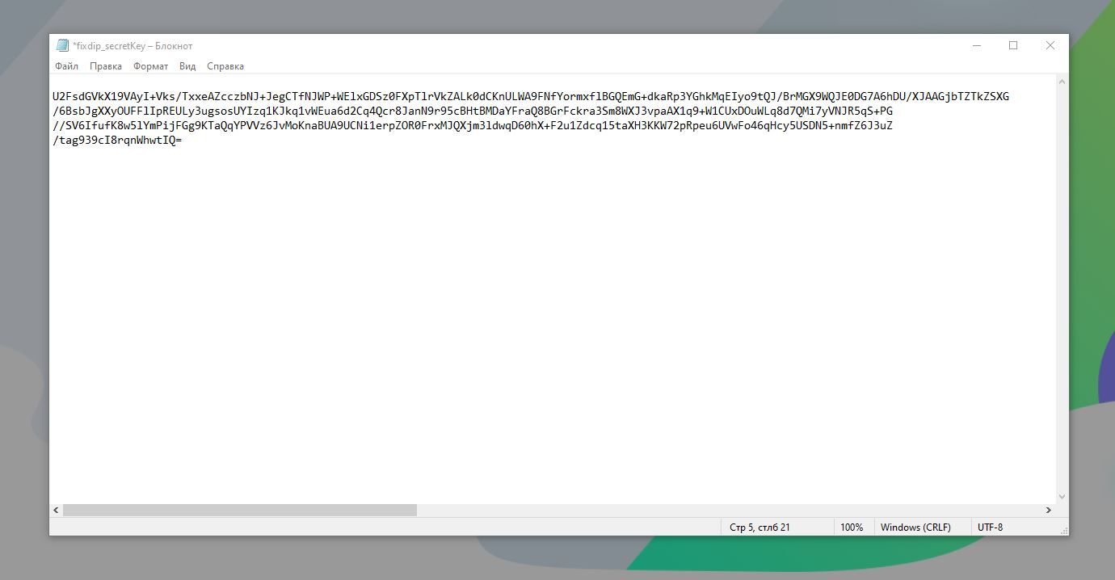
CRYPTO CONTAINER Encryption systems
Encryption systems is a commercial open-source product. The purpose is the generation of files (crypto containers), which contain certain sets of combinations, which are encrypted data from crypto wallets of various systems (Bitcoin, Ethereum, etc.).

Slide 6
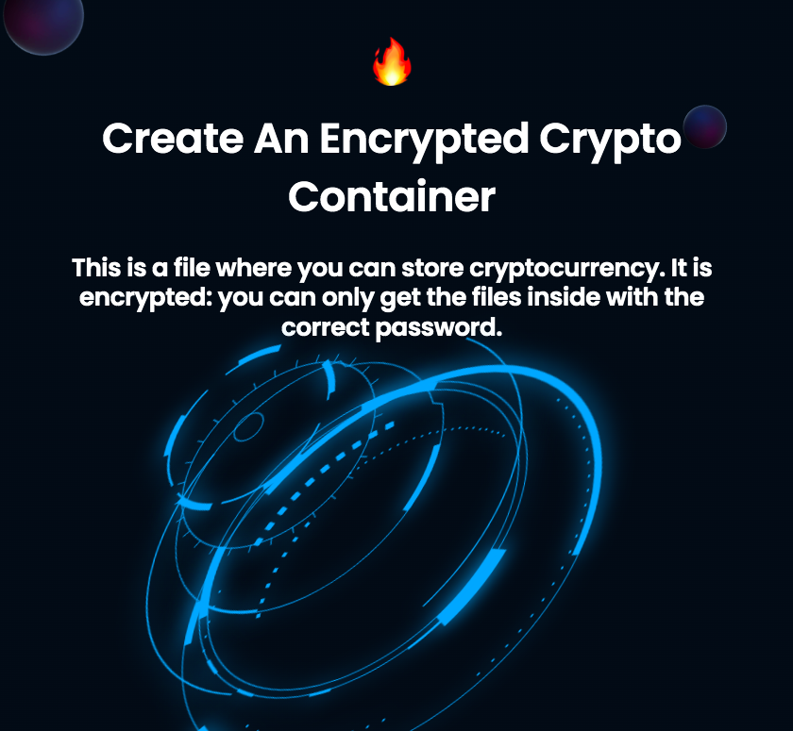
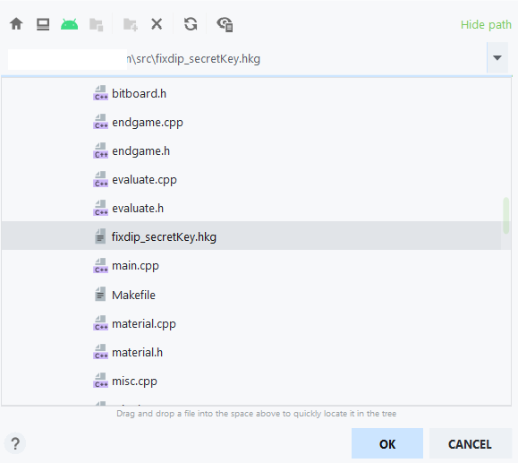
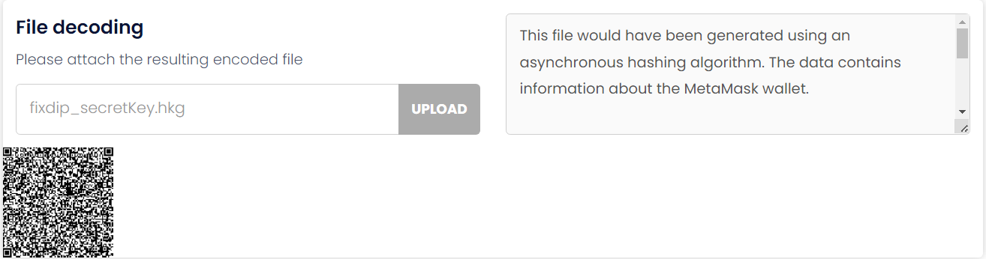
CRYPTO CONTAINER
A crypto container (.hkg) can be archived, send as a file or archive.
It can be made as QR code, picture or sound file
6

Slide 7

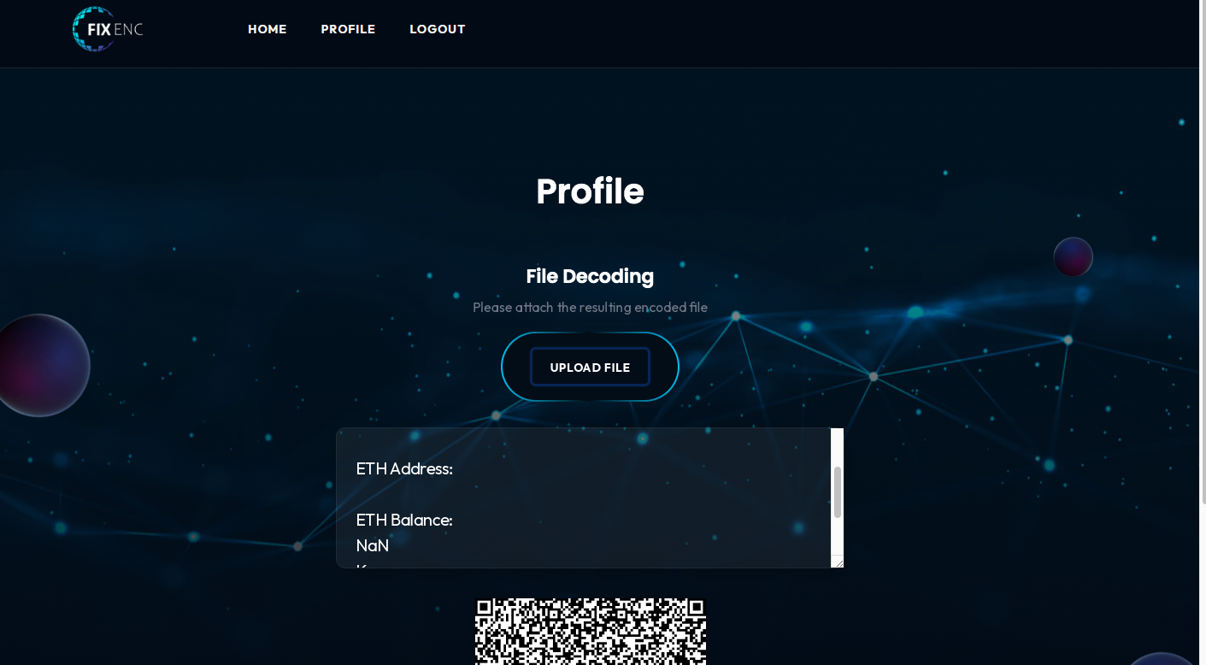
DECRYPTION
The next step: with the help of our program the crypto container is decrypted. This program may be installed both in your crypto wallet and payment system.
If it’s money – to the banking system too.
7

Slide 8
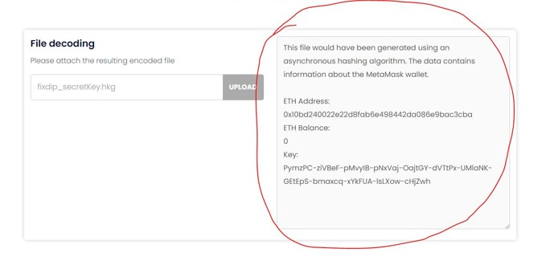
DECRYPTION
When we receive the crypto container file, we decrypt it with the program, for example, in the wallet.
At that, the crypto currency, which was specified in the wallet with the help of which the crypto container was created, is credited to the wallet at once.
8

Slide 9
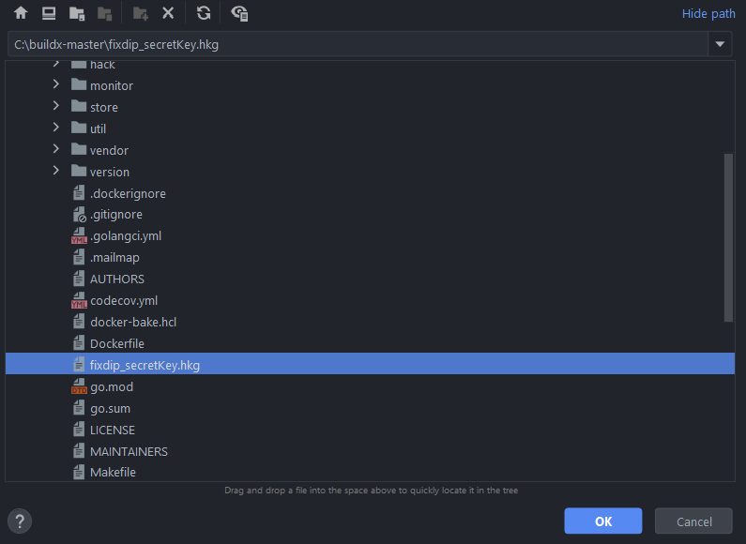
CRYPTO CONTAINER
The format of the encoded file is perfectly recognized by the decoding system and can be interpreted into the usual form without any problems.

Slide 10

Data transfer
Crypto container can also be securely transferred from one person to another using various social networks or instant messengers. You should not worry about the safety of your data.

Slide 11
Crypto Container and investments in DeFi
Collective investments in DeFi. Investment fund only on a smart contract.
W 1
CRYPTO CONTAINER
SmartContract
DeFi
W2
W3
investment strategy

Slide 12



Team
Founder
@irctechcrypto
Co-Founder
@saint_yeah
Design UX
@Ser_AI_Bot
12

Slide 13

@irctechcrypto

