Slide 1
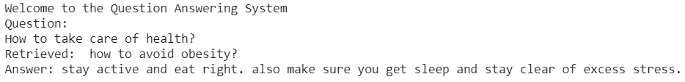
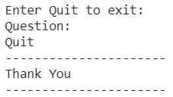
Evaluation of different benchmark Models for Question-Answering System using FAQs By Avineet Kumar Singh
Evaluation
Discussion
This study was important to understand how these models behave differently based on different levels of datasets.
Paraphrasing manually could be a challenge in testing these models as it varies from person to person, we could see the performance was equally low for all four models.
In future we could study other latest models.
The dataset could be improved by increasing the data size and improving the methods of paraphrasing.
Implement a dataset which has multiple questions in a single sentence.
Background
Such applications should be able to understand semantically similar queries from users.
texts/documents are converted to a vector of features (word embeddings)
Then compared by measuring the distance between these vectors (Using Cosine similarity ).
The best system(model) using SQuAD v2.0 was BERT + MMFT + ADA (F1: 87.615)
Problem
Which model to implement for a smaller chatbot projects which could be more feasible in terms of space instead of loading heavy models.
Approach
Code: https://github.com/AVINEET-Singh/NLP_Project
Different Embeddings + Cosine Similarity
Datasets:
Big dataset with 85282 FAQs
Easy, Medium and Hard with 10 FAQs(Paraphrased Differently)
Sl. No. | Model | Easy Dataset | Medium Dataset | Hard Dataset
1 | BOW | 0.3 | 0.2 | 0.2
2 | Word2Vec-Skipgram | 1 | 1 | 0.4
3 | Glove | 0.3 | 0.2 | 0.2
4 | BERT | 0.9 | 0.9 | 0.4

