Slide 1
Airbnb Bookings Analysis Since 2008, guests and hosts have used Airbnb to expand on traveling possibilities and present a more unique, personalized way of experiencing the world. Today, Airbnb became one-of-a-kind service that is used and recognized by the whole world. Data analysis on millions of listings provided through Airbnb is a crucial factor for the company. These millions of listings generate a lot of data - data that can be analysed and used for security, business decisions, understanding of customers' and providers' (hosts) behaviour and performance on the platform, guiding marketing initiatives, implementation of innovative additional services and much more. This dataset has around 49,000 observations in it with 16 columns and it is a mix between categorical and numeric values.

Slide 2
What is Airbnb
Airbnb is an online marketplace that connects people who want to rent out their homes with people who are looking for accommodations in specific locales and hospitality service for people to lease or rent short-term lodging including holiday cottages, apartments, homestays, hostel beds, or hotel rooms. Basically they provide the platform that is shared by hosts and visitors worldwide. Lets look at the dataset once.
Objectives
In this project, we will perform an exploratory data analysis(EDA) in order to investigate each of the variables and also come up with a conclusion for the relationship between variables. The main purpose is to identify which variables affect the price mostly. In addition to these, we will explore which neighborhood groups and room types are the most popular ones among the guests, and which hosts are the most preferred ones. The processes during the extraction can be listed as below:
Data Cleaning
Data Preprocessing
Data Manipulation
Data Visualization
Exploring the information

Slide 3
Questions that can be answered by this analysis
- Number of Neighborhood in each Neighborhood Groups
- Distribution of rooms according to latitude and longitude and room density in their regions
- Room types and their count in each neighborhood groups
- Relationship between room type and Price
- Price and Review Relationship
- Minimum, Maximum and Average Price according to the neighbourhood group
- The Most and Least Expensive Neighborhoods

Slide 4
Used Libraries
I have used several packages during the analysis of the historical data of Airbnb in NYC in order to make data manipulation and visualization. The list of packages used in this EDA can be seen below:
NumPy > To perform mathematical operations
pandas > For data frame
matplotlib > For Visualization of Data
seaborn > For Visualization of Data
plotly.express > For Visualization of Data
plotline > For Visualization of Data
warnings > For ignorance of any kind of unnecessary warnings

Slide 5
Lets now understand about every column in the data frame.
'id' => It is the unique id given for listings.
'name' => It is a column which contains the descriptions/names provided by the respective hosts for the reference of their customers.
'host_id' and 'host_name' => Many properties are being offered by many hosts. This 'host_id' and 'host_name' holds the records of all those hosts.
'neighbourhood' and 'neighbourhood_group' => These columns holds the information about the city and areas of the properties which are offered in airbnb New York.
'Longitude' and 'Latitude' => As the name suggests it just contains the longitude and latitude of the property location
'Room_type' => It displays the room_type of the property ( either private room / entire home / shared room )
'price' => Its an important column which holds the price value of all those properties.
'minimum_nights' => It gives us information about the minimum number of nights that is offered by hosts for particular property.
'number_of_reviews' and 'reviews_month' => It contains information about the number of reviews and reviews per month for those properties and hosts hospitality.
'availabilty_365' => It gives information about the availability of the listings.

Slide 6
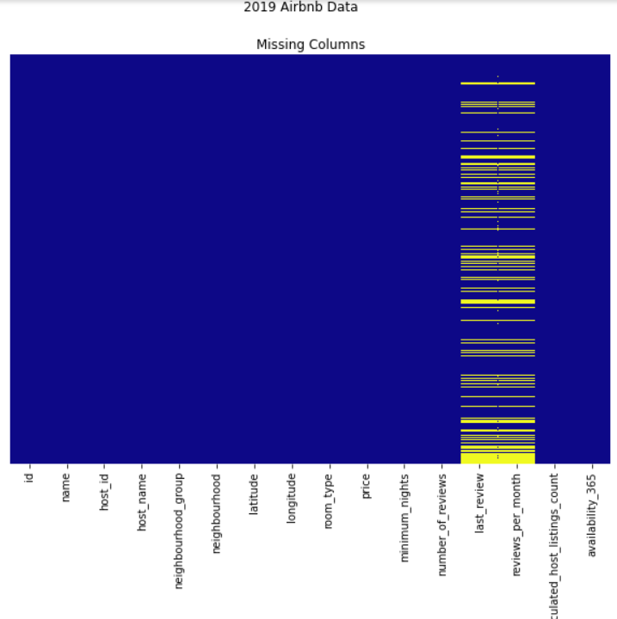
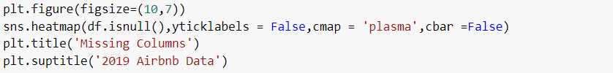
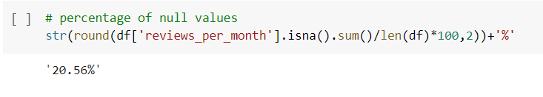
By using heatmap we can see that the last_review and reviews_per_month has maximum number of null values.

Slide 7
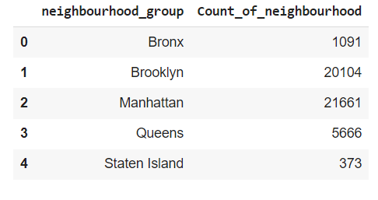
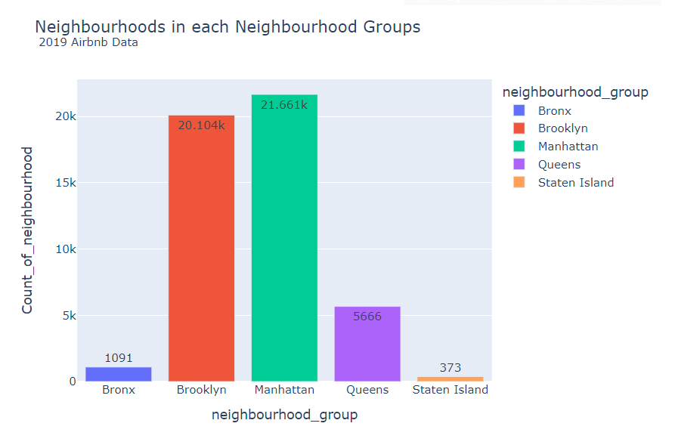
Calculating the number of neighborhood in each neighborhood group

Slide 8
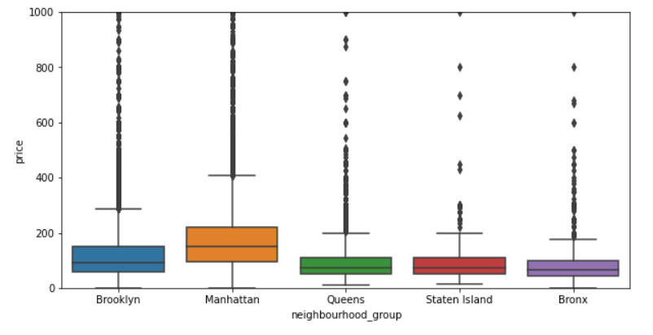
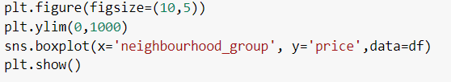
Range of Prices in Neighborhoods groups

Slide 9
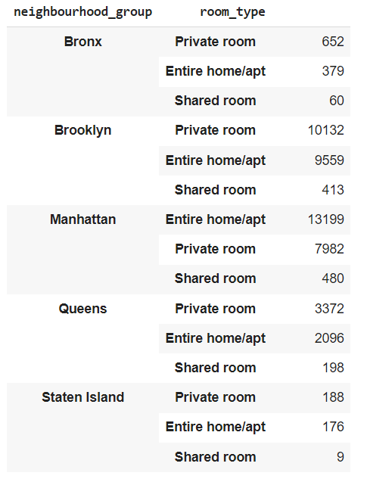
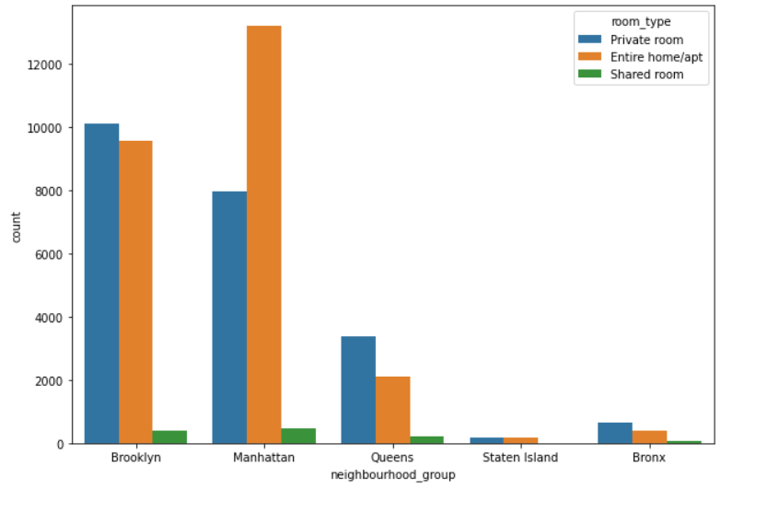

No. of rental properties group by type and there count

Slide 10
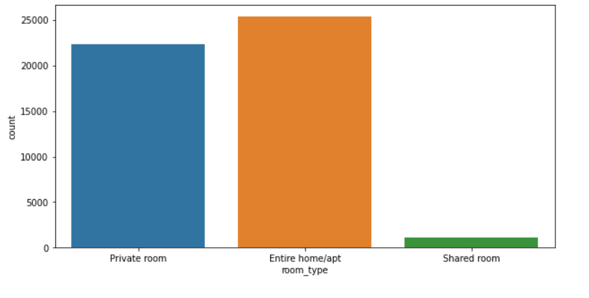

Total count of room types available in NYC

Slide 11
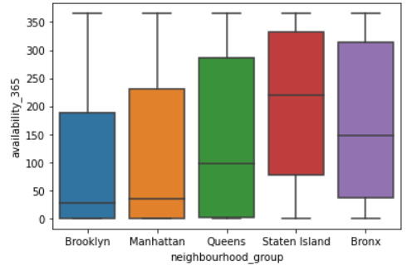
Availability_365 and the neighborhood_group

Slide 12
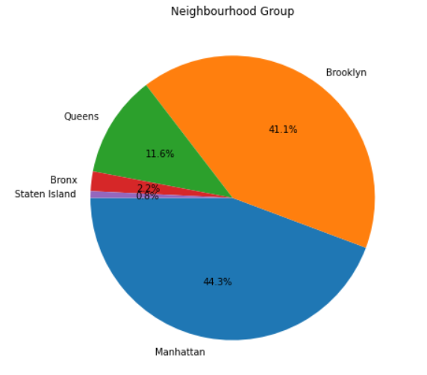
Overall contributions of each neighborhood in the count of listings throughout NYC

Slide 13

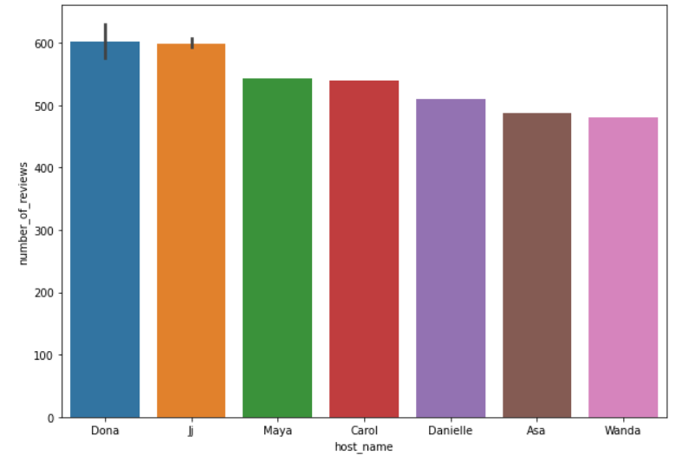
Finding the top best review of all time

Slide 14
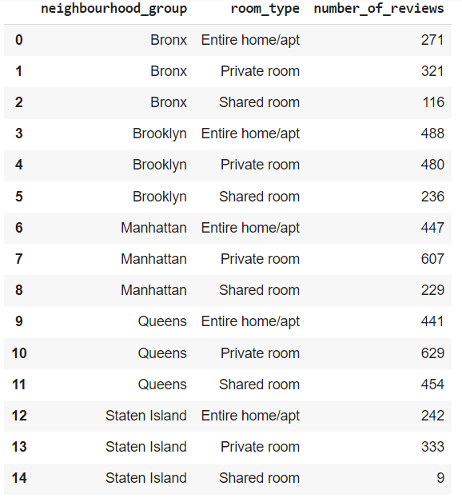
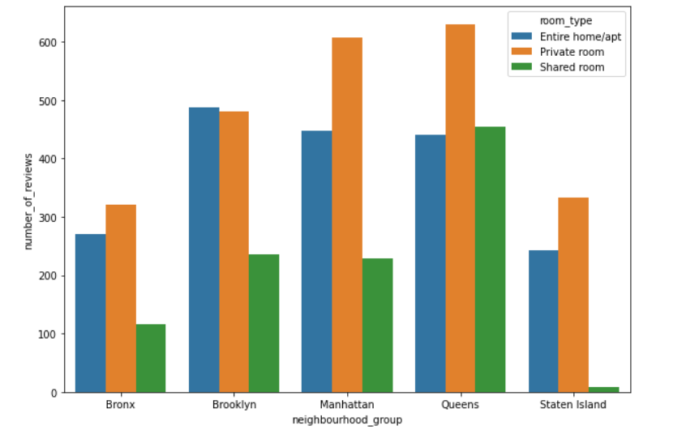
Number of reviews for each neighbourhood_group

Slide 15

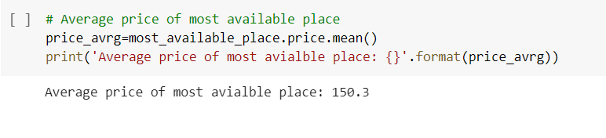
Most available room of all time

Slide 16
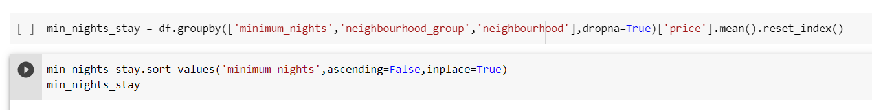
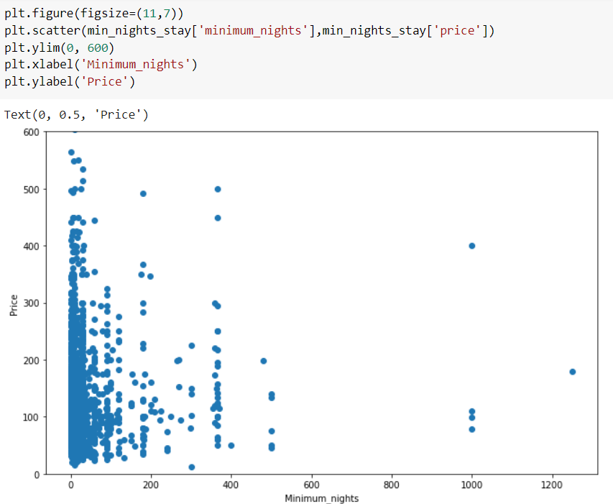
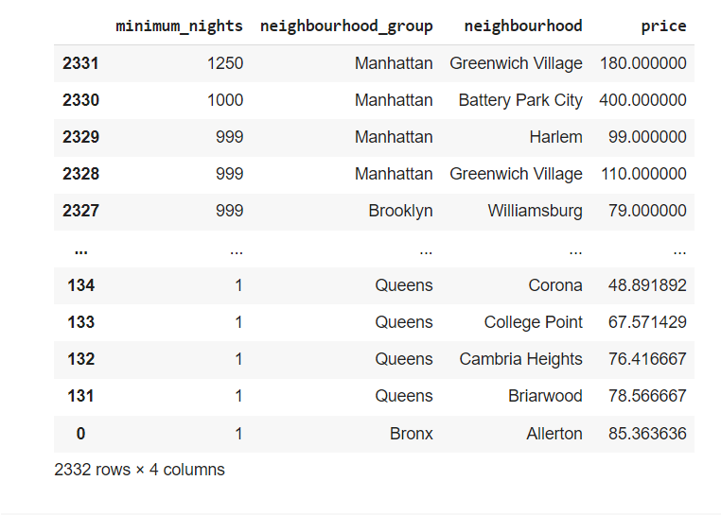
Average price based on minimum_nights of stay in descending order

Slide 17
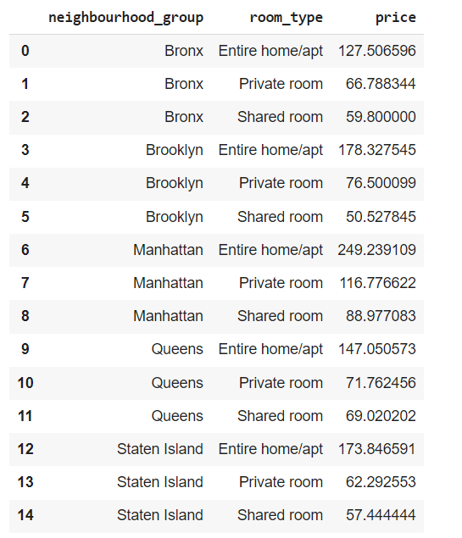
Average price per night for each neighbourhood along with room_type

Slide 18
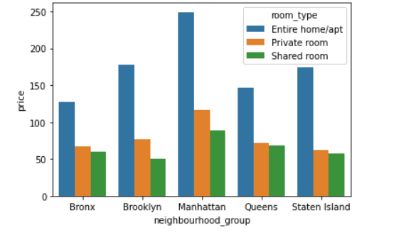
Barplot of average price

Slide 19

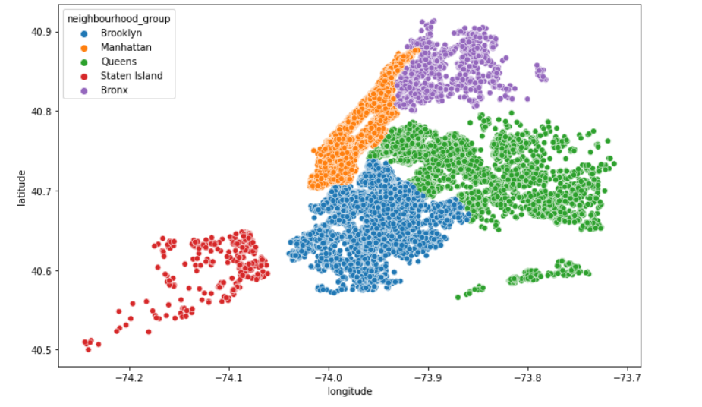
Map based on properties of Neighbourhood_group

Slide 20
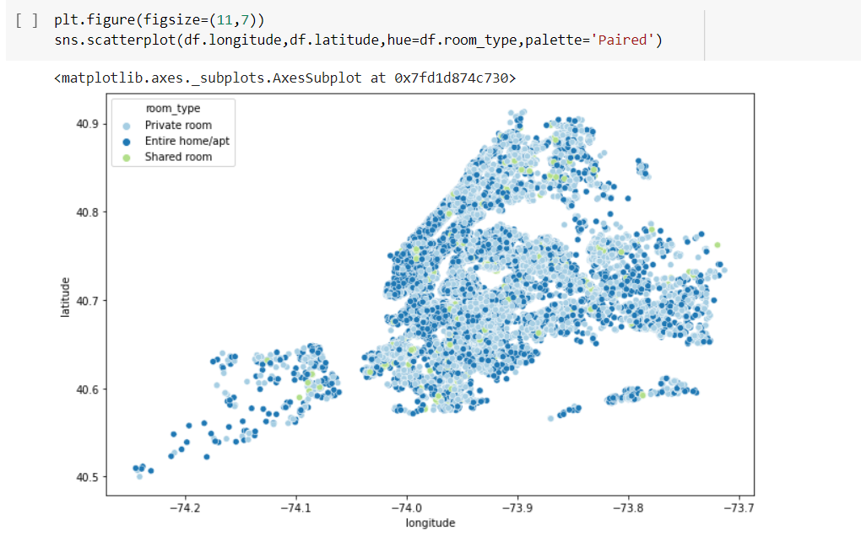
Maps with respect to room_types available throughout NY

Slide 21
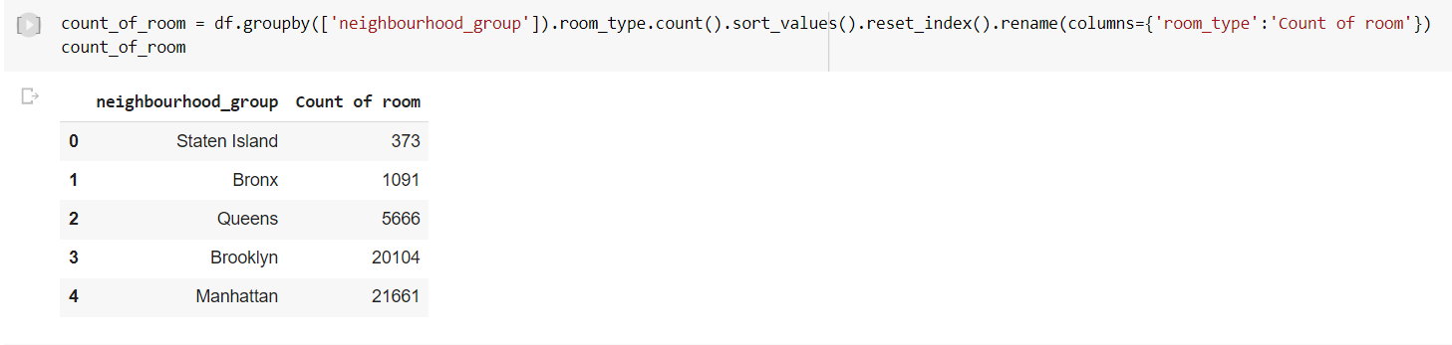
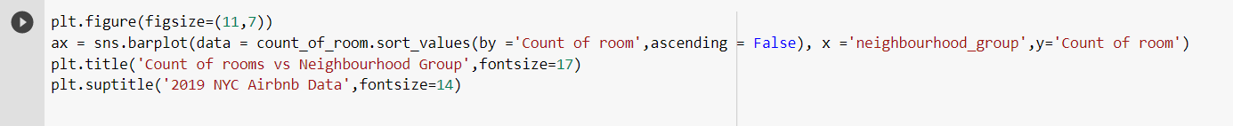
Count the number of rooms in every neighbourhood group

Slide 22
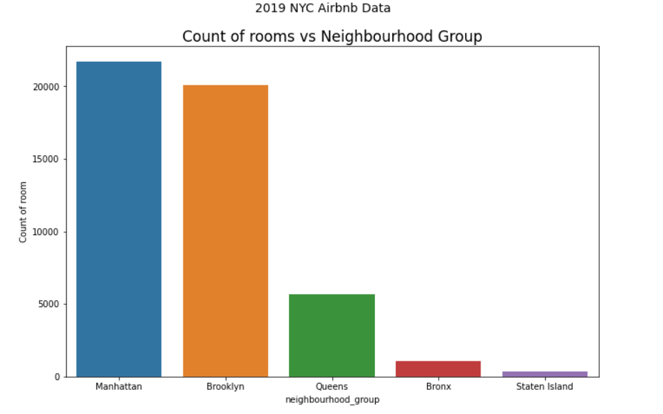

Slide 23
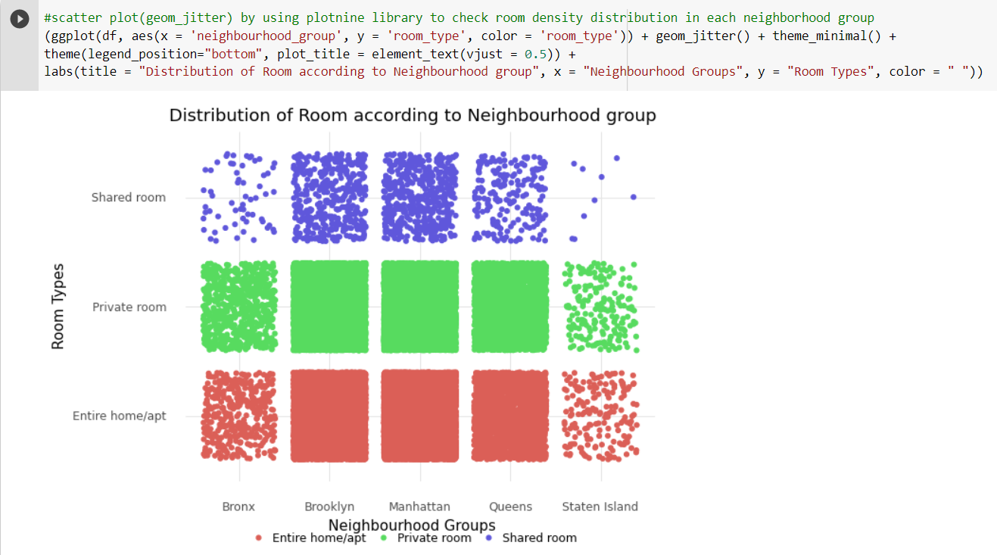
Now, let’s check for the distribution of room types across all neighbourhood groups of NYC!

Slide 24
